Slide 1
P1 Chapter 2: Quadratics Quadratic Graphs

Slide 2
Quadratic Graphs
Recall that $x$ refers to the input of a function, and the expression $f(x)$ refers to the output. For graph sketches, we often write $y=f(x)$, i.e. we set the $y$ values to be the output of the function.
$$y$$
A ‘sketch’ in maths has a clearly defined meaning:
We care about the general shape of the graph, not exact points.
The axes should have no scale.
Generally the only coordinates indicated are intercepts with the axis or other points of interest (e.g. intersections of multiple graphs)
Features needed in sketch of quadratic?
Recall a root of a function is where the output, in this case the $y$ value, is 0.
Roots
?
$$x$$
?
General shape: Smiley face or hill?
?
$y$-intercept
?
Turning point

Slide 3
Example
Sketch the graph of $y=x^{2}+3x−4$ and find the coordinates of the turning point.
$$y$$
Roots:
?
$$x^{2}+3x−4=0 \\ \left(x+4\right)\left(x−1\right)=0 \\ x=−4 or x=1$$
$y$-intercept:
When $x=0,$ $$y=0^{2}+3\left(0\right)−4=−4$$
?
$$y={\left(x+\frac{3}{2}\right)}^{2}−\frac{9}{4}−4 \\ y={\left(x+\frac{3}{2}\right)}^{2}−\frac{25}{4}$$
Min point: $\left(−\frac{3}{2},−\frac{25}{4}\right)$
Turning point:
?
$$x$$
-4
1
$$\left(−\frac{3}{2},−\frac{25}{4}\right)$$
-4
Recall that if $f\left(x\right)={\left(x+a\right)}^{2}+b$, the minimum output is $b$ and $−a$ is the $x$ value which minimises it. i.e. Turning point is $(−a,b)$

Slide 4
Example
Sketch the graph of $y=4x−2x^{2}−3$ and find the coordinates of the turning point. Write down the equation of the line of symmetry.
Roots:
$$y$$
?
$$−2x^{2}+4x−3=0 \\ a=−2, b=4, c=−3 \\ x=\frac{−4±\sqrt{4^{2}−\left(4×−2×−3\right)}}{−4}$$
$$=\frac{−4±\sqrt{−8}}{−4}$$
This has no solutions, so the $y$ value can never be 0, i.e. the parabola does not touch the $x$-axis.
$$x=1$$
$$x$$
-3 (by inspection)
$y$-intercept:
?
$$\left(1,−1\right)$$
Turning point:
$$y=−2x^{2}+4x−3 \\ =−2\left(x^{2}−2x\right)−3 \\ =−2\left({\left(x−1\right)}^{2}−1\right)−3 \\ =−2{\left(x−1\right)}^{2}+2−3 \\ =−2{\left(x−1\right)}^{2}−1$$
Max point is $(1,−1)$
-3
?
?
Line of reflection:
$$x=1$$

Slide 5
Test Your Understanding
Sketch the following, indicating any intercepts with the axis, the turning point and the equation of the line of symmetry.
a
$$y=x^{2}+4$$
c
$$y=5x+3−2x^{2}$$
$$y$$
?
?
$$\left(\frac{5}{4},\frac{49}{8}\right)$$
3
$$\left(0,4\right)$$
$$x$$
$$−\frac{1}{2}$$
3
$$x$$
$$x=0$$
$$x=\frac{5}{4}$$
b
$$y=x^{2}−7x+10$$
d
$$y=x^{2}+4x+11$$
?
?
$$x=\frac{7}{2}$$
11
10
$$\left(−2,7\right)$$
2
5
$$x$$
$$x$$
$$\left(\frac{7}{2}, −\frac{9}{4}\right)$$
$$x=−2$$

Slide 6
Determining the Equation using a Graph
$$y$$
Determine the equation of this quadratic graph, in the form $y=ax^{2}+bx+c$.
?
Since the roots are $−3$ and $2$, a good start would be:
$$y=(x+3)(x−2)$$
noting that this gives us the correct ‘positive quadratic’ shape.
However, expanding, we get the wrong $y$-intercept of -6:
$$y=x^{2}+x−6$$
We can simply scale the $y$-value appropriately without affecting the roots:
$$y=2\left(x+3\right)\left(x−2\right) \\ =2x^{2}+2x−12$$
$$x$$
-3
2
-12

Slide 7
Further Example
$$y$$
Determine the equation of this quadratic graph, in the form $y=ax^{2}+bx+c$, where $a,b,c$ are integers.
?
A good start would be:
$$y=−(x+1)(x−3.5)$$
The minus on the front ensures we get a negative $x^{2}$ term for the correct shape.
Expanding:
$$y=−x^{2}+2.5x+3.5$$
Note that no $y$-intercept has been specified, so we can scale the whole expression without affecting the roots (i.e. we only scale in the $y$ direction). Doubling:
$$y=−2x^{2}+5x+7$$
$$x$$
-1
3.5

Slide 8
Test Your Understanding
$$y$$
Determine an equation of this quadratic graph.
10
?
A good start to get the roots correct is:
$$y=−(x+3)(x−3)$$
The minus on the front ensures we get a negative $x^{2}$ term for the correct shape.
Expanding this gives us the incorrect $y$-intercept of 9:
$$y=−x^{2}+9$$
To scale 9 to 10, without affecting the root, we need to scale by $\frac{10}{9}$:
$$y=−\frac{10}{9}(x+3)(x−3)$$
Or more cleanly:
$$y=\frac{10}{9}\left(x+3\right)\left(3−x\right)$$
$$x$$
-3
3

Slide 9
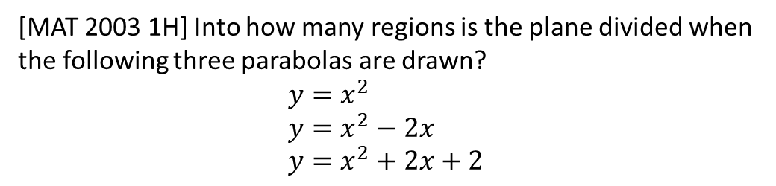



Exercise 2.4
Pearson Pure Mathematics Year 1/AS
Page 9
Extension Question:
[MAT 2003 1H] Into how many regions is the plane divided when the following three parabolas are drawn?
$$y=x^{2} \\ y=x^{2}−2x \\ y=x^{2}+2x+2$$
$$y$$
?
Completing the square:
$$y=x^{2} \\ y={\left(x−1\right)}^{2}−1 \\ y={\left(x+1\right)}^{2}+1$$
2
5
3
6
7
1
4
$$x$$

Slide 10
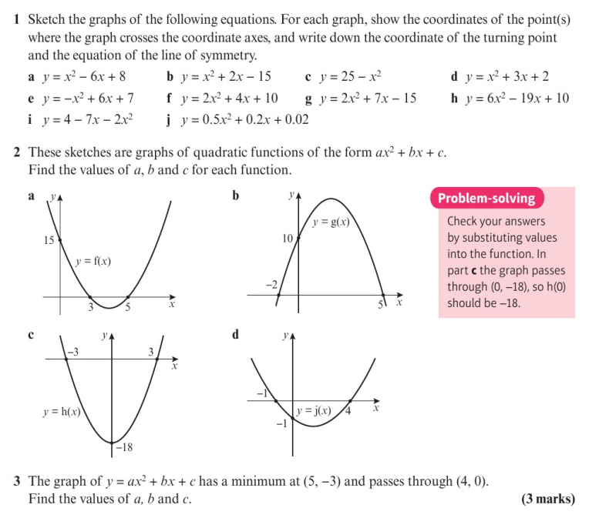
Homework Exercise

Slide 11
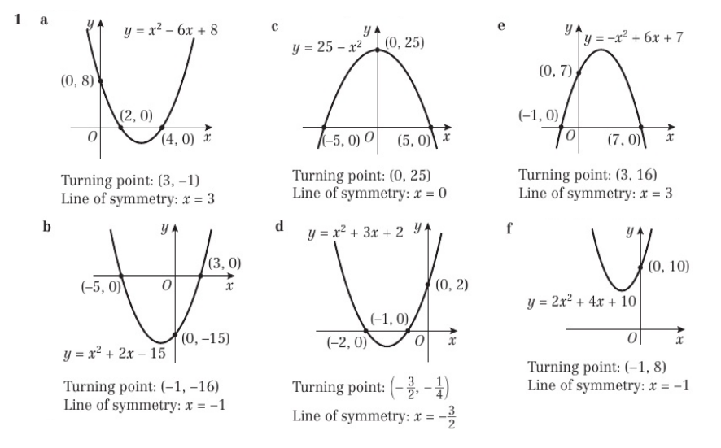
Homework Answers

Slide 12
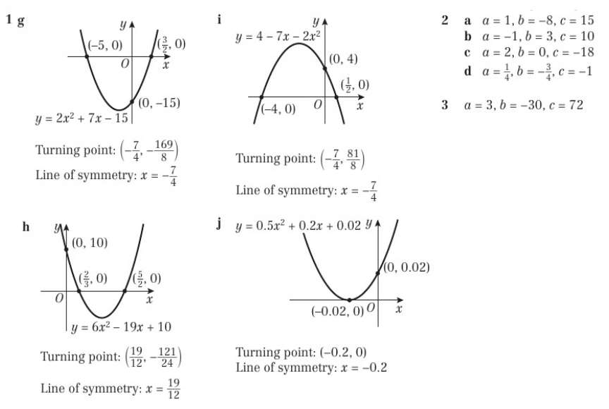
Homework Answers

