Slide 1
P1 Chapter 3: Inequalities Quadratic Simultaneous Equations

Slide 2

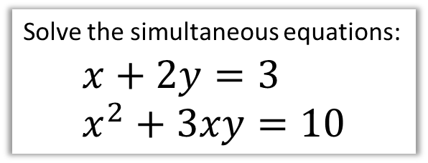
Simultaneous Equations
Solve the simultaneous equations:
$$x+2y=3 \\ x^{2}+3xy=10$$
We can’t use elimination this time as nothing would cancel.
We instead:
Rearrange linear equation to make $x$ or $y$ the subject.
Substitute into quadratic equation and solve.
$$x=3−2y$$
Substitute into other equation:
$${\left(3−2y\right)}^{2}+3y\left(3−2y\right)=10 \\ …2y^{2}+3y+1=0 \\ \left(2y+1\right)\left(y+1\right)=0 \\ y=−\frac{1}{2} → x=4 \\ y=−1 → x=5$$
?

Slide 3

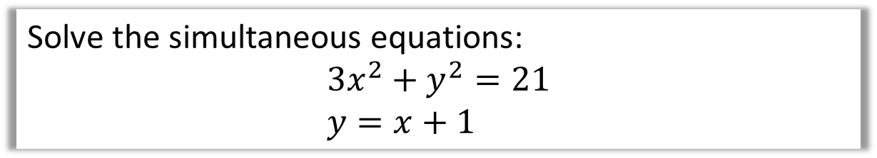
Test Your Understanding
Solve the simultaneous equations:
$$3x^{2}+y^{2}=21 \\ y=x+1$$
?
$$3x^{2}+{\left(x+1\right)}^{2}=21 \\ 3x^{2}+x^{2}+2x+1=21 \\ 4x^{2}+2x−20=0 \\ 2x^{2}+x−10=0 \\ \left(2x+5\right)\left(x−2\right)=0 \\ x=−\frac{5}{2} or x=2 \\ y=−\frac{3}{2} or y=3$$

Slide 4
Exercise 3.2
Pearson Pure Mathematics Year 1/AS
Page 17

Slide 5
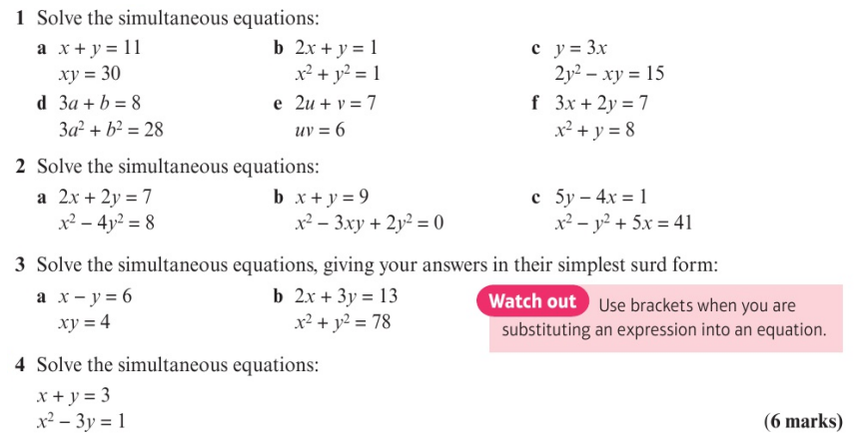
Homework Exercise

Slide 6
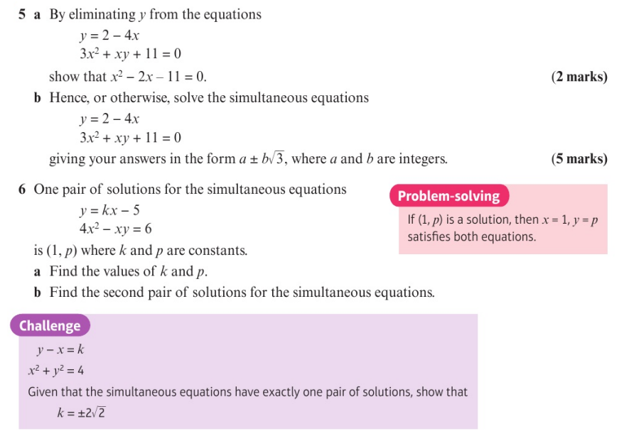
Homework Exercise

Slide 7
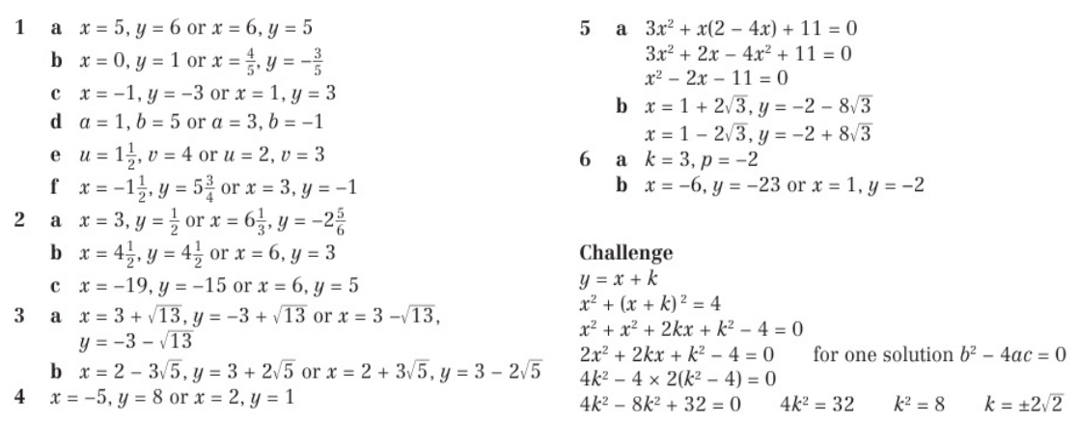
Homework Answers

