Slide 1
M2 Chapter 4: Moments Tilting

Slide 2


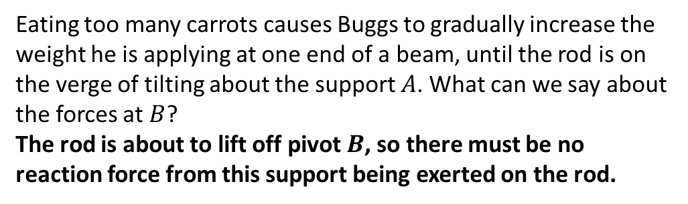

Tilting
Buggs
$$A$$
$$B$$
Eating too many carrots causes Buggs to gradually increase the weight he is applying at one end of a beam, until the rod is on the verge of tilting about the support $A$. What can we say about the forces at $B$?
The rod is about to lift off pivot $B$, so there must be no reaction force from this support being exerted on the rod.
?
! When a rigid body is on the point of tilting about a pivot, the reaction at any other support (or tension in any other wire/string) is zero.

Slide 3



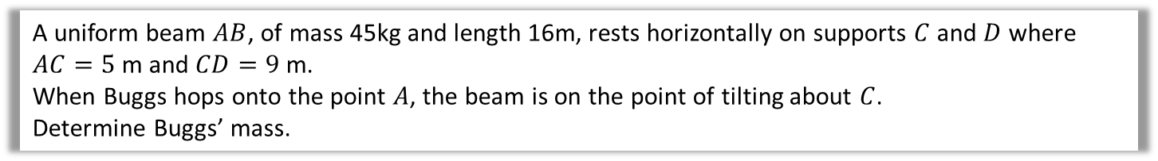


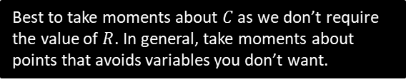

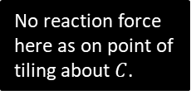
Example
$$R N$$
No reaction force here as on point of tiling about $C$.
Buggs
3m
5m
9m
2m
$$mg$$
$$C$$
$$45g N$$
$$D$$
A uniform beam $AB$, of mass 45kg and length 16m, rests horizontally on supports $C$ and $D$ where $AC=5$ m and $CD=9$ m.
When Buggs hops onto the point $A$, the beam is on the point of tilting about $C$.
Determine Buggs’ mass.
Best to take moments about $C$ as we don’t require the value of $R$. In general, take moments about points that avoids variables you don’t want.
Take moments about $C$:
$$mg×5=3×45g \\ 5mg=135g \\ m=\frac{135g}{5g}=27$$ Buggs is now 27kg, and has eaten too many carrots.
?

Slide 4





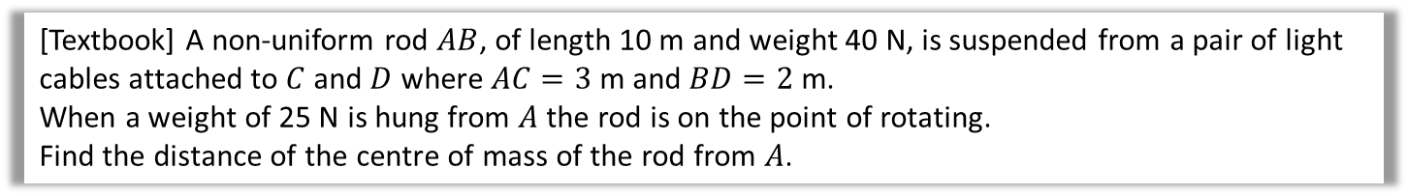

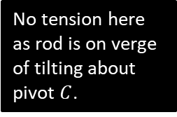

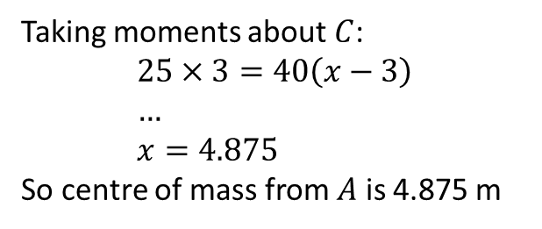



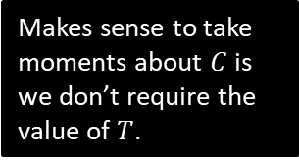
Suspended System Example
[Textbook] A non-uniform rod $AB$, of length 10 m and weight 40 N, is suspended from a pair of light cables attached to $C$ and $D$ where $AC=3$ m and $BD=2$ m.
When a weight of 25 N is hung from $A$ the rod is on the point of rotating.
Find the distance of the centre of mass of the rod from $A$.
$x$m
? Diagram
No tension here as rod is on verge of tilting about pivot $C$.
$$T N$$
$$A$$
$3$m
$2$m
$$C$$
$$D$$
$$B$$
$$25 N$$
Makes sense to take moments about $C$ is we don’t require the value of $T$.
$$40 N$$
? Working
Taking moments about $C$:
$$25×3=40\left(x−3\right) \\ … \\ x=4.875$$
So centre of mass from $A$ is 4.875 m

Slide 5
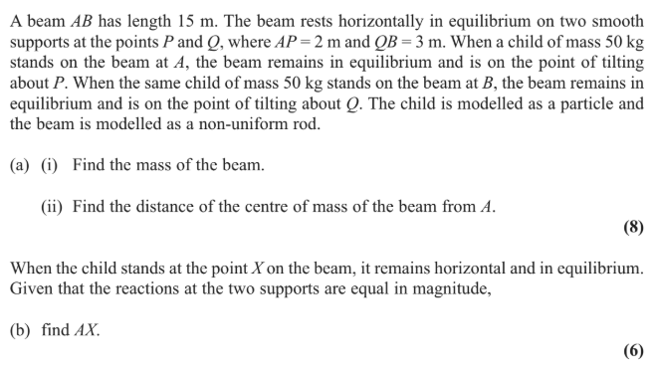
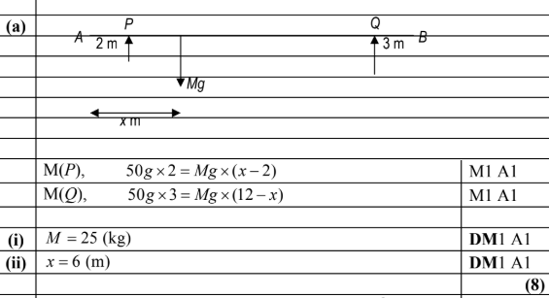
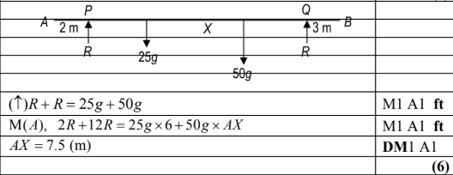
Test Your Understanding
Edexcel M1(Old) May 2013 Q6
a
?
b
?

Slide 6
Exercise 4.5
Pearson Stats/Mechanics Year 2
Page 39-41

Slide 7
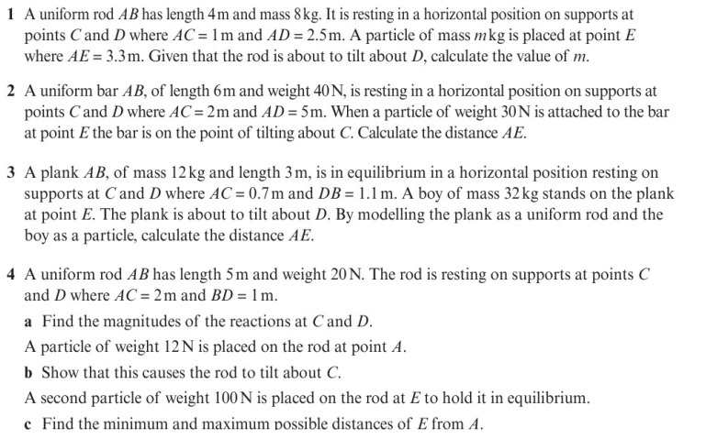
Homework Exercise

Slide 8
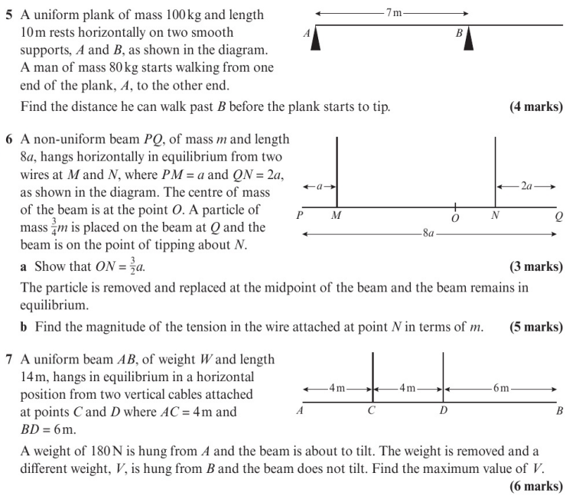
Homework Exercise

Slide 9
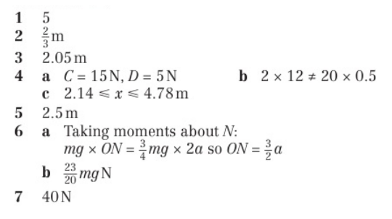
Homework Answers

