Slide 1
P1 Chapter 12: Differentiation
Increasing and Decreasing

Slide 2
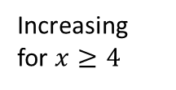
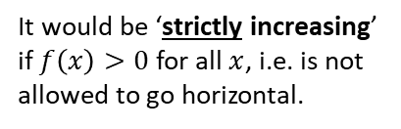


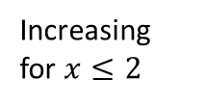


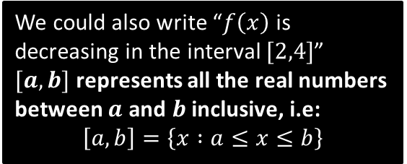
Increasing and Decreasing Functions
A function can also be increasing and decreasing in certain intervals.
$$\left(2,3\right)$$
What do you think it means for a function to be an ‘increasing function’?
$$\left(4,−1\right)$$
Increasing for $x≤2$
?
?
?
! An increasing function is one whose gradient is always at least 0.
$f^{′}\left(x\right)≥0$ for all $x$.
Decreasing for
$$2≤x≤4$$
Increasing for $x≥4$
We could also write “$f\left(x\right)$ is decreasing in the interval $[2,4]$”
$[a,b]$ represents all the real numbers between $a$ and $b$ inclusive, i.e:
$$\left[a,b\right]=\left\{x :a≤x≤b\right\}$$
It would be ‘strictly increasing’ if $f\left(x\right)>0$ for all $x$, i.e. is not allowed to go horizontal.

Slide 3

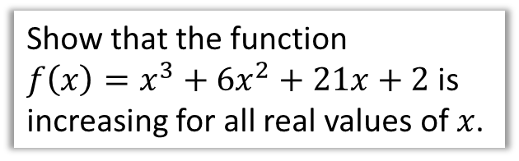

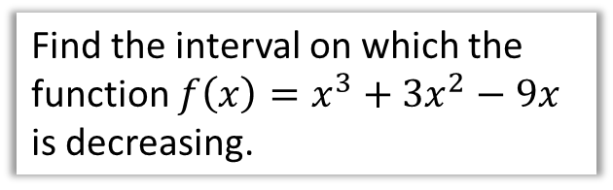
Examples
Show that the function
$f\left(x\right)=x^{3}+6x^{2}+21x+2$ is increasing for all real values of $x$.
Find the interval on which the function $f\left(x\right)=x^{3}+3x^{2}−9x$ is decreasing.
?
?
$$f\left(x\right)=x^{3}+3x^{2}−9x \\ f^{′}\left(x\right)=3x^{2}+6x−9$$
$$f^{′}\left(x\right)≤0 \\ 3x^{2}+6x−9≤0 \\ x^{2}+2x−3≤0 \\ \left(x+3\right)\left(x−1\right)≤0 \\ −3≤x≤1$$
So $f(x)$ is decreasing in the interval $[−3,1]$
$$f^{′}\left(x\right)=3x^{2}+12x+21$$
$$f^{′}\left(x\right)=3\left(x^{2}+4x+7\right) \\ =3{\left(x+2\right)}^{2}+9$$
${\left(x+2\right)}^{2}≥0$ for all real $x$,
$∴3{\left(x+2\right)}^{2}+9≥0$ for all real $x$
$∴f(x)$ is an increasing function for all $x$.
Fro Tip: To show a quadratic is always positive, complete the square, then indicate the squared term is always at least 0.

Slide 4
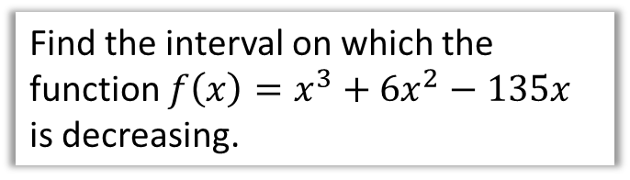
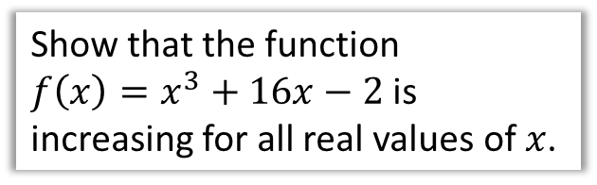

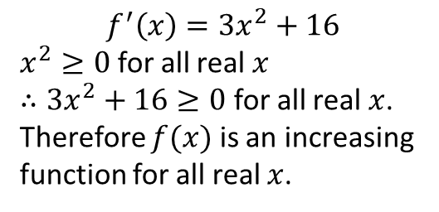
Test Your Understanding
Show that the function
$f\left(x\right)=x^{3}+16x−2$ is increasing for all real values of $x$.
Find the interval on which the function $f\left(x\right)=x^{3}+6x^{2}−135x$ is decreasing.
?
?
$$f^{′}\left(x\right)=3x^{2}+16$$
$x^{2}≥0$ for all real $x$
$∴3x^{2}+16≥0$ for all real $x$.
Therefore $f(x)$ is an increasing function for all real $x$.
$$f^{′}\left(x\right)=3x^{2}+12x−135 \\ f^{′}\left(x\right)≤0 \\ ∴3x^{2}+12x−135≤0 \\ x^{2}+4x−45≤0 \\ \left(x+9\right)\left(x−5\right)≤0 \\ −9≤x≤5$$
So $f(x)$ is decreasing in the interval $[−9,5]$

Slide 5
Exercise 12.7
Pearson Pure Mathematics Year 1/AS
Page 97

Slide 6
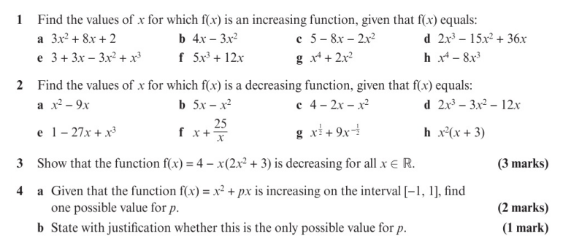
Homework Exercise

Slide 7
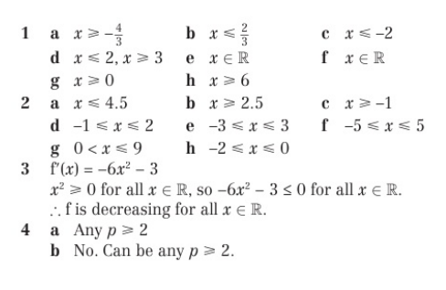
Homework Exercise

