Slide 1
P1 Chapter 9: Trigonometric Ratios Graph Transformation

Slide 2

















Transforming Trigonometric Graphs
There is no new theory here: just use your knowledge of transforming graphs, i.e. whether the transformation occurs ‘inside’ the function (i.e. input modified) or ‘outside’ the function (i.e. output modified).
Sketch $y=4\sin{x}$, $0≤x≤360°$
Sketch $y=\cos\left(x+45°\right)$, $0≤x≤360°$
?
?
$$y$$
$$y$$
$$×4$$
$$45°$$
$$4$$
$$1$$
$$x$$
$$x$$
$$90°$$
$$180°$$
$$270°$$
$$360°$$
$$−90°$$
$$90°$$
$$180°$$
$$270°$$
$$360°$$
$$−4$$
$$−1$$

Slide 3












Transforming Trigonometric Graphs
Sketch $y=−\tan{x}$, $0≤x≤360°$
Sketch $y=\sin\left(\frac{x}{2}\right)$, $0≤x≤360°$
?
?
$$×(−1)$$
$$y$$
$$×2$$
$$y$$
$$1$$
$$x$$
$$90°$$
$$180°$$
$$270°$$
$$360°$$
$$x$$
$$90°$$
$$180°$$
$$270°$$
$$360°$$
$$−1$$

Slide 4
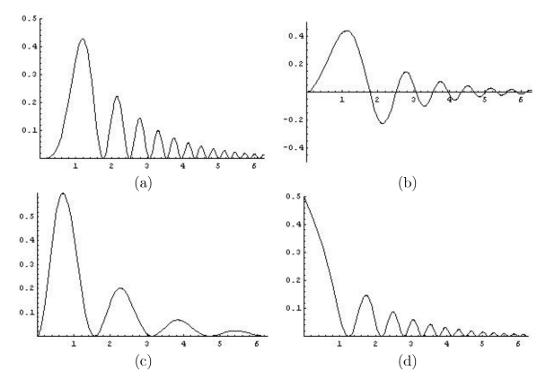
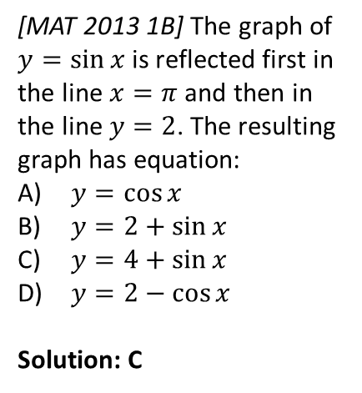
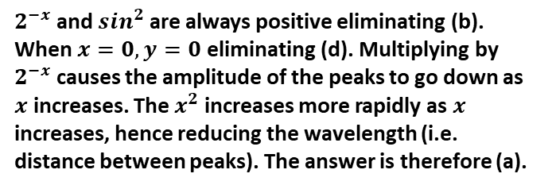
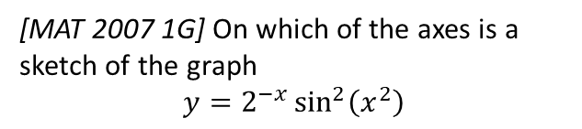
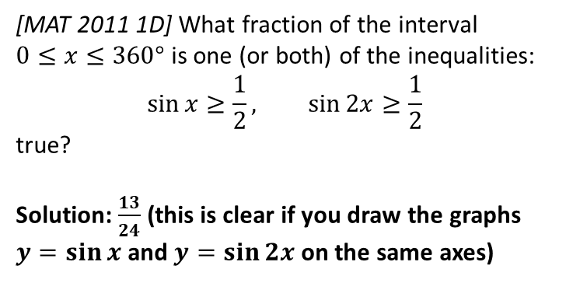
Exercise 9.6
Pearson Pure Mathematics Year 1/AS
Page 75
Extension
1
[MAT 2013 1B] The graph of $y=\sin{x}$ is reflected first in the line $x=π$ and then in the line $y=2$. The resulting graph has equation:
$y=\cos{x}$
$y=2+\sin{x}$
$y=4+\sin{x}$
$y=2−\cos{x}$
Solution: C
3
[MAT 2007 1G] On which of the axes is a sketch of the graph
$$y=2^{−x}\sin^{2}\left(x^{2}\right)$$
?
2
[MAT 2011 1D] What fraction of the interval $0≤x≤360°$ is one (or both) of the inequalities:
$$\sin{x}≥\frac{1}{2}, \sin{2x}≥\frac{1}{2}$$ true?
Solution: $\frac{13}{24}$ (this is clear if you draw the graphs $y=\sin{x}$ and $y=\sin{2x}$ on the same axes)
$2^{−x}$ and $s{in}^{2}$ are always positive eliminating (b). When $x=0, y=0$ eliminating (d). Multiplying by $2^{−x}$ causes the amplitude of the peaks to go down as $x$ increases. The $x^{2}$ increases more rapidly as $x$ increases, hence reducing the wavelength (i.e. distance between peaks). The answer is therefore (a).
?
?

Slide 5
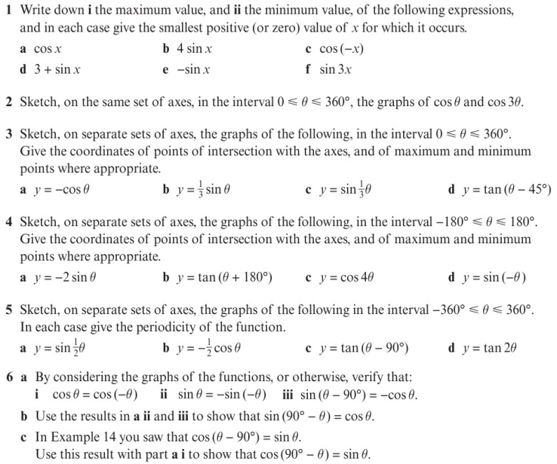
Homework Exercise

Slide 6
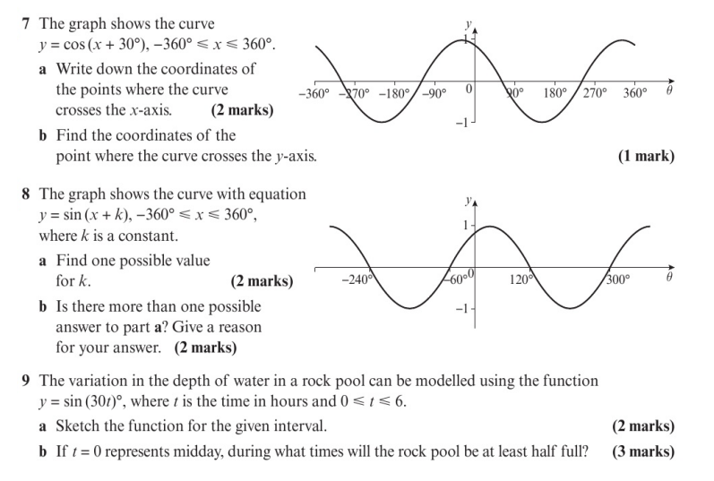
Homework Exercise

Slide 7
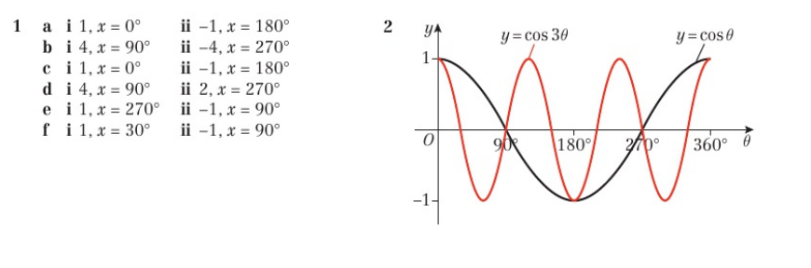
Homework Answers

Slide 8
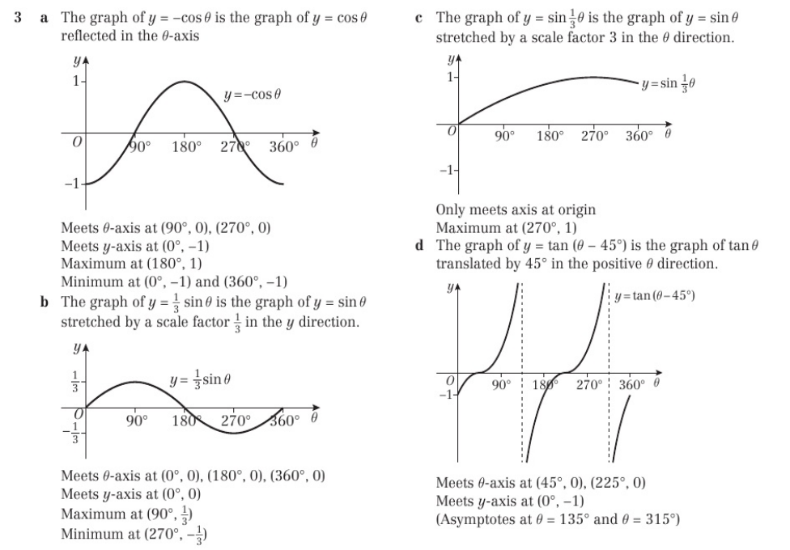
Homework Answers

Slide 9
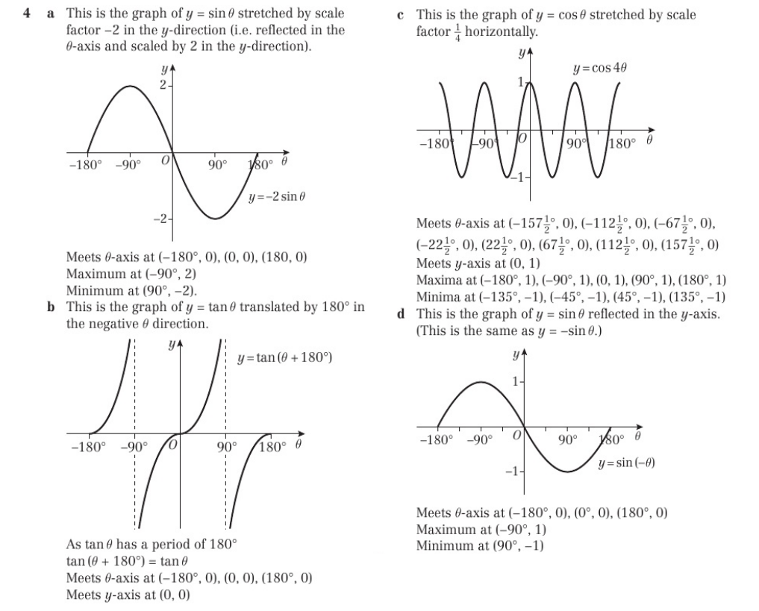
Homework Answers

Slide 10
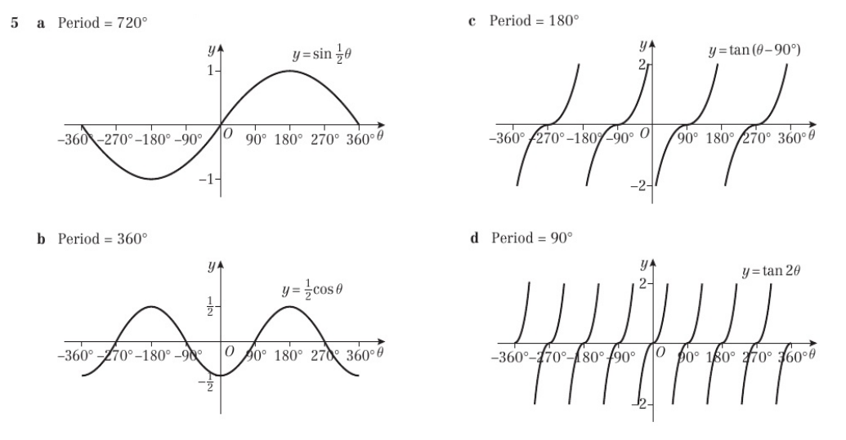
Homework Answers

Slide 11
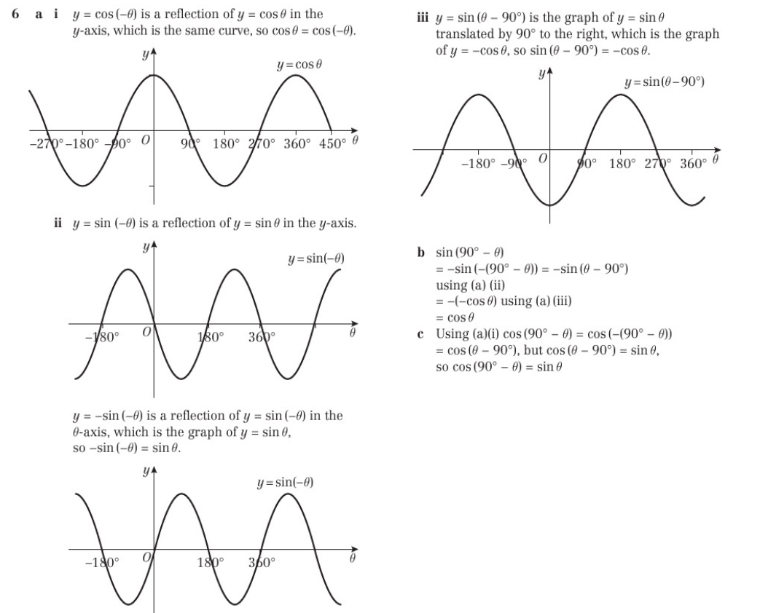
Homework Answers

Slide 12
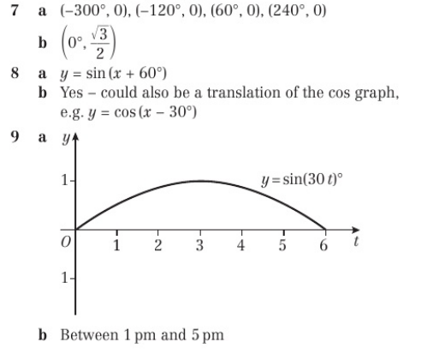
Homework Answers

