Slide 1
P1 Chapter 1: Algebra Expanding Brackets

Slide 2
Expanding Brackets
If you have ever been taught ‘FOIL’ to multiply brackets please purge it from your mind now – instead:
Multiply each term in the first bracket by each term in the second.
$$\left(x−y\right)\left(x+y−1\right)$$
Tip: My order is “first term in first brackets times each in second, then second term in first bracket times each in second, etc.”
$$=x^{2}$$
$$+xy$$
$$−x$$
$$−xy$$
$$−y^{2}$$
$$+y$$
$$=x^{2}−y^{2}−x+y$$
Tip: For more than 2 brackets, multiply two out each time to reduce the number of brackets by one.
$$\left(x+1\right)\left(x+2\right)\left(x+3\right) \\ =\left(x+1\right)\left(x^{2}+5x+6\right) \\ =x^{3}+5x^{2}+6x+x^{2}+5x+6 \\ =x^{3}+6x^{2}+11x+6$$
?

Slide 3
Test Your Understanding
1
Expand and simplify
$$\left(x+5\right)\left(x−2\right)\left(x+1\right)$$
2
Expand and simplify:
$$2\left(x−3\right)\left(x−4\right)$$
?
?
$$=\left(x+5\right)\left(x^{2}−x−2\right) \\ =x^{3}−x^{2}−2x+5x^{2}−5x−10 \\ =x^{3}+4x^{2}−7x−10$$
$$=2\left(x^{2}−7x+12\right) \\ =2x^{2}−14x+24$$
3
Expand and simplify:
$${\left(2x−1\right)}^{3}$$
?
$$=\left(2x−1\right)\left(2x−1\right)\left(2x−1\right) \\ =\left(2x−1\right)\left(4x^{2}−4x+1\right) \\ =8x^{3}−8x^{2}+2x−4x^{2}+4x−1 \\ =8x^{3}−12x^{2}+6x−1$$

Slide 4
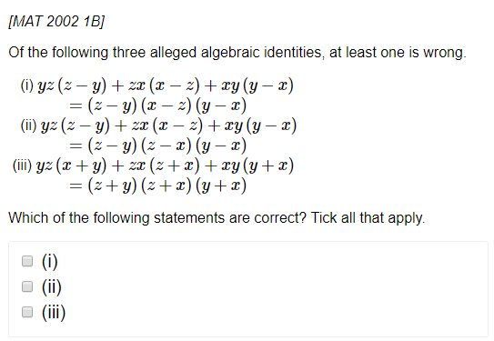
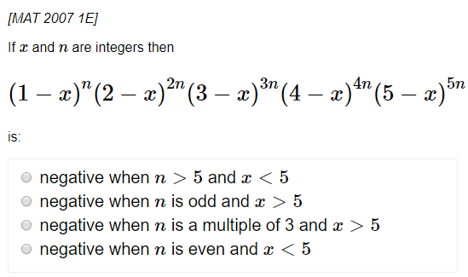

Exercise 1.2
Pearson Pure Mathematics Year 1/AS
Page 1
1
2
?
?
Solution: (ii) only
Solution: $n$ is odd and $x>5$

Slide 5
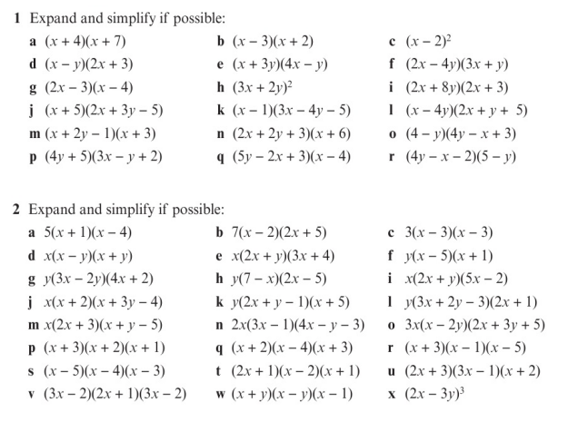
Homework Exercise

Slide 6
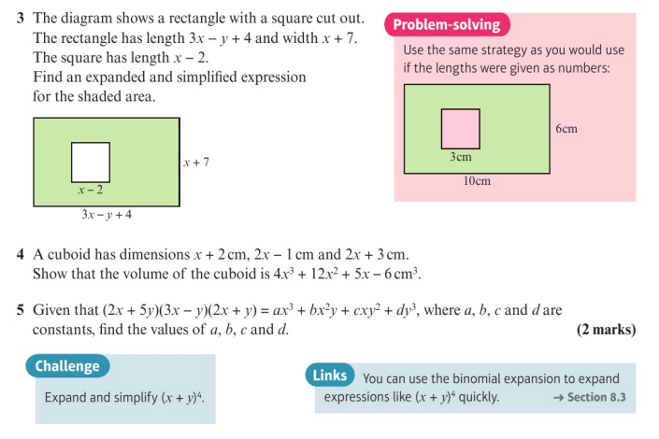
Homework Exercise

Slide 7
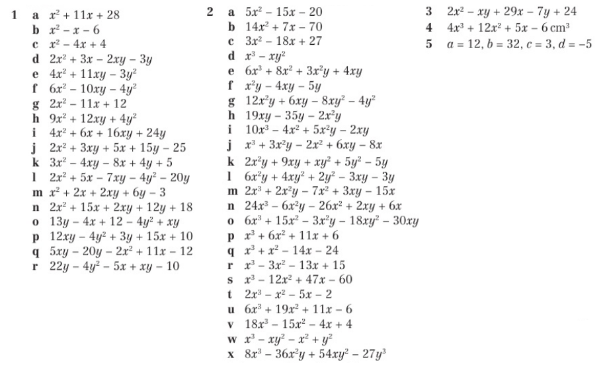
Homework Answers

