Slide 1
Stats2 Chapter 1: Measuring Correlation Product Moment Coefficient

Slide 2

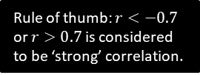


Measuring Correlation
You’re used to use qualitative terms such as “positive correlation” and “negative correlation” and “no correlation” to describe the type of correlation, and terms such as “perfect”, “strong” and “weak” to describe the strength.
The Product Moment Correlation Coefficient is one way to quantify this:
! The product moment correlation coefficient (PMCC), denoted by $r$, describes the linear correlation between two variables. It can take values between -1 and 1.
$$r=−1$$
$$0$$
$$1$$
Perfect negative
Strong negative
No correlation
Weak positive
Perfect positive
Rule of thumb: $r<−0.7$ or $r>0.7$ is considered to be ‘strong’ correlation.
Note that PMCC is only applicable for a linear correlation, i.e. closeness of fit to a linear regression line (i.e. a straight ‘line of best fit’). It may be the data exhibits strong correlation with respect to a different model (e.g. exponential) even when the PMCC is low.

Slide 3



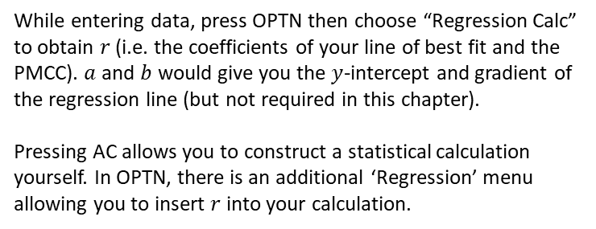

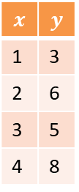

Calculating $r$ on your calculator
You must have a calculator that is capable of calculating $r$ directly: in the A Level 2017+ syllabus you are no longer required to use formulae to calculate $r$.
$$x$$ | $$y$$
1 | 3
2 | 6
3 | 5
4 | 8
6: Statistics
The following instructions are for the Casio ClassWiz.
Press MODE then select ‘Statistics’.
$$y=a+bx$$
We want to measure linear correlation, so select $y=a+bx$
Data Entry
Enter each of the $x$ values in the table on the left, press = after each input. Use the arrow keys to get to the top of the $y$ column.
PMCC
While entering data, press OPTN then choose “Regression Calc” to obtain $r$ (i.e. the coefficients of your line of best fit and the PMCC). $a$ and $b$ would give you the $y$-intercept and gradient of the regression line (but not required in this chapter).
Pressing AC allows you to construct a statistical calculation yourself. In OPTN, there is an additional ‘Regression’ menu allowing you to insert $r$ into your calculation.
You should obtain $r=0.868$

Slide 4
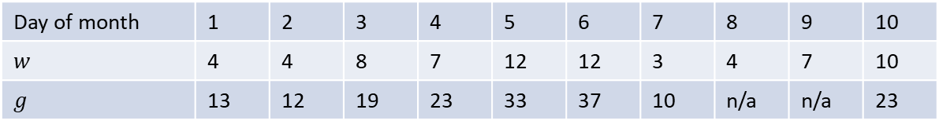
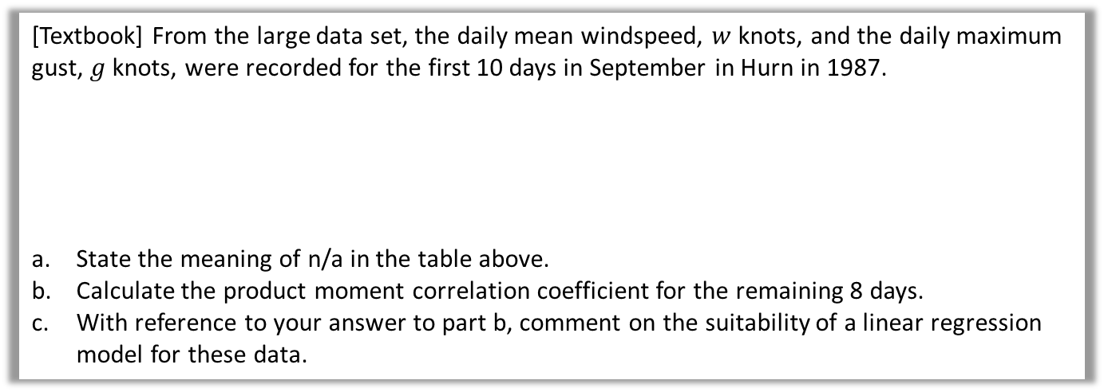
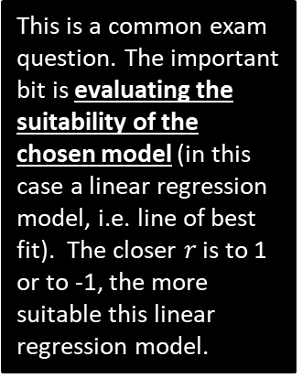

Example
[Textbook] From the large data set, the daily mean windspeed, $w$ knots, and the daily maximum gust, $g$ knots, were recorded for the first 10 days in September in Hurn in 1987.
State the meaning of n/a in the table above.
Calculate the product moment correlation coefficient for the remaining 8 days.
With reference to your answer to part b, comment on the suitability of a linear regression model for these data.
Day of month | 1 | 2 | 3 | 4 | 5 | 6 | 7 | 8 | 9 | 10
$$w$$ | 4 | 4 | 8 | 7 | 12 | 12 | 3 | 4 | 7 | 10
$$g$$ | 13 | 12 | 19 | 23 | 33 | 37 | 10 | n/a | n/a | 23
a
Data on daily maximum gust is not available for these days.
$$r=0.9533$$
$r$ is close to 1 so there is a strong positive correlation between daily mean windspeed and daily maximum gust. This means that the data points lie close to a straight line, so a linear regression model is suitable.
?
This is a common exam question. The important bit is evaluating the suitability of the chosen model (in this case a linear regression model, i.e. line of best fit). The closer $r$ is to 1 or to -1, the more suitable this linear regression model.
b
?
c
?

Slide 5
Exercise 1.2
Pearson Stats/Mechanics Year 2
Pages 3-5

Slide 6
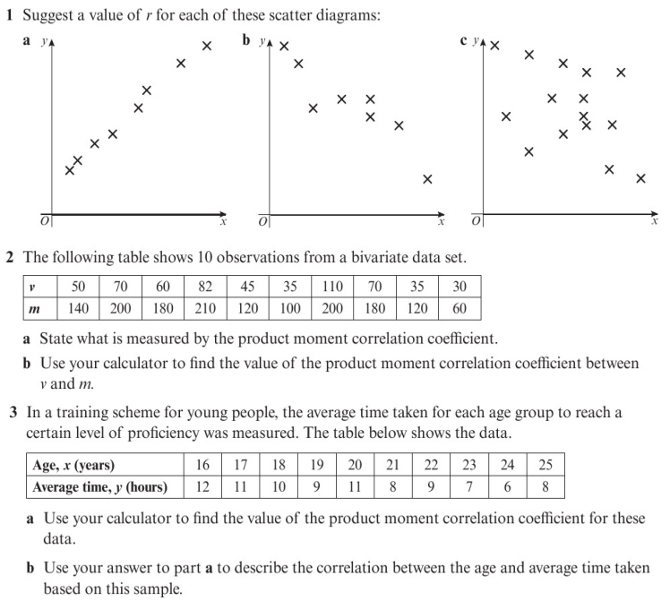
Homework Exercise

Slide 7
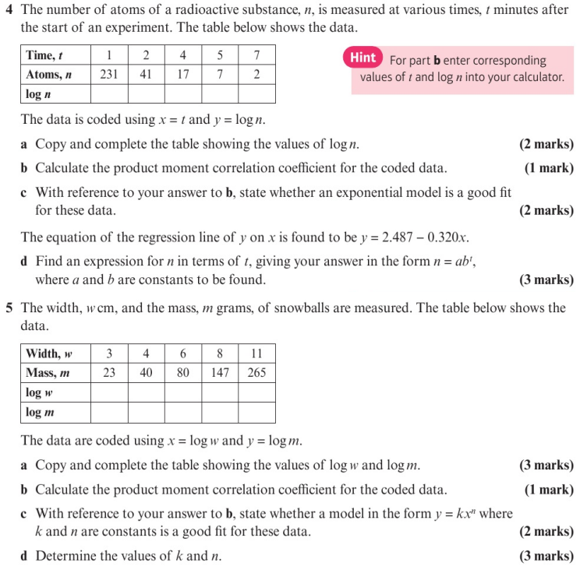
Homework Exercise

Slide 8
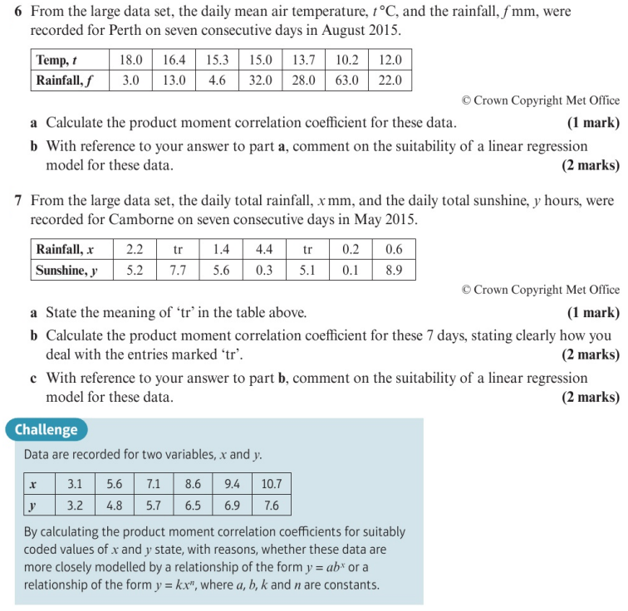
Homework Exercise

Slide 9
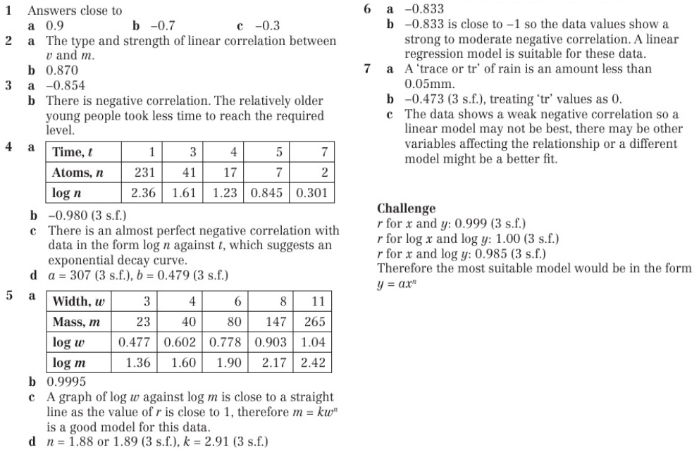
Homework Answers

