Slide 1
M2 Chapter 8: Further Kinematics Vector Integration

Slide 2
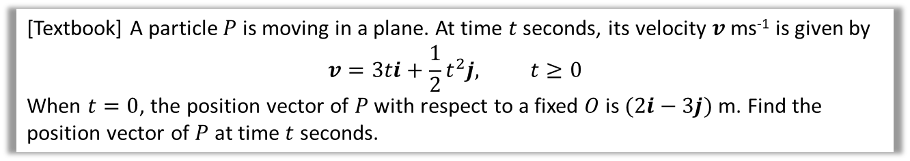

Integrating Vectors
We can similarly integrate the $i$ and $j$ components to get from acceleration to velocity and velocity to displacement.
[Textbook] A particle $P$ is moving in a plane. At time $t$ seconds, its velocity $v$ ms⁻¹ is given by
$$v=3ti+\frac{1}{2}t^{2}j, t≥0$$
When $t=0$, the position vector of $P$ with respect to a fixed $O$ is $(2i−3j)$ m. Find the position vector of $P$ at time $t$ seconds.
?
$$r=\int{\left(\begin{matrix}3t \\ \frac{1}{2}t^{2}\end{matrix}\right)dt}=\left(\begin{matrix}\frac{3}{2}t^{2} \\ \frac{1}{6}t^{3}\end{matrix}\right)+c$$ When $t=0,$
$$r=\left(\begin{matrix}0 \\ 0\end{matrix}\right)+c=\left(\begin{matrix}2 \\ −3\end{matrix}\right) → c=\left(\begin{matrix}2 \\ −3\end{matrix}\right)$$
$∴r=\left(\begin{matrix}\frac{3}{2}t^{2} \\ \frac{1}{6}t^{3}\end{matrix}\right)+\left(\begin{matrix}2 \\ −3\end{matrix}\right)=$ $\left(\begin{matrix}\frac{3}{2}t^{2}+2 \\ \frac{1}{6}t^{3}−3\end{matrix}\right) m$
The constant of integration is a vector.

Slide 3



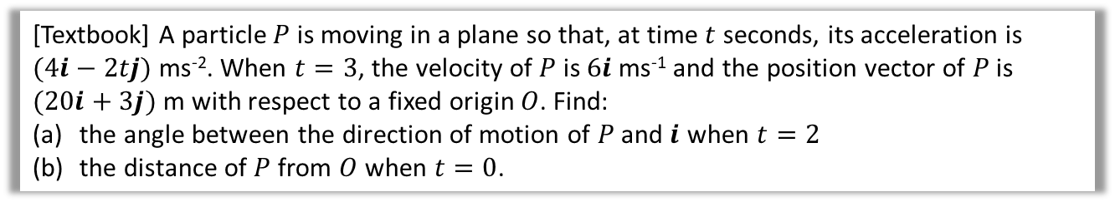


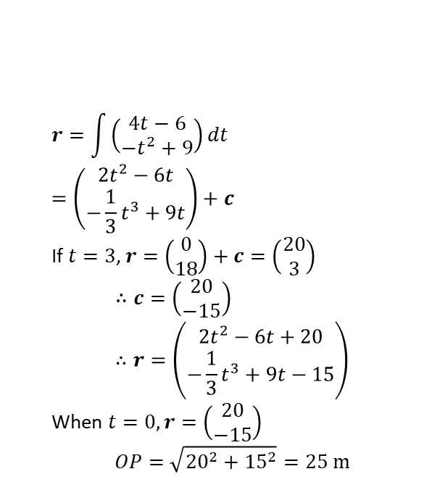


Further Example
[Textbook] A particle $P$ is moving in a plane so that, at time $t$ seconds, its acceleration is $(4i−2tj)$ ms⁻². When $t=3$, the velocity of $P$ is $6i$ ms⁻¹ and the position vector of $P$ is $(20i+3j)$ m with respect to a fixed origin $O$. Find:
the angle between the direction of motion of $P$ and $i$ when $t=2$
the distance of $P$ from $O$ when $t=0$.
a
?
b
?
The direction of motion is the velocity:
$$v=∫\left(\begin{matrix}4 \\ −2t\end{matrix}\right)dt=\left(\begin{matrix}4t \\ −t^{2}\end{matrix}\right)+c$$
When $t=3, v=\left(\begin{matrix}12 \\ −9\end{matrix}\right)+c=\left(\begin{matrix}6 \\ 0\end{matrix}\right)$ $$∴c=\left(\begin{matrix}6 \\ 0\end{matrix}\right)−\left(\begin{matrix}12 \\ −9\end{matrix}\right)=\left(\begin{matrix}−6 \\ 9\end{matrix}\right) \\ ∴v=\left(\begin{matrix}4t−6 \\ −t^{2}+9\end{matrix}\right) ms^{−1}$$
When $t=2,$ $v=\left(\begin{matrix}2 \\ 5\end{matrix}\right)$
$$r=\int{\left(\begin{matrix}4t−6 \\ −t^{2}+9\end{matrix}\right)dt} \\ =\left(\begin{matrix}2t^{2}−6t \\ −\frac{1}{3}t^{3}+9t\end{matrix}\right)+c$$
If $t=3$, $r=\left(\begin{matrix}0 \\ 18\end{matrix}\right)+c=\left(\begin{matrix}20 \\ 3\end{matrix}\right)$ $$∴c=\left(\begin{matrix}20 \\ −15\end{matrix}\right) \\ ∴r=\left(\begin{matrix}2t^{2}−6t+20 \\ −\frac{1}{3}t^{3}+9t−15\end{matrix}\right)$$
When $t=0, r=\left(\begin{matrix}20 \\ −15\end{matrix}\right)$
$$OP=\sqrt{{20}^{2}+{15}^{2}}=25 m$$
Use $t=3$ to get constant of integration.
$$θ=\tan^{−1}\left(\frac{5}{2}\right)=68.2°$$
$$5$$
$$θ$$
$$i$$
$$2$$

Slide 4
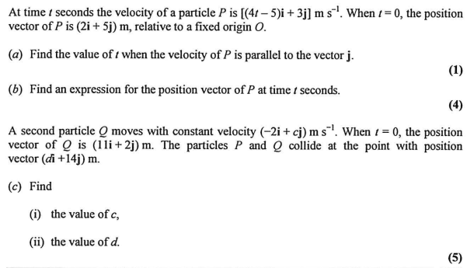
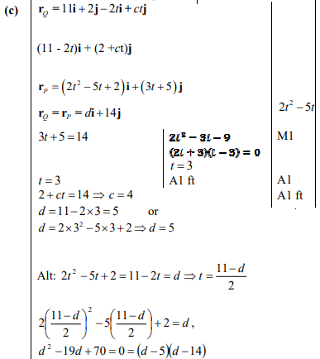
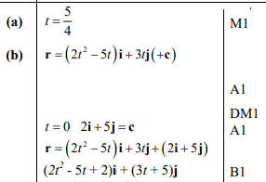
Test Your Understanding
Edexcel M2(Old) Jan 2013 Q4
?
?
?

Slide 5
Exercise 8.5
Pearson Stats/Mechanics Year 2
Pages 73-74

Slide 6
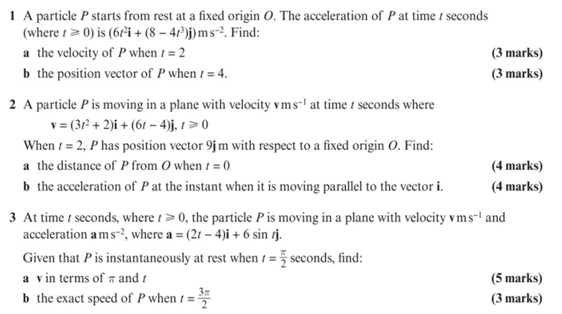
Homework Exercise

Slide 7
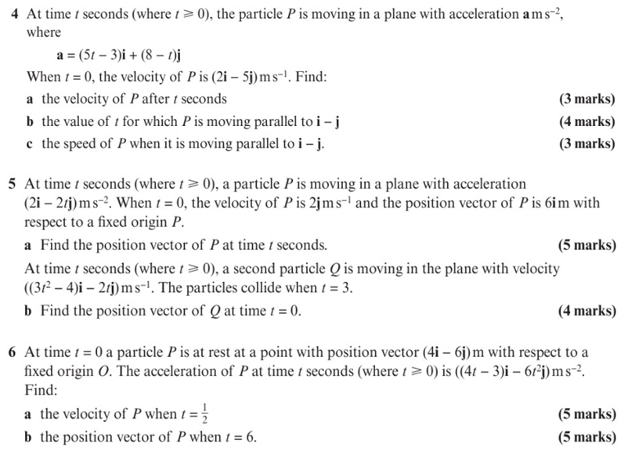
Homework Exercise

Slide 8
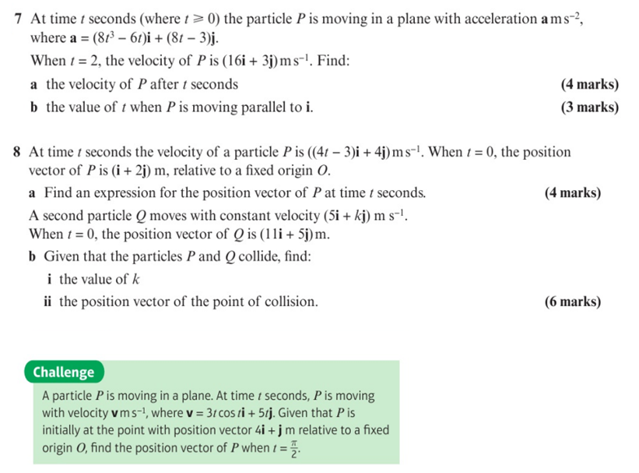
Homework Exercise

Slide 9
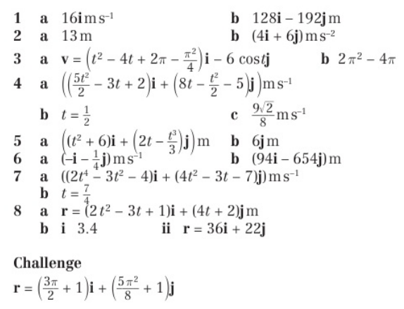
Homework Answers

