Slide 1
Stats1 Chapter 2: Measures of Data Coding

Slide 2
Coding
What do you reckon is the mean height of people in this room?
Now, stand on your chair, as per the instructions below.
INSTRUCTIONAL VIDEO
Is there an easy way to recalculate the mean based on your new heights? And the variance of your heights?
The mean would increase by the height of the chairs. The spread however is unaffected thus the variance would remain the same.
?

Slide 3
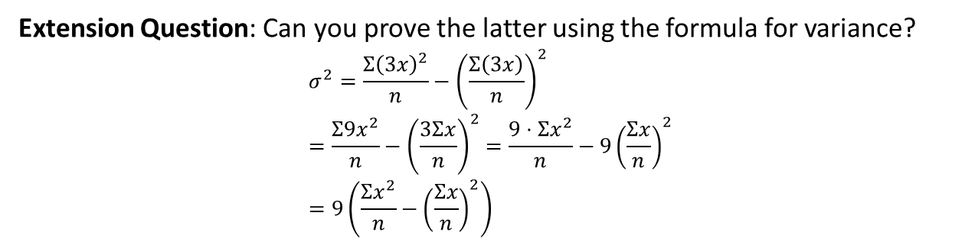
Starter
Suppose now after a bout of ‘stretching you to your limits’, you’re now all 3 times your original height.
What do you think happens to the standard deviation of your heights?
It becomes 3 times larger (i.e. your heights are 3 times as spread out!)
?
What do you think happens to the variance of your heights?
?
It becomes 9 times larger. We use the scale factor of the standard deviation, squared.
Extension Question: Can you prove the latter using the formula for variance?
$$σ^{2}=\frac{Σ{\left(3x\right)}^{2}}{n}−{\left(\frac{Σ\left(3x\right)}{n}\right)}^{2} \\ =\frac{Σ9x^{2}}{n}−{\left(\frac{3Σx}{n}\right)}^{2}=\frac{9⋅Σx^{2}}{n}−9{\left(\frac{Σx}{n}\right)}^{2} \\ =9\left(\frac{Σx^{2}}{n}−{\left(\frac{Σx}{n}\right)}^{2}\right)$$
?

Slide 4
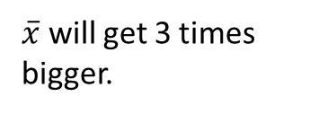
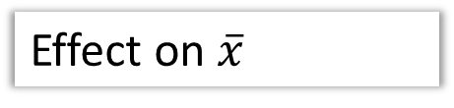

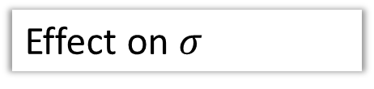
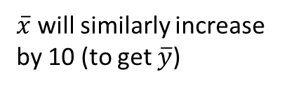
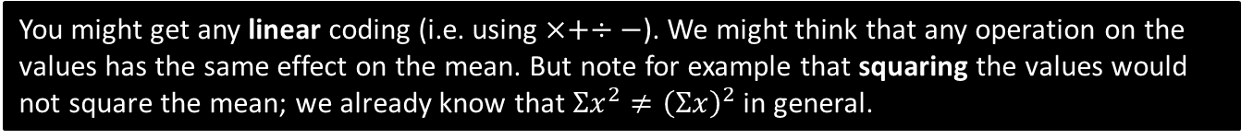
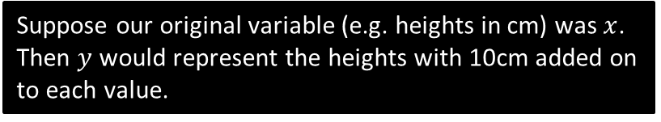
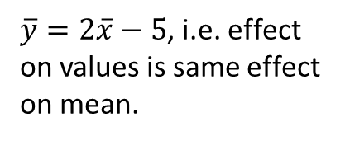


Rules of coding
Suppose our original variable (e.g. heights in cm) was $x$.
Then $y$ would represent the heights with 10cm added on to each value.
Coding
Effect on $\overline{x}$
Effect on $σ$
?
?
$$y=x+10$$
$\overline{x}$ will similarly increase by 10 (to get $\overline{y}$)
As discussed, adding (and subtracting) has no effect on standard deviation or any measure of spread.
$$y=3x$$
?
?
$\overline{x}$ will get 3 times bigger.
Standard deviation will get 3 times larger.
?
?
$$y=2x−5$$
$\overline{y}=2\overline{x}−5$, i.e. effect on values is same effect on mean.
-5 has no effect but standard deviation will get 2 times larger.
You might get any linear coding (i.e. using $×+÷−$). We might think that any operation on the values has the same effect on the mean. But note for example that squaring the values would not square the mean; we already know that $Σx^{2}≠{\left(Σx\right)}^{2}$ in general.

Slide 5
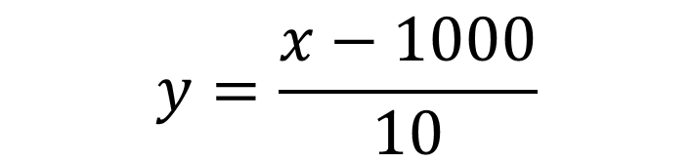
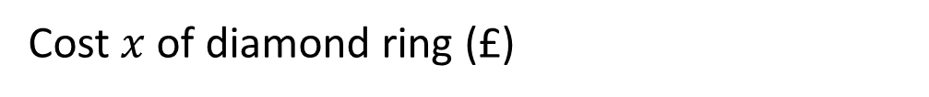

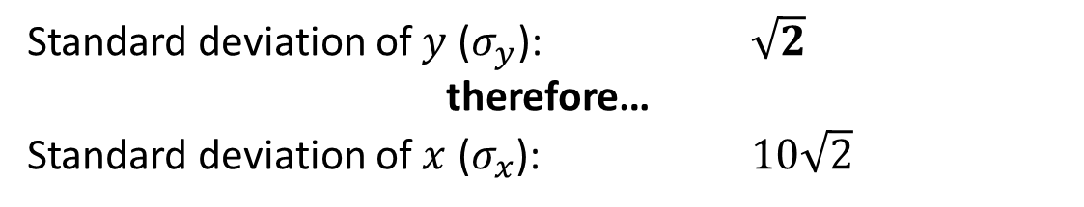
The point of coding
Cost $x$ of diamond ring (£)
£1010 £1020 £1030 £1040 £1050
We ‘code’ our variable using the following:
$$y=\frac{x−1000}{10}$$
New values $y$:
?
£1 £2 £3 £4 £5
Standard deviation of $y$ ($σ_{y}$): $\sqrt{2}$
therefore…
Standard deviation of $x$ ($σ_{x}$): $10\sqrt{2}$
?
?
The jist of coding: We want to find the mean/standard deviation of a variable. We transform the values, using some rule, to make them simpler. We can then more easily calculate the mean/standard deviation of the ‘coded’ data, and from this we can then determine what the mean/standard deviation would have been for the original uncoded data.

Slide 6
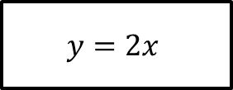
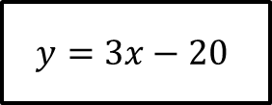
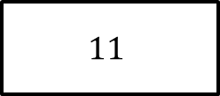

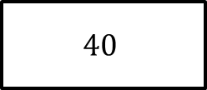

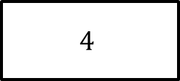



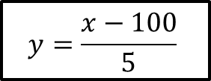

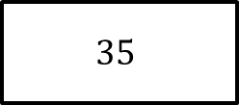


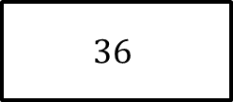

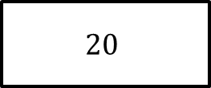
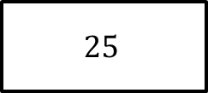


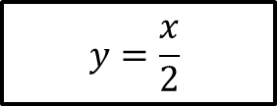
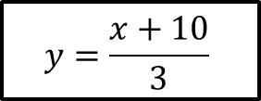


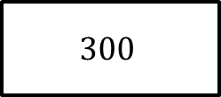




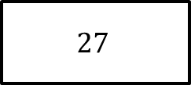


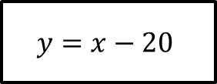
Quickfire Questions
Old mean $\overline{x}$
Old $σ_{x}$
Coding
New mean $\overline{y}$
New $σ_{y}$
$$36$$
$$4$$
$$y=x−20$$
$$16$$
$$4$$
?
?
?
?
$$72$$
$$16$$
$$36$$
$$8$$
$$y=2x$$
?
?
$$35$$
$$4$$
$$y=3x−20$$
$$85$$
$$12$$
$$40$$
$$3$$
$$y=\frac{x}{2}$$
$$20$$
$$\frac{3}{2}$$
?
?
$$11$$
$$27$$
$$y=\frac{x+10}{3}$$
$$7$$
$$9$$
?
?
$$300$$
$$25$$
$$y=\frac{x−100}{5}$$
$$40$$
$$5$$
?
?

Slide 7
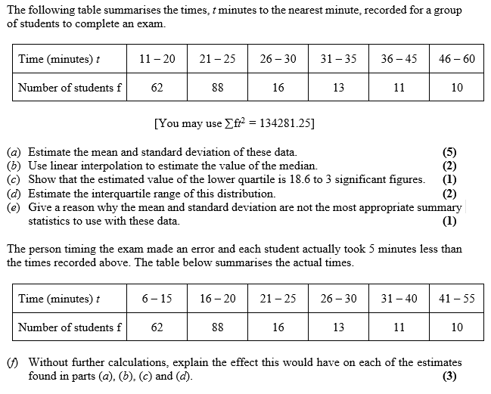

Example Exam Question
Suppose we’ve worked all these out already.
f)
Coding is
$$t_{2}=t_{1}−5$$
Mean decreases by 5.
$σ$ unaffected.
Median decreases by 5.
Lower quartile decreases by 5.
Interquartile range unaffected.
?

Slide 8
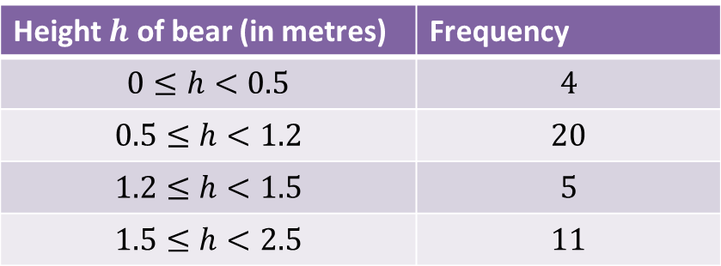
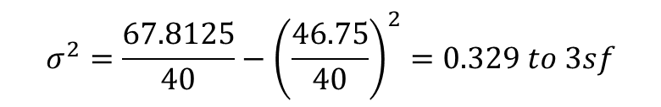
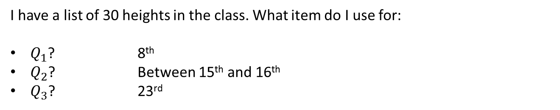
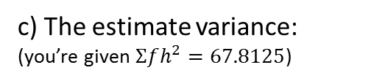
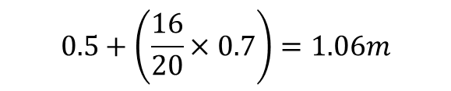
Chapter 2 Summary
I have a list of 30 heights in the class. What item do I use for:
$Q_{1}$? 8th
$Q_{2}$? Between 15th and 16th
$Q_{3}$? 23rd
?
?
?
For the following grouped frequency table, calculate:
Height $h$ of bear (in metres) | Frequency
$$0≤h<0.5$$ | $$4$$
$$0.5≤h<1.2$$ | $$20$$
$$1.2≤h<1.5$$ | $$5$$
$$1.5≤h<2.5$$ | $$11$$
$$\overline{h}=\frac{\left(0.25×4\right)+\left(0.85×20\right)+…}{40}=\frac{46.75}{40}=1.17m to 3sf$$
?
a) The estimate mean:
?
b) The estimate median:
$$0.5+\left(\frac{16}{20}×0.7\right)=1.06m$$
?
c) The estimate variance:
(you’re given $Σfh^{2}=67.8125$)
$$σ^{2}=\frac{67.8125}{40}−{\left(\frac{46.75}{40}\right)}^{2}=0.329 to 3sf$$

Slide 9
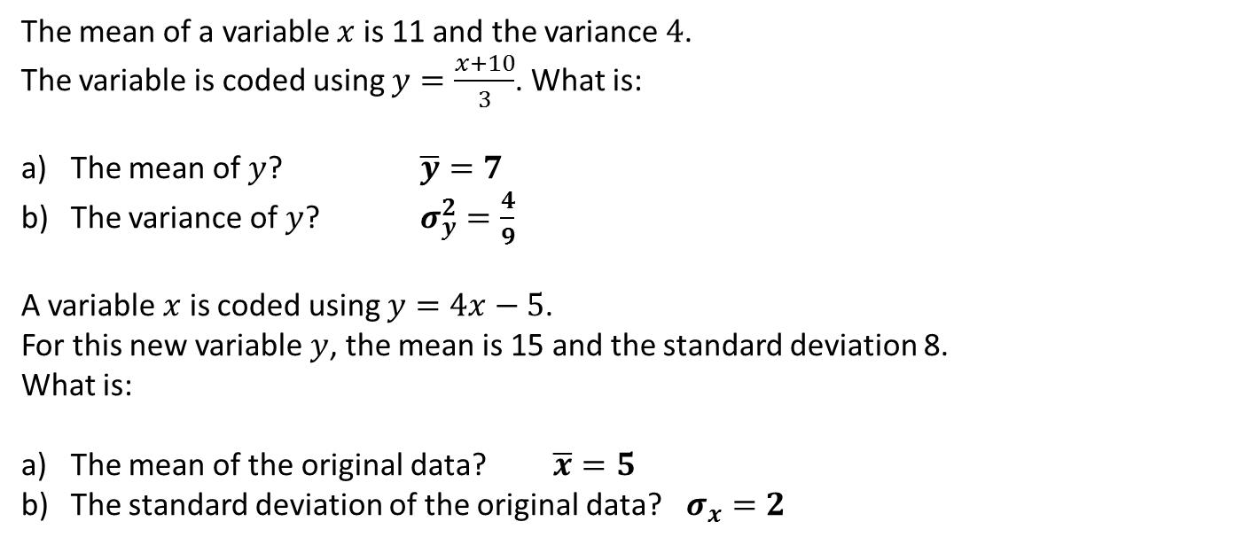
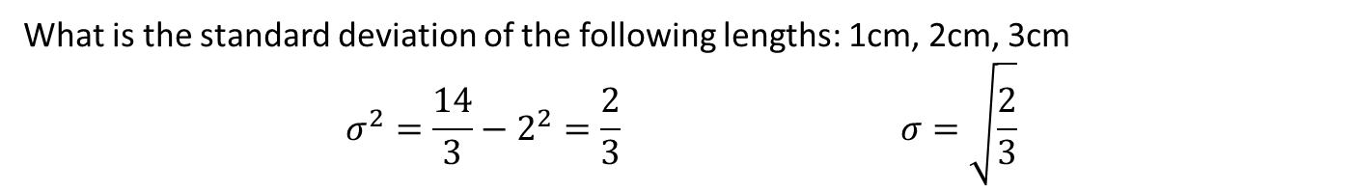
Chapter 2 Summary
What is the standard deviation of the following lengths: 1cm, 2cm, 3cm
$$σ^{2}=\frac{14}{3}−2^{2}=\frac{2}{3} σ=\sqrt{\frac{2}{3}}$$
?
The mean of a variable $x$ is 11 and the variance $4$.
The variable is coded using $y=\frac{x+10}{3}$. What is:
The mean of $y$? $\overline{y}=7$
The variance of $y$? $σ_{y}^{2}=\frac{4}{9}$
A variable $x$ is coded using $y=4x−5$.
For this new variable $y$, the mean is 15 and the standard deviation 8.
What is:
The mean of the original data? $\overline{x}=5$
The standard deviation of the original data? $σ_{x}^{}=2$
?
?
?
?

Slide 10
Exercise 2.5
Pearson Statistics & Mechanics Year 1/AS
Pages 13-14

Slide 11
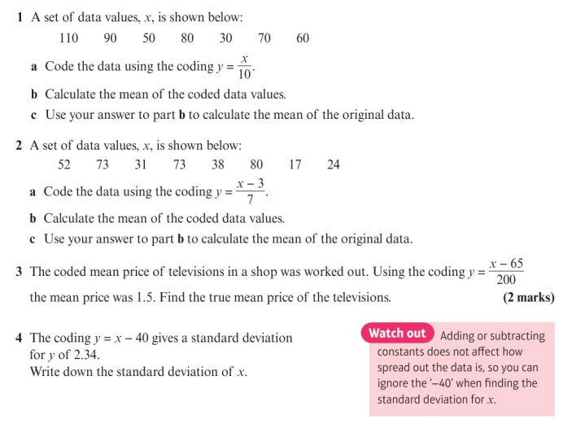
Homework Exercise

Slide 12
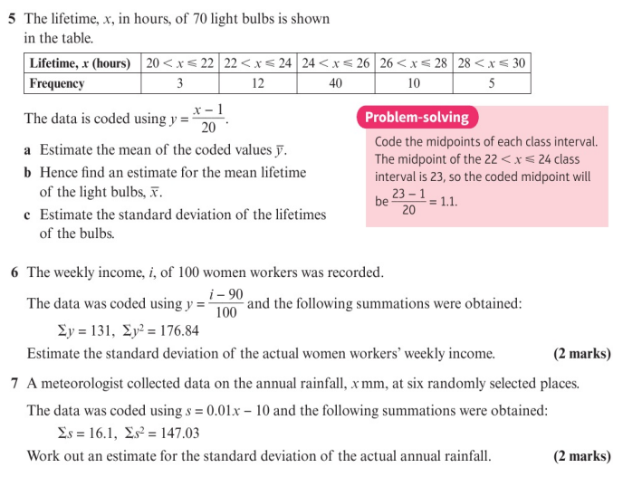
Homework Exercise

Slide 13
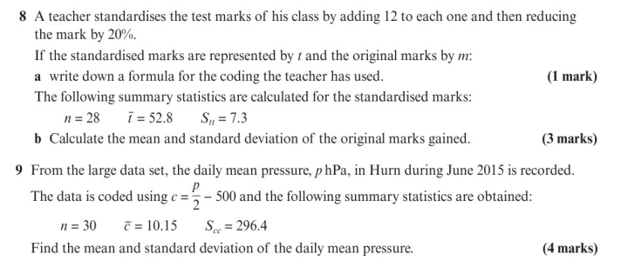
Homework Exercise

Slide 14
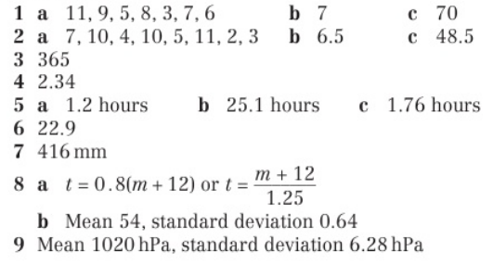
Homework Answers

