Slide 1
M1 Chapter 10: Forces and Motion Force Diagrams

Slide 2

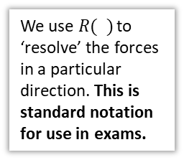




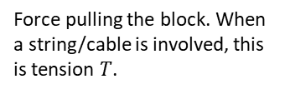






Force Diagrams (Free Body Diagrams)
The normal support force of the plane on the block (holding up the block; always at 90 ͦ to the surface.)
We consider the forces acting on each object one at a time.
$$N$$
Recall that we often model an object as a particle, i.e. a point with negligible dimensions.
$$R$$
$$P$$
Force pulling the block. When a string/cable is involved, this is tension $T$.
Resistive force: in this case the friction between the block and the plane.
$$W$$
The weight of the block.
! Newton’s 1st Law of Motion states than an object at rest will stay at rest and that an object moving with constant velocity will remain at that velocity unless an unbalanced force acts on the object.
Resultant forces need to be non-zero to cause acceleration.
If forces are balanced in every direction there will be no acceleration.
e.g. forces up = forces down & forces left = forces right.
We use $R( )$ to ‘resolve’ the forces in a particular direction. This is standard notation for use in exams.
?
! The ‘resultant force’ is the overall force acting on the object. An object will accelerate in the direction of the resultant force.
$$40 N$$
$$R\left(→\right): 30−30=0 N$$
?
$$R\left(↑\right): 40−5=35 N$$
$$30 N$$
$$30 N$$
$$35 N$$
Therefore a ‘resultant’ force of 35 N upwards and the object will accelerate upwards.
$$5 N$$

Slide 3















Quickfire Examples
$$5 N$$
?
? Resultant Force
$$R\left(→\right): \left(P−3\right) N$$
$$3 N$$
$$P N$$
$$\left(P−3\right) N$$
?
$$R\left(↑\right): 5−5=0 N$$
$$5 N$$
$$4 N$$
$$R\left(→\right): 5−7=−2 N$$
? Resultant Force
?
$$7 N$$
$$2 N$$
F = $\left(\begin{matrix}−2 \\ −2\end{matrix}\right) N$
$$3 N$$
?
$$R\left(↑\right): 4−6=−2 N$$
$$6 N$$

Slide 4
Exercise 10.1 Force Diagrams
Pearson Stats/Mechanics Year 1
Pages 67

Slide 5
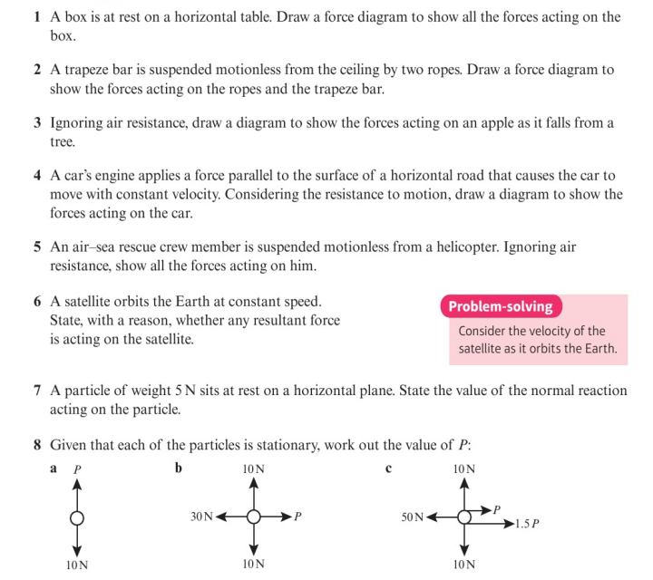
Homework Exercise

Slide 6
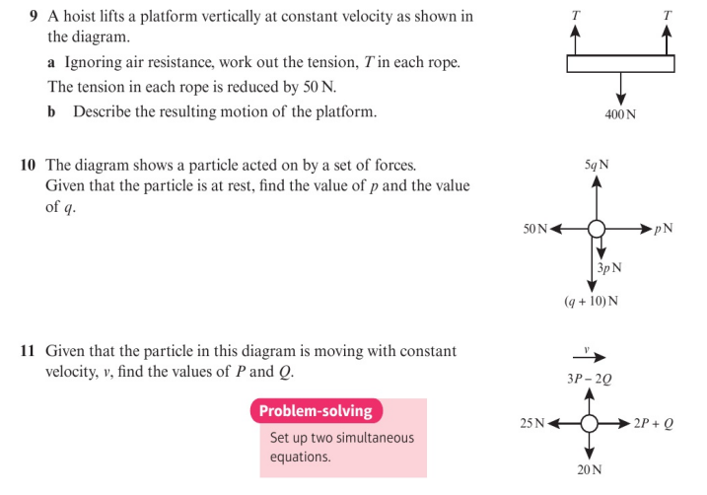
Homework Exercise

Slide 7
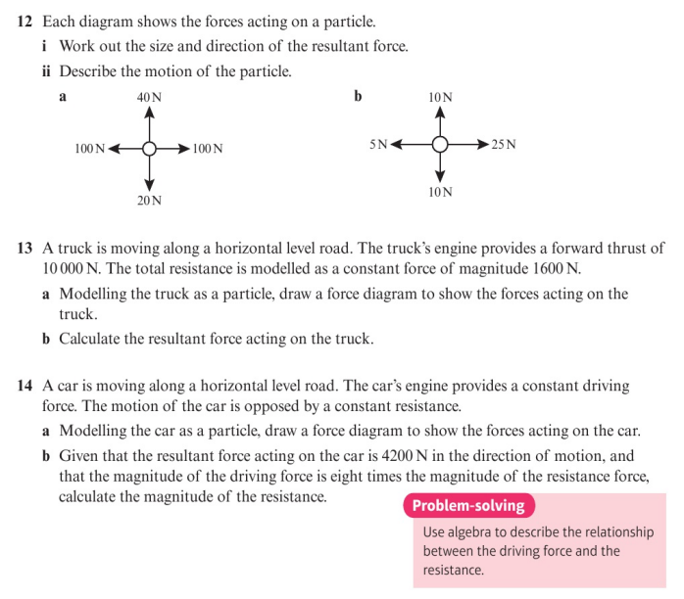
Homework Exercise

Slide 8
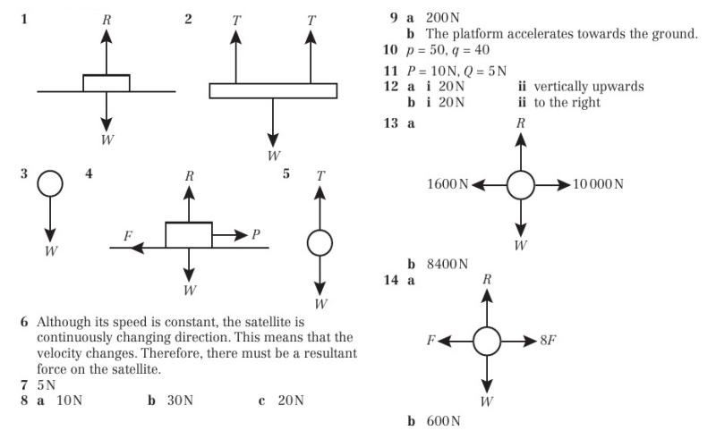
Homework Answers

