Slide 1
Stats Yr2 Chapter 2: Probability Theory Probability with Venn Diagrams

Slide 2





Examples
1
Using the Venn Diagram, determine:
a
$P\left(A | B\right)$
Method 1: Using the formula
$$P\left(A | B\right)=\frac{P\left(A∩B\right)}{P\left(B\right)}=\frac{2/15}{6/15}=\frac{1}{3}$$
Method 2: Restricted sample space
$$P\left(A | B\right)=\frac{2}{6}=\frac{1}{3}$$
$$ξ$$
$$A$$
$$B$$
?
?
2
3
Out of 6 things in $B$, 2 are in $A∩B$.
6
4
?
?
$P\left(A′ | B′\right)=\frac{3}{9}=\frac{1}{3} P\left(B | A∪B\right)=\frac{6}{12}=\frac{1}{2}$
b
c

Slide 3





Further Examples
Given that $P\left(A\right)=0.5$ and $P\left(A∩B\right)=0.3$, what is $P\left(B | A\right)$?
$$P\left(B | A\right)=\frac{P\left(A∩B\right)}{P\left(A\right)}=\frac{0.3}{0.5}=0.6$$
Given that $P\left(Y\right)=0.6$ and $P\left(X∩Y\right)=0.4$, what is $P\left(X^{′} | Y\right)$? (Hint: Drawing a Venn Diagram will help!)
$P\left(X^{′} | Y\right)=\frac{P\left(X^{′}∩Y\right)}{P\left(Y\right)}$ $∴P\left(X^{′} | Y\right)=\frac{0.2}{0.6}=\frac{1}{3}$
Given that $P\left(A\right)=0.5$, $P\left(B\right)=0.5$ and $P\left(A∩B\right)=0.4$, what is $P\left(B | A^{′}\right)$?
$$P\left(B | A^{′}\right)=\frac{P\left(A^{′}∩B\right)}{P\left(A^{′}\right)} \\ =\frac{0.1}{0.5}$$
$$=0.2$$
a
Fro Tip: The ‘restricted sample space’ method also works for Venn Diagrams with probabilities.
?
b
?
$$X$$
$$Y$$
0.4
0.2
c
?
$$A$$
$$B$$
0.1
0.4
0.1
0.4

Slide 4
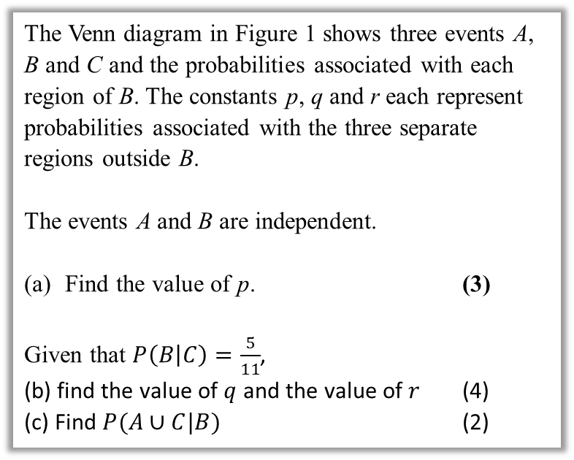

Further Test Your Understanding
May 2013 (R) Q6
(From earlier) $0.1=\left(p+0.1\right)×0.4$ $p+0.1=0.25$ $p=0.15$
$P\left(B | C\right)=\frac{P\left(B∩C\right)}{P\left(C\right)}$ $\frac{5}{11}=\frac{0.2}{0.2+q}$ $q=0.24$ $r=1−0.15−0.1−0.1−0.2−0.24$ $=0.21$
$P\left(A∪C | B\right)=\frac{P\left(\left(A∪C\right)∩B\right)}{P\left(B\right)}$ $=\frac{0.1+0.2}{0.4}=0.75$
?
The Venn diagram in Figure 1 shows three events A, B and C and the probabilities associated with each region of B. The constants p, q and r each represent probabilities associated with the three separate regions outside B.
The events A and B are independent.
Find the value of p. (3)
Given that $P\left(B | C\right)=\frac{5}{11}$,
(b) find the value of $q$ and the value of $r$ (4)
(c) Find $P(A∪C|B)$ (2)
?

Slide 5

Exercise 2.3
Pearson Stats/Mechanics Year 2
Pages 13-15
Extension:
[Classic puzzle] I have 2 children. One of them is a boy. What’s the probability the other is a boy?
If (at least) one is a boy, restricted sample space is BB, BG, GB. Of these, only in one case is the other a boy. $∴\frac{1}{3}$
1
?

Slide 6
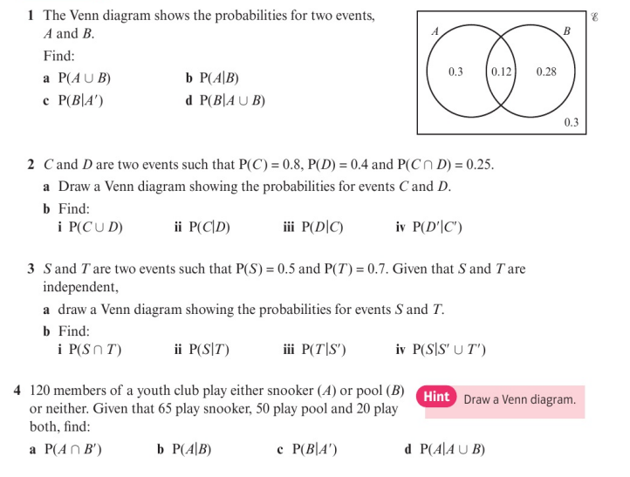
Homework Exercise

Slide 7
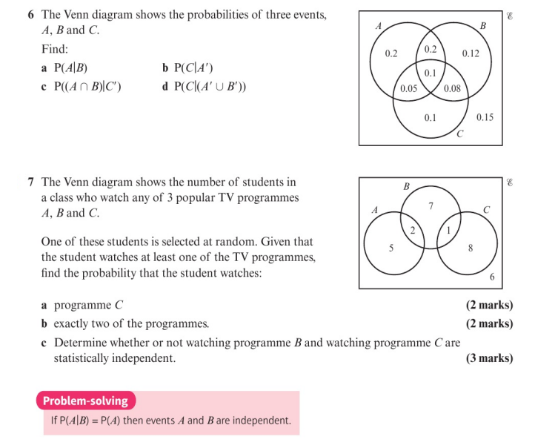
Homework Exercise

Slide 8
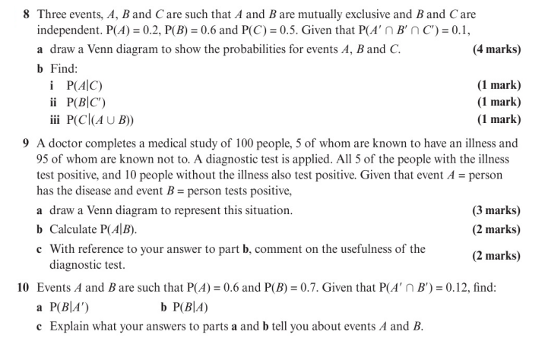
Homework Exercise

Slide 9
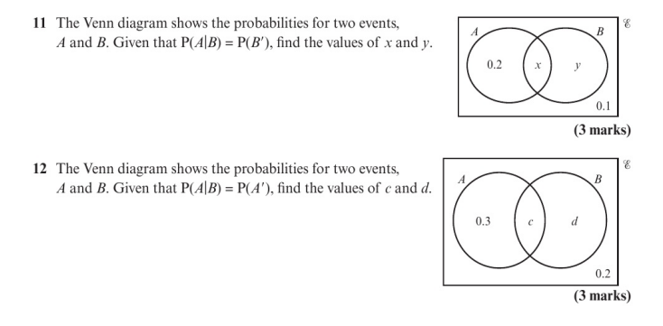
Homework Exercise

Slide 10
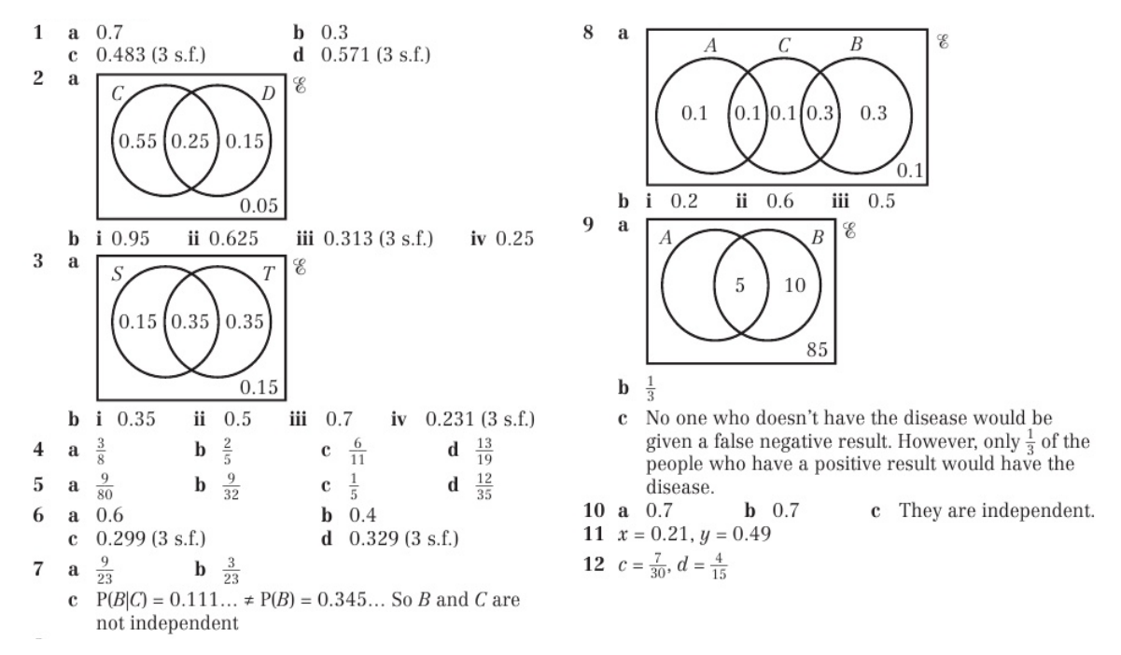
Homework Answers

