Slide 1
P2 Chapter 3: Sequences and Series
Arithmetic Series

Slide 2
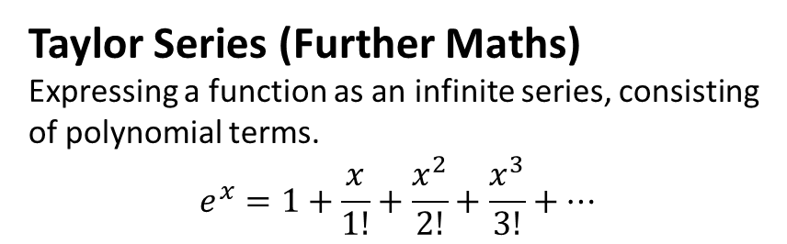

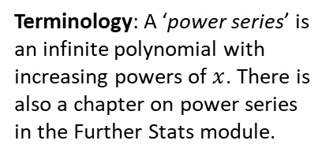
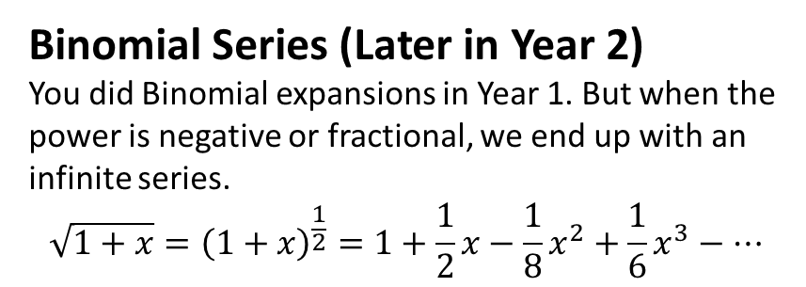
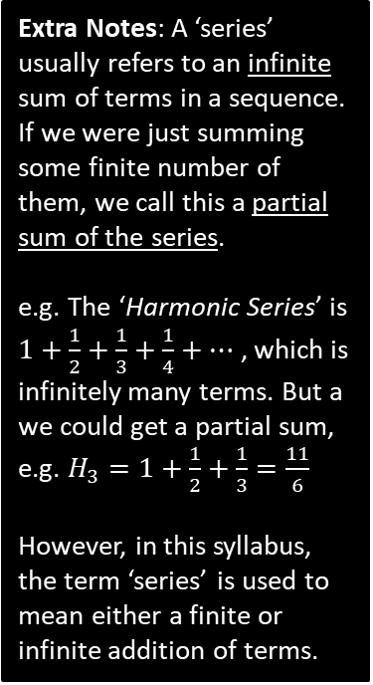
Series
A series is a sum of terms in a sequence.
You will encounter ‘series’ in many places in A Level:
Extra Notes: A ‘series’ usually refers to an infinite sum of terms in a sequence. If we were just summing some finite number of them, we call this a partial sum of the series.
e.g. The ‘Harmonic Series’ is $1+\frac{1}{2}+\frac{1}{3}+\frac{1}{4}+…$ , which is infinitely many terms. But a we could get a partial sum, e.g. $H_{3}=1+\frac{1}{2}+\frac{1}{3}=\frac{11}{6}$
However, in this syllabus, the term ‘series’ is used to mean either a finite or infinite addition of terms.
Arithmetic Series (this chapter!)
Sum of terms in an arithmetic sequence.
$$2+5+8+11$$
Binomial Series (Later in Year 2)
You did Binomial expansions in Year 1. But when the power is negative or fractional, we end up with an infinite series.
$$\sqrt{1+x}={\left(1+x\right)}^{\frac{1}{2}}=1+\frac{1}{2}x−\frac{1}{8}x^{2}+\frac{1}{6}x^{3}−…$$
Taylor Series (Further Maths)
Expressing a function as an infinite series, consisting of polynomial terms.
$$e^{x}=1+\frac{x}{1!}+\frac{x^{2}}{2!}+\frac{x^{3}}{3!}+…$$
Terminology: A ‘power series’ is an infinite polynomial with increasing powers of $x$. There is also a chapter on power series in the Further Stats module.

Slide 3
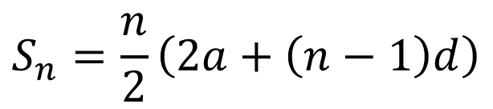
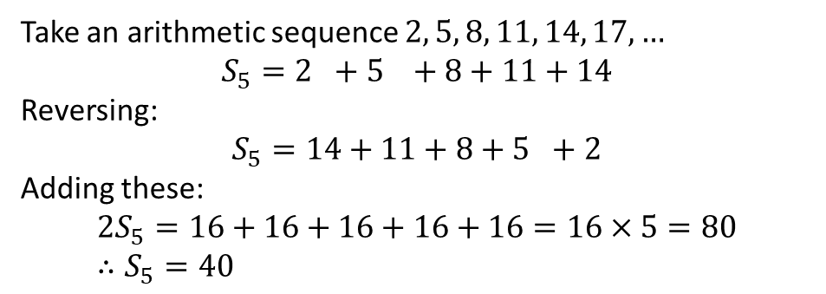

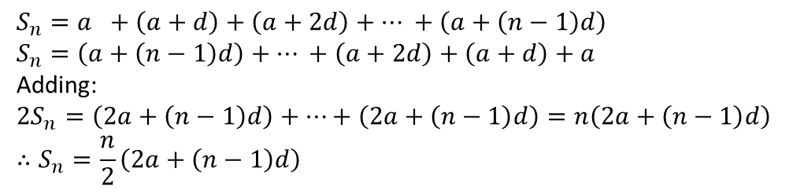


Arithmetic Series
$n$^{th} term
! Sum of first $n$ terms
?
$$S_{n}=\frac{n}{2}\left(2a+\left(n−1\right)d\right)$$
$$u_{n}=a+\left(n−1\right)d$$
Example:
Let’s prove it!
Take an arithmetic sequence $2, 5, 8, 11, 14, 17, …$
$$S_{5}=2 +5 +8+11+14$$
Reversing:
$$S_{5}=14+11+8+5 +2$$
Adding these:
$$2S_{5}=16+16+16+16+16=16×5=80 \\ ∴S_{5}=40$$
The idea is that each pair of terms, at symmetrically opposite ends, adds to the same number.
Proving more generally:
Fro Exam Note: The proof has been an exam question before. It’s also a university interview favourite!
$$S_{n}=a +\left(a+d\right)+\left(a+2d\right)+… +\left(a+\left(n−1\right)d\right) \\ S_{n}=\left(a+\left(n−1\right)d\right)+… +\left(a+2d\right)+\left(a+d\right)+a$$
Adding:
$$2S_{n}=\left(2a+\left(n−1\right)d\right)+…+\left(2a+\left(n−1\right)d\right)=n\left(2a+\left(n−1\right)d\right) \\ ∴S_{n}=\frac{n}{2}\left(2a+\left(n−1\right)d\right)$$

Slide 4
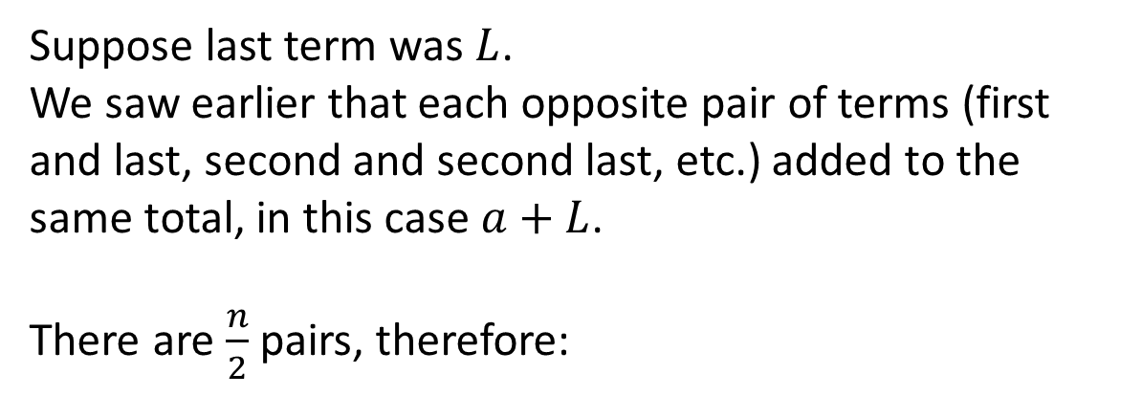

Alternative Formula
$$a+\left(a+d\right)+…+L$$
Suppose last term was $L$.
We saw earlier that each opposite pair of terms (first and last, second and second last, etc.) added to the same total, in this case $a+L$.
There are $\frac{n}{2}$ pairs, therefore:
!
$$S_{n}=\frac{n}{2}\left(a+L\right)$$

Slide 5

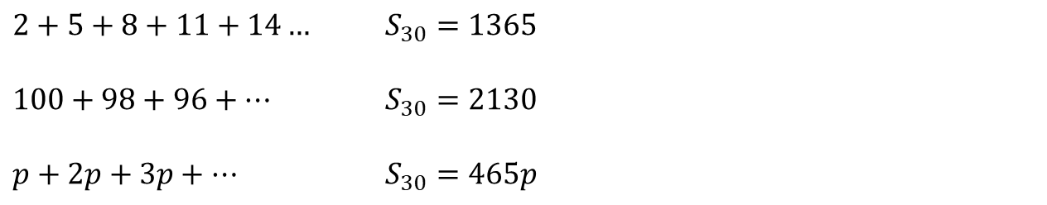
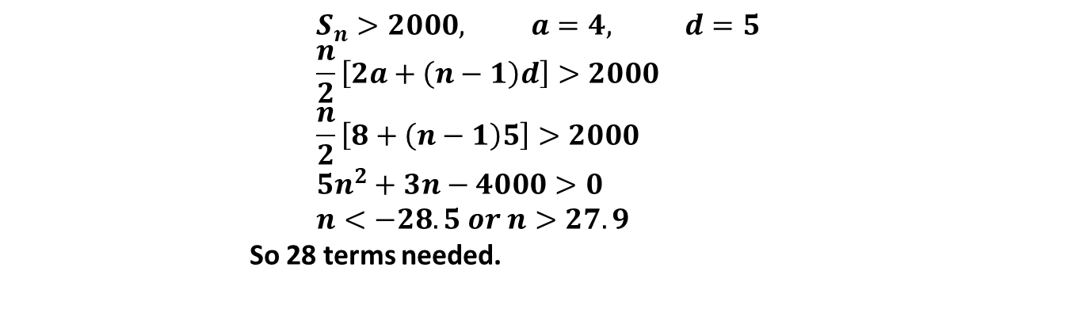
Examples
Find the sum of the first 30 terms of the following arithmetic sequences…
1
?
Fro Tips: Again, explicitly write out $"a=…, d=…, n=…$”. You’re less likely to make incorrect substitutions into the formula.
Make sure you write $S_{n}=…$ so you make clear to yourself (and the examiner) that you’re finding the sum of the first $n$ terms, not the $n$th term.
$2+5+8+11+14…$ $S_{30}=1365$
$100+98+96+…$ $S_{30}=2130$
$p+2p+3p+…$ $S_{30}=465p$
2
?
3
?
Find the minimum number of terms for the sum of $4+9+14+…$ to exceed 2000.
?
$$S_{n}>2000, a=4, d=5 \\ \frac{n}{2}\left[2a+\left(n−1\right)d\right]>2000 \\ \frac{n}{2}\left[8+\left(n−1\right)5\right]>2000 \\ 5n^{2}+3n−4000>0 \\ n<−28.5 or n>27.9$$
So 28 terms needed.

Slide 6
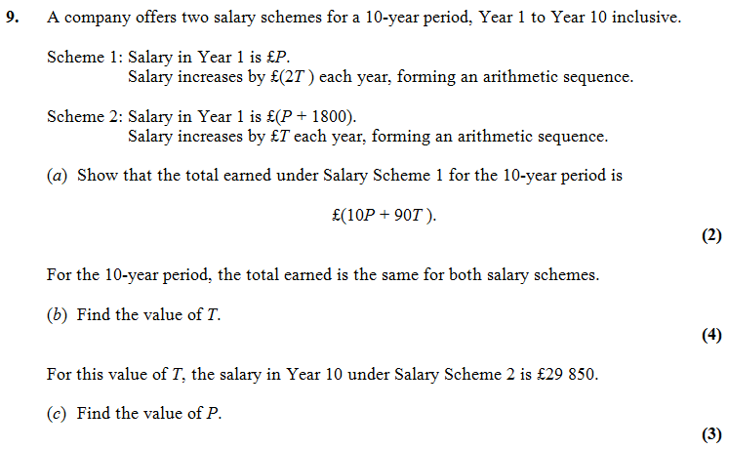


Test Your Understanding
Edexcel C1 Jan 2012 Q9
?
$$T=400$$
$$P=£24450$$
?

Slide 7
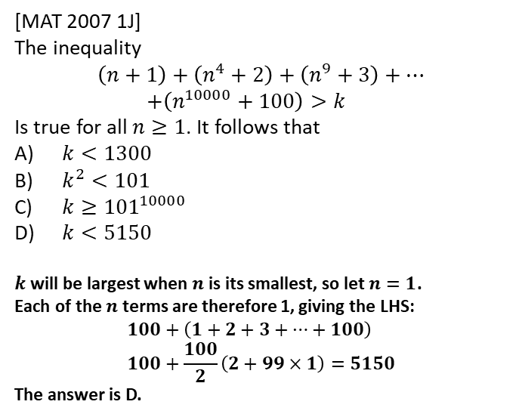
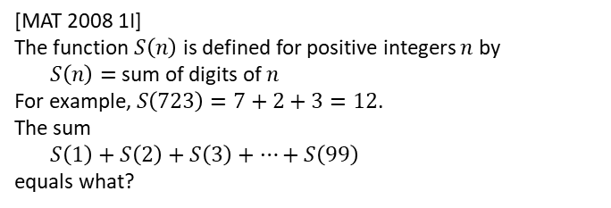
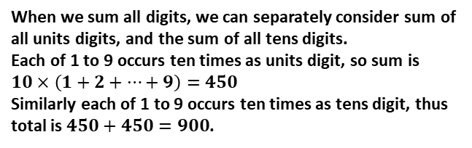
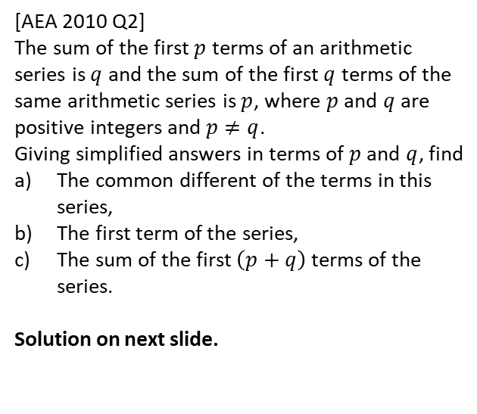
Exercise 3.2
Pearson Pure Mathematics Year 2/AS
Page 18
Extension
1
[MAT 2007 1J]
The inequality
$$\left(n+1\right)+\left(n^{4}+2\right)+\left(n^{9}+3\right)+… \\ +\left(n^{10000}+100\right)>k$$
Is true for all $n≥1$. It follows that
$k<1300$
$k^{2}<101$
$k≥{101}^{10000}$
$k<5150$
$k$ will be largest when $n$ is its smallest, so let $n=1$.
Each of the $n$ terms are therefore 1, giving the LHS:
$$100+\left(1+2+3+…+100\right) \\ 100+\frac{100}{2}\left(2+99×1\right)=5150$$
The answer is D.
2
[AEA 2010 Q2]
The sum of the first $p$ terms of an arithmetic series is $q$ and the sum of the first $q$ terms of the same arithmetic series is $p$, where $p$ and $q$ are positive integers and $p≠q$.
Giving simplified answers in terms of $p$ and $q$, find
The common different of the terms in this series,
The first term of the series,
The sum of the first $\left(p+q\right)$ terms of the series.
Solution on next slide.
?
3
[MAT 2008 1I]
The function $S\left(n\right)$ is defined for positive integers $n$ by
$S\left(n\right)=$sum of digits of $n$
For example, $S\left(723\right)=7+2+3=12$.
The sum
$S\left(1\right)+S\left(2\right)+S\left(3\right)+…+S\left(99\right)$
equals what?
?
When we sum all digits, we can separately consider sum of all units digits, and the sum of all tens digits.
Each of 1 to 9 occurs ten times as units digit, so sum is $10×\left(1+2+…+9\right)=450$
Similarly each of 1 to 9 occurs ten times as tens digit, thus total is $450+450=900$.

Slide 8
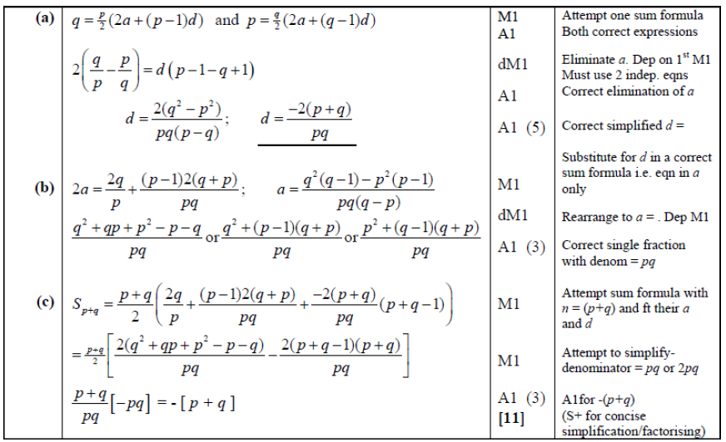
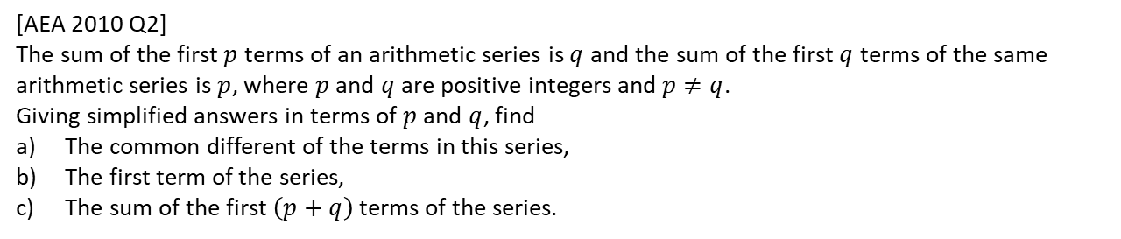
Solution to Extension Q2
[AEA 2010 Q2]
The sum of the first $p$ terms of an arithmetic series is $q$ and the sum of the first $q$ terms of the same arithmetic series is $p$, where $p$ and $q$ are positive integers and $p≠q$.
Giving simplified answers in terms of $p$ and $q$, find
The common different of the terms in this series,
The first term of the series,
The sum of the first $\left(p+q\right)$ terms of the series.

Slide 9
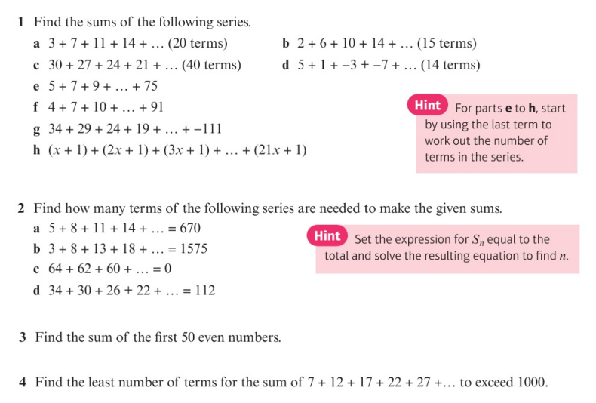
Homework Exercise

Slide 10
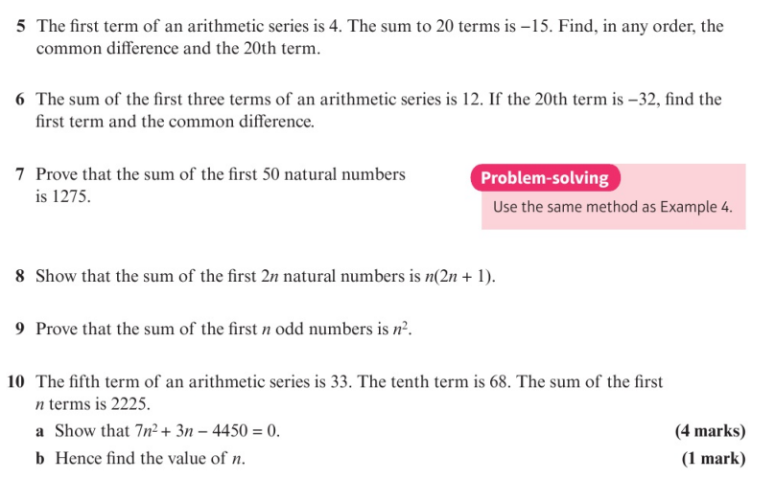
Homework Exercise

Slide 11
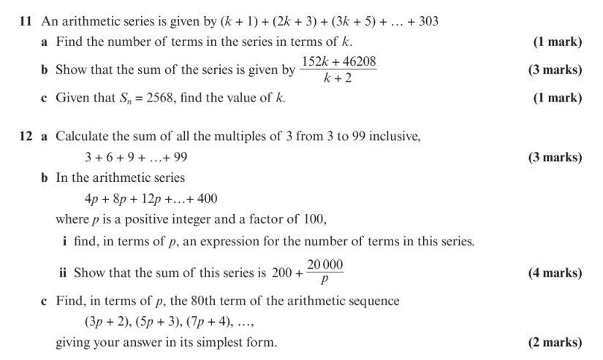
Homework Exercise

Slide 12
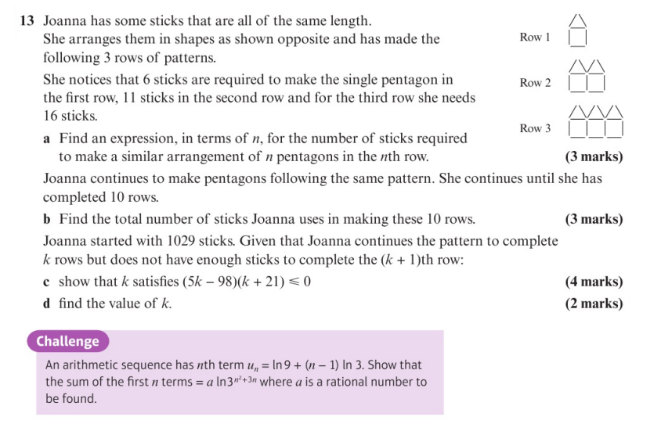
Homework Exercise

Slide 13
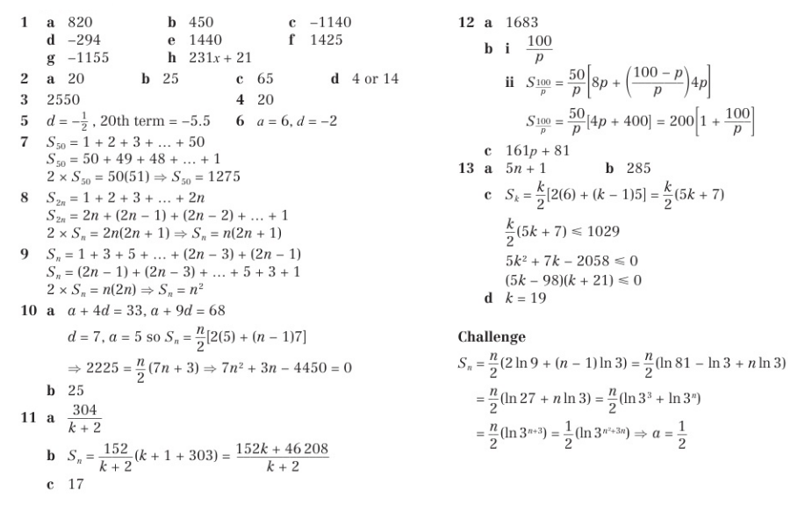
Homework Answers

