Slide 1
P2 Chapter 3: Sequences and Series
Infinite Sums

Slide 2
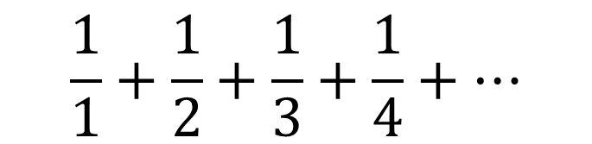
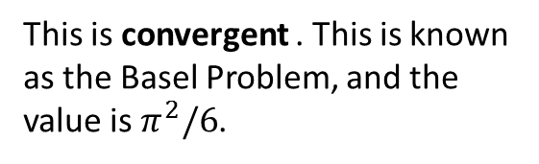
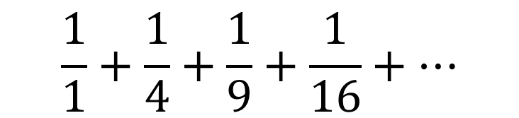
Divergent vs Convergent
What can you say about the sum of each series up to infinity?
1 + 2 + 4 + 8 + 16 + ...
?
This is divergent – the sum of the values tends towards infinity.
?
1 – 2 + 3 – 4 + 5 – 6 + …
This is divergent – the running total alternates either side of 0, but gradually gets further away from 0.
1 + 0.5 + 0.25 + 0.125 + ...
This is convergent – the sum of the values tends towards a fixed value, in this case 2.
?
Definitely NOT in the A Level syllabus, and just for fun...
$$\frac{1}{1}+\frac{1}{2}+\frac{1}{3}+\frac{1}{4}+…$$
?
This is divergent . This is known as the Harmonic Series
$$\frac{1}{1}+\frac{1}{4}+\frac{1}{9}+\frac{1}{16}+…$$
This is convergent . This is known as the Basel Problem, and the value is $π^{2}/6$.
?

Slide 3
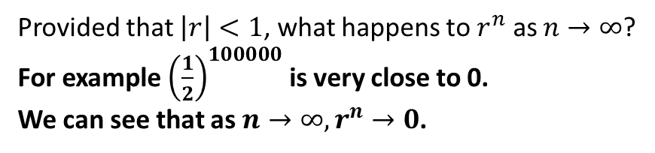
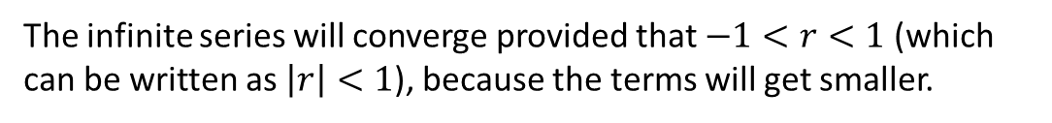
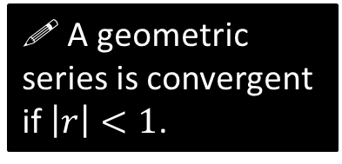

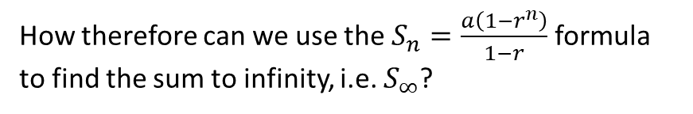
Sum to Infinity
1 + 0.5 + 0.25 + 0.125 + ...
Why did this infinite sum converge (to 2)…
1 + 2 + 4 + 8 + 16 + ...
…but this diverge to infinity?
The infinite series will converge provided that $−1<r<1$ (which can be written as $\left|r\right|<1$), because the terms will get smaller.
! A geometric series is convergent if $\left|r\right|<1$.
Provided that $\left|r\right|<1$, what happens to $r^{n}$ as $n→∞$?
For example ${\left(\frac{1}{2}\right)}^{100000}$ is very close to 0.
We can see that as $n→∞, r^{n}→0$.
?
How therefore can we use the $S_{n}=\frac{a\left(1−r^{n}\right)}{1−r}$ formula to find the sum to infinity, i.e. $S_{∞}$?
! For a convergent geometric series,
$$S_{∞}=\frac{a}{1−r}$$

Slide 4

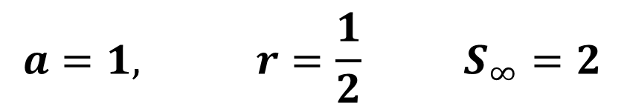
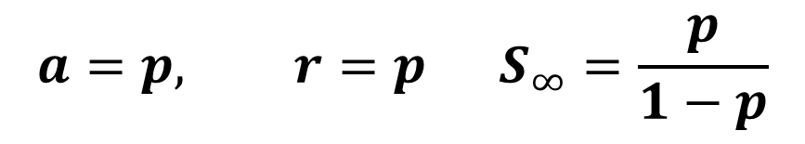
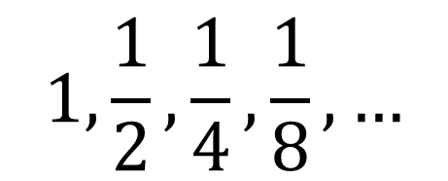
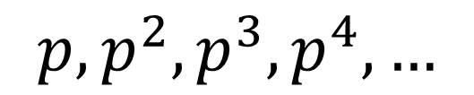
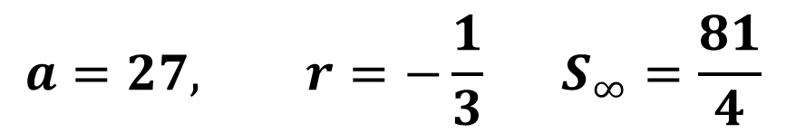
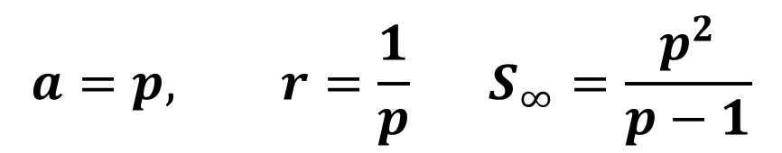
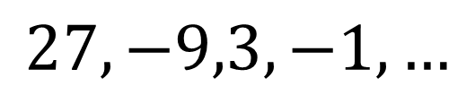
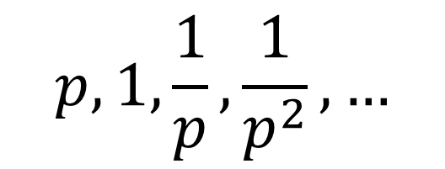
Quickfire Examples
$$1,\frac{1}{2},\frac{1}{4},\frac{1}{8},…$$
?
$$a=1, r=\frac{1}{2} S_{∞}=2$$
?
?
$$a=27, r=−\frac{1}{3} S_{∞}=\frac{81}{4}$$
?
?
?
$$27,−9,3,−1,…$$
?
?
$$a=p, r=p S_{∞}=\frac{p}{1−p}$$
$$p, p^{2},p^{3},p^{4},…$$
?
$$where −1<p<1$$
$$a=p, r=\frac{1}{p} S_{∞}=\frac{p^{2}}{p−1}$$
$$p, 1,\frac{1}{p},\frac{1}{p^{2}},…$$
?
?
?

Slide 5
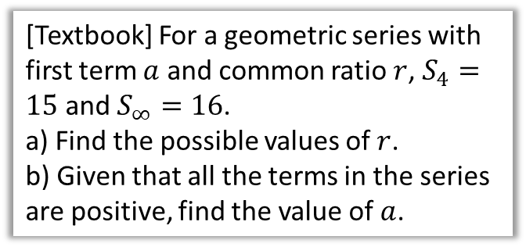

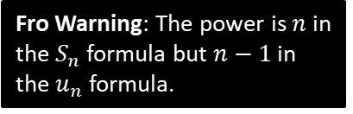

Further Examples
[Textbook] The fourth term of a geometric series is 1.08 and the seventh term is 0.23328.
Show that this series is convergent.
Find the sum to infinity of this series.
[Textbook] For a geometric series with first term $a$ and common ratio $r$, $S_{4}=15$ and $S_{∞}=16$.
a) Find the possible values of $r$.
b) Given that all the terms in the series are positive, find the value of $a$.
Fro Warning: The power is $n$ in the $S_{n}$ formula but $n−1$ in the $u_{n}$ formula.
? a
$$u_{4}=1.08 → ar^{3}=1.08 \\ u_{7}=0.23328 → ar^{6}=0.23328$$
Dividing:
$$r^{3}=0.216 ∴r=0.6$$
The series converges because $\left|0.6\right|<1$.
$$a=\frac{1.08}{r^{3}}=\frac{1.08}{0.216}=5$$
$$∴S_{∞}=\frac{5}{1−0.6}=12.5$$
? a
$$S_{4}=15 → \frac{a\left(1−r^{4}\right)}{1−r}=15 (1)$$
$$S_{∞}=16 → \frac{a}{1−r}=16 (2)$$
Substituting $\frac{a}{1−r}$ for 16 in equation (1):
$$16\left(1−r^{4}\right)=15$$
Solving: $r=±\frac{1}{2}$
As terms positive, $r=\frac{1}{2}$, $∴a=16\left(1−\frac{1}{2}\right)=8$
? b
? b

Slide 6
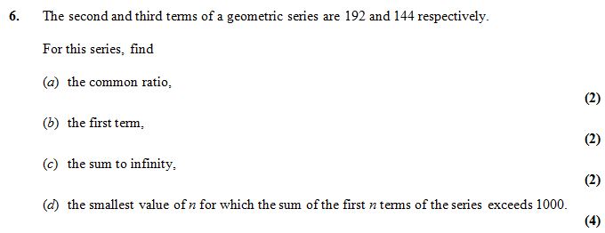




Test Your Understanding
Edexcel C2 May 2011 Q6
?
$$r=\frac{3}{4}$$
?
$$a=256$$
?
$$S_{∞}=1024$$
?
$$\frac{256\left(1−{\left(\frac{3}{4}\right)}^{n}\right)}{0.25}>1000$$
$$n>\frac{log\left(\frac{6}{256}\right)}{log\left(0.75\right)} ⇒n=14$$

Slide 7



Exercise 3.5
Pearson Pure Mathematics Year 2/AS
Page 22
Extension
2
[MAT 2003 1F] Two players take turns to throw a fair six-sided die until one of them scores a six. What is the probability that the first player to throw the die is the first to score a six?
$$P\left(win 1st throw\right)=\frac{1}{6} \\ P\left(win 3rd throw\right)={\left(\frac{5}{6}\right)}^{2}×\left(\frac{1}{6}\right) \\ P\left(win 5th throw\right)={\left(\frac{5}{6}\right)}^{4}×\left(\frac{1}{6}\right)$$
The total probability of the 1st player winning is the sum of these up to infinity.
$$a=\frac{1}{6}, r={\left(\frac{5}{6}\right)}^{2}=\frac{25}{36} \\ S_{∞}=\frac{1/6}{1−25/36}=\frac{6}{11}$$
1
[MAT 2006 1H] How many solutions does the equation
$$2=\sin{x}+\sin^{2}{x}+\sin^{3}{x}+\sin^{4}{x}+…$$
have in the range $0≤x<2π$
RHS is geometric series. $a=\sin{x}, r=\sin{x}$.
$$2=\frac{\sin{x}}{1−\sin{x}} → 2−2\sin{x}=\sin{x} \\ \sin{x}=\frac{2}{3}$$
By considering the graph of sin for $0≤x<2π$, this has 2 solutions.
?
?
N
[Frost] Determine the value of $x$ where:
$$x=\frac{1}{1}+\frac{2}{2}+\frac{3}{4}+\frac{4}{8}+\frac{5}{16}+\frac{6}{32}+…$$
(Hint: Use an approach similar to proof of geometric $S_{n}$ formula)
Doubling:
$$2x=2+\frac{1}{1}+\frac{1}{2}+\frac{1}{4}+\frac{1}{8}+…$$
Subtracting the two equations:
$$x=2+\frac{1}{1}+\frac{1}{2}+\frac{1}{4}+\frac{1}{8}+… \\ =2+2=4$$
?

Slide 8
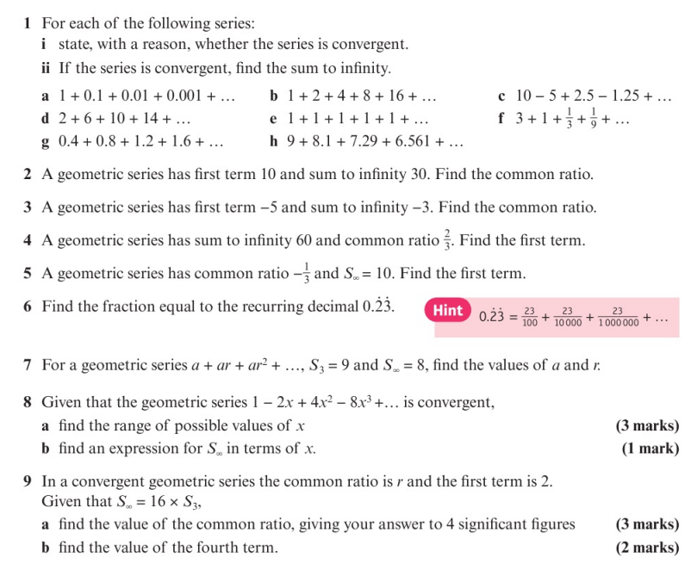
Homework Exercise

Slide 9
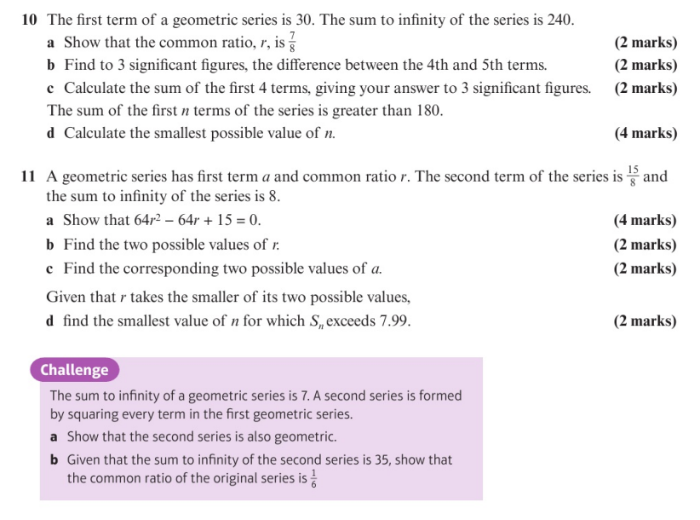
Homework Exercise

Slide 10
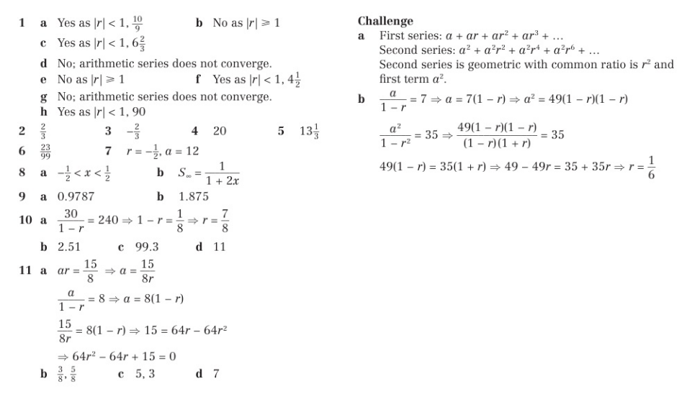
Homework Answers

