Slide 1
M1 Chapter 11: Variable Acceleration Integrating Variable Motion

Slide 2

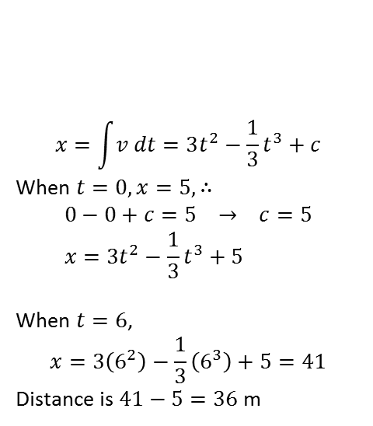

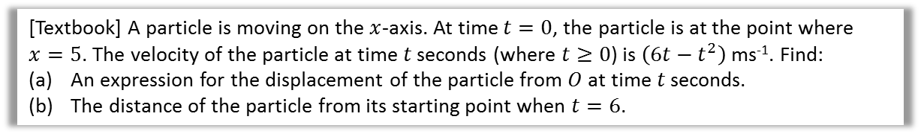


Using Integration
$$s$$
$$v$$
$$a$$
Differentiating (with respect to time) gets us from displacement to velocity, and from velocity to acceleration.
So naturally, integrating (with respect to time) gets us from acceleration to velocity, and from velocity to displacement. As mentioned earlier, it’s helpful to picture the flowchart on the left: we move down to differentiate and up to integrate.
$$∫v dt$$
$$\frac{d}{dt}$$
$$∫a dt$$
$$\frac{d}{dt}$$
[Textbook] A particle is moving on the $x$-axis. At time $t=0$, the particle is at the point where $x=5$. The velocity of the particle at time $t$ seconds (where $t≥0$) is $\left(6t−t^{2}\right)$ ms⁻¹. Find:
An expression for the displacement of the particle from $O$ at time $t$ seconds.
The distance of the particle from its starting point when $t=6$.
a
$$x=\int{v dt}=3t^{2}−\frac{1}{3}t^{3}+c$$
When $t=0, x=5, ∴$
$$0−0+c=5 → c=5 \\ x=3t^{2}−\frac{1}{3}t^{3}+5$$
When $t=6$,
$$x=3\left(6^{2}\right)−\frac{1}{3}\left(6^{3}\right)+5=41$$
Distance is $41−5=36$ m
?
Recall in Pure Year 1 that we can find the constant of integration by using known values.
b
?

Slide 3





Further Example
[Textbook] A particle travels in a straight line. After $t$ seconds its velocity, $v$ ms⁻¹, is given by $v=5−3t^{2}$, $t≥0$. Find the distance travelled by the particle in the third second of its motion.
?
$$s=\int_{2}^{3}{\left(5−3t^{2}\right) dt} \\ ={\left[5t−t^{3}\right]}_{2}^{3}=\left(15−27\right)−\left(10−8\right) \\ =−12−2=−14$$
Distance travelled is 14 m.
$$v$$
$$2$$
$$3$$
$$t$$

Slide 4
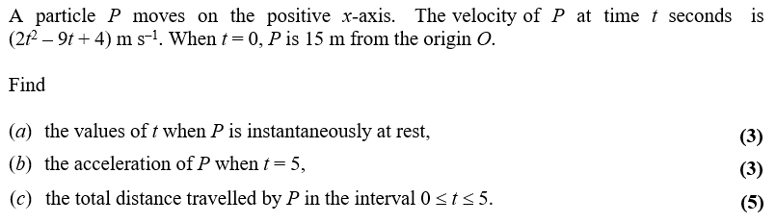
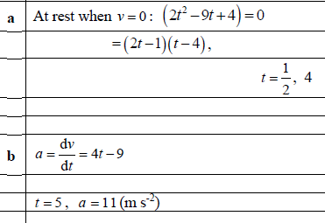
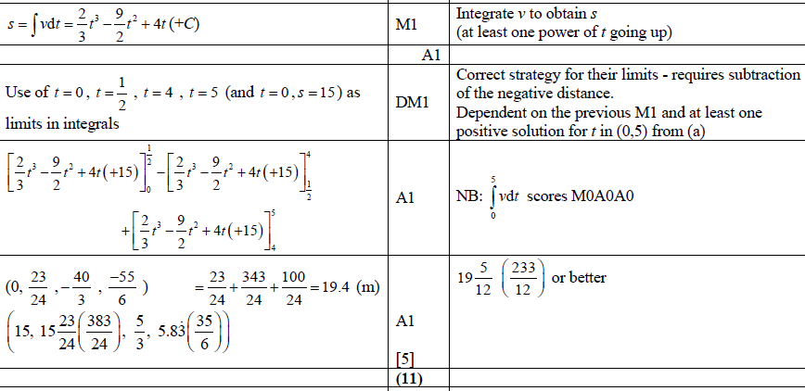

Further Example
Edexcel M2 June 2015 Q6
Hint: recall that if the curve goes above and below the $x$-axis, we need to find each distance-area separately.
a
?
c
?
b
?

Slide 5
Exercise 11.4 Using Integration
Pearson Stats/Mechanics Year 1
Page 81-82

Slide 6
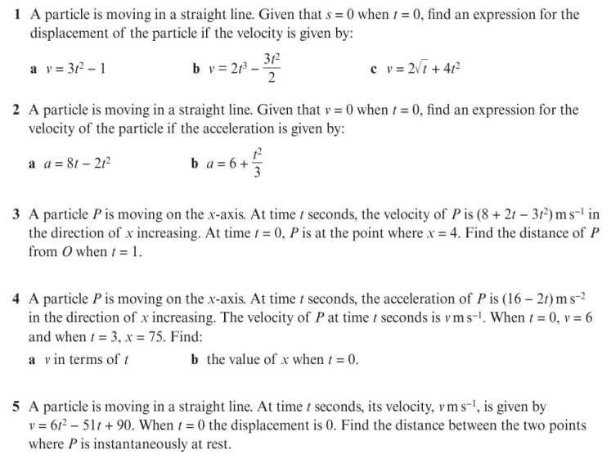
Homework Exercise

Slide 7
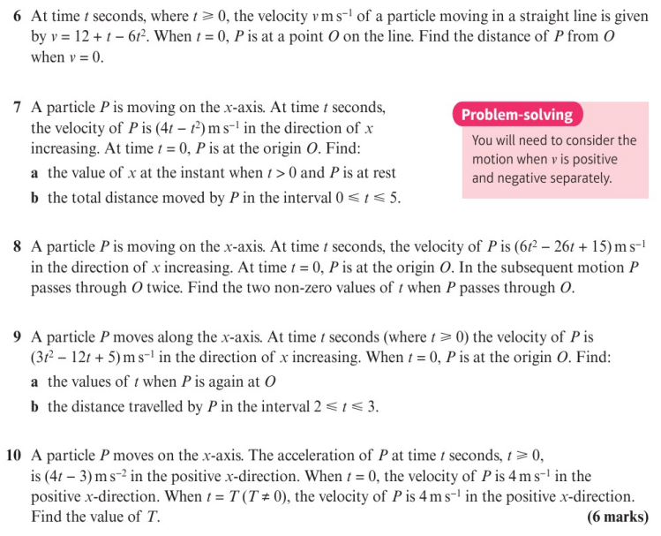
Homework Exercise

Slide 8
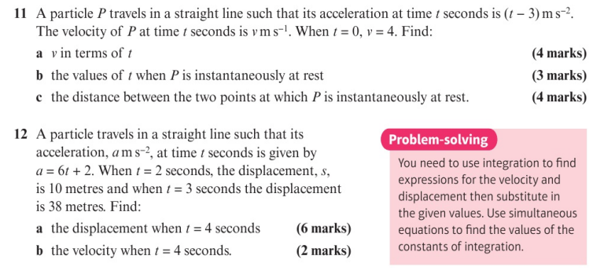
Homework Exercise

Slide 9
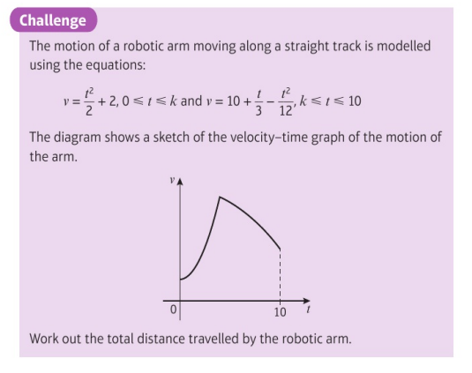
Homework Exercise

Slide 10
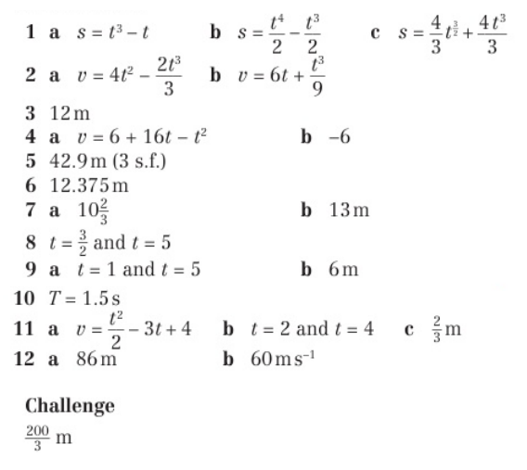
Homework Answers

