Slide 1
M1 Chapter 11: Variable Acceleration Changing Velocity

Slide 2


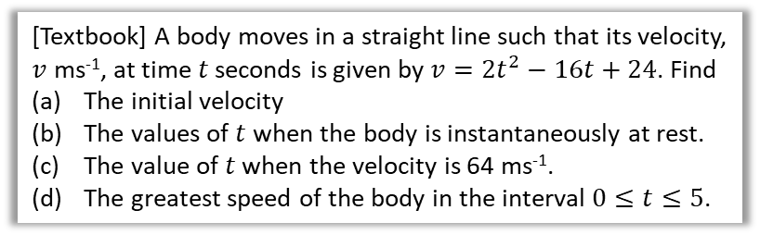
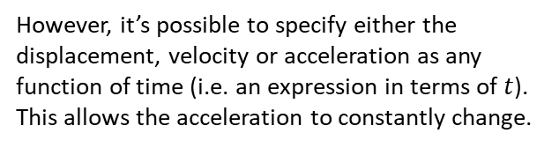

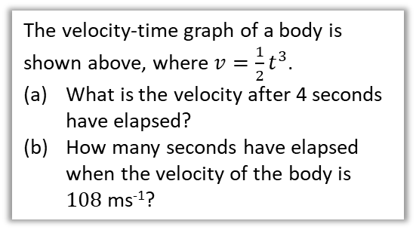
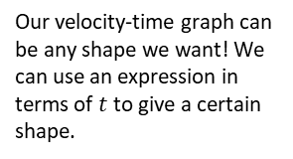
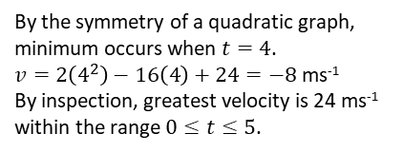
Functions of time
constant acceleration
no acceleration
Up to now, the acceleration has always been constant in any particular period of time…
velocity
constant deceleration
time
Our velocity-time graph can be any shape we want! We can use an expression in terms of $t$ to give a certain shape.
However, it’s possible to specify either the displacement, velocity or acceleration as any function of time (i.e. an expression in terms of $t$). This allows the acceleration to constantly change.
velocity
$$v=\frac{1}{2}t^{3}$$
time
The velocity-time graph of a body is shown above, where $v=\frac{1}{2}t^{3}$.
What is the velocity after 4 seconds have elapsed?
How many seconds have elapsed when the velocity of the body is $108$ ms⁻¹?
[Textbook] A body moves in a straight line such that its velocity, $v$ ms⁻¹, at time $t$ seconds is given by $v=2t^{2}−16t+24$. Find
The initial velocity
The values of $t$ when the body is instantaneously at rest.
The value of $t$ when the velocity is 64 ms⁻¹.
The greatest speed of the body in the interval $0≤t≤5$.
d
?
a
When $t=0, v=24$ ms⁻¹.
$$0=2t^{2}−16t+24 \\ t^{2}−8t+12=0$$ $→ t=2$ or $t=6$.
$$64=2t^{2}−16t+24 \\ t^{2}−8t−20=0$$ $→ t=10$ or $t=−2$
24
?
b
?
$v=\frac{1}{2}×4^{3}=32$ ms⁻¹
$$108=\frac{1}{2}t^{3}$$ $t^{3}=216 → t=6$ s
2
6
a
?
(4,-8)
c
?
By the symmetry of a quadratic graph, minimum occurs when $t=4$.
$v=2\left(4^{2}\right)−16\left(4\right)+24=−8$ ms⁻¹
By inspection, greatest velocity is 24 ms⁻¹ within the range $0≤t≤5$.
b
?

Slide 3
Exercise 11.1 Functions of time
Pearson Stats/Mechanics Year 1
Pages 77-78

Slide 4

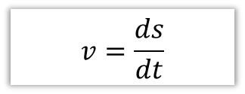

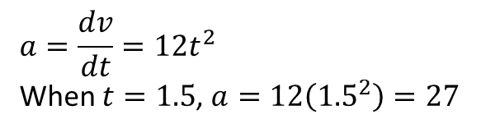
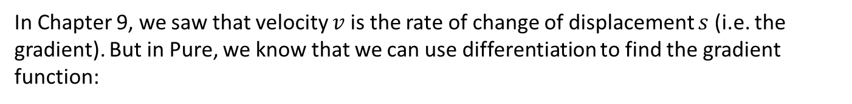


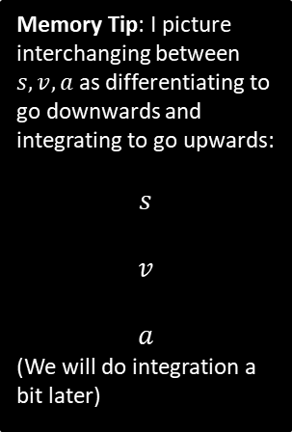
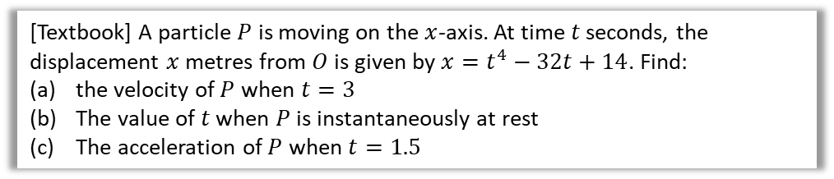
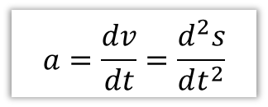

Using Differentiation
In Chapter 9, we saw that velocity $v$ is the rate of change of displacement $s$ (i.e. the gradient). But in Pure, we know that we can use differentiation to find the gradient function:
Memory Tip: I picture interchanging between $s,v,a$ as differentiating to go downwards and integrating to go upwards:
$$s$$
$$v$$
$$a$$
(We will do integration a bit later)
$$v=\frac{ds}{dt}$$
and similarly…
$$a=\frac{dv}{dt}=\frac{d^{2}s}{dt^{2}}$$
?
?
velocity is the rate of change of displacement
acceleration is the rate of change of velocity
$$∫v dt$$
$$\frac{d}{dt}$$
[Textbook] A particle $P$ is moving on the $x$-axis. At time $t$ seconds, the displacement $x$ metres from $O$ is given by $x=t^{4}−32t+14$. Find:
the velocity of $P$ when $t=3$
The value of $t$ when $P$ is instantaneously at rest
The acceleration of $P$ when $t=1.5$
$$∫a dt$$
$$\frac{d}{dt}$$
$$v=\frac{dx}{dt}=4t^{3}−32$$
When $t=3, v=4\left(3^{3}\right)−32=76$ ms⁻²
$$4t^{3}−32=0 → t=2$$
$$a=\frac{dv}{dt}=12t^{2}$$
When $t=1.5$, $a=12\left({1.5}^{2}\right)=27$
a
?
c
?
b
?

Slide 5

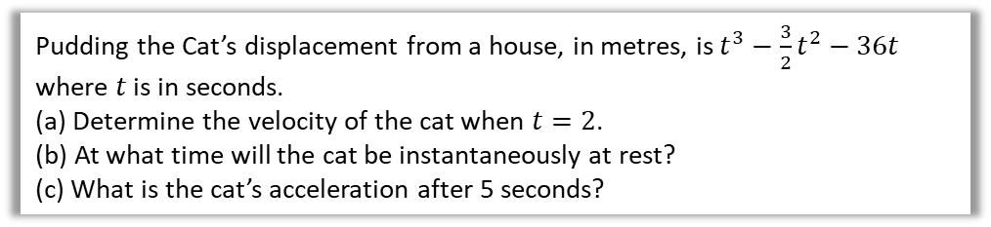

Test Your Understanding
Pudding the Cat’s displacement from a house, in metres, is $t^{3}−\frac{3}{2}t^{2}−36t$ where $t$ is in seconds.
(a) Determine the velocity of the cat when $t=2$.
(b) At what time will the cat be instantaneously at rest?
(c) What is the cat’s acceleration after 5 seconds?
a
$$s=t^{3}−\frac{3}{2}t^{2}−36t \\ v=3t^{2}−3t−36$$
When $t=2$, $v=3\left(2^{2}\right)−3\left(2\right)−36=−30$ ms⁻¹
When $v=0$, $3t^{2}−3t−36=0$ $$t^{2}−t−12=0 \\ \left(t+3\right)\left(t−4\right)=0$$ $t=4$ s
$$a=6t−3$$
When $t=5$, $a=30−3=27$ ms⁻²
?
b
?
c
?

Slide 6
Exercise 11.2 Using Differentiation
Pearson Stats/Mechanics Year 1
Pages 78-79

Slide 7
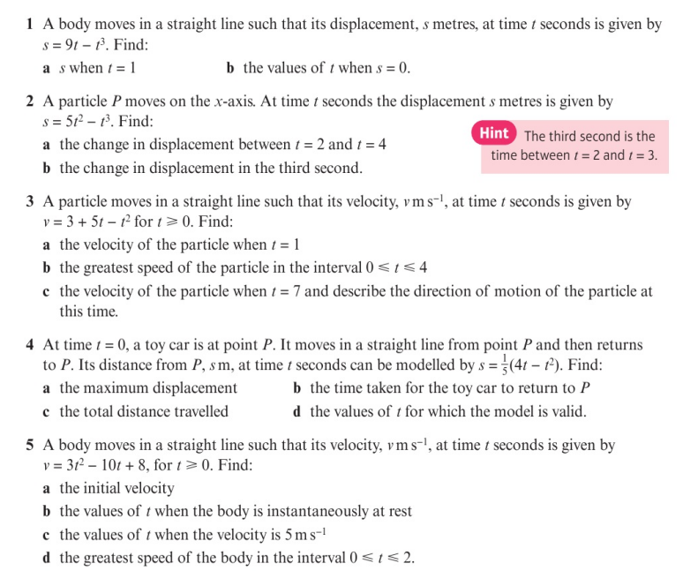
Homework Exercise

Slide 8
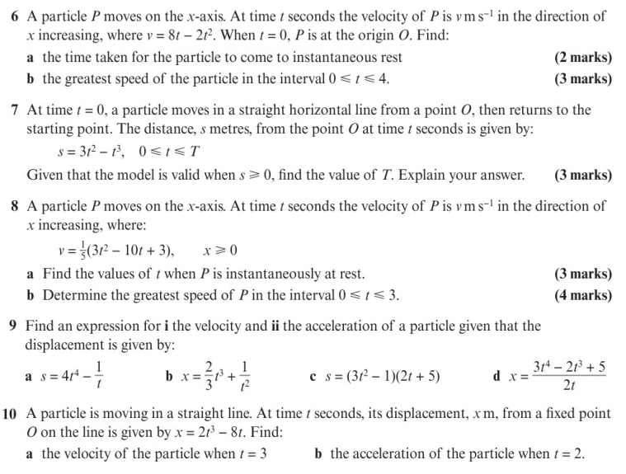
Homework Exercise

Slide 9
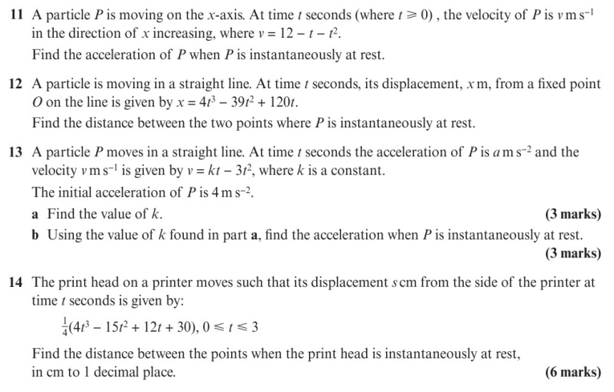
Homework Exercise

Slide 10
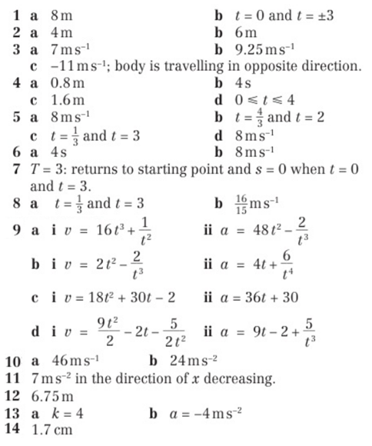
Homework Answers

