Slide 1
P1 Chapter 4: Transforming Graphs Translation of Graphs

Slide 2

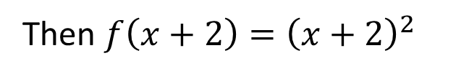



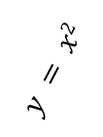
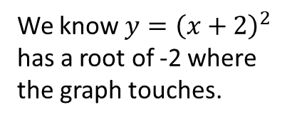
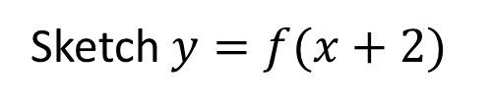
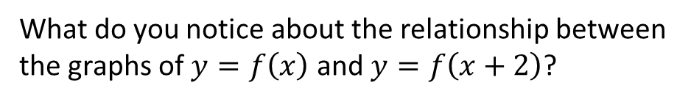
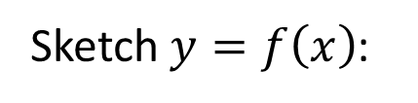
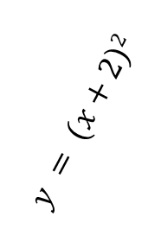
Transformations of Functions
Suppose $f\left(x\right)=x^{2}$
?
Then $f\left(x+2\right)={\left(x+2\right)}^{2}$
Sketch $y=f\left(x\right)$:
Sketch $y=f(x+2)$
We know $y={\left(x+2\right)}^{2}$ has a root of -2 where the graph touches.
?
?
$$y$$
y
$$y = x2$$
$$y = (x+2)2$$
x
$$x$$
-2
The graph has been translated by $\left(\begin{matrix}−2 \\ 0\end{matrix}\right)$, i.e. we have subtracted 2 from each $x$ value.
What do you notice about the relationship between the graphs of $y=f\left(x\right)$ and $y=f\left(x+2\right)$?
?

Slide 3



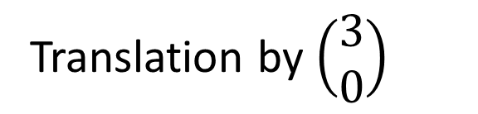



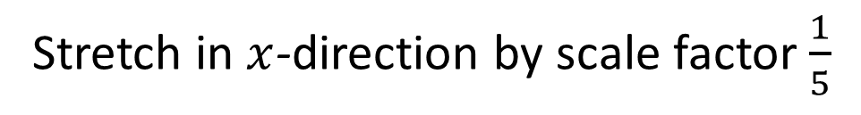



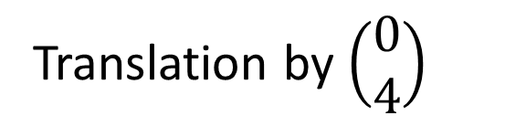
Transformations of Functions
This is all you need to remember when considering how transforming your function transforms your graph...
!
Affects which axis?
What we expect or opposite?
Change inside $f( )$
?
$$x$$
?
Opposite
$$y$$
Change outside $f( )$
?
?
What we expect
Therefore...
Translation by $\left(\begin{matrix}3 \\ 0\end{matrix}\right)$
$$y=f\left(x−3\right)$$
?
$$y=f\left(x\right)+4$$
Translation by $\left(\begin{matrix}0 \\ 4\end{matrix}\right)$
?
$$y=f\left(5x\right)$$
Stretch in $x$-direction by scale factor $\frac{1}{5}$
?
$$y=2f\left(x\right)$$
Stretch in $y$-direction by scale factor 2
?

Slide 4

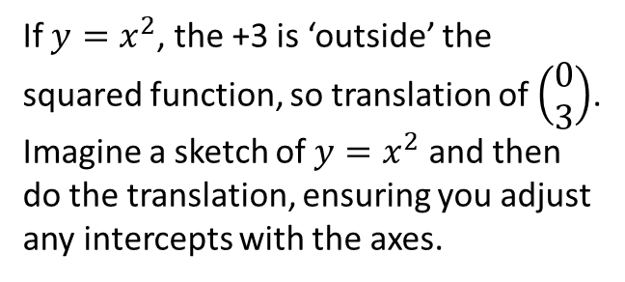


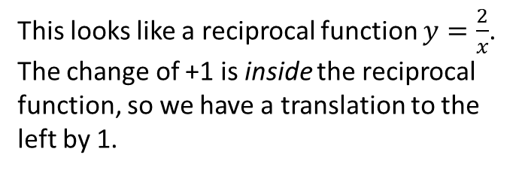

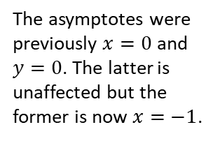
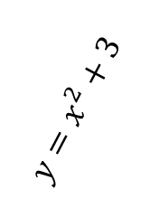

Sketching transformed graphs
Sketch $y=x^{2}+3$
Sketch $y=\frac{2}{x+1}$
?
?
If $y=x^{2}$, the +3 is ‘outside’ the squared function, so translation of $\left(\begin{matrix}0 \\ 3\end{matrix}\right)$.
Imagine a sketch of $y=x^{2}$ and then do the translation, ensuring you adjust any intercepts with the axes.
This looks like a reciprocal function $y=\frac{2}{x}$.
The change of +1 is inside the reciprocal function, so we have a translation to the left by 1.
$$y$$
The transformation might result in new intercepts or roots. You can find these in the usual way. Do not forget them!
y
$$x=−1$$
$$y=x^{2}+3$$
2
$$x$$
3
The asymptotes were previously $x=0$ and $y=0$. The latter is unaffected but the former is now $x=−1$.
x
Draw asymptotes using a dotted line and write its equation on it.

Slide 5

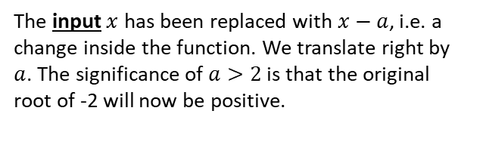
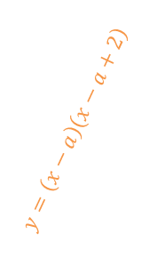
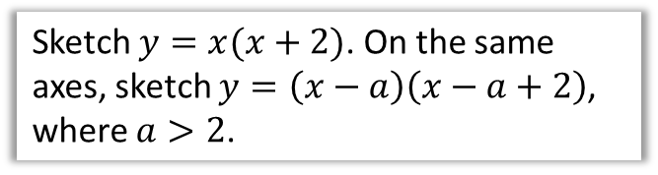
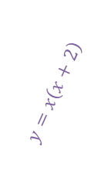





Example
Sketch $y=x(x+2)$. On the same axes, sketch $y=\left(x−a\right)\left(x−a+2\right)$, where $a>2$.
The input $x$ has been replaced with $x−a$, i.e. a change inside the function. We translate right by $a$. The significance of $a>2$ is that the original root of -2 will now be positive.
?
$$y$$
$$y=x\left(x+2\right)$$
$$y=\left(x−a\right)\left(x−a+2\right)$$
$$−a\left(−a+2\right)$$
$$a$$
$$x$$
-2
$$a−2$$
Note that our intercepts are in terms of $a$.

Slide 6
Exercise 4.5
Pearson Pure Mathematics Year 1/AS
Page 30

Slide 7
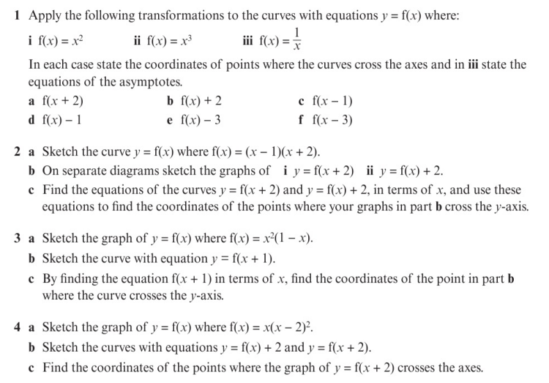
Homework Exercise

Slide 8
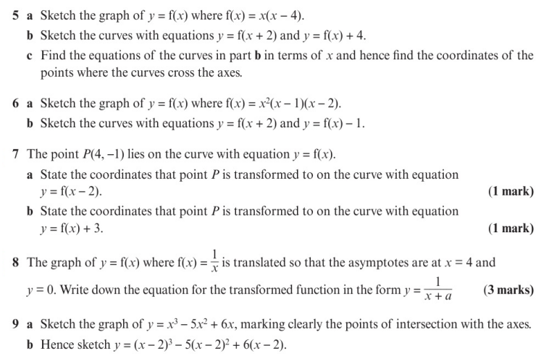
Homework Exercise

Slide 9
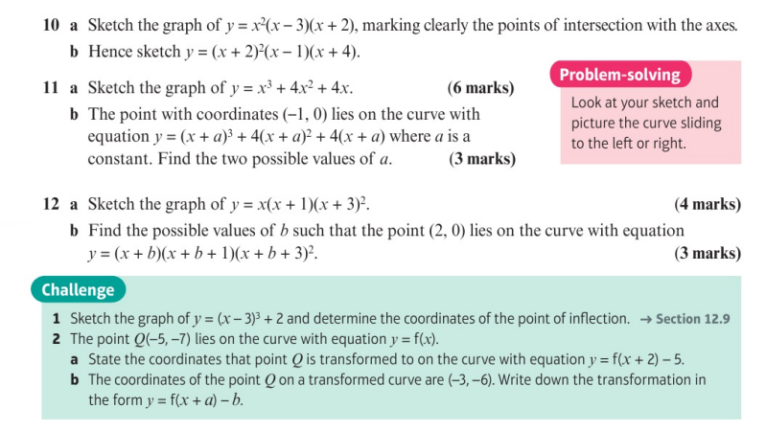
Homework Exercise

Slide 10
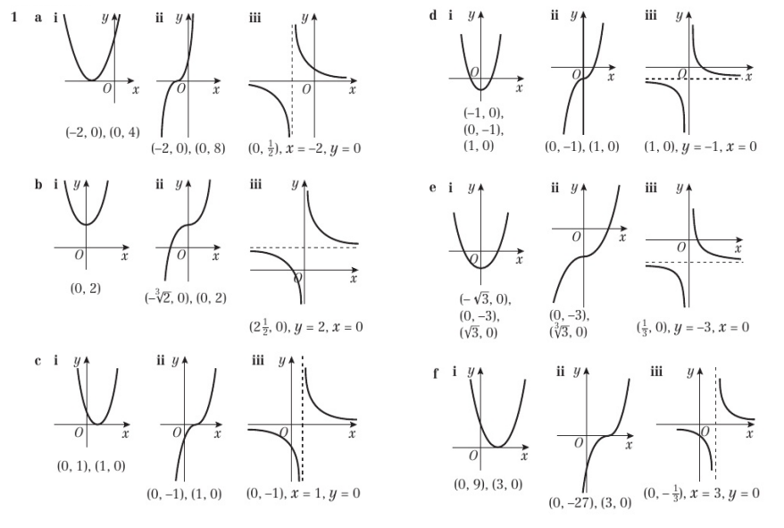
Homework Answers

Slide 11
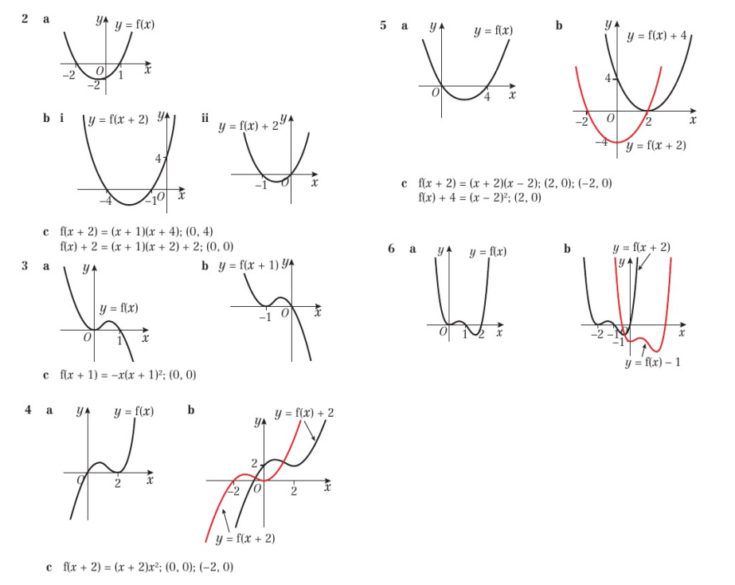
Homework Answers

Slide 12
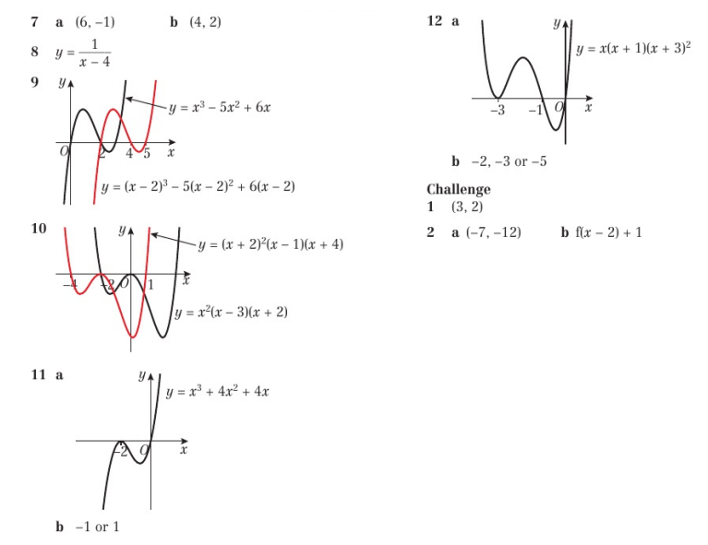
Homework Answers

