Slide 1
M2 Chapter 5: Inclined Planes Ramps

Slide 2



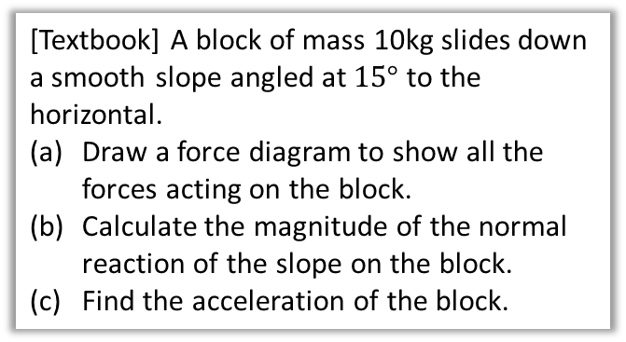





Inclined Planes
! For problems involving inclined planes, resolve forces parallel and perpendicular to the plane.
? Diagram
[Textbook] A block of mass 10kg slides down a smooth slope angled at $15°$ to the horizontal.
Draw a force diagram to show all the forces acting on the block.
Calculate the magnitude of the normal reaction of the slope on the block.
Find the acceleration of the block.
Indicate direction of acceleration with double arrow.
$$R$$
$$a$$
10kg
Recall the recommendation that force components are shown with dotted arrows.
$$10g\cos{15}$$
$$15°$$
$$15°$$
$$10g\sin{15}$$
? Working
Mark-schemes: This means “resolving forces in the indicated direction”.
$$R\left(↖\right): R=10g\cos{15} \\ R\left(↙\right): Force=ma \\ 10g\sin{15}=10a$$ $a=2.5$ms⁻²
Recall that because we used $g=9.8$, which is only accurate to 2sf, we should only give the final answer to 2sf. In past mark schemes 3sf was condoned but 4 or more penalised.

Slide 3













Inclined Plane with an additional force
[Textbook] A particle of mass $m$ is pushed up a smooth slope, inclined at $30°$ by a force of magnitude $5g$ N acting at angle of $60°$ to the slope, causing the particle to accelerate up the slope at 0.5 ms⁻². Show that the mass of the particle is $\left(\frac{5g}{1+g}\right)$ kg
? Diagram
$$0.5 ms^{−2}$$
$$R$$
$$5g$$
$$5g\sin{60}$$
$m$ kg
$$60°$$
$$5g\cos{60}$$
$$mg\cos{30}$$
$$mg$$
$$30°$$
$$30°$$
$$mg\sin{30}$$
$$R\left(↗\right): 5g\cos{60°}−mg\sin{30°}=0.5m \\ 2.5g−0.5mg=0.5m \\ 2.5g=0.5m+0.5mg \\ 5g=m+mg \\ 5g=m\left(1+g\right)$$ $m=\left(\frac{5g}{1+g}\right)$ kg
? Working

Slide 4
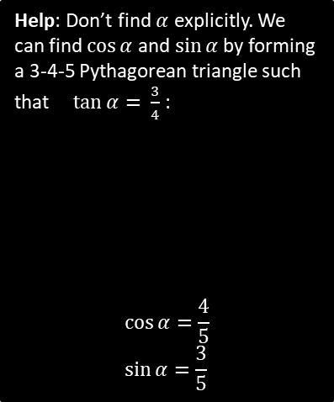







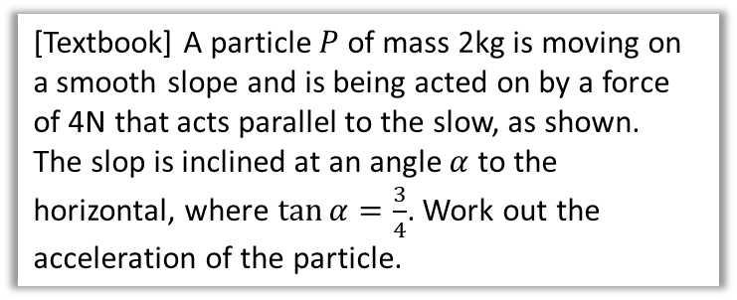






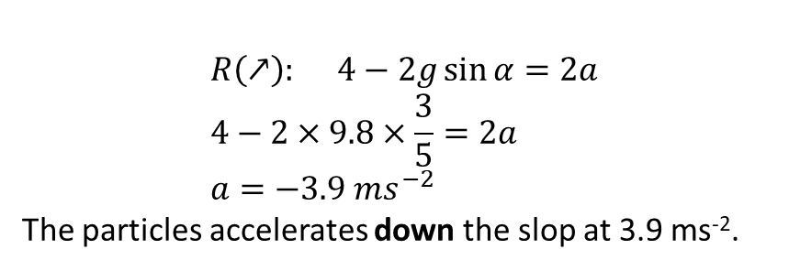






Test Your Understanding
[Textbook] A particle $P$ of mass 2kg is moving on a smooth slope and is being acted on by a force of 4N that acts parallel to the slow, as shown.
The slop is inclined at an angle $α$ to the horizontal, where $\tan{α}=\frac{3}{4}$. Work out the acceleration of the particle.
$$a$$
$$P$$
$2$ kg
$$4N$$
$$α$$
$$a$$
? Diagram
$$R$$
Help: Don’t find $α$ explicitly. We can find $\cos{α}$ and $\sin{α}$ by forming a 3-4-5 Pythagorean triangle such that $\tan{α= }$ $\frac{3}{4}$ :
$$\cos{α}=\frac{4}{5} \\ \sin{α}=\frac{3}{5}$$
$$P$$
$2$ kg
$$4$$
$$2g\cos{α}$$
$$α$$
$$2g$$
$$α$$
$$2g\sin{α}$$
$$5$$
$$3$$
$$R\left(↗\right): 4−2g\sin{α}=2a \\ 4−2×9.8×\frac{3}{5}=2a \\ a=−3.9 ms^{−2}$$
The particles accelerates down the slop at 3.9 ms⁻².
$$α$$
? Working
$$4$$
?
?

Slide 5
Exercise 5.2
Pearson Stats/Mechanics Year 2
Pages 45-46

Slide 6
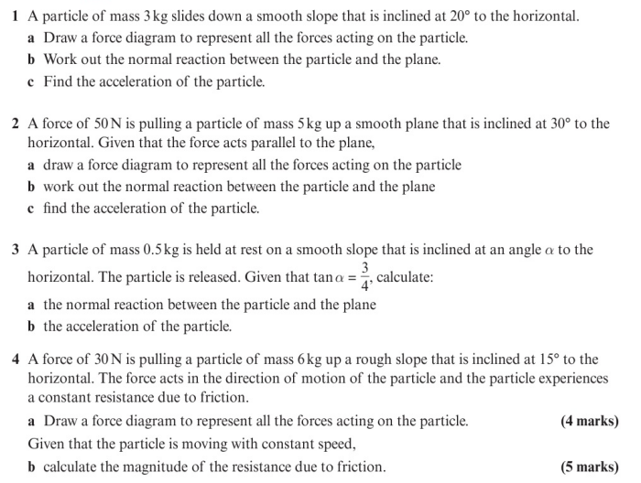
Homework Exercise

Slide 7
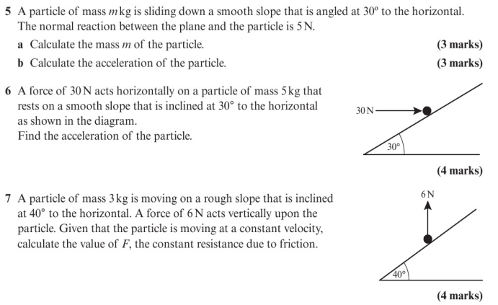
Homework Exercise

Slide 8
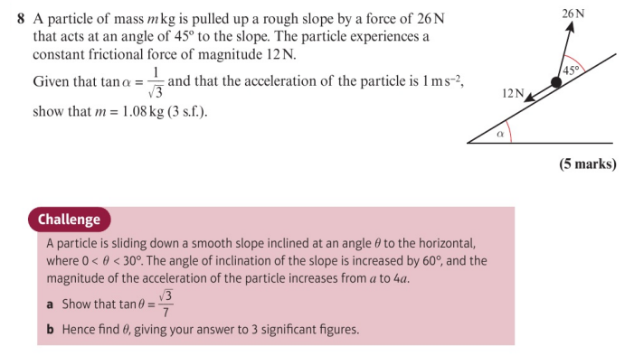
Homework Exercise

Slide 9
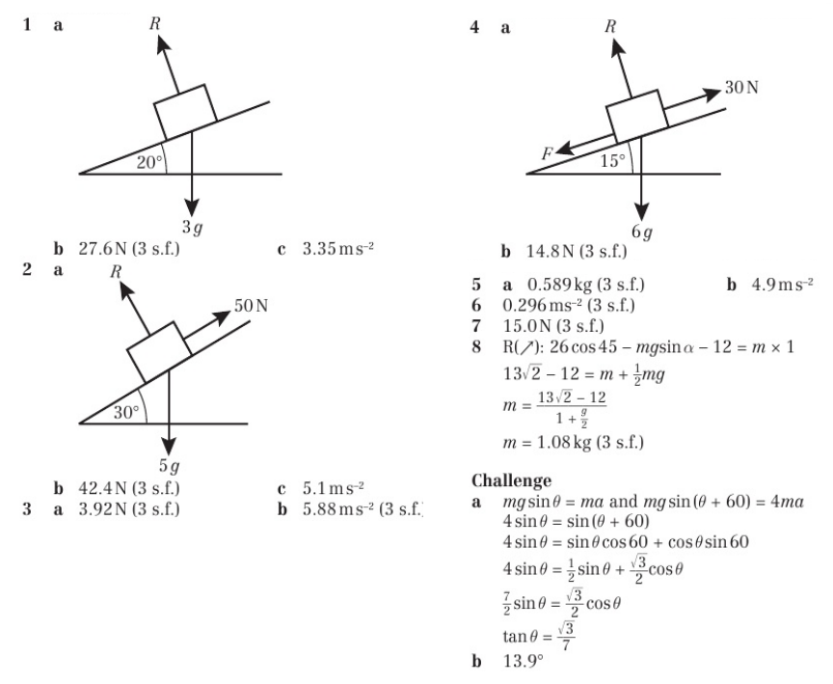
Homework Answers

