Slide 1
P1 Chapter 6: Circles Straight Line Intersections

Slide 2

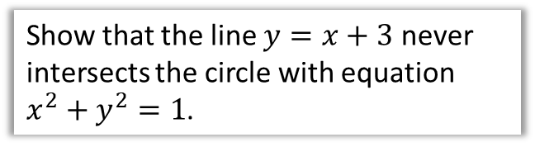
Intersections of Lines and Circles
Recall that to consider the intersection of two lines, we attempt to solve them simultaneously by substitution, potentially using the discriminant to show that there are no solutions (and hence no points of intersection).
Show that the line $y=x+3$ never intersects the circle with equation $x^{2}+y^{2}=1$.
?
Using substitution:
$$x^{2}+{\left(x+3\right)}^{2}=1 \\ x^{2}+x^{2}+6x+9=1 \\ 2x^{2}+6x+8=0 \\ x^{2}+3x+4=0$$
Discriminant:
$$a=1, b=3, c=4 \\ 9−16=−7$$
$−7<0$ therefore no solutions.
2 intersections (such a line is known as a secant of the circle)
1 intersections (such a line is known as a tangent of the circle)
0 intersections

Slide 3
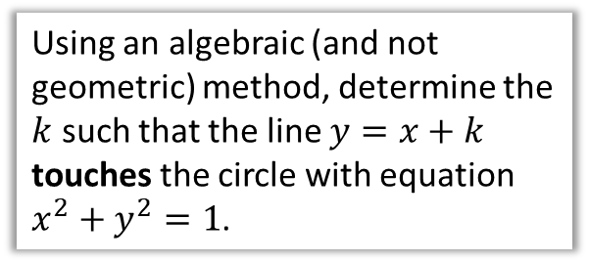
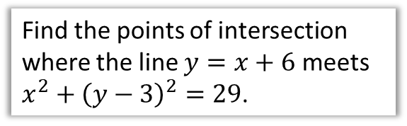


Test Your Understanding
Find the points of intersection where the line $y=x+6$ meets $x^{2}+{\left(y−3\right)}^{2}=29$.
Using an algebraic (and not geometric) method, determine the $k$ such that the line $y=x+k$ touches the circle with equation $x^{2}+y^{2}=1$.
?
$$x^{2}+{\left(x+6−3\right)}^{2}=29 \\ x^{2}+x^{2}+6x+9=29 \\ 2x^{2}+6x−20=0 \\ x^{2}+3x−10=0 \\ \left(x+5\right)\left(x−2\right)=0 \\ x=−5 or x=2 \\ y=1 or y=8 \\ \left(−5, 1\right), \left(2,8\right)$$
?
$$x^{2}+{\left(x+k\right)}^{2}=1 \\ x^{2}+x^{2}+2kx+k^{2}=1 \\ 2x^{2}+2kx+k^{2}−1=0$$
If the line touches the circle, one point of intersection and therefore one solution.
Discriminant:
$$a=2, b=2k, c=k^{2}−1 \\ 4k^{2}−4\left(2\right)\left(k^{2}−1\right)=0 \\ 4k^{2}−8k^{2}+8=0 \\ 4k^{2}−8=0 \\ k=±\sqrt{2}$$

Slide 4
Exercise 6.3
Pearson Pure Mathematics Year 1/AS
Page 48

Slide 5
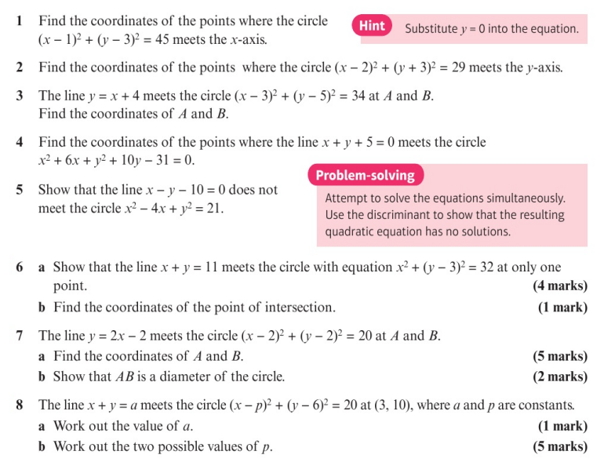
Homework Exercise

Slide 6
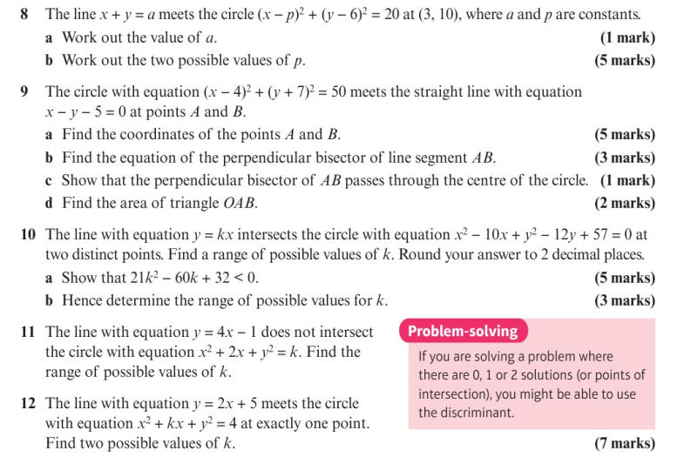
Homework Exercise

Slide 7
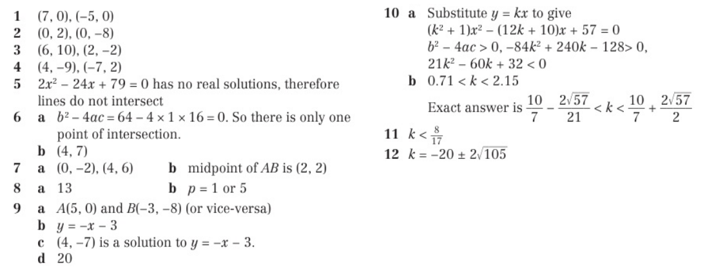
Homework Answers

