Slide 1
P2 Chapter 7: Trigonometric Equations
Adding Sine and Cosine

Slide 2
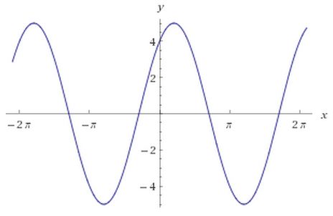

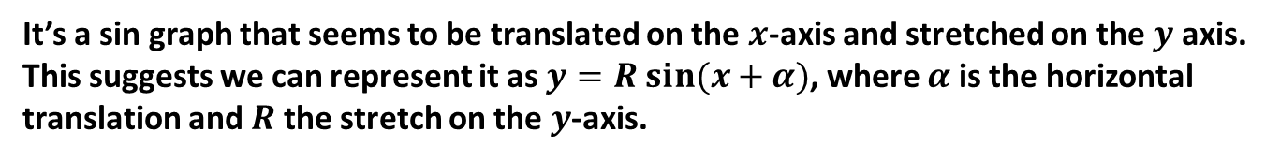
$$a\sin{θ}+b\cos{θ}$$
Here’s a sketch of $y=3\sin{x}+4\cos{x}$.
What do you notice?
?
It’s a sin graph that seems to be translated on the $x$-axis and stretched on the $y$ axis.
This suggests we can represent it as $y=R sin⁡(x+α)$, where $α$ is the horizontal translation and $R$ the stretch on the $y$-axis.

Slide 3
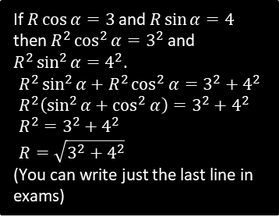

$$a\sin{θ}+b\cos{θ}$$
Q
Put $3\sin{x}+4\cos{x}$ in the form $R\sin\left(x+α\right)$ giving $α$ in degrees to 1dp.
STEP 1: Expanding:
$$R\sin\left(x+α\right)=R\sin{x}\cos{α}+R\cos{x}\sin{α}$$
STEP 2: Comparing coefficients:
$$R\cos{α}=3 R\sin{α}=4$$
STEP 3: Using the fact that $R^{2}\sin^{2}{α}+R^{2}\cos^{2}{α}=R^{2}$:
$$R=\sqrt{3^{2}+4^{2}}=5$$
STEP 4: Using the fact that $\frac{R\sin{α}}{R\cos{α}}=\tan{α}$:
$$\tan{α}=\frac{4}{3}$$
$$α=53.1°$$
STEP 5: Put values back into original expression.
$$3\sin{x}+4\cos{x}≡5\sin\left(x+53.1°\right)$$
Fro Tip: I recommend you follow this procedure every time – I’ve tutored students who’ve been taught a ‘shortcut’ (usually skipping Step 1), and they more often than not make a mistake.
?
?
?
If $R\cos{α=3}$ and $R\sin{α=4}$ then $R^{2}\cos^{2}{α}=3^{2}$ and $R^{2}\sin^{2}{α=4^{2}}$.
$$R^{2}\sin^{2}{α}+R^{2}\cos^{2}{α}=3^{2}+4^{2} \\ R^{2}\left(\sin^{2}{α}+\cos^{2}{α}\right)=3^{2}+4^{2} \\ R^{2}=3^{2}+4^{2} \\ R=\sqrt{3^{2}+4^{2}}$$
(You can write just the last line in exams)
?
?

Slide 4


Test Your Understanding
Q
Put $\sin{x}+\cos{x}$ in the form $R\sin\left(x+α\right)$ giving $α$ in terms of $π$.
?
$$R\sin\left(x+α\right)≡R\sin{x}\cos{α}+R\cos{x}\sin{α}$$
$$R\cos{α}=1 R\sin{α}=1$$
$$R=\sqrt{1^{2}+1^{2}}=\sqrt{2}$$
$$\tan{α}=1$$
$$α=\frac{π}{4}$$
$$\sin{x}+\cos{x}≡\sqrt{2}\sin\left(x+\frac{π}{4}\right)$$
Q
Put $\sin{x}−\sqrt{3}\cos{x}$ in the form $R\sin\left(x−α\right)$ giving $α$ in terms of $π$.
?
$$R\sin\left(x−α\right)≡R\sin{x}\cos{α}−R\cos{x}\sin{α}$$
$$R\cos{α}=1 R\sin{α}=\sqrt{3} \\ R=2$$
$$\tan{α}=\sqrt{3} so α=\frac{π}{3}$$
$$sinx−\sqrt{3}\cos{x}≡2\sin\left(x−\frac{π}{3}\right)$$

Slide 5

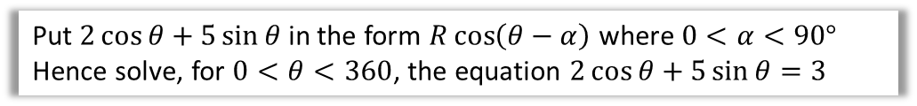
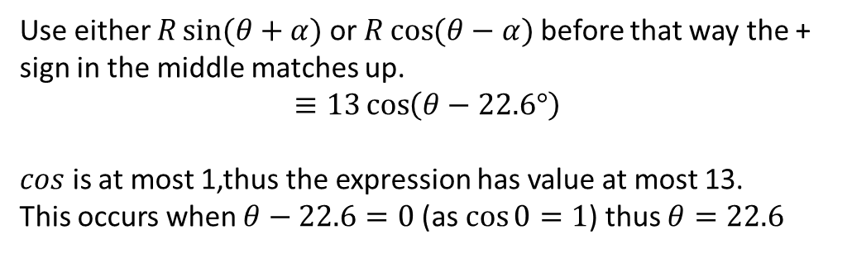
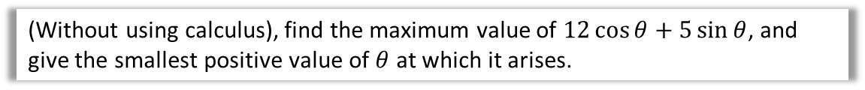
Further Examples
Q
Put $2\cos{θ}+5\sin{θ}$ in the form $R\cos\left(θ−α\right)$ where $0<α<90°$
Hence solve, for $0<θ<360$, the equation $2\cos{θ}+5\sin{θ}=3$
?
$$2\cos{θ}+5\sin{θ}≡\sqrt{29}\cos\left(θ−68.2°\right)$$
Therefore:
$$\sqrt{29}\cos\left(θ−68.2°\right)=3 \\ \cos\left(θ−68.2°\right)=\frac{3}{\sqrt{29}} \\ θ−68.2°=−56.1…°, 56.1…° \\ θ=12.1°, 124.3°$$
Fro Tip: This is an exam favourite!
Q
(Without using calculus), find the maximum value of $12\cos{θ}+5\sin{θ}$, and give the smallest positive value of $θ$ at which it arises.
?
Use either $R\sin{(θ+α)}$ or $R\cos{(θ−α})$before that way the + sign in the middle matches up.
$$≡13\cos\left(θ−22.6°\right)$$
$cos$ is at most 1,thus the expression has value at most 13.
This occurs when $θ−22.6=0$ (as $\cos{0}=1$) thus $θ=22.6$

Slide 6
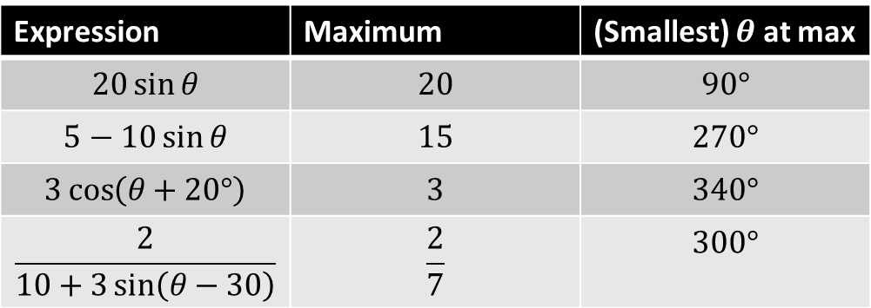

Quickfire Maxima
What is the maximum value of the expression and determine the smallest positive value of $θ$ (in degrees) at which it occurs.
Expression | Maximum | (Smallest) $θ$ at max
$$20\sin{θ}$$ | $$20$$ | $$90°$$
$$5−10\sin{θ}$$ | $$15$$ | $$270°$$
$$3\cos\left(θ+20°\right)$$ | $$3$$ | $$340°$$
$$\frac{2}{10+3\sin\left(θ−30\right)}$$ | $$\frac{2}{7}$$ | $$300°$$
?
?
?
?
?
?
?
?

Slide 7
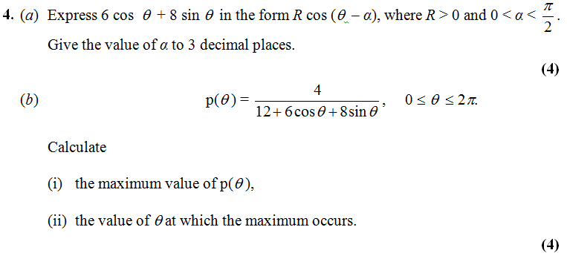
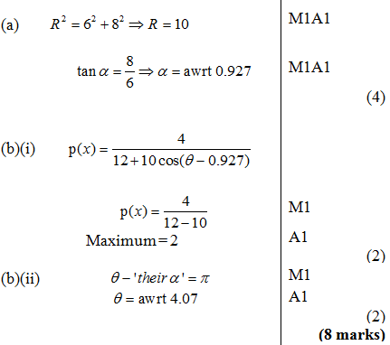
Further Test Your Understanding
Edexcel C3 Jan 2013 Q4
?

Slide 8
Exercise 7.5
Pearson Pure Mathematics Year 2/AS
Page 52

Slide 9
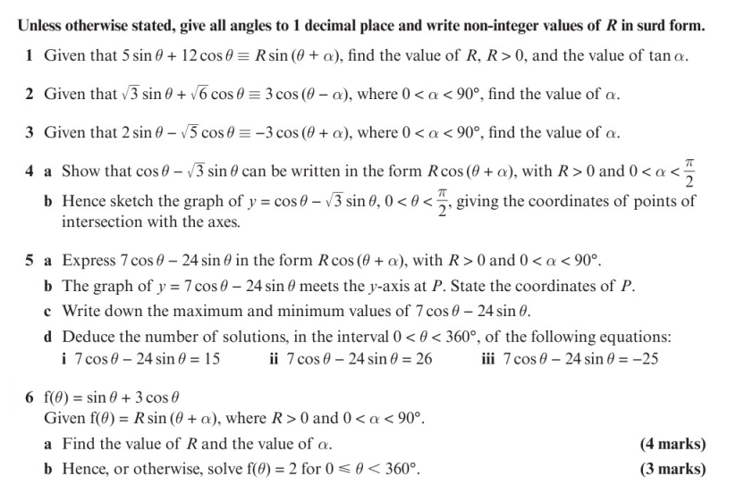
Homework Exercise

Slide 10
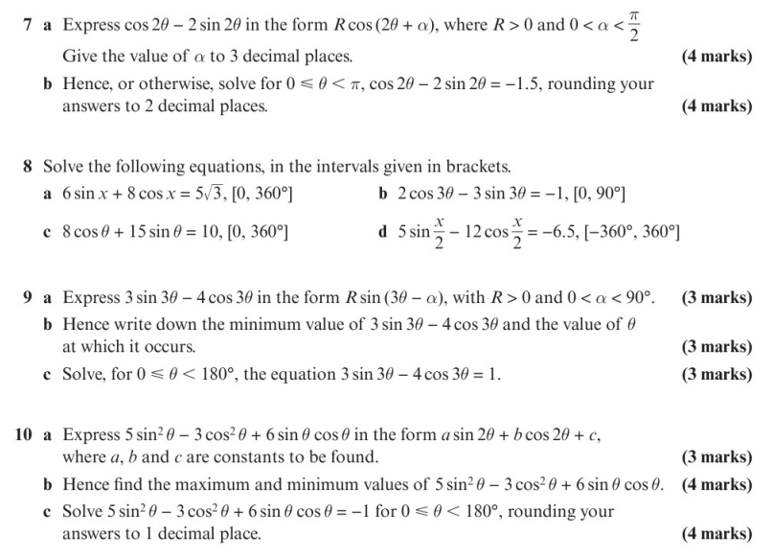
Homework Exercise

Slide 11
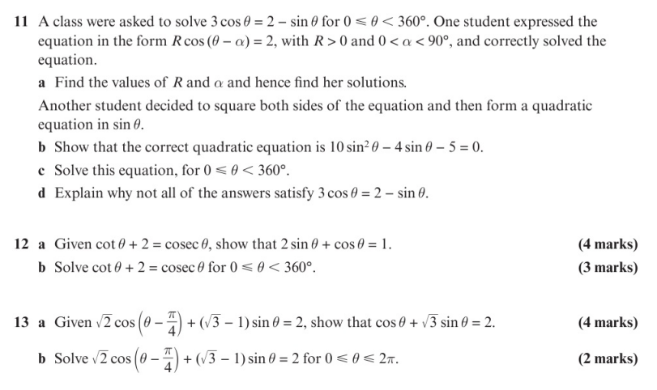
Homework Exercise

Slide 12
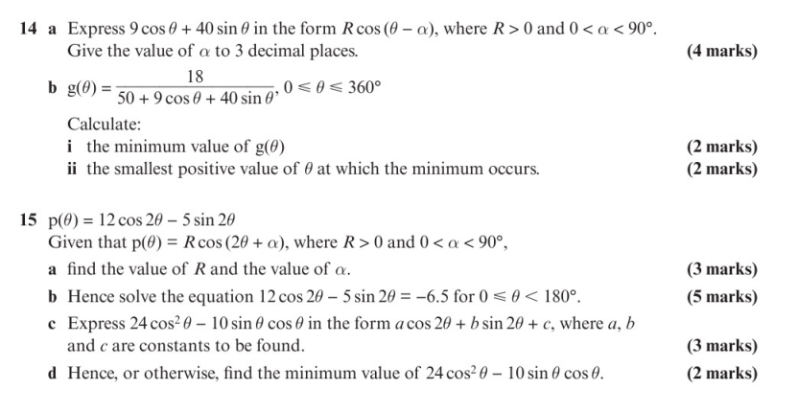
Homework Exercise

Slide 13
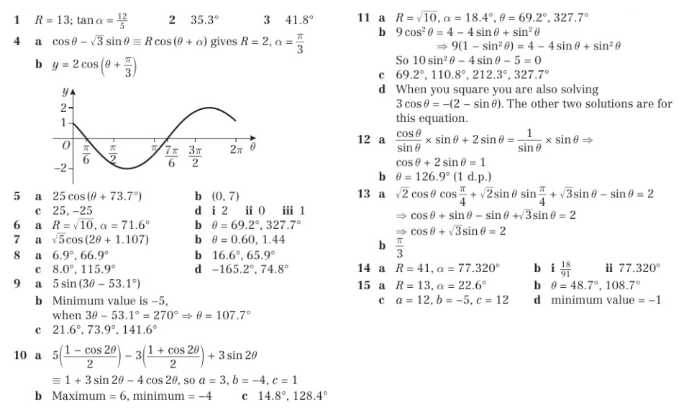
Homework Answers

