Slide 1
P2 Chapter 9: Differentiation The Product Rule

Slide 2
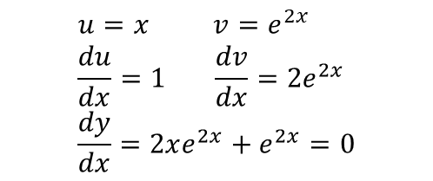
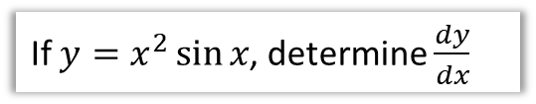
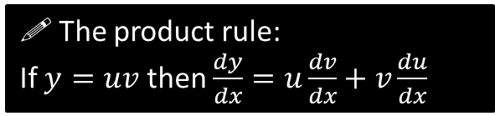
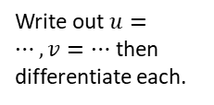



The Product Rule
As mentioned previously, the product rule is used, unsurprisingly, when we have a product of two functions.
! The product rule:
If $y=uv$ then $\frac{dy}{dx}=u\frac{dv}{dx}+v\frac{du}{dx}$
This is quite easy to remember. Differentiate one of the things but leave the other. Then do the other way round. Then add!
Since addition is commutative, it doesn’t matter which way round we do it.
If $y=x^{2}\sin{x}$, determine $\frac{dy}{dx}$
?
Write out $u=…, v=…$ then differentiate each.
Fro Tip: While with the chain rule I encourage you to put the bits together without writing out $u=$, in contrast, with the product rule I do encourage you to write out in full as per the left. This is because each of $u$ and $v$ can be more complicated to differentiate – it thus helps you avoid trying to do too much at once.
$$u=x^{2} v=\sin{x} \\ \frac{du}{dx}=2x \frac{dv}{dx}=\cos{x} \\ \frac{dy}{dx}=x^{2}\cos{x}+2x\sin{x}$$
Sub into product rule.
If $y=xe^{2x}$, determine the coordinates of the turning point.
?
$$u=x v=e^{2x} \\ \frac{du}{dx}=1 \frac{dv}{dx}=2e^{2x} \\ \frac{dy}{dx}=2xe^{2x}+e^{2x}=0$$
$$e^{2x}\left(2x+1\right)=0$$
But $e^{2x}≠0$ $$∴2x+1=0 → x=−\frac{1}{2}$$
$$y=−\frac{1}{2}e^{−1}=−\frac{1}{2e} → \left(−\frac{1}{2},−\frac{1}{2e}\right)$$
It’s typical to factorise when finding a turning point.
The fact that exponential terms can never be 0 comes up frequently in exams.

Slide 3
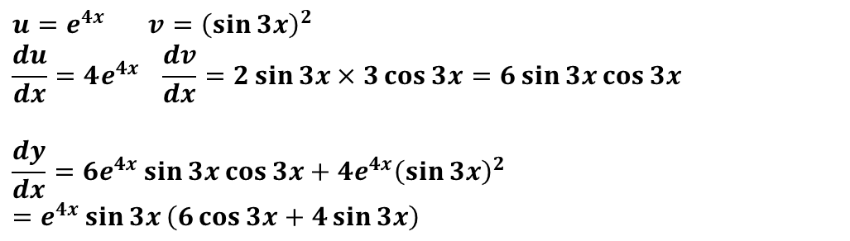

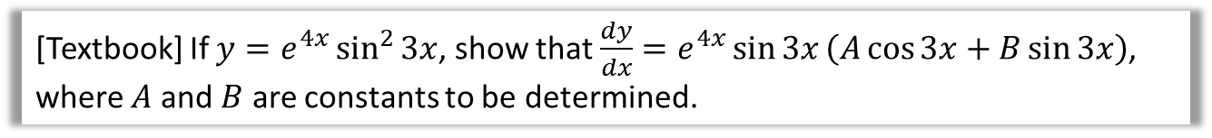


Product + Chain Rule Examples
[Textbook] If $y=e^{4x}\sin^{2}{3x}$, show that $\frac{dy}{dx}=e^{4x}\sin{3x}\left(A\cos{3x}+B\sin{3x}\right)$, where $A$ and $B$ are constants to be determined.
?
$$u=e^{4x} v={\left(\sin{3x}\right)}^{2} \\ \frac{du}{dx}=4e^{4x} \frac{dv}{dx}=2\sin{3x}×3\cos{3x}=6\sin{3x}\cos{3x}$$
$$\frac{dy}{dx}=6e^{4x}\sin{3x}\cos{3x}+4e^{4x}{\left(\sin{3x}\right)}^{2} \\ =e^{4x}\sin{3x}\left(6\cos{3x}+4\sin{3x}\right)$$
[Textbook] Given that $f\left(x\right)=x^{2}\sqrt{3x−1}$, find $f′(x)$
$$u=x^{2} v={\left(3x−1\right)}^{\frac{1}{2}} \\ \frac{du}{dx}=2x \frac{dv}{dx}=\frac{1}{2}{\left(3x−1\right)}^{−\frac{1}{2}}×3=\frac{3}{2}{\left(3x−1\right)}^{−\frac{1}{2}} \\ \frac{dy}{dx}=\frac{3}{2}x^{2}{\left(3x−1\right)}^{−\frac{1}{2}}+2x{\left(3x−1\right)}^{\frac{1}{2}} \\ =\frac{1}{2}x{\left(3x−1\right)}^{−\frac{1}{2}}\left[3x+4\left(3x−1\right)\right] \\ =\frac{1}{2}x{\left(3x−1\right)}^{−\frac{1}{2}}\left(15x −4\right) \\ =\frac{x\left(15x−4\right)}{2\sqrt{3x−1}}$$
?
This is when the manipulation is a little tricky. Remember to:
Factor out the smallest power, in this case $−\frac{1}{2}$. Since a power of $\frac{1}{2}$ is 1 more than $−\frac{1}{2}$, we have an extra $\left(3x−1\right)$
Factor out the fraction. $\frac{1}{2}$ goes into both $\frac{3}{2}$ and 2.
This last step is optional. Try to avoid negative powers, and $√$ is tidier.

Slide 4

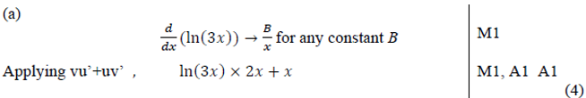

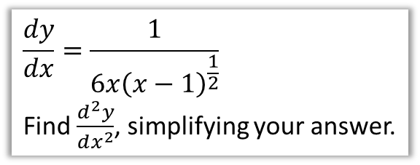
Test Your Understanding
Edexcel C3 Jan 2012 Q1a
?
Edexcel C3 June 2013 Q5(c)
Examiner’s Report: “Perhaps the most challenging question in the paper”. And this is on a paper described as having “a level of demand higher than any previous C3 paper”.
So it’s DAMN FRIKKIN’ HARD. 😐😐
$$\frac{dy}{dx}=\frac{1}{6x{\left(x−1\right)}^{\frac{1}{2}}}$$
Find $\frac{d^{2}y}{dx^{2}}$, simplifying your answer.
$$\frac{dy}{dx}=\frac{1}{6}x^{−1}{\left(x−1\right)}^{−\frac{1}{2}}$$
$$\frac{d^{2}y}{dx^{2}}=−\frac{1}{6}x^{−2}{\left(x−1\right)}^{−\frac{1}{2}}−\frac{1}{12}x^{−1}{\left(x−1\right)}^{−\frac{3}{2}}$$
$$=−\frac{1}{12}x^{−2}{\left(x−1\right)}^{−\frac{3}{2}}\left(2\left(x−1\right)+x\right) \\ =\frac{2−3x}{12x^{2}{\left(x−1\right)}^{\frac{3}{2}}}$$
?

Slide 5
Exercise 9.4
Pearson Pure Year 2
Page 72

Slide 6
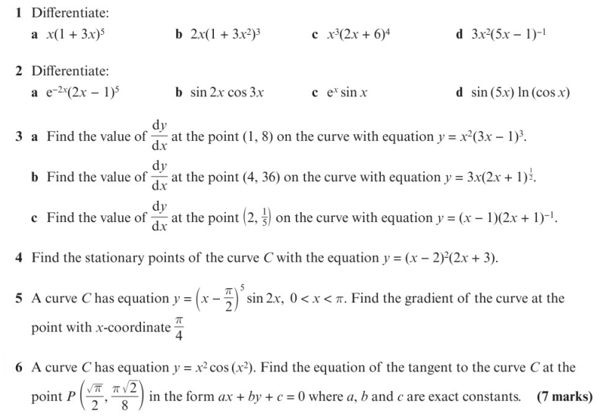
Homework Exercise

Slide 7
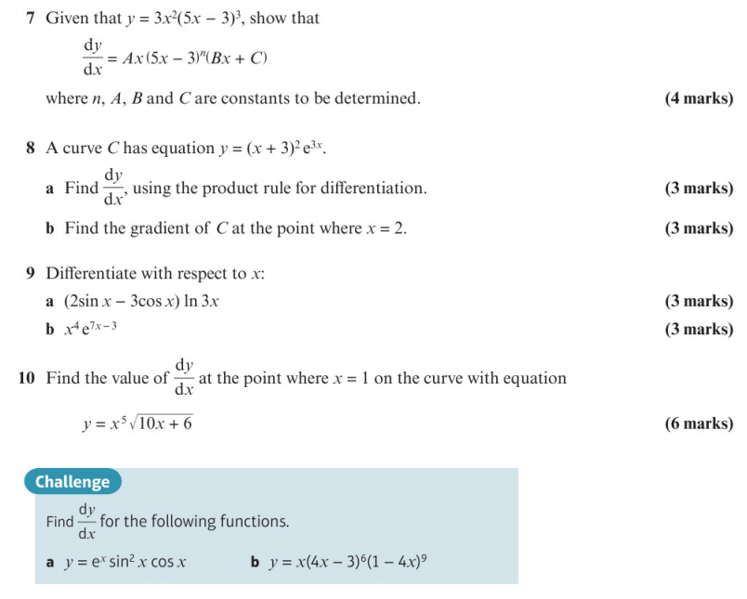
Homework Exercise

Slide 8
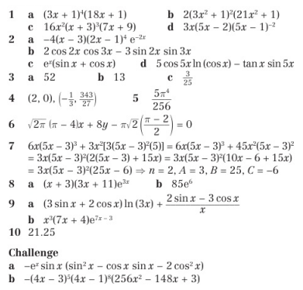
Homework Answers

