Slide 1
Stats1 Chapter 1: Data Collection 1.2 Sampling

Slide 2
Types of Sampling
I recommend laying out your notes like this for next bit of the chapter. Use a full page.
Type
How to carry out
Advantages
Disadvantages
Simple Random Sampling
Systematic Sampling
Random Sampling
Stratified Sampling
Quota
Sampling
Non-Random
Opportunity
Sampling

Slide 3
Random Sampling
Population
Ordinarily, we would want each thing in our sampling frame to have an equal chance of being chosen, in order to avoid bias.
This is known as random sampling.
There are a few ways of doing this…

Slide 4
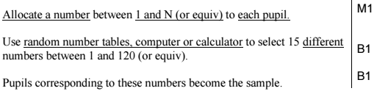
Simple Random Sampling
Type
How to carry out
Advantages
Disadvantages
Simple Random Sampling
What is it :
Every sample has an equal chance of being selected.
Method:
In sampling frame each item has identifying number. Use random number generator, or ‘lottery sampling’ (names in a hat).
Bias free.
Easy and cheap to implement.
Each number has a known equal chance of being selected.
Not suitable when population size is large.
Sampling frame needed.
?
?
?
?
Edexcel S3 June 2004 Q1a
There are 64 girls and 56 boys in a school. Explain briefly how you could take a random sample of 15 pupils using a simple random sample. (3)
?
Mark for allocating identifier to each sampling unit.
Mark for one (bias-free) method to select such a number.
Mark for explicitly mentioning how that number is actually used.

Slide 5


Systematic Sampling
Type
How to carry out
Advantages
Disadvantages
?
?
Systematic Sampling
What is it :
Required elements are chosen at regular intervals in ordered list.
i.e. Take every k^{th} elements where: $$k=\frac{pop size \left(N\right)}{samp size \left(n\right)}$$
starting at random item between 1 and $k$.
Simple and quick to use.
Suitable for large samples/ populations.
Sampling frame again needed.
Can introduce bias if sampling frame not random.
?
Edexcel S3 June 2009 Q1a
A telephone directory contains 50 000 names. A researcher wishes to select a systematic sample of 100 names from the directory. Explain in detail how the researcher should obtain such a sample. (2)
?
We need a random first item.

Slide 6

Stratified Sampling
Population
We want to sample 20% of the population. If the population were divided into distinct groups (e.g. age ranges), known as ‘strata’, we could randomly sample 20% from each group, ensuring each group is equally represented.
Type
How to carry out
Advantages
Disadvantages
Stratified Sampling
What is it :
Population divided into groups (strata) and a simple random sample carried out in each group.
Same proportion $\frac{samp size \left(n\right)}{pop size \left(N\right)}$ sampled from each strata.
Used when sample is large and population naturally divides into groups.
Reflects population structure.
Guarantees proportional representation of groups within population.
?
?
Population must be clearly classified into distinct strata.
Selection within each stratum suffers from same disadvantages as simple random sampling.
?

Slide 7
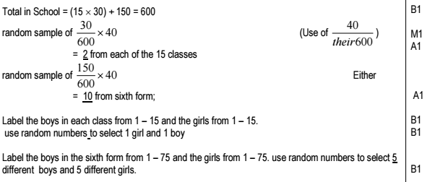
Example Question
Edexcel S3 Jan 2006 Q1
A school has 15 classes and a sixth form. In each class there are 30 students. In the sixth form there are 150 students. There are equal numbers of boys and girls in each class. There are equal numbers of boys and girls in the sixth form. The head teacher wishes to obtain the opinions of the students about school uniforms. Explain how the head teacher would take a stratified sample of size 40. (7)
?
You would certainly want to know your mark scheme on this one!

Slide 8
Exercise 1.2
Pearson Statistics & Mechanics Year 1/AS
Pages 2-3

Slide 9
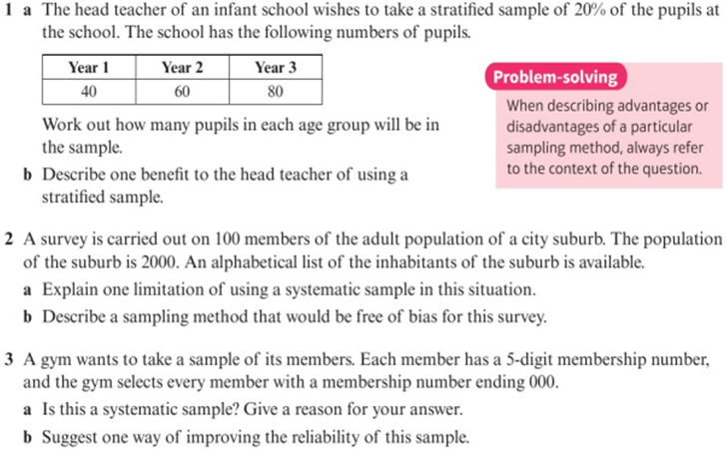
Homework Exercise

Slide 10
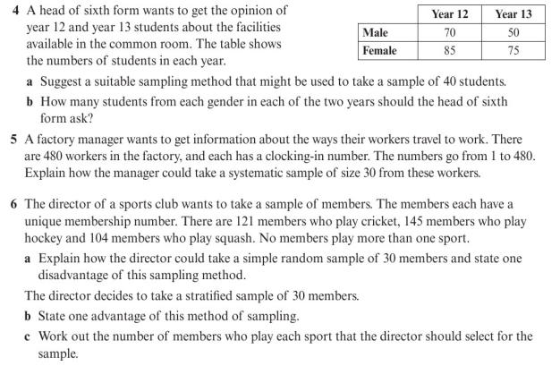
Homework Exercise

Slide 11
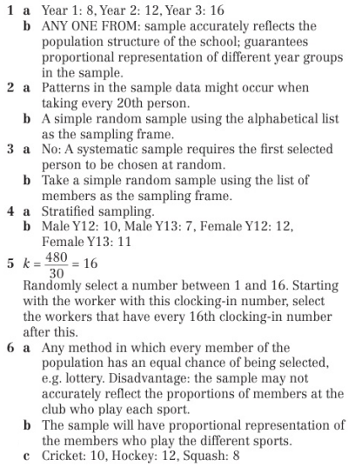
Homework Answers

