Slide 1
P2 Chapter 11: Integration Chapter Practice

Slide 2
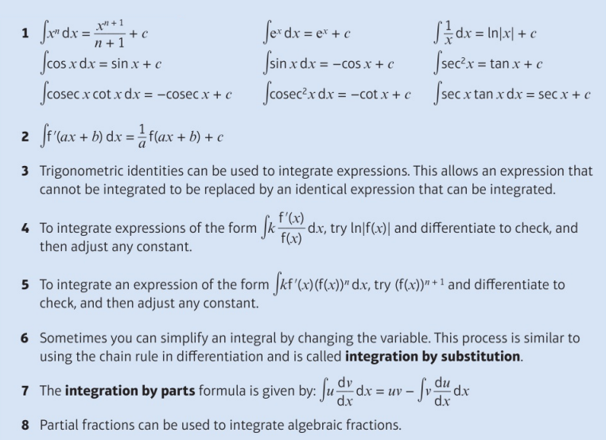
Key Points

Slide 3
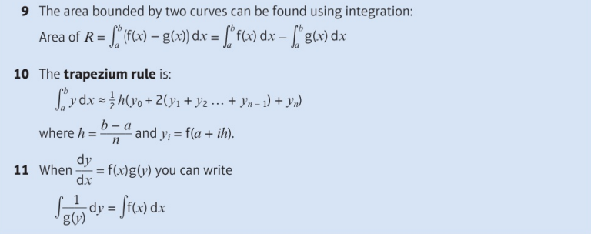
Key Points

Slide 4
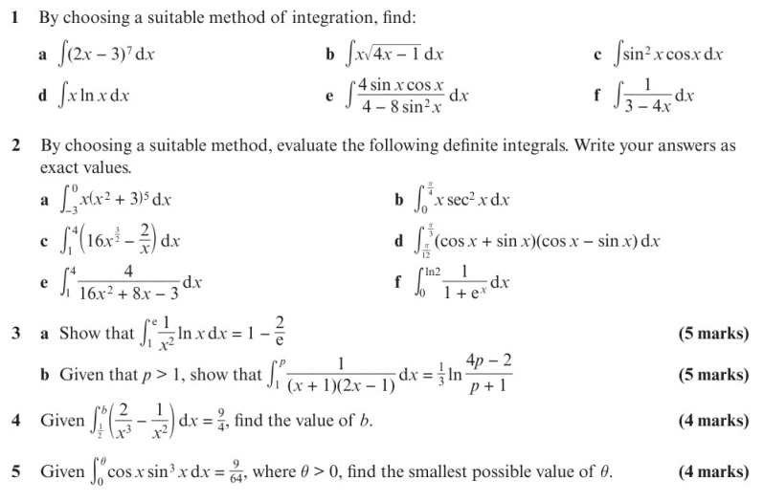
Chapter Exercises

Slide 5
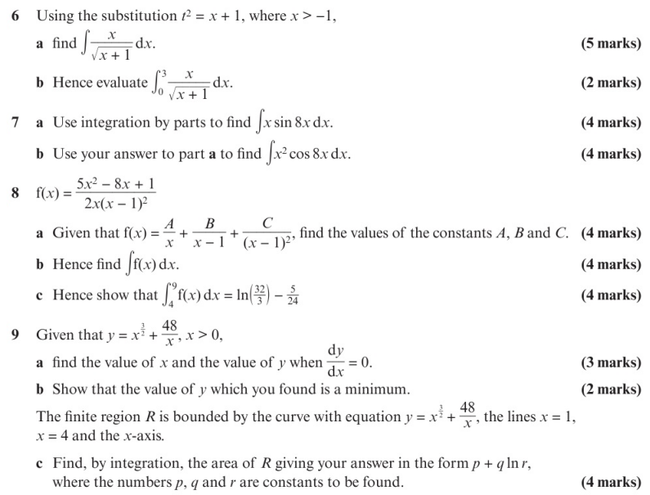
Chapter Exercises

Slide 6
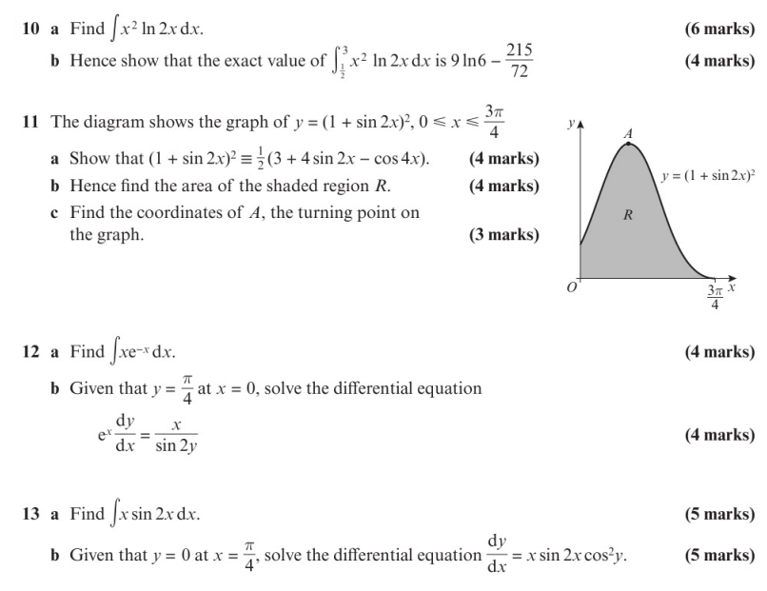
Chapter Exercises

Slide 7
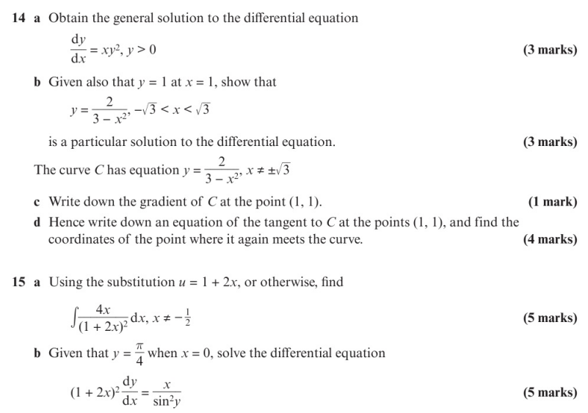
Chapter Exercises

Slide 8
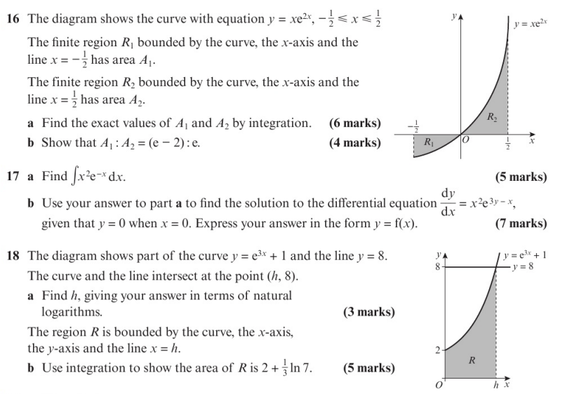
Chapter Exercises

Slide 9
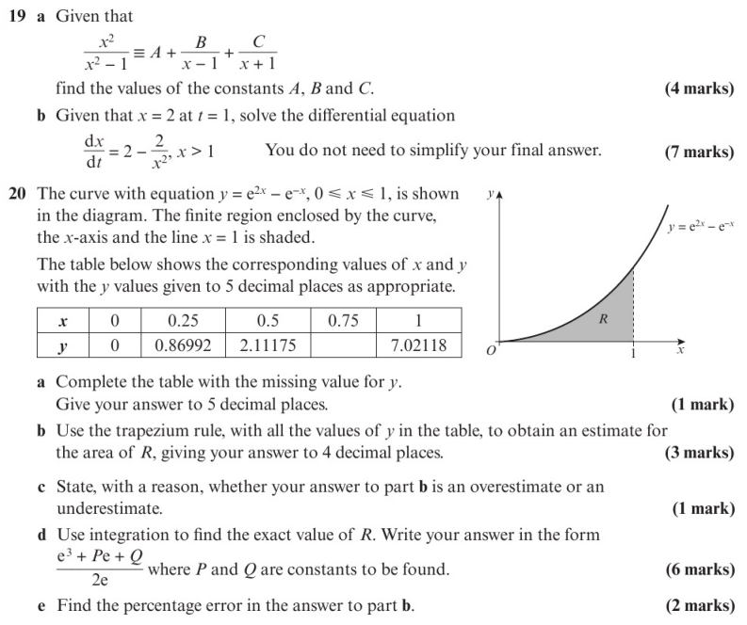
Chapter Exercises

Slide 10
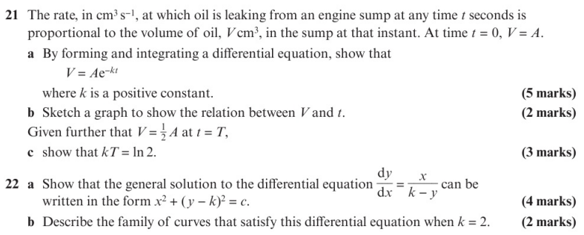
Chapter Exercises

Slide 11
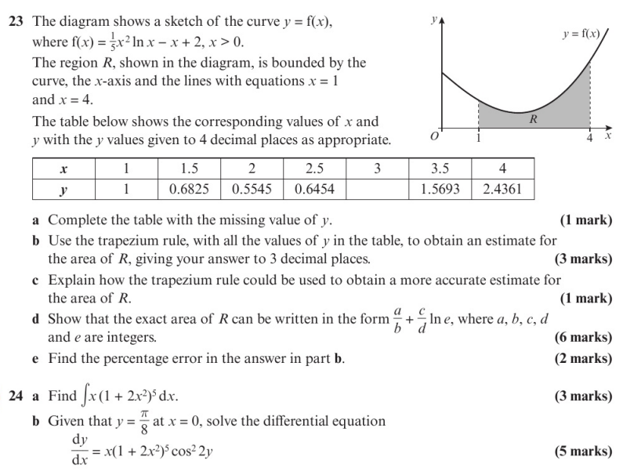
Chapter Exercises

Slide 12
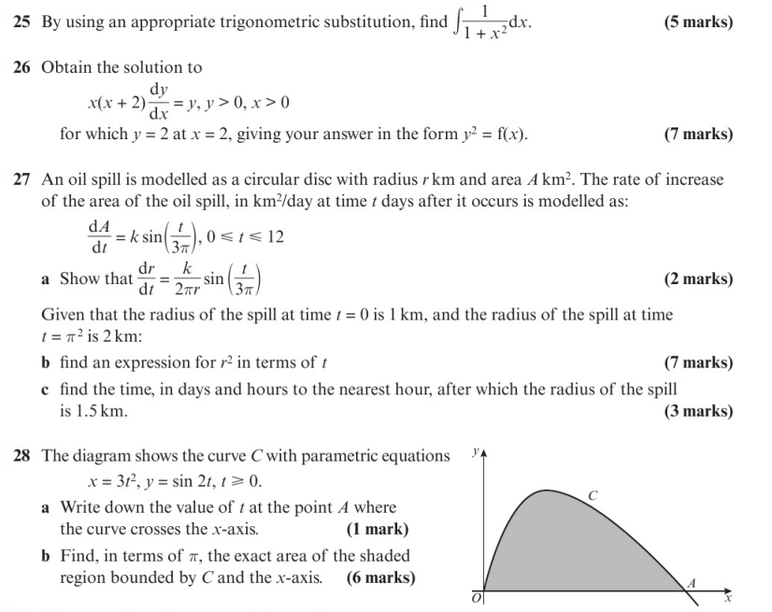
Chapter Exercises

Slide 13
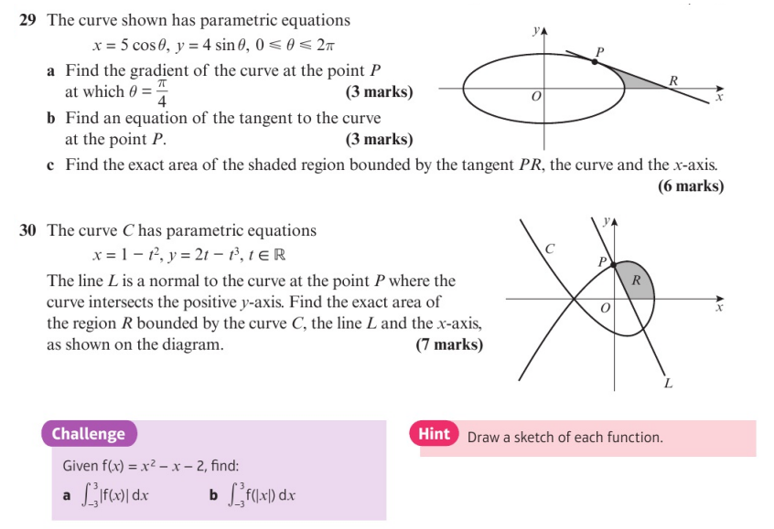
Chapter Exercises

Slide 14
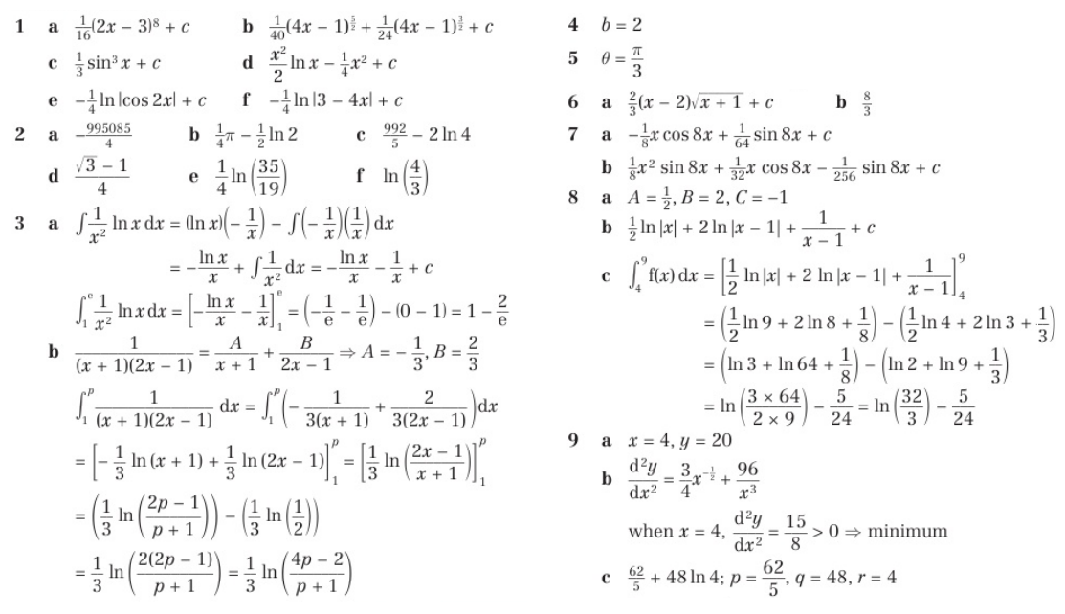
Chapter Answers

Slide 15
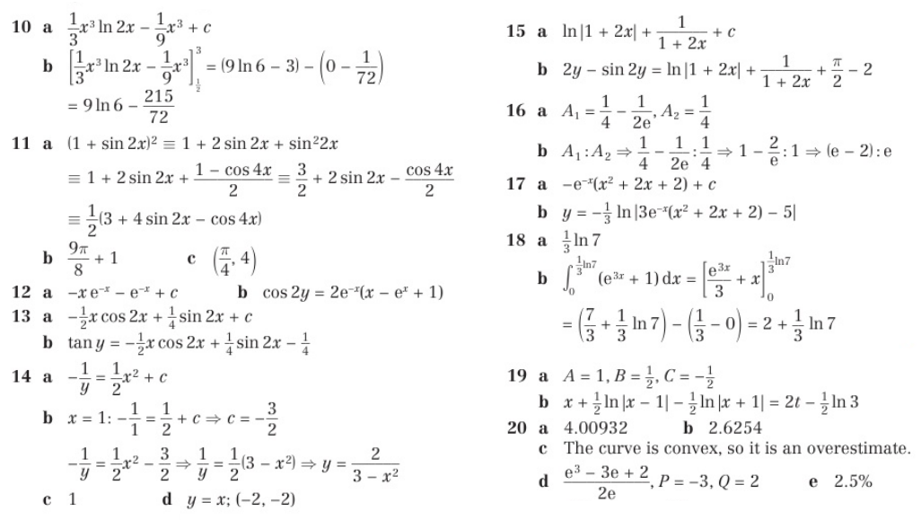
Chapter Answers

Slide 16
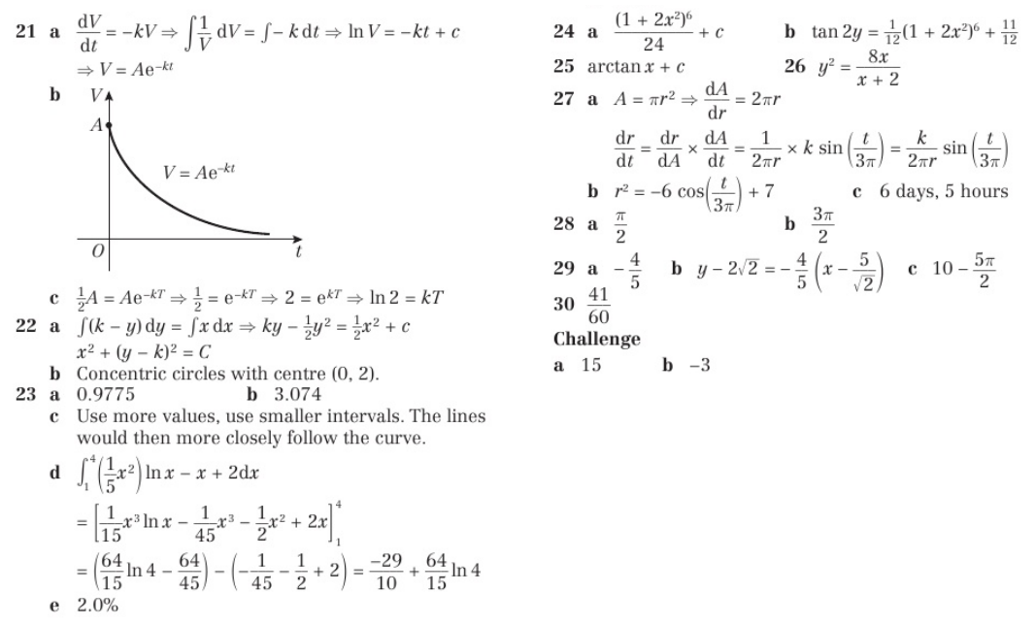
Chapter Answers

