Slide 1
P1 Chapter 14: Logarithms The Natural Base

Slide 2
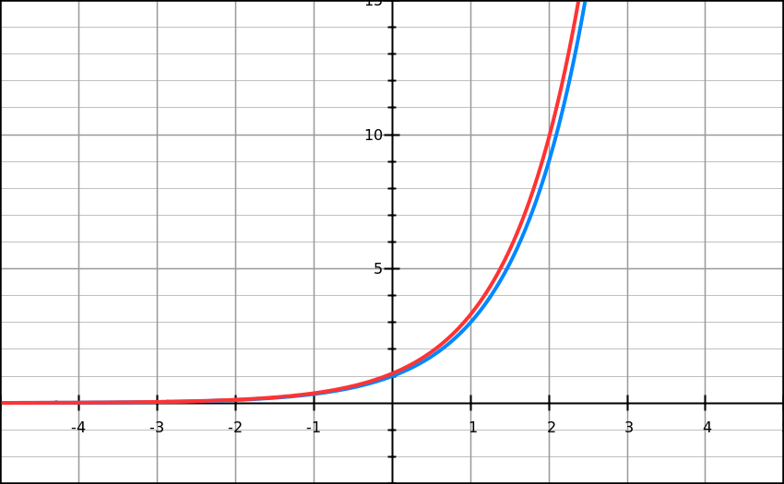
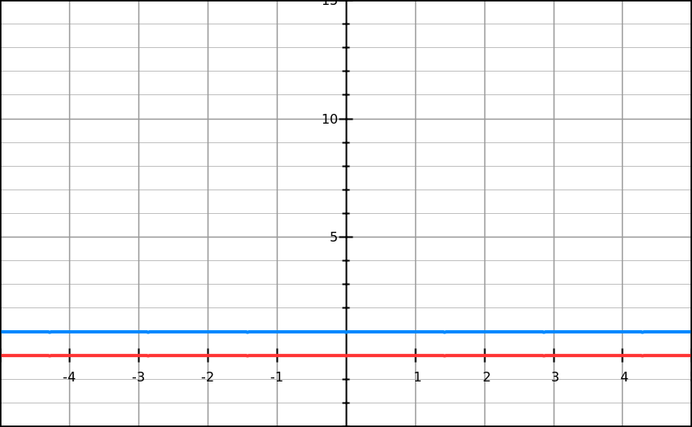
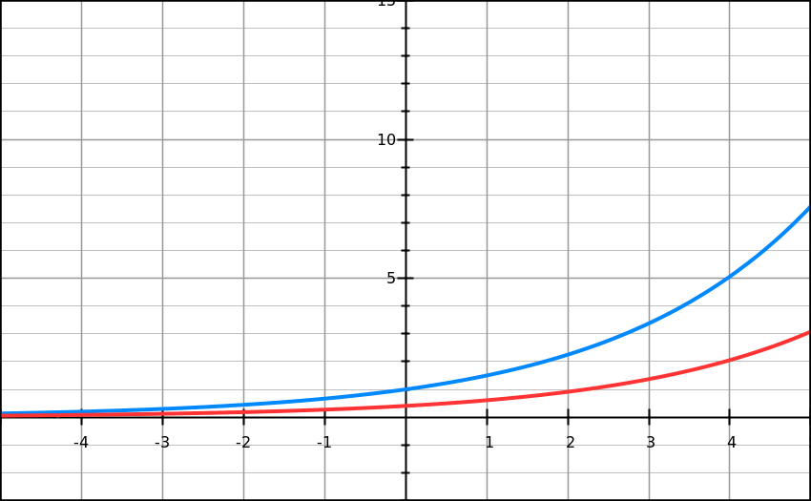
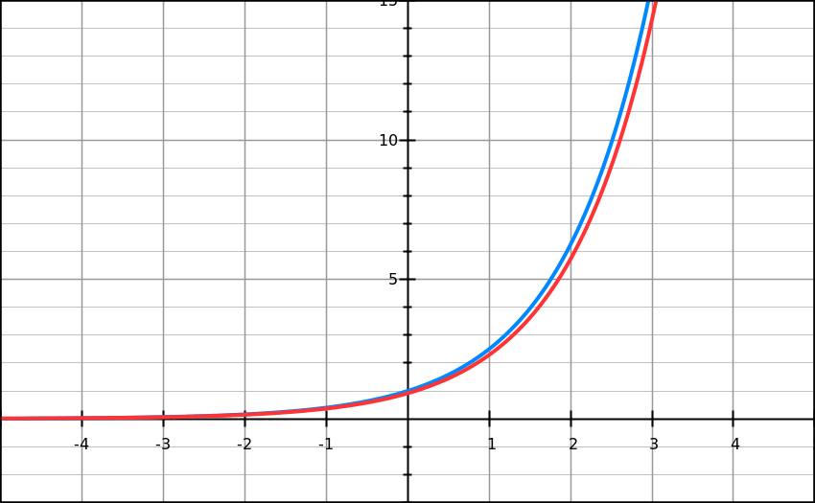
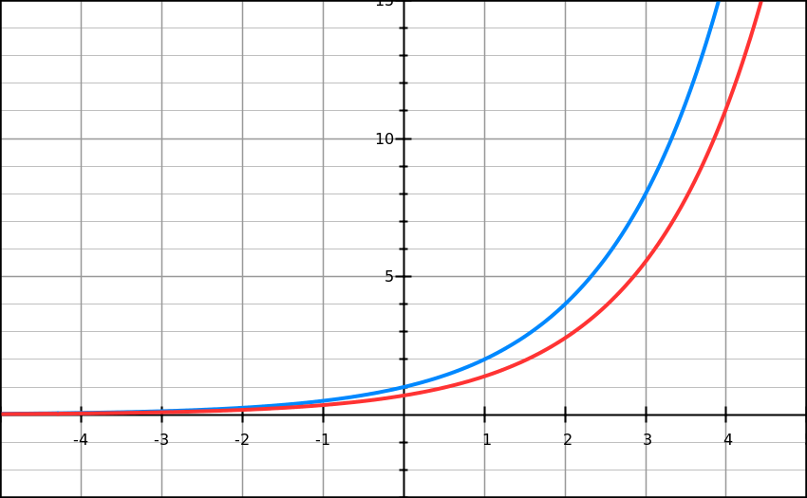
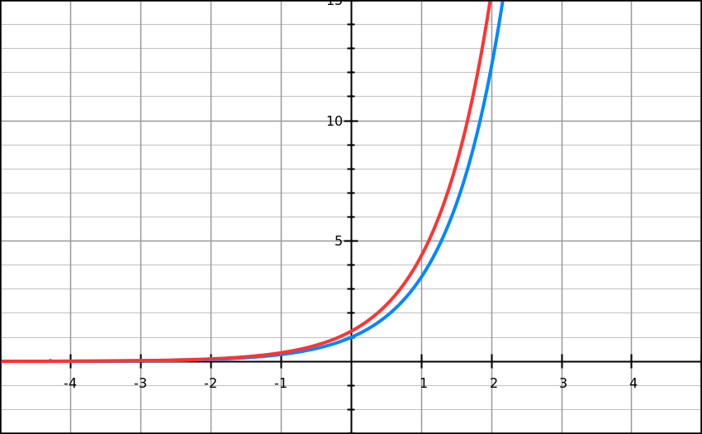













$y=e^{x}$
Click
You won’t yet be able to differentiate general exponential functions $y=a^{x}$ until Year 2.
But I’ve calculated the gradient functions for you – click the black arrow to reveal the graph and gradient function.
Function
Gradient
$$y=1^{x}$$
$$\frac{dy}{dx}=0$$
>
$$y={1.5}^{x}$$
$$\frac{dy}{dx}=0.41×{1.5}^{x}$$
>
$$y=2^{x}$$
$$\frac{dy}{dx}=0.69×2^{x}$$
>
$$y={2.5}^{x}$$
$$\frac{dy}{dx}=0.92×{2.5}^{x}$$
>
$$y=3^{x}$$
$$\frac{dy}{dx}=1.10×3^{x}$$
>
$$y={3.5}^{x}$$
$$\frac{dy}{dx}=1.25×{3.5}^{x}$$
>
Compare each exponential function against its respective gradient function. What do you notice?

Slide 3


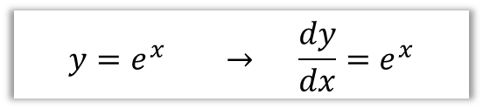

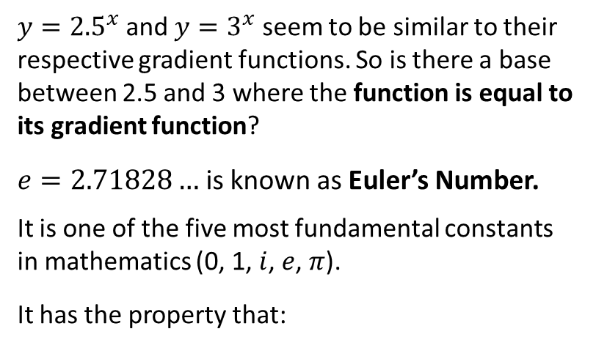

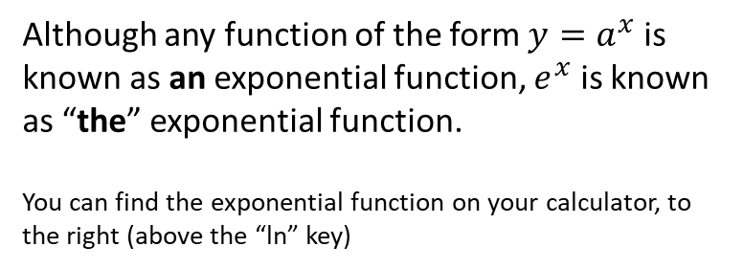
$y=e^{x}$
Function
Gradient
$y={2.5}^{x}$ and $y=3^{x}$ seem to be similar to their respective gradient functions. So is there a base between 2.5 and 3 where the function is equal to its gradient function?
$e=2.71828…$ is known as Euler’s Number.
It is one of the five most fundamental constants in mathematics (0, 1, $i$, $e$, $π$).
It has the property that:
$$y=1^{x}$$
$$\frac{dy}{dx}=0$$
>
$$y={1.5}^{x}$$
$$\frac{dy}{dx}=0.41×{1.5}^{x}$$
>
$$y=2^{x}$$
$$\frac{dy}{dx}=0.69×2^{x}$$
>
$$y={2.5}^{x}$$
$$\frac{dy}{dx}=0.92×{2.5}^{x}$$
>
$$y=e^{x}$$
$$\frac{dy}{dx}=1.10×3^{x}$$
$$y=3^{x}$$
$$\frac{dy}{dx}=e^{x}$$
>
>
$$y={3.5}^{x}$$
$$\frac{dy}{dx}=1.25×{3.5}^{x}$$
>
$$y=e^{x} → \frac{dy}{dx}=e^{x}$$
Although any function of the form $y=a^{x}$ is known as an exponential function, $e^{x}$ is known as “the” exponential function.
You can find the exponential function on your calculator, to the right (above the “ln” key)

Slide 4

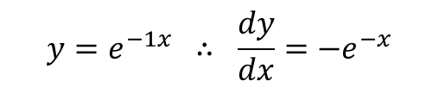

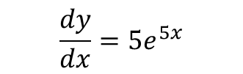


Differentiating $y=ae^{kx}$
! If $y=e^{kx}$, where $k$ is a constant, then $\frac{dy}{dx}=ke^{kx}$
Different $e^{5x}$ with respect to $x$.
Note: This is not a standalone rule but an application of something called the ‘chain rule’, which you will encounter in Year 2.
?
$$\frac{dy}{dx}=5e^{5x}$$
Different $e^{−x}$ with respect to $x$.
?
$$y=e^{−1x} ∴ \frac{dy}{dx}=−e^{−x}$$
Different $4e^{3x}$ with respect to $x$.
?
Note: In general, when you scale the function, you scale the derivative/integral.
$$\frac{dy}{dx}=12e^{3x}$$

Slide 5







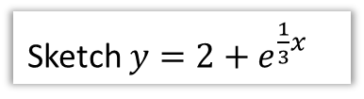






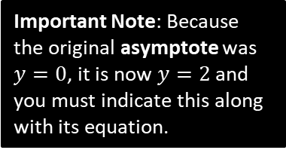









More Graph Transformations
Sketch $y=e^{3x}$
Sketch $y=5e^{−x}$
?
?
$$y$$
$$y=e^{3x}$$
$$y$$
Note: Recall the shape of a $y=a^{−x}$ graph.
5 is ‘outside’ function, so stretch of scale factor 5 on $y$-axis.
Input $x$ is being replaced with $3x$, so stretch of scale factor $\frac{1}{3}$ on $x$-axis.
$$y=e^{x}$$
$$y=5e^{−x}$$
$$y=e^{x}$$
$$1$$
$$5$$
$$x$$
$$1$$
$$x$$
Sketch $y=2+e^{\frac{1}{3}x}$
?
$$y=2+e^{\frac{1}{3}x}$$
$$y$$
We have a stretch on $x$-axis by scale factor 3, and a translation up by 2.
$$y=e^{x}$$
Important Note: Because the original asymptote was $y=0$, it is now $y=2$ and you must indicate this along with its equation.
$$3$$
$$y=2$$
$$1$$
$$x$$

Slide 6




Test Your Understanding
Sketch $y=e^{−2x}−1$
?
$$y$$
$$y=e^{−2x}−1$$
$$y=e^{−2\left(0\right)}−1=0$$
$$x$$
$$y=−1$$

Slide 7

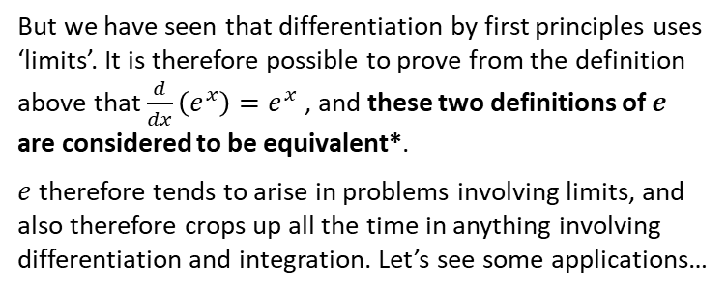
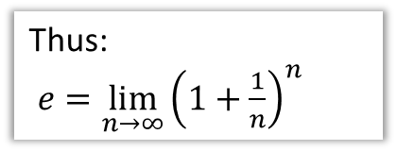

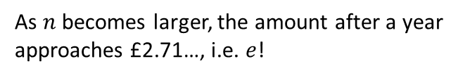
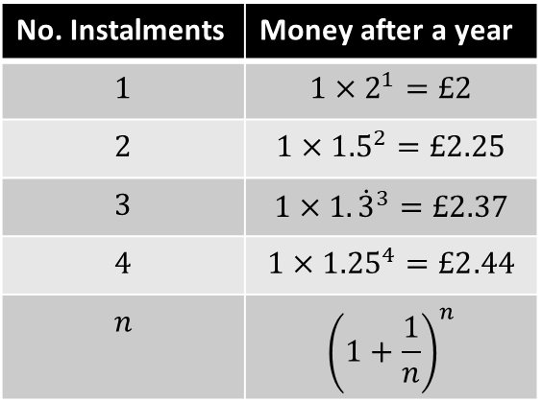
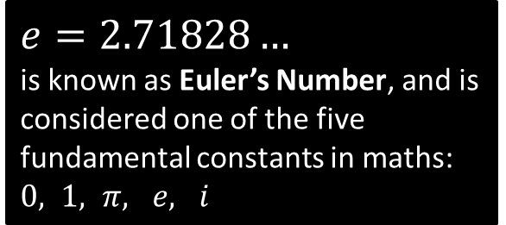
Just for your interest…
Where does $e$ come from, and why is it so important?
$e=2.71828…$
is known as Euler’s Number, and is considered one of the five fundamental constants in maths: $0, 1, π, e, i$
Its value was originally encountered by Bernoulli who was solving the following problem:
You have £1. If you put it in a bank account with 100% interest, how much do you have a year later? If the interest is split into 2 instalments of 50% interest, how much will I have? What about 3 instalments of 33.3%? And so on…
Thus:
$e=\lim_{n→∞}{{\left(1+\frac{1}{n}\right)}^{n}}$
No. Instalments | Money after a year
$$1$$ | $$1×2^{1}=£2$$
$$2$$ | $${1×1.5}^{2}=£2.25$$
$$3$$ | $$1×1.{\dot{3}}^{3}=£2.37$$
$$4$$ | $${1×1.25}^{4}=£2.44$$
$$n$$ | $${\left(1+\frac{1}{n}\right)}^{n}$$
But we have seen that differentiation by first principles uses ‘limits’. It is therefore possible to prove from the definition above that $\frac{d}{dx}\left(e^{x}\right)=e^{x}$ , and these two definitions of $e$ are considered to be equivalent*.
$e$ therefore tends to arise in problems involving limits, and also therefore crops up all the time in anything involving differentiation and integration. Let’s see some applications…
As $n$ becomes larger, the amount after a year approaches £2.71…, i.e. $e$!
*You can find a full proof here in my Graph Sketching/Limits slides: http://www.drfrostmaths.com/resources/resource.php?rid=163

Slide 8
Exercise 14.2
Pearson Pure Mathematics Year 1/AS
Page 114

Slide 9
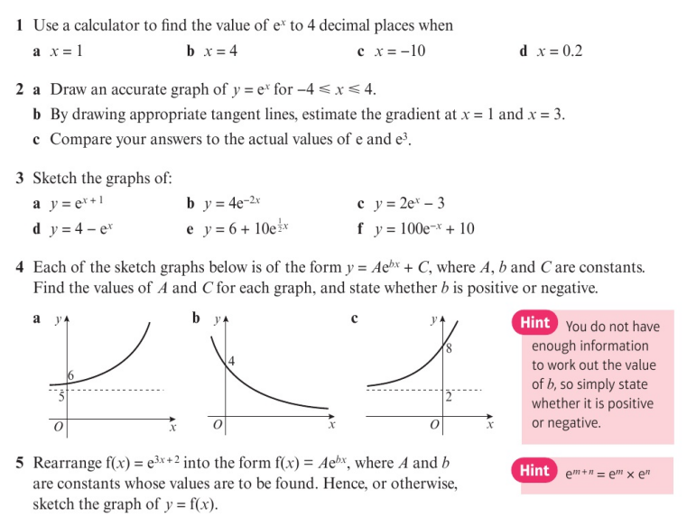
Homework Exercise

Slide 10
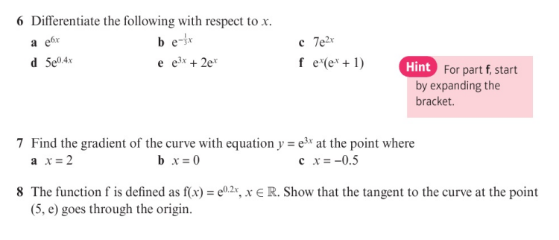
Homework Exercise

Slide 11
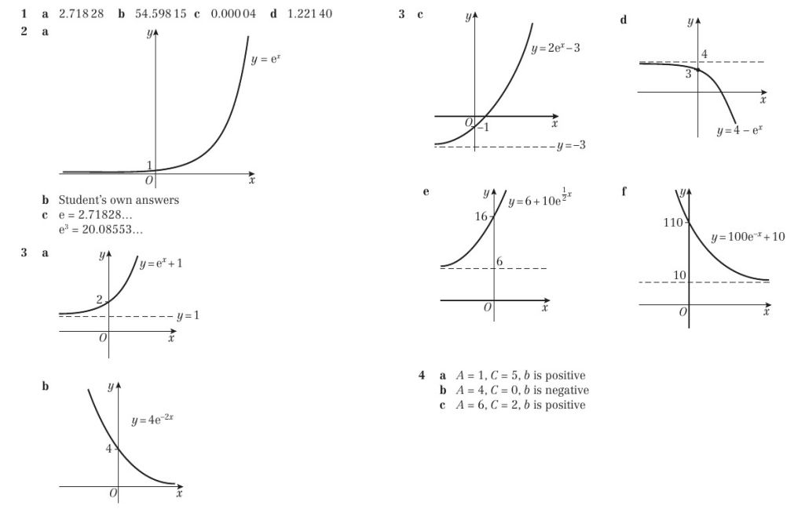
Homework Answers

Slide 12
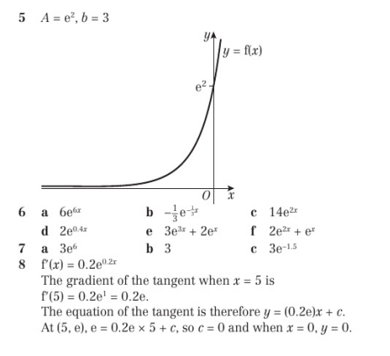
Homework Answers

