Slide 1
Stats1 Chapter 5: Probability Venn Diagrams

Slide 2


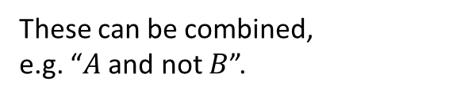






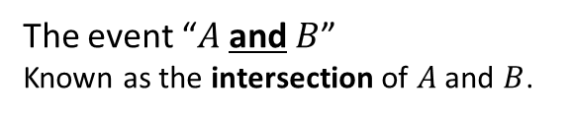






Venn Diagrams
Venn Diagrams allow us to combine events, e.g. “$A$ happened and $B$ happened”.
$$S$$
$$S$$
$$A$$
$$B$$
$$A$$
$$B$$
The event “$A$ and $B$”
Known as the intersection of $A$ and $B$.
The event “$A$ or $B$”
Known as the union of $A$ and $B$.
$$S$$
$$S$$
$$A$$
$$B$$
$$A$$
$$B$$
The event “not $A$”
Known as the union of $A$ and $B$.
These can be combined,
e.g. “$A$ and not $B$”.

Slide 3

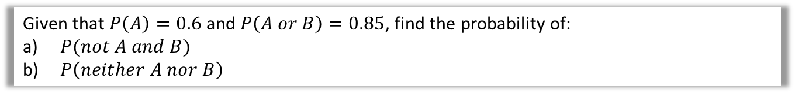
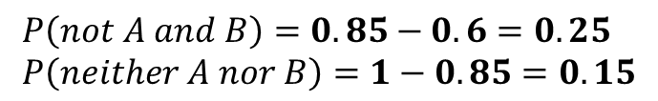


Example involving probabilities
We can either put frequencies or probabilities into the Venn Diagram.
Given that $P\left(A\right)=0.6$ and $P\left(A or B\right)=0.85$, find the probability of:
$P(not A and B)$
$P\left(neither A nor B\right)$
?
$$S$$
0.15
$$A$$
$$B$$
$$P\left(not A and B\right)=0.85−0.6=0.25 \\ P\left(neither A nor B\right)=1−0.85=0.15$$
0.6
0.25
0.85

Slide 4
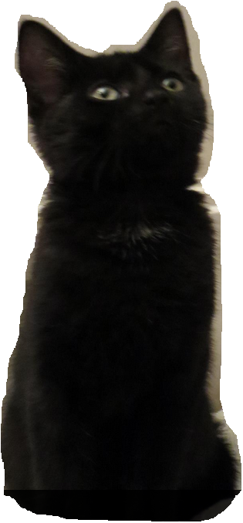





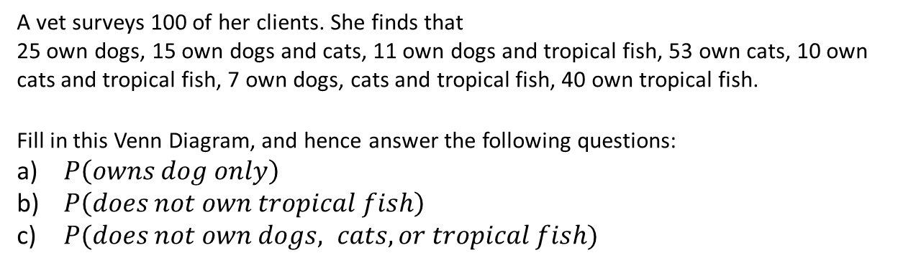








Example involving frequencies
A vet surveys 100 of her clients. She finds that
25 own dogs, 15 own dogs and cats, 11 own dogs and tropical fish, 53 own cats, 10 own cats and tropical fish, 7 own dogs, cats and tropical fish, 40 own tropical fish.
Fill in this Venn Diagram, and hence answer the following questions:
$P\left(owns dog only\right)$
$P\left(does not own tropical fish\right)$
$P(does not own dogs, cats, or tropical fish)$
$$S$$
Tip: Start from the centre frequency and work your way outwards using subtraction.
$$C$$
?
?
$$35$$
$$11$$
?
?
$$8$$
$$3$$
?
$$D$$
$$7$$
$\frac{6}{100}=\frac{3}{50}$
$\frac{60}{100}=\frac{3}{5}$
$\frac{11}{100}$
$$F$$
?
?
?
?
$$26$$
$$6$$
$$4$$
?
Dr Frost’s cat “Pippin”

Slide 5
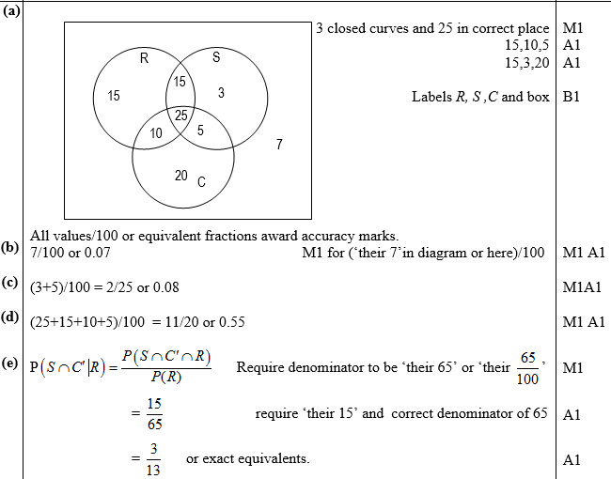
Test Your Understanding
Jan 2012 Q6
Tip: You’ll lose a mark if you don’t have a box!
The following shows the results of a survey on the types of exercise taken by a group of 100 people.
65 run 48 swim
60 cycle 40 run and swim
30 swim and cycle 35 run and cycle 25 do all three
(a) Draw a Venn Diagram to represent these data. (4)
Find the probability that a randomly selected person from the survey
(b) takes none of these types of exercise, (2)
(c) swims but does not run, (2)
takes at least two of these types of exercise. (2)
Jason is one of the above group. Given that Jason runs,
(e) find the probability that he swims but does not cycle. (3)
?
?
?
?

Slide 6
Exercise 5.2
Pearson Applied Year 1/AS
Pages 32-33

Slide 7
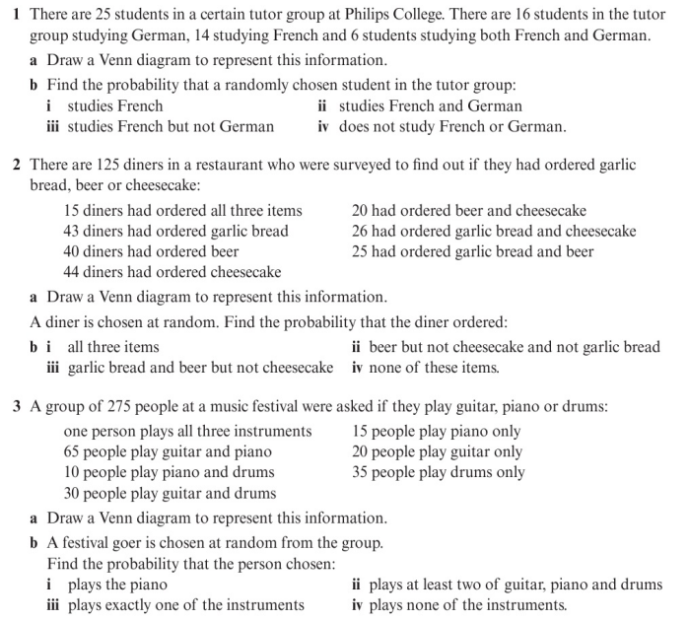
Homework Exercise

Slide 8
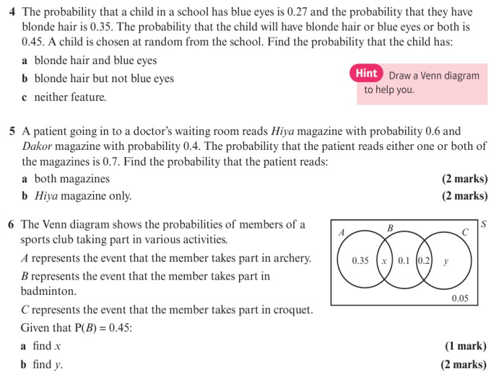
Homework Exercise

Slide 9
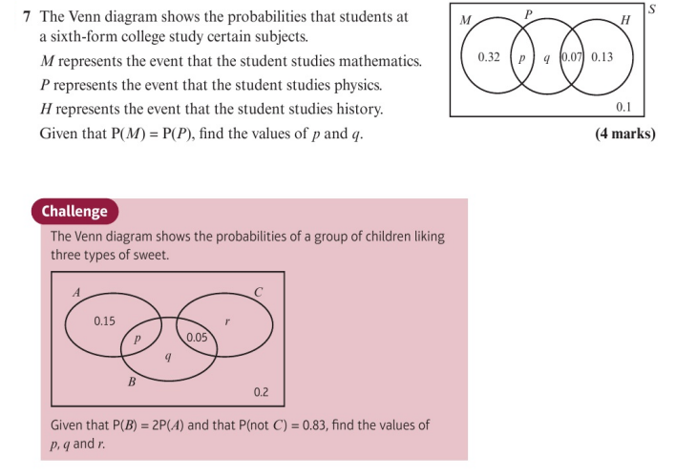
Homework Exercise

Slide 10
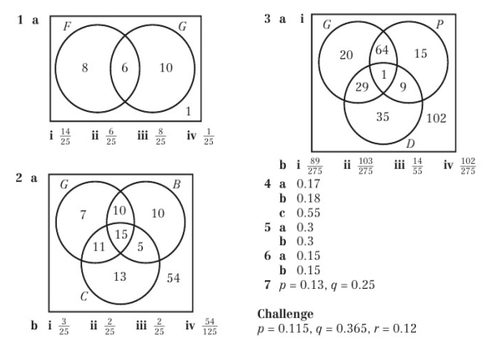
Homework Answers

