Slide 1
P1 Chapter 3: Inequalities Graph Inequality

Slide 2


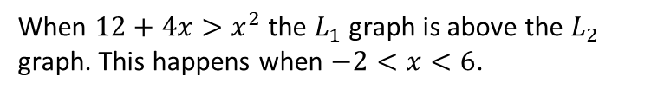

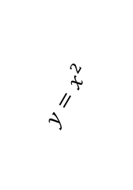





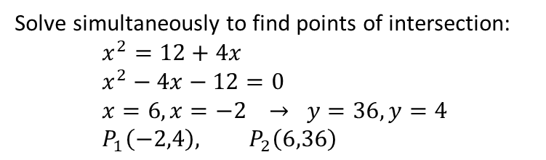
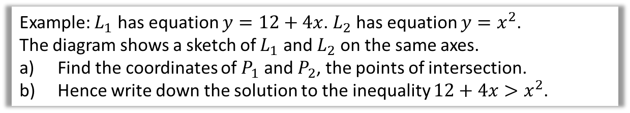

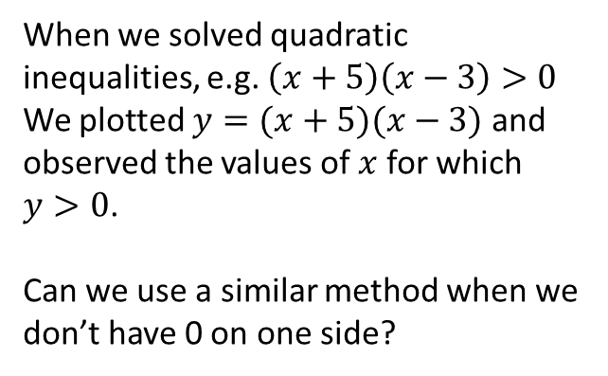
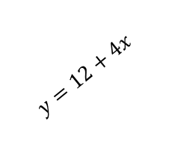
Inequalities on Graphs
(New to the 2017 spec)
$$y$$
When we solved quadratic inequalities, e.g. $\left(x+5\right)\left(x−3\right)>0$
We plotted $y=(x+5)(x−3)$ and observed the values of $x$ for which $y>0$.
Can we use a similar method when we don’t have 0 on one side?
$$y=(x+5)(x−3)$$
$$x$$
$$−5$$
$$3$$
Example: $L_{1}$ has equation $y=12+4x$. $L_{2}$ has equation $y=x^{2}$.
The diagram shows a sketch of $L_{1}$ and $L_{2}$ on the same axes.
Find the coordinates of $P_{1}$ and $P_{2}$, the points of intersection.
Hence write down the solution to the inequality $12+4x>x^{2}$.
$$y$$
a
Solve simultaneously to find points of intersection:
$$x^{2}=12+4x \\ x^{2}−4x−12=0 \\ x=6, x=−2 → y=36, y=4 \\ P_{1}\left(−2,4\right), P_{2}\left(6,36\right)$$
?
$$P_{2}$$
$$y=12+4x$$
$$y=x^{2}$$
$$P_{1}$$
When $12+4x>x^{2}$ the $L_{1}$ graph is above the $L_{2}$ graph. This happens when $−2<x<6$.
$$x$$
b
?
$$−2$$
$$6$$

Slide 3
Exercise 3.6
Pearson Pure Mathematics Year 1/AS
Page 21

Slide 4
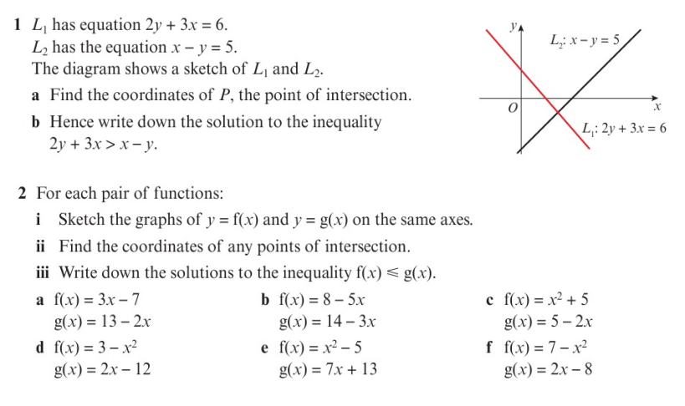
Homework Exercise

Slide 5
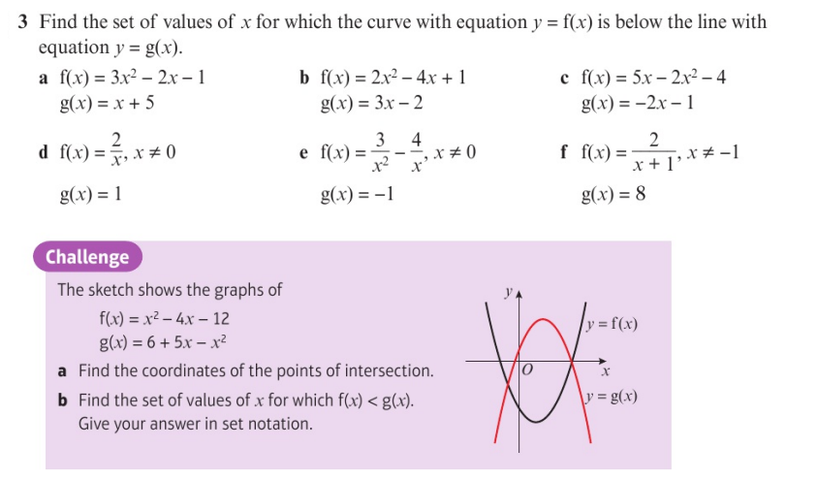
Homework Exercise

Slide 6
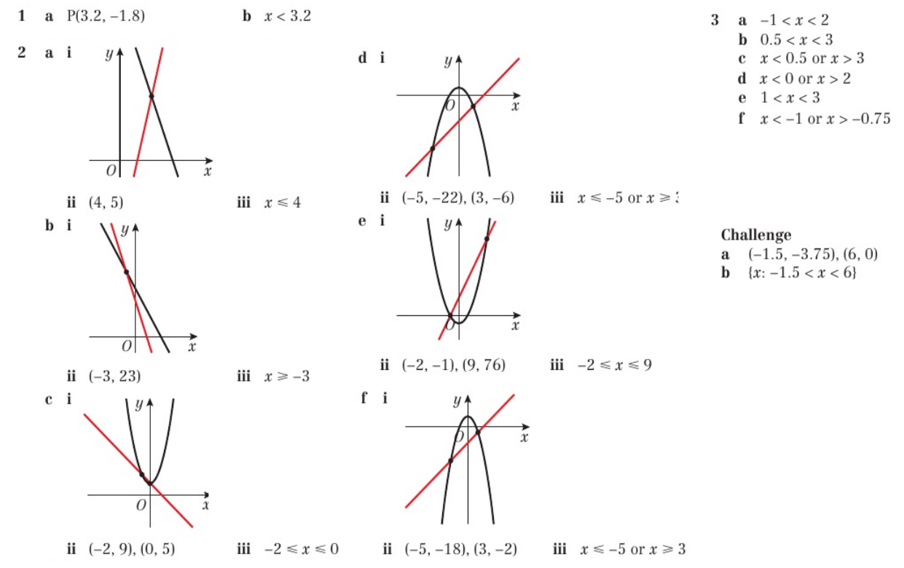
Homework Answers

