Slide 1
P1 Chapter 6: Circles Inscribed Triangles

Slide 2
Triangles in Circles
We’d say:
The triangle inscribes the circle. (A shape inscribes another if it is inside and its boundaries touch but do not intersect the outer shape)
The circle circumscribes the triangle.
If the circumscribing shape is a circle, it is known as the circumcircle of the triangle.
The centre of a circumcircle is known as the circumcentre.

Slide 3




Triangles in Circles
$$B$$
$$C$$
$$A$$
If $∠ABC=90°$ then:
$AC$ is the diameter of the circumcircle of triangle $ABC$.
Similarly if $AC$ is the diameter of a circle:
$∠ABC=90°$ therefore $AB$ is perpendicular to $BC$.
$AB^{2}+BC^{2}=AC^{2}$
Given three points/a triangle we can find the centre of the circumcircle by:
Finding the equation of the perpendicular bisectors of two different sides.
Find the point of intersection of the two bisectors.
?
?
?

Slide 4
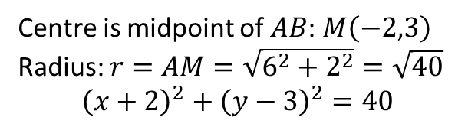


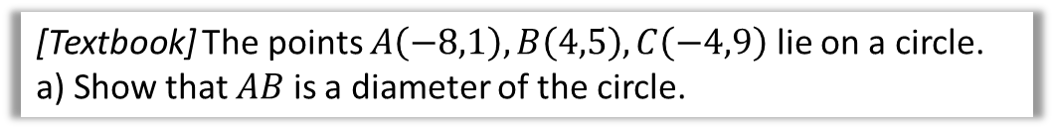



Example
$$C\left(−4,9\right)$$
[Textbook] The points $A\left(−8,1\right), B\left(4,5\right),C\left(−4,9\right)$ lie on a circle.
a) Show that $AB$ is a diameter of the circle.
$$B\left(4,5\right)$$
$$A\left(−8,1\right)$$
Method 1:
Show that $AC^{2}+BC^{2}=AB^{2}$
$$AC=\sqrt{4^{2}+8^{2}}=\sqrt{80} \\ BC=\sqrt{8^{2}+4^{2}}=\sqrt{80} \\ AB=\sqrt{{12}^{2}+4^{2}}=\sqrt{160} \\ 80+80=160$$
Therefore $AB$ is the diameter.
Method 2: (not in textbook!)
Show that $AC$ is perpendicular to $BC$.
$$m_{AC}=\frac{8}{4}=2 \\ m_{CB}=−\frac{4}{8}=−\frac{1}{2} \\ 2×−\frac{1}{2}=−1$$ $∴$ $AC$ is perpendicular to $BC$
Therefore $AB$ is the diameter.
?
?
b) Hence find the equation of the circle.
?
Centre is midpoint of $AB$: $M\left(−2,3\right)$
Radius: $r=AM=\sqrt{6^{2}+2^{2}}=\sqrt{40}$
$${\left(x+2\right)}^{2}+{\left(y−3\right)}^{2}=40$$

Slide 5

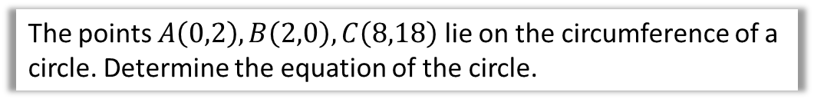



Example
$$C\left(8,18\right)$$
The points $A\left(0,2\right), B\left(2,0\right),C\left(8,18\right)$ lie on the circumference of a circle. Determine the equation of the circle.
Perpendicular bisector of $AB$:
By inspection, $y=x$
Perpendicular bisector of $AC$:
Midpoint: $\left(4,10\right)$
$$m_{AC}=\frac{16}{8}=2 ∴m_{⊥}=−\frac{1}{2}$$
$$y−10=−\frac{1}{2}\left(x−4\right)$$
Solving simultaneously with $y=x$:
$$x−10=−\frac{1}{2}\left(x−4\right) \\ 2x−20=−x+4 \\ 3x=24 \\ x=8 ∴y=8$$
Centre is $(8,8)$.
Using $A$ and centre of circle: $r=\sqrt{8^{2}+6^{2}}=10$
Equation of circle: ${\left(x−8\right)}^{2}+{\left(y−8\right)}^{2}=100$
?
$$A\left(0,2\right)$$
$$B\left(2,0\right)$$

Slide 6
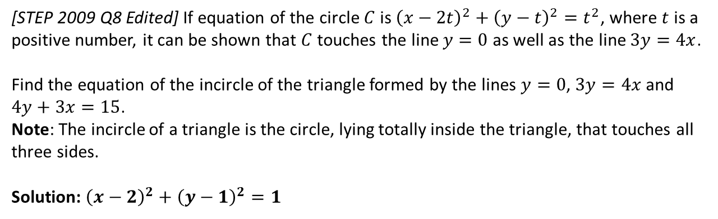
Exercise 6.5
Pearson Pure Mathematics Year 1/AS
Page 51
Extension:
1
[STEP 2009 Q8 Edited] If equation of the circle $C$ is ${\left(x−2t\right)}^{2}+{\left(y−t\right)}^{2}=t^{2}$, where $t$ is a positive number, it can be shown that $C$ touches the line $y=0$ as well as the line $3y=4x$.
Find the equation of the incircle of the triangle formed by the lines $y=0$, $3y=4x$ and $4y+3x=15$.
Note: The incircle of a triangle is the circle, lying totally inside the triangle, that touches all three sides.
Solution: ${\left(x−2\right)}^{2}+{\left(y−1\right)}^{2}=1$
?

Slide 7
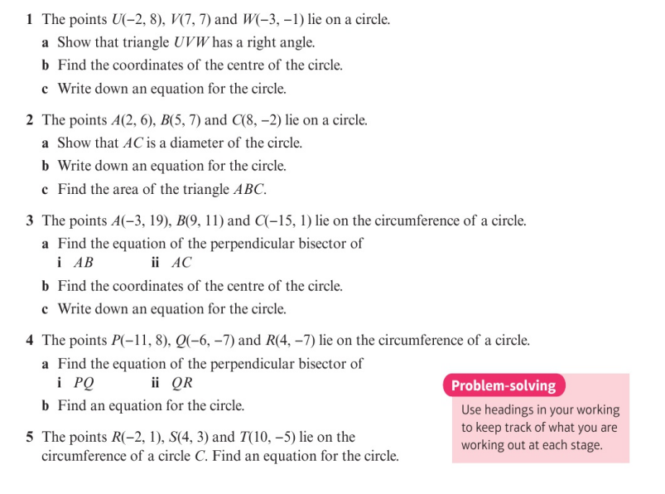
Homework Exercise

Slide 8
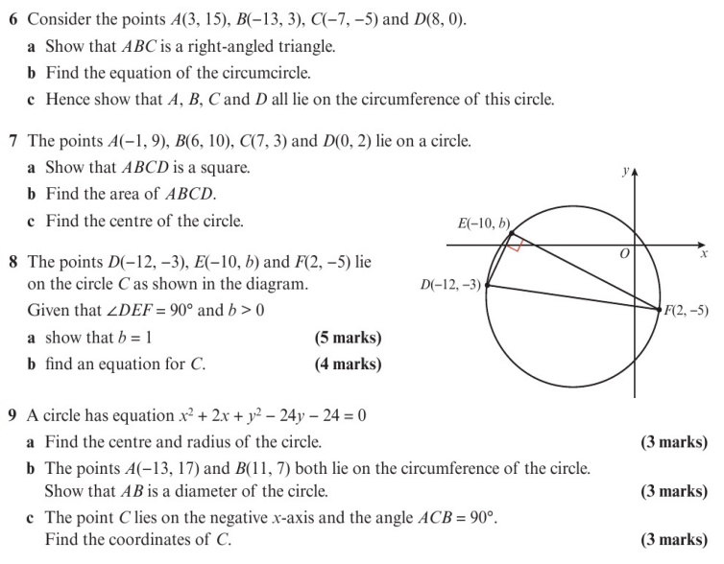
Homework Exercise

Slide 9
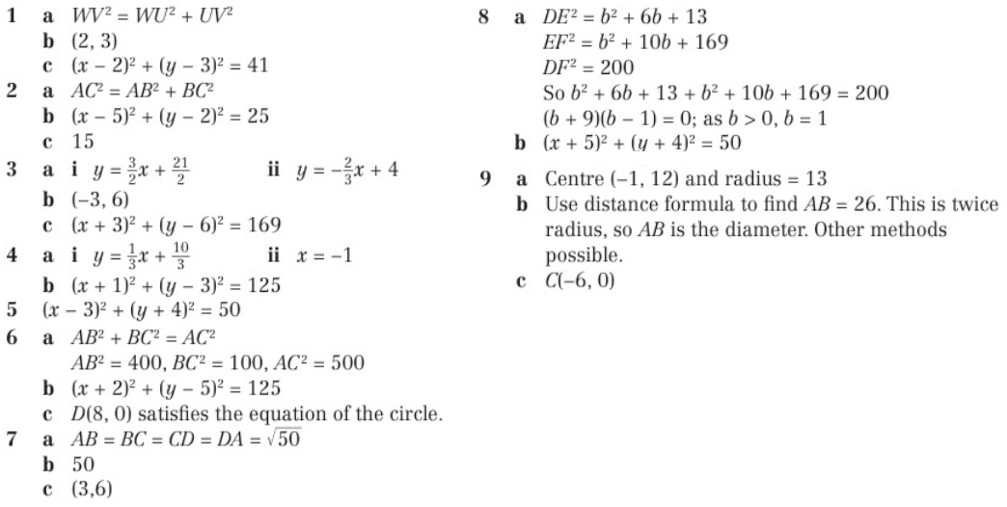
Homework Answers

