Slide 1
P1 Chapter 12: Differentiation
Stationary Points

Slide 2

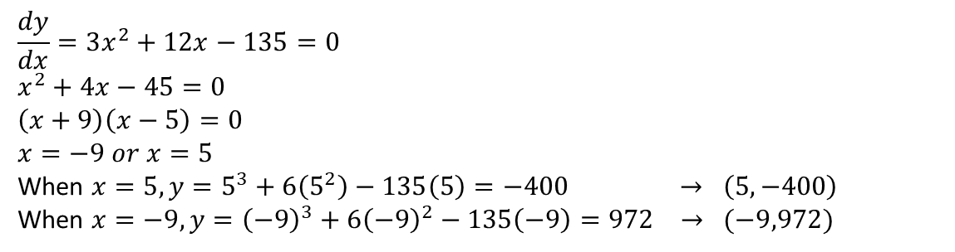

Stationary/Turning Points
A stationary point is where the gradient is 0, i.e. $f^{′}\left(x\right)=0$.
Local maximum
$$f^{′}\left(x\right)=0$$
Fro Note: It’s called a ‘local’ maximum because it’s the function’s largest output within the vicinity. Functions may also have a ‘global’ maximum, i.e. the maximum output across the entire function. This particular function doesn’t have a global maximum because the output keeps increasing up to infinity. It similarly has no global minimum, as with all cubics.
Local minimum
$$f^{′}\left(x\right)=0$$
Find the coordinates of the turning points of $y=x^{3}+6x^{2}−135x$
?
$$\frac{dy}{dx}=3x^{2}+12x−135=0 \\ x^{2}+4x−45=0 \\ \left(x+9\right)\left(x−5\right)=0 \\ x=−9 or x=5$$
When $x=5, y=5^{3}+6\left(5^{2}\right)−135\left(5\right)=−400 → \left(5,−400\right)$
When $x=−9, y={\left(−9\right)}^{3}+6{\left(−9\right)}^{2}−135\left(−9\right)=972 → (−9,972)$

Slide 3
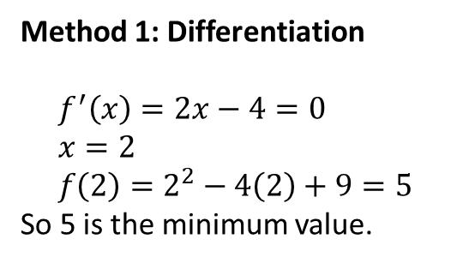



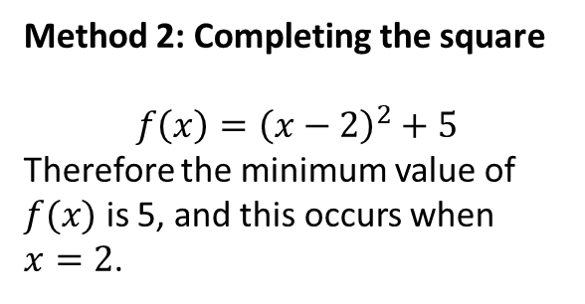
More Examples
Find the least value of
$$f\left(x\right)=x^{2}−4x+9$$
Find the turning point of
$$y=\sqrt{x}−x$$
?
Method 1: Differentiation
?
Method 1: Differentiation
$$f^{′}\left(x\right)=2x−4=0 \\ x=2 \\ f\left(2\right)=2^{2}−4\left(2\right)+9=5$$
So 5 is the minimum value.
$$y=x^{\frac{1}{2}}−x \\ \frac{dy}{dx}=\frac{1}{2}x^{−\frac{1}{2}}−1=0 \\ \frac{1}{2}x^{−\frac{1}{2}}=1 \\ x^{−\frac{1}{2}}=2 → \frac{1}{\sqrt{x}}=2 \\ \sqrt{x}=\frac{1}{2} → x=\frac{1}{4}$$
When $x=\frac{1}{4}$,
$$y=\sqrt{\frac{1}{4}}−\frac{1}{4}=\frac{1}{4}$$
So turning point is $\left(\frac{1}{4},\frac{1}{4}\right)$
?
Method 2:
Completing the Square
Method 2: Completing the square
$$f\left(x\right)={\left(x−2\right)}^{2}+5$$
Therefore the minimum value of $f(x)$ is 5, and this occurs when
$x=2$.
Fro Note: Method 2 is only applicable for quadratic functions. For others, differentiation must be used.

Slide 4


Points of Inflection
There’s a third type of stationary point (that we’ve encountered previously):
A point of inflection is where the curve changes from convex concave (or vice versa).
$$f^{′}\left(x\right)=0$$
concave
convex
(the same terms used in optics!)
Technically we could label these either way round depending on where we view the curve from. What’s important is that the concavity changes.
i.e. the line curves in one direction before the point of inflection, then curves in the other direction after.
Fro Side Note: Not all points of inflection are stationary points, as can be seen in the example on the right.
A point of inflection which is a stationary point is known as a saddle point.
$$f^{′}\left(x\right)≠0$$

Slide 5
How do we tell what type of stationary point?
Method 1: Look at gradient just before and just after point.
Local Maximum
Gradient just before | Gradient at maximum | Gradient just after
+ve | 0 | +ve
?
?
?
Point of Inflection
Gradient just before | Gradient at p.o.i | Gradient just after
+ve | 0 | +ve
Local Minimum
Gradient just before | Gradient at minimum | Gradient just after
-ve | 0 | +ve
?
?
?
?
?
?

Slide 6
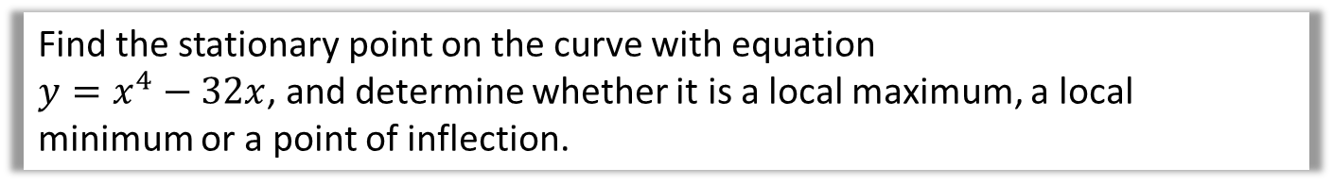
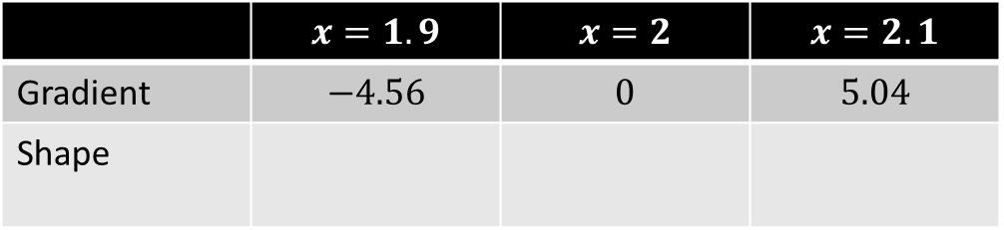
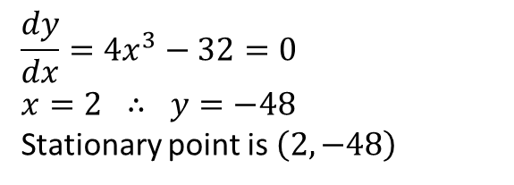
How do we tell what type of stationary point?
Method 1: Look at gradient just before and just after point.
Find the stationary point on the curve with equation
$y=x^{4}−32x$, and determine whether it is a local maximum, a local minimum or a point of inflection.
? Turning Point
$$\frac{dy}{dx}=4x^{3}−32=0 \\ x=2 ∴ y=−48$$
Stationary point is $\left(2,−48\right)$
?
Strategy: Find the gradient for values just before and after $x=2$. Let’s try $x=1.9$ and $x=2.1$.
? Determine point type
 | $$x=1.9$$ | $$x=2$$ | $$x=2.1$$
Gradient | $$−4.56$$ | $$0$$ | $$5.04$$
Shape
Looking at the shape, we can see that $\left(2,−48\right)$ is a minimum.

Slide 7
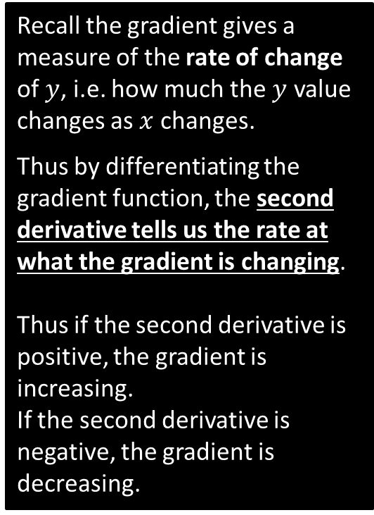
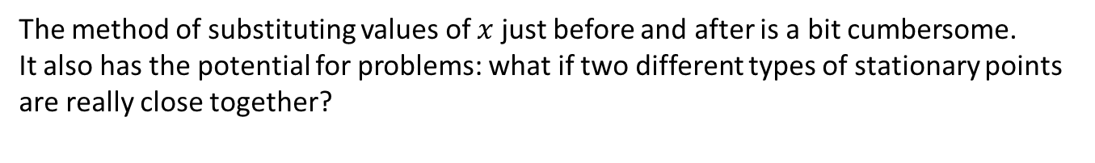
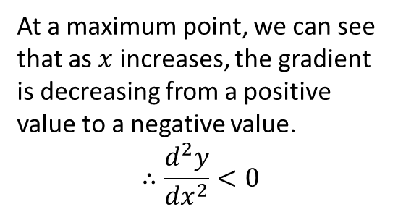
Method 2: Using the second derivative
The method of substituting values of $x$ just before and after is a bit cumbersome.
It also has the potential for problems: what if two different types of stationary points are really close together?
0
gradient
Recall the gradient gives a measure of the rate of change of $y$, i.e. how much the $y$ value changes as $x$ changes.
Thus by differentiating the gradient function, the second derivative tells us the rate at what the gradient is changing.
Thus if the second derivative is positive, the gradient is increasing.
If the second derivative is negative, the gradient is decreasing.
+ve
gradient
-ve
gradient
At a maximum point, we can see that as $x$ increases, the gradient is decreasing from a positive value to a negative value.
$$∴\frac{d^{2}y}{{dx}^{2}}<0$$

Slide 8
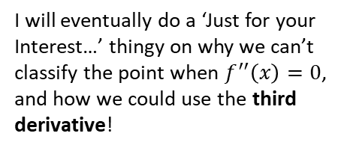
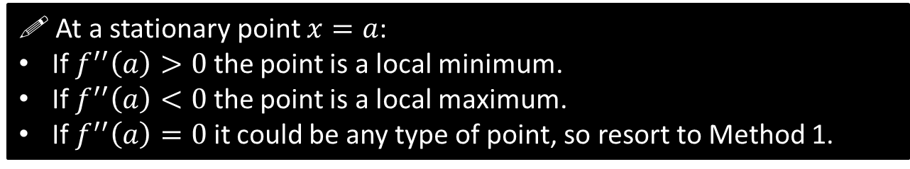
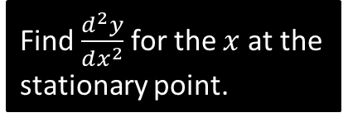
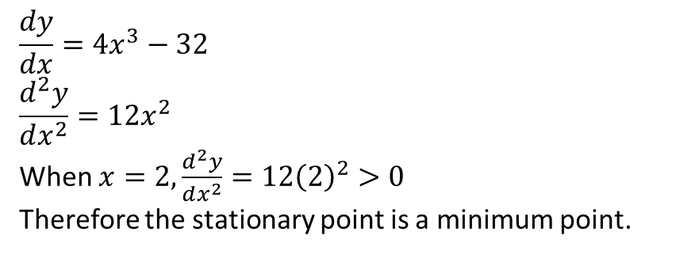
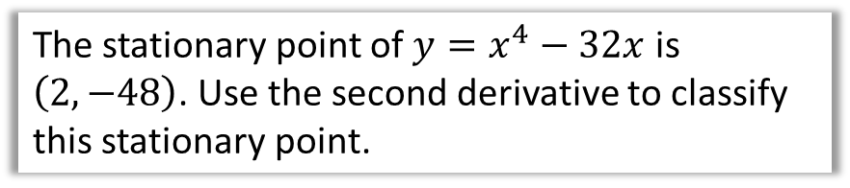
Method 2: Using the second derivative
! At a stationary point $x=a$:
If $f^{′′}\left(a\right)>0$ the point is a local minimum.
If $f^{′′}\left(a\right)<0$ the point is a local maximum.
If $f^{′′}\left(a\right)=0$ it could be any type of point, so resort to Method 1.
I will eventually do a ‘Just for your Interest…’ thingy on why we can’t classify the point when $f^{′′}\left(x\right)=0$, and how we could use the third derivative!
The stationary point of $y=x^{4}−32x$ is $\left(2,−48\right)$. Use the second derivative to classify this stationary point.
?
$$\frac{dy}{dx}=4x^{3}−32 \\ \frac{d^{2}y}{dx^{2}}=12x^{2}$$
When $x=2,\frac{d^{2}y}{dx^{2}}=12{\left(2\right)}^{2}>0$
Therefore the stationary point is a minimum point.
Find $\frac{d^{2}y}{dx^{2}}$ for the $x$ at the stationary point.

Slide 9
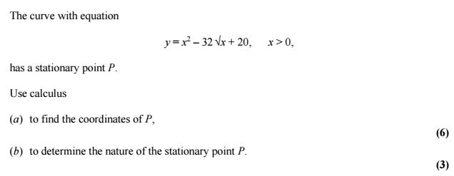
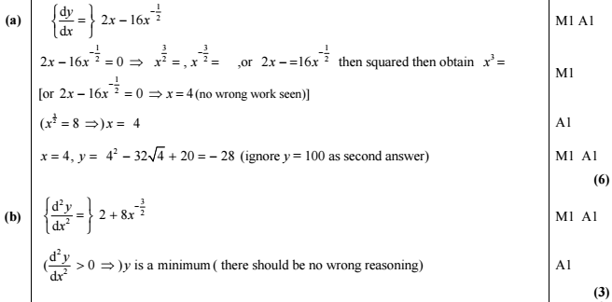
Test Your Understanding
Edexcel C2 May 2013 Q9
?
?

Slide 10
Exercise 12.9
Pearson Pure Mathematics Year 1/AS
Page 98

Slide 11
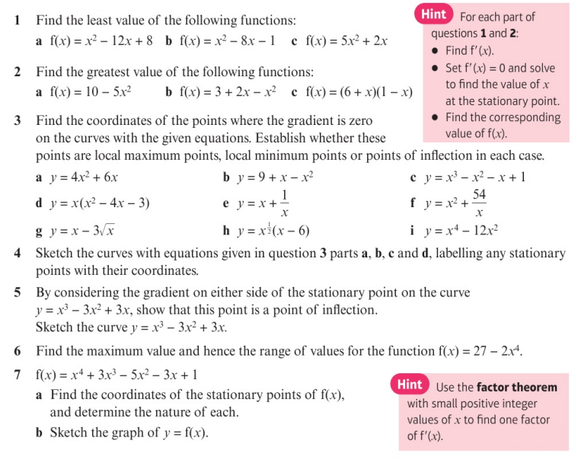
Homework Exercise

Slide 12
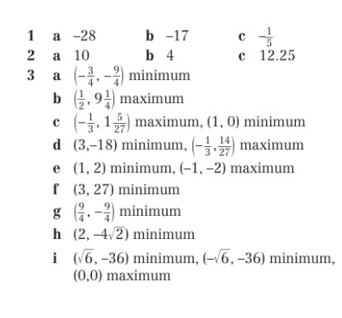
Homework Answers

Slide 13
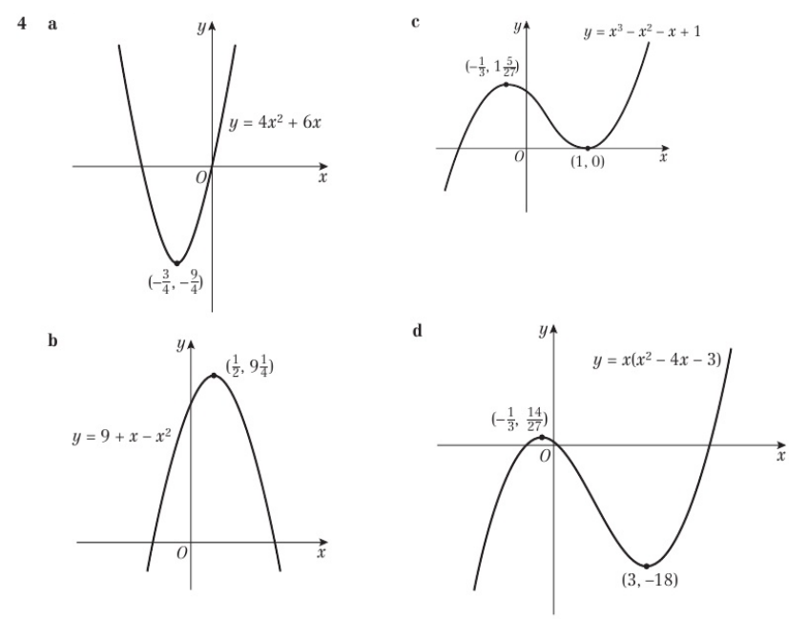
Homework Answers

Slide 14
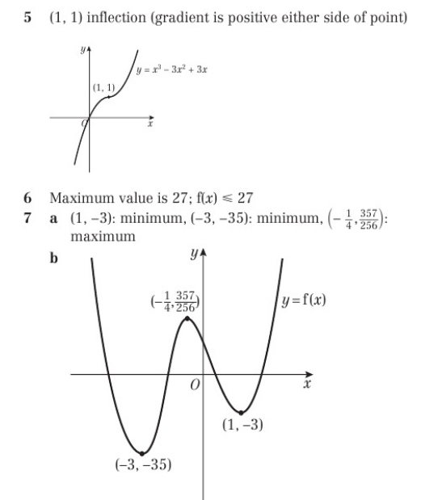
Homework Answers

