Slide 1
P1 Chapter 1: Algebra Index Laws

Slide 2



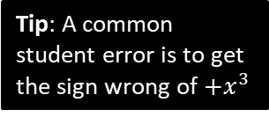
Index Laws
exponent or index (plural: indices)
base
!
$$a^{m}×a^{n}=a^{m+n} \\ a^{m}÷a^{n}=a^{m−n} \\ {\left(a^{m}\right)}^{n}=a^{mn} \\ {\left(ab\right)}^{n}=a^{n}b^{n}$$
$$3^{5}$$
power
Some also refer to the 5 as the ‘power’. But this would lead to unfortunate ambiguous phrases like “when we multiply two powers together, we add the powers” instead of “when we multiply two powers together, we add the indices”.
Simplify ${\left(a^{3}\right)}^{2}×2a^{2}$
Simplify ${\left(4x^{3}y\right)}^{3}$
?
?
$$=a^{6}×2a^{2}=2a^{8}$$
$$=64x^{9}y^{3}$$
Simplify $2x^{2}\left(3+5x\right)−x\left(4−x^{2}\right)$
Simplify $\frac{x^{3}−2x}{3x^{2}}$
?
$$=\frac{x^{3}}{{3x}^{2}}−\frac{2x}{3x^{2}} \\ =\frac{1}{3}x−\frac{2}{3x}$$
$$=6x^{2}+10x^{3}−4x+x^{3} \\ =11x^{3}+6x^{2}−4x$$
?
Tip: While $\frac{a+b}{c}$ can be split into $\frac{a}{c}+\frac{b}{c}$, a common student error is to think that $\frac{a}{b+c}=\frac{a}{b}+\frac{a}{c}$
Tip: A common student error is to get the sign wrong of $+x^{3}$

Slide 3
Test Your Understanding
1
Simplify ${\left(\frac{2a^{5}}{a^{2}}\right)}^{2}×3a$
2
Simplify $\frac{2x+x^{5}}{4x^{3}}$
?
?
$$={\left(2a^{3}\right)}^{2}×3a \\ =4a^{6}×3a \\ =12a^{7}$$
$$=\frac{1}{2}x^{−2}+\frac{1}{4}x^{2}$$
or $\frac{1}{2x^{2}}+\frac{x^{2}}{4}$
3
Expand and simplify
$$2x\left(3−x^{2}\right)−4x^{3}\left(3−x\right)$$
4
Simplify $2^{x}×3^{x}$
?
$$=6^{x}$$
Fro Note: This is using ${\left(ab\right)}^{n}=a^{n}b^{n}$ law backwards.
?
$$=6x−2x^{3}−12x^{3}+4x^{4} \\ =4x^{4}−14x^{3}+6x$$

Slide 4
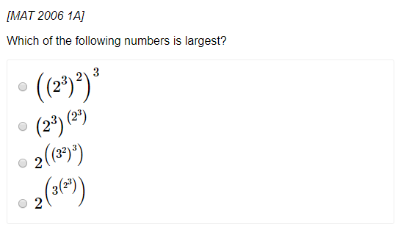
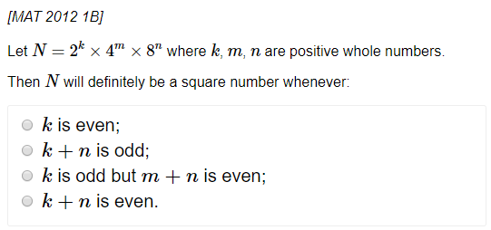
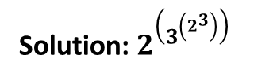
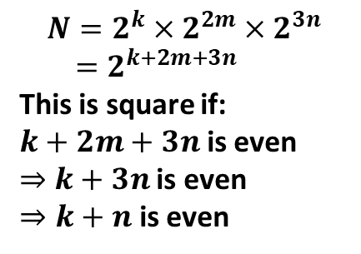
Exercise 1.1
Pearson Pure Mathematics Year 1/AS
Pages 1
1
2
?
$$N=2^{k}×2^{2m}×2^{3n} \\ =2^{k+2m+3n}$$
This is square if:
$k+2m+3n$ is even
$⇒$ $k+3n$ is even
$⇒k+n$ is even
?
Solution: $2^{\left(3^{\left(2^{3}\right)}\right)}$

Slide 5
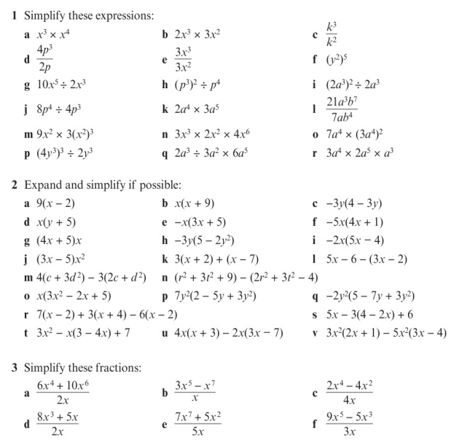
Homework Exercise

Slide 6
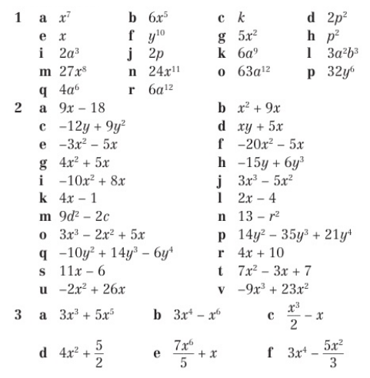
Homework Answers

