Slide 1
Stats Yr2 Chapter 2: Probability Theory Probability Trees

Slide 2
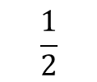
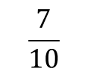


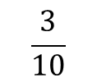


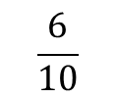

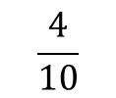

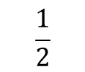

Probability Trees
We saw probability trees in Year 1. The only difference here is determining a conditional probability using your tree.
Example: You have two bags, the first with 5 red balls and 5 blue balls, and the second with 3 red balls and 6 blue balls. You first pick a ball from the first bag, and place it in the second. You then pick a ball from the second bag. Complete the tree diagram.
Hence find the probability that:
You pick a red ball on your second pick. $P\left(R_{2}\right)=P\left(R_{1}∩R_{2}\right)+P\left(B_{1}{∩R}_{2}\right)=\frac{1}{5}+\frac{3}{20}=\frac{7}{20}$
Given that your second pick was red, the first pick was also red. $P\left(R_{1} | R_{2}\right)=\frac{P\left(R_{1}∩R_{2}\right)}{P\left(R_{2}\right)}$ $=\frac{\frac{1}{5}}{\frac{7}{20}}=\frac{4}{7}$
$$\frac{4}{10}$$
?
$$R_{2}$$
?
?
$$\frac{1}{2}$$
$$R_{1}$$
$$\frac{6}{10}$$
?
$$B_{2}$$
?
$$\frac{3}{10}$$
$$R_{2}$$
$$\frac{1}{2}$$
?
$$B_{1}$$
?
$$\frac{7}{10}$$
?
$$B_{2}$$
It’s vitally important that you use good notation, making use of the | symbol.
Tip: Use variable subscripting to indicate what pick you’re referring to.

Slide 3
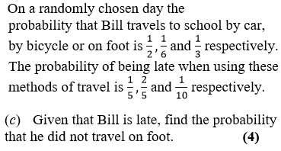
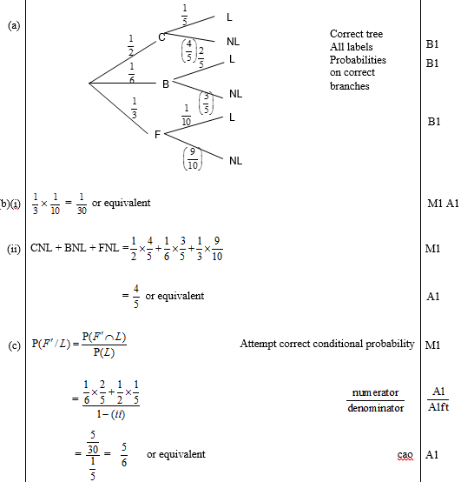
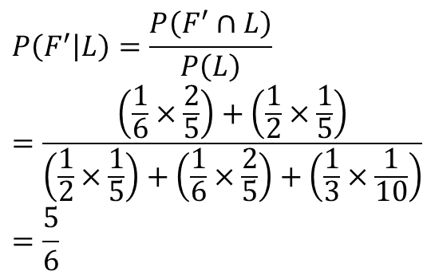
Further Example
Edexcel S1 May 2009 Q2
(Part (a) asks for a tree diagram, which may help with this question)
?
$$P\left(F^{′} | L\right)=\frac{P\left(F^{′}∩L\right)}{P\left(L\right)} \\ =\frac{\left(\frac{1}{6}×\frac{2}{5}\right)+\left(\frac{1}{2}×\frac{1}{5}\right)}{\left(\frac{1}{2}×\frac{1}{5}\right)+\left(\frac{1}{6}×\frac{2}{5}\right)+\left(\frac{1}{3}×\frac{1}{10}\right)} \\ =\frac{5}{6}$$

Slide 4
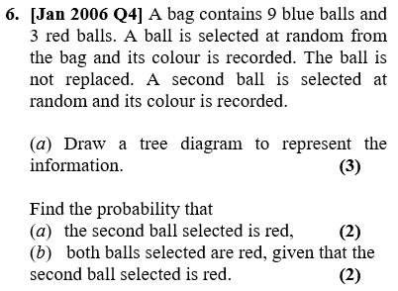
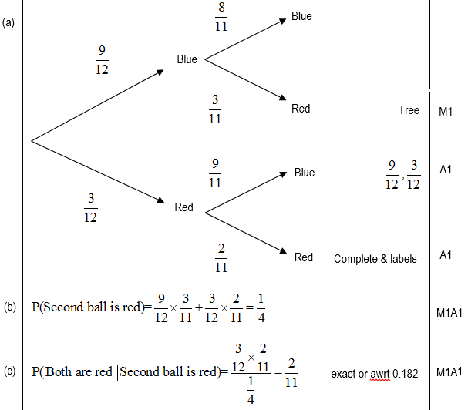
Testing Your Understanding
Edexcel S1
?
?
?

Slide 5
Exercise 2E
Pearson Stats/Mechanics Year 2
Pages 17-18

Slide 6
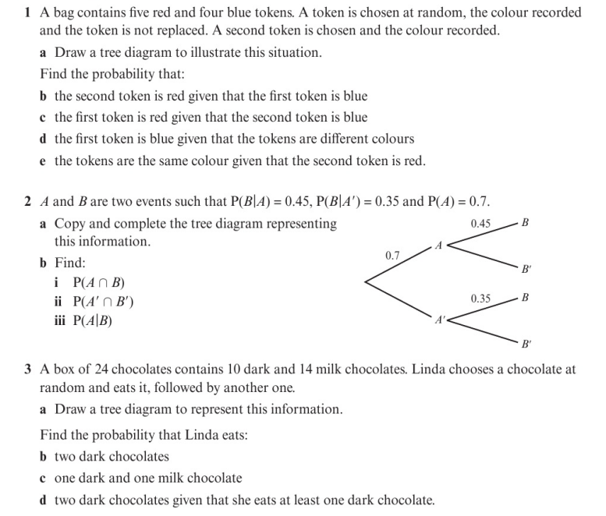
Homework Exercise

Slide 7
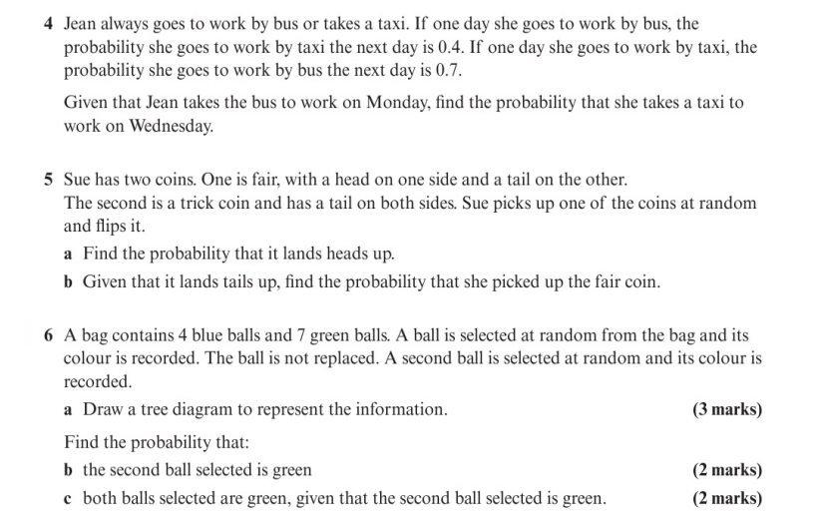
Homework Exercise

Slide 8
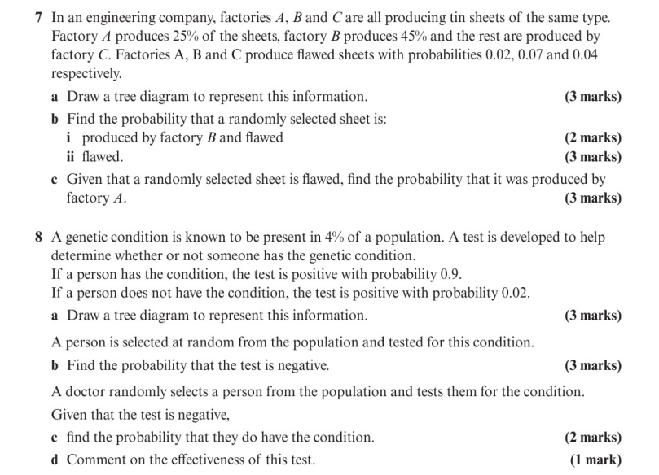
Homework Exercise

Slide 9
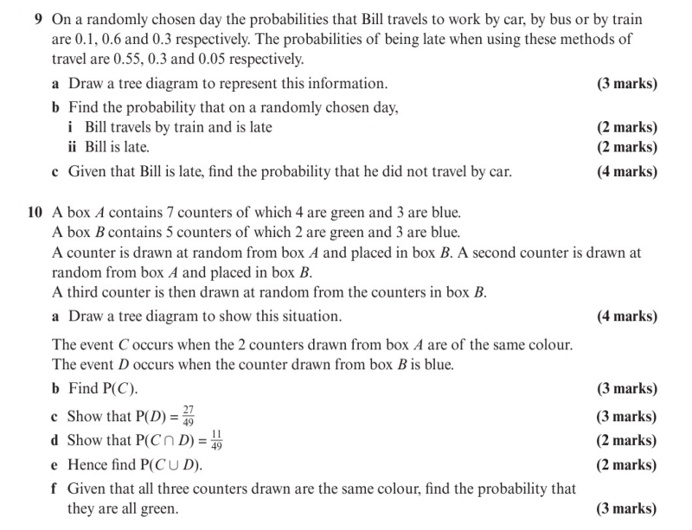
Homework Exercise

Slide 10
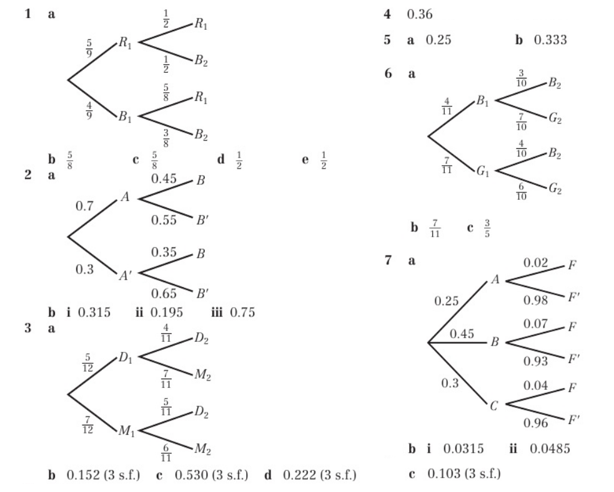
Homework Answers

Slide 11
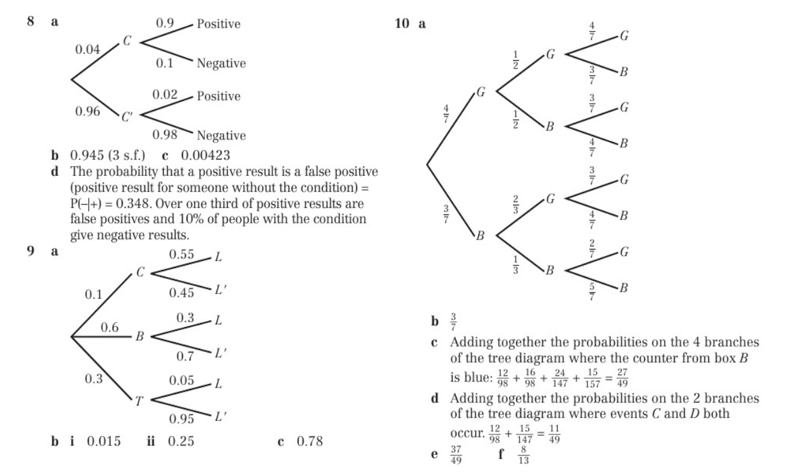
Homework Answers

