Slide 1
P2 Chapter 9: Differentiation Parametric Differentiation

Slide 2

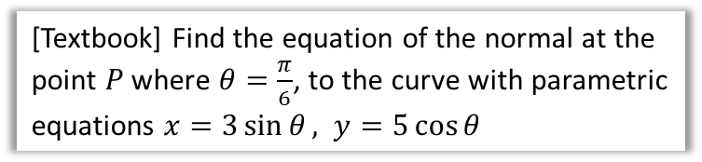
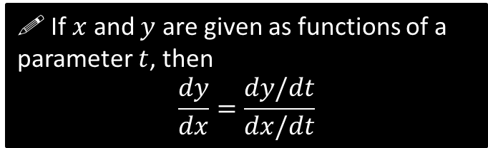

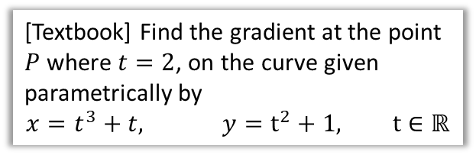
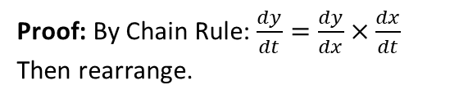
Parametric Differentiation
Recall from the previous chapter that parametric equations are when we define each of $x$ and $y$ (and possibly $z$) in terms of some separate parameter, e.g. $t$.
! If $x$ and $y$ are given as functions of a parameter $t$, then
$$\frac{dy}{dx}=\frac{dy/dt}{dx/dt}$$
Proof: By Chain Rule: $\frac{dy}{dt}=\frac{dy}{dx}×\frac{dx}{dt}$
Then rearrange.
[Textbook] Find the gradient at the point $P$ where $t=2$, on the curve given parametrically by
$$x=t^{3}+t, y=t^{2}+1, t∈ℝ$$
[Textbook] Find the equation of the normal at the point $P$ where $θ=\frac{π}{6}$, to the curve with parametric equations $x=3\sin{θ}, y=5\cos{θ}$
?
$$\frac{dx}{dθ}=3\cos{θ}, \frac{dy}{dθ}=−5\sin{θ} 0≤θ<2π$$
$$∴ \frac{dy}{dx}=−\frac{5\sin{θ}}{3\cos{θ}}=−\frac{5}{3}\tan{θ}$$
When $θ=\frac{π}{6}$,
$\frac{dy}{dx}=−\frac{5}{3\sqrt{3}}$ , $y=5\cos{\frac{π}{6}}=\frac{5\sqrt{3}}{2}$, $x=\frac{3}{2}$
$∴$ Equation of normal:
$$y−\frac{5\sqrt{3}}{2}=\frac{3\sqrt{3}}{5}\left(x−\frac{3}{2}\right)$$
?
$$\frac{dy}{dt}=2t \frac{dx}{dt}=3t^{2}+1 \\ ∴\frac{dy}{dx}=\frac{2t}{3t^{2}+1}$$
When $t=2,\frac{dy}{dx}=\frac{4}{13}$

Slide 3
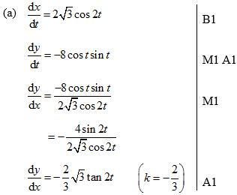
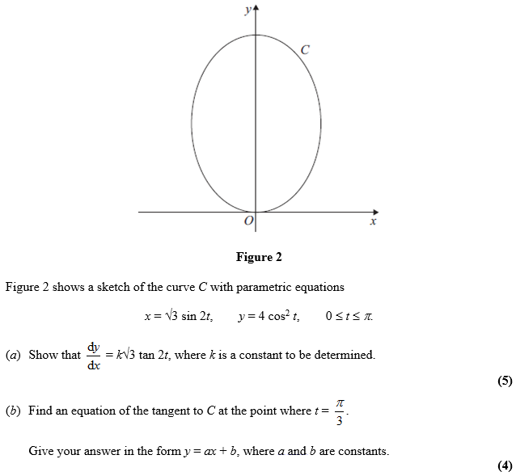
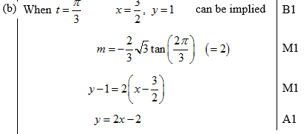
Test Your Understanding
C4 June 2012 Q6
?
?

Slide 4
Exercise 9.7
Pearson Pure Year 2
Page 75

Slide 5
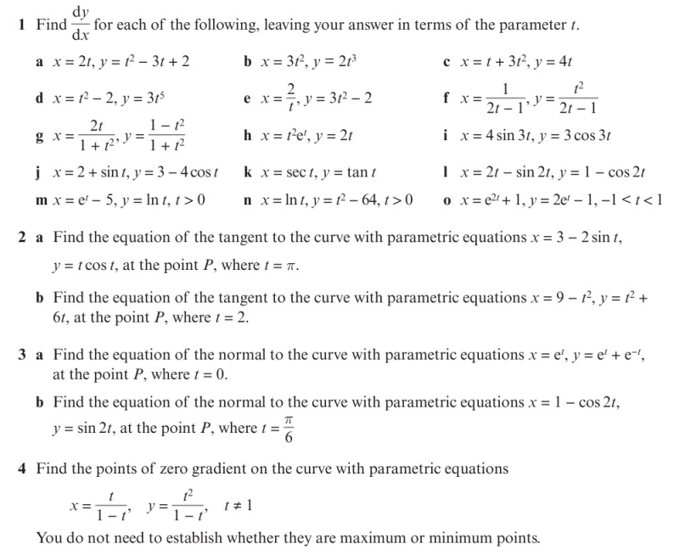
Homework Exercise

Slide 6
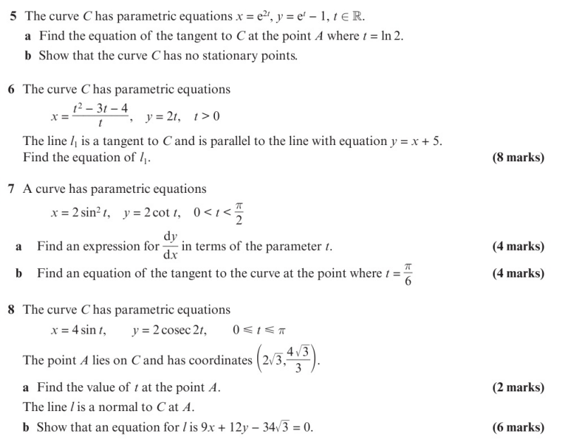
Homework Exercise

Slide 7
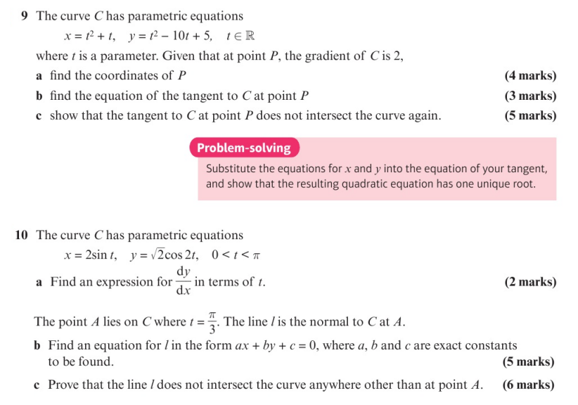
Homework Exercise

Slide 8
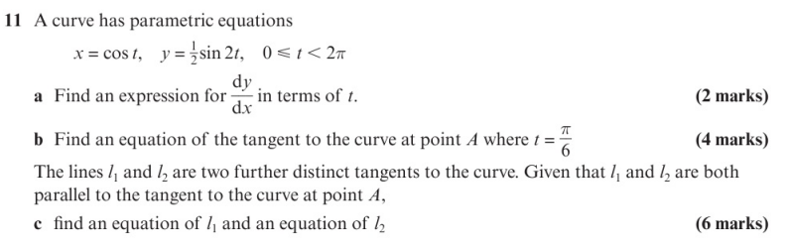
Homework Exercise

Slide 9
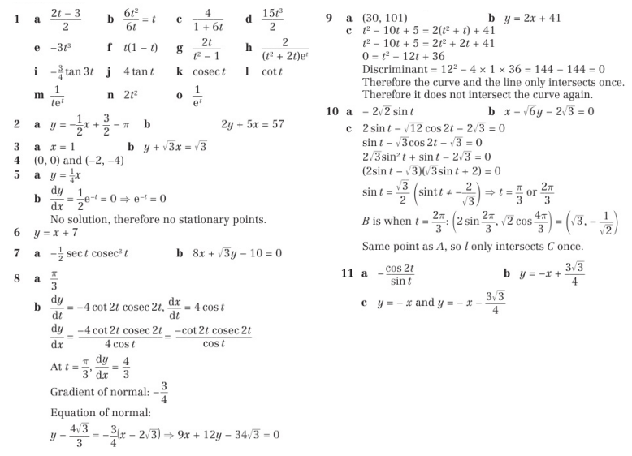
Homework Answers

