Slide 1
Stats1 Chapter 1: Data Collection 1.1 Populations and Samples

Slide 2
The chapters of Stats Year 1 could be broadly organised as follows:
Experimental
i.e. Dealing with collected data.
Chp2: Measures of Location/Spread
Chp3: Representation of Data
Chp1: Data Collection
Statistics used to summarise data, including mean, standard deviation, quartiles, percentiles. Use of linear interpolation for estimating medians/quartiles.
Producing and interpreting visual representations of data, including box plots and histograms.
Methods of sampling, types of data, and populations vs samples.
Chp4: Correlation
Measuring how related two variables are, and using linear regression to predict values.
Theoretical
Deal with probabilities and modelling to make inferences about what we ‘expect’ to see or make predictions, often using this to reason about/contrast with experimentally collected data.
Chp5: Probability
Chp6: Statistical Distributions
Chp7: Hypothesis Testing
Venn Diagrams, mutually exclusive + independent events, tree diagrams.
Common distributions used to easily find probabilities under certain modelling conditions, e.g. binomial distribution.
Determining how likely observed data would have happened ‘by chance’, and making subsequent deductions.

Slide 3

This Chapter Overview
There is little ‘calculation’ involved in this chapter; consider this a ‘bookwork’ one!
1a: Types of data
1b: Populations vs samples
Continuous vs discrete, terms such as class intervals, class boundaries, class width.
“Suggest why we would not test all the light bulbs.”
“Identify the sampling frame.”
2:: Random Sampling
3:: Non-Random Sampling
Describe the disadvantages of systematic sampling.
Describe how a stratified sample would be conducted, including strata sizes.
5:: Edexcel’s ‘Large Data Set’
What you’re expected to know about the ‘large data set’ of weather data, and how to use it.

Slide 4

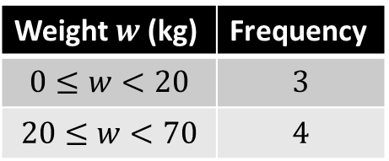
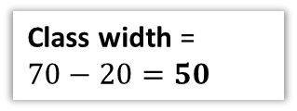
Types of Data
Qualitative/Categorical
Quantitative
Non-numerical values, e.g. colour.
Numerical values.
Note that while discrete variables only allow specific values, the range could still be infinite, e.g. “number of attempts before success”.
Discrete
Continuous
Can only take specific values, e.g. shoe size, number of children.
Can take any decimal value (possible with a specified range).
Data can be grouped for conciseness, at the expense of losing the exact original values.
Weight $w$ (kg) | Frequency
$$0≤w<20$$ | $$3$$
$$20≤w<70$$ | $$4$$
This is known as a
class interval.
$$20≤w<70$$
?
Lower class boundary
Upper class boundary
?
Midpoint = 45
?
Class width =
$70−20=50$
?
?

Slide 5
Populations and samples
Population
Sample
!
A population is: the whole set of items that are of interest.
A sample is: some subset of the population intended to represent the population.
?
?
You’re probably used to a ‘population’ meaning all humans/animals within a country/ecosystem. But a population could be “all the lightbulbs in a factory” or “all the cars in the UK”.

Slide 6
Sampling key terms
Population
Sample
! Each individual thing in the population that can be sampled is known as a sampling unit.
! Often sampling units of a population are individually named or numbered to form a list called the sampling frame.

Slide 7
Populations vs Samples
We could collect data either from a sample, or from the entire population.
Data collected from the entire population is known as a census.
?
 | Advantages | Disadvantages
Census | Should give completely accurate result. | Time consuming and expensive. Can not be used when testing involves destruction. Large volume of data to process.
Sample | Cheaper. Quicker. Less data to process. | Data may not be accurate. Data may not be large enough to represent small sub-groups.
?
?
?
?
Example: A supermarket wants to test a delivery of avocados for ripeness by cutting them in half.
Suggest a reason why the supermarket should not test all the avocados in the delivery.
The supermarket tests a sample of 5 avocados and finds that 4 of them are ripe. They estimate that 80% of the avocados in the deliver are ripe. Suggest one way that the supermarket could improve their estimate.
?
a
Testing the avocados destroys them (and thus can’t be sold).
Use a larger sample size (as this would be better estimate of the proportion of ripe avocados).
b
?

Slide 8
Exercise 1.1
Pearson Statistics & Mechanics Year 1/AS
Page 1-2

Slide 9
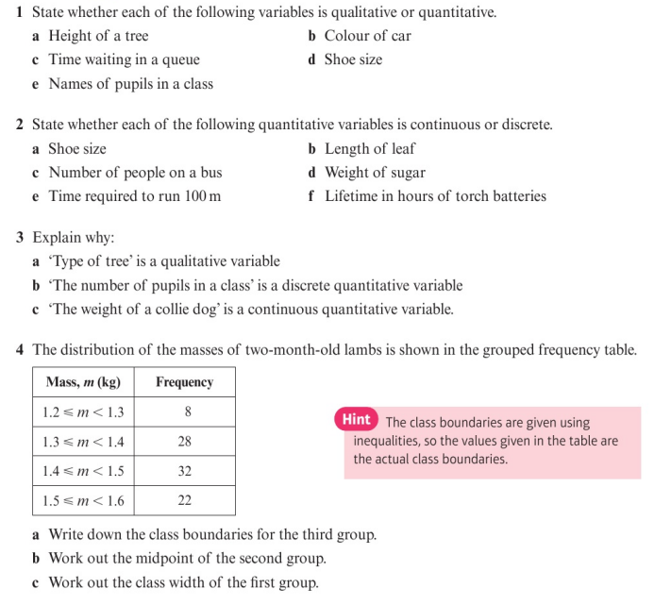
Homework Exercise

Slide 10
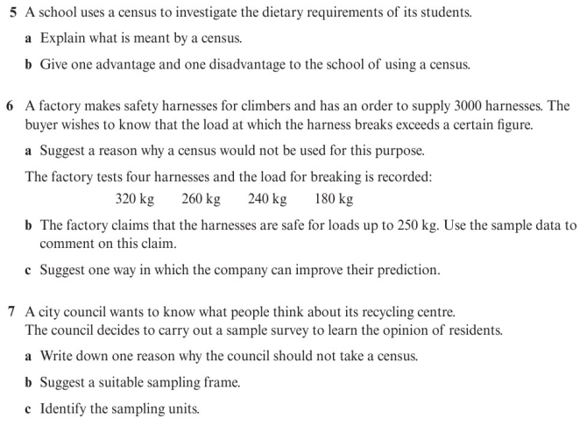
Homework Exercise

Slide 11
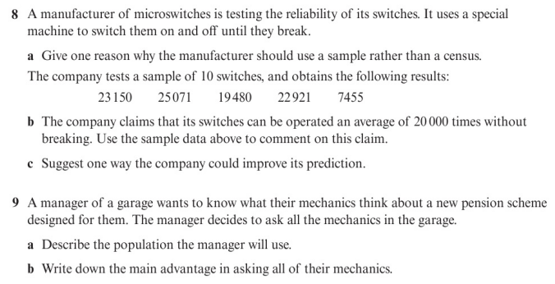
Homework Exercise

Slide 12
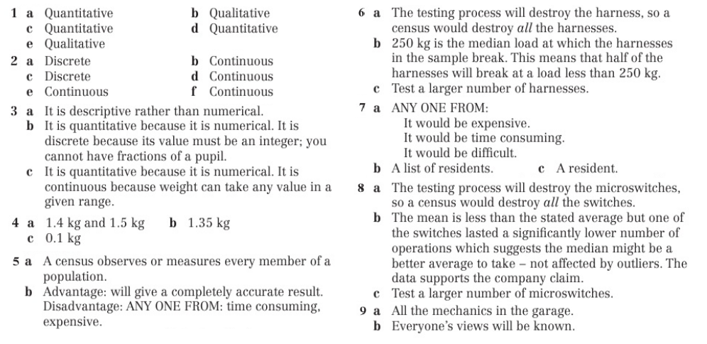
Homework Answers

