Slide 1
P1 Chapter 12: Differentiation
Limiting Chords

Slide 2




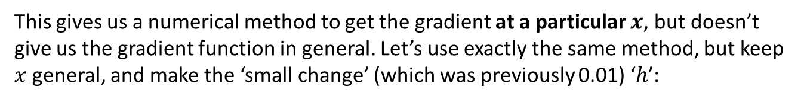
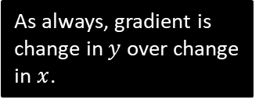
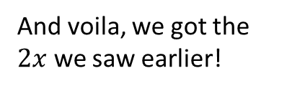

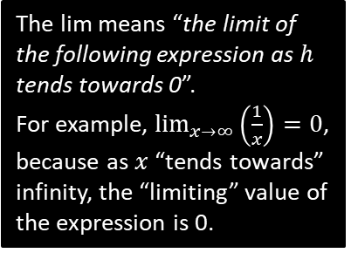


Finding the Gradient Function
This gives us a numerical method to get the gradient at a particular $x$, but doesn’t give us the gradient function in general. Let’s use exactly the same method, but keep $x$ general, and make the ‘small change’ (which was previously 0.01) ‘$h$’:
$$y=x^{2}$$
?
?
As always, gradient is change in $y$ over change in $x$.
$$\left(x+h,{\left(x+h\right)}^{2}\right)$$
$$gradient=\lim_{h→0}{\frac{{\left(x+h\right)}^{2}−x^{2}}{h}} \\ =\lim_{h→0}{\frac{2xh+h^{2}}{h}} \\ =\lim_{h→0}\left(2x+h\right) \\ =2x$$
?
$$?$$
$$\left(x,x^{2}\right)$$
?
$$?$$
?
The lim means “the limit of the following expression as $h$ tends towards 0”.
For example, $\lim_{x→∞}\left(\frac{1}{x}\right)=0$, because as $x$ “tends towards” infinity, the “limiting” value of the expression is 0.
?
The $h$ disappears as $h$ tends towards 0, i.e. we can effectively treat it as 0 at this point.
And voila, we got the $2x$ we saw earlier!

Slide 3
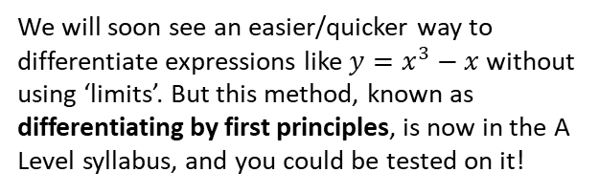

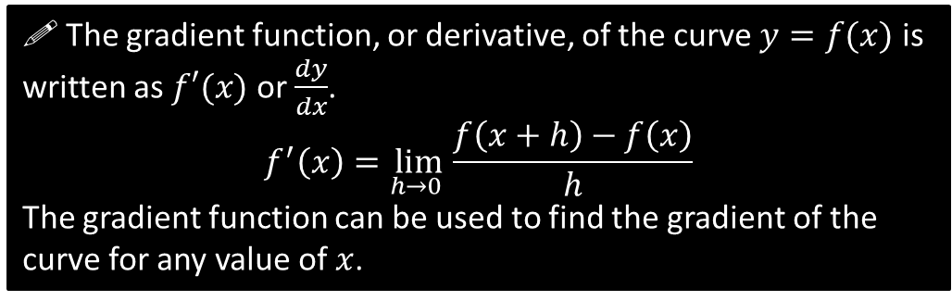
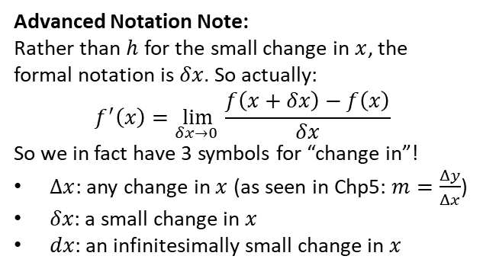
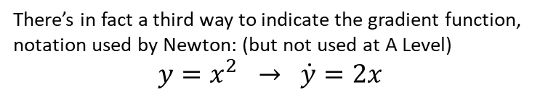
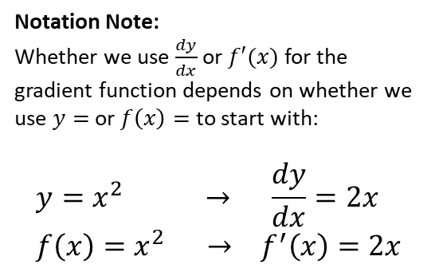
Finding the Gradient Function
! The gradient function, or derivative, of the curve $y=f(x)$ is written as $f′(x)$ or $\frac{dy}{dx}$.
$$f^{′}\left(x\right)=\lim_{h→0 }{\frac{f\left(x+h\right)−f\left(x\right)}{h}}$$
The gradient function can be used to find the gradient of the curve for any value of $x$.
Notation Note:
Whether we use $\frac{dy}{dx}$ or $f′(x)$ for the gradient function depends on whether we use $y=$ or $f\left(x\right)=$ to start with:
$$y=x^{2} → \frac{dy}{dx}=2x \\ f\left(x\right)=x^{2} → f^{′}\left(x\right)=2x$$
We will soon see an easier/quicker way to differentiate expressions like $y=x^{3}−x$ without using ‘limits’. But this method, known as differentiating by first principles, is now in the A Level syllabus, and you could be tested on it!
“Leibniz’s notation”
“Lagrange’s notation”
Advanced Notation Note:
Rather than $h$ for the small change in $x$, the formal notation is $δx$. So actually:
$$f^{′}\left(x\right)=\lim_{δx→0 }{\frac{f\left(x+δx\right)−f\left(x\right)}{δx}}$$
So we in fact have 3 symbols for “change in”!
$Δx$: any change in $x$ (as seen in Chp5: $m=\frac{Δy}{Δx}$)
$δx$: a small change in $x$
$dx$: an infinitesimally small change in $x$
There’s in fact a third way to indicate the gradient function, notation used by Newton: (but not used at A Level)
$$y=x^{2} → \dot{y}=2x$$
So the estimated gradient using some point close by was $\frac{δy}{δx}$, but in the ‘limit’ as $δx→0$, $\frac{δy}{δx}→\frac{dy}{dx}$

Slide 4

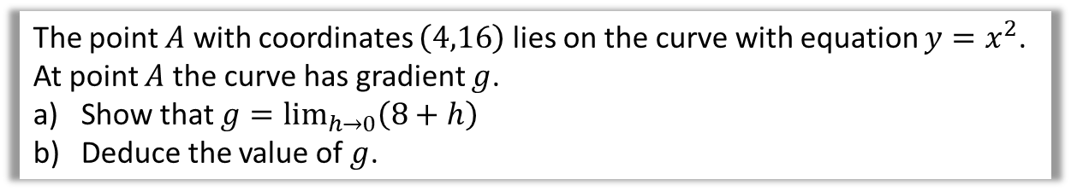

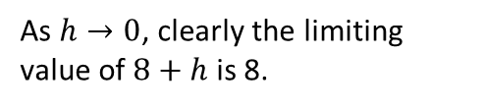
Example
!
The point $A$ with coordinates $\left(4,16\right)$ lies on the curve with equation $y=x^{2}$.
At point $A$ the curve has gradient $g$.
Show that $g=\lim_{h→0}\left(8+h\right)$
Deduce the value of $g$.
a
?
$$g=\lim_{h→0}{\frac{f\left(4+h\right)−f\left(4\right)}{h}} \\ =\lim_{h→0}{\frac{{\left(4+h\right)}^{2}−4^{2}}{h}} \\ =\lim_{h→0}{\frac{16+8h+h^{2}−16}{h}} \\ =\lim_{h→0}{\frac{8h+h^{2}}{h}} \\ =\lim_{h→0}\left(8+h\right)$$
$$g=8$$
Use the “differentiation by first principles” formula.
Function is $f\left(x\right)=x^{2}$
As $h→0$, clearly the limiting value of $8+h$ is 8.
b
?

Slide 5


Test Your Understanding
Prove from first principles that the derivative of $x^{4}$ is $4x^{3}$.
?
Helping Hand:
“Row 4” of Pascal’s Triangle is:
1 4 6 4 1
You’re welcome.
$$f^{′}\left(x\right)=\lim_{h→0}{\frac{f\left(x+h\right)−f\left(x\right)}{h}} \\ =\lim_{h→0}{\frac{{\left(x+h\right)}^{4}−x^{4}}{h}} \\ =\lim_{h→0}{\frac{x^{4}+4x^{3}h+6x^{2}h^{2}+4xh^{3}+h^{4}−x^{4}}{h}} \\ =\lim_{h→0}{\frac{4x^{3}h+6x^{2}h^{2}+4xh^{3}+h^{4}}{h}} \\ =\lim_{h→0}{4x^{3}+6x^{2}h+4xh^{2}+h^{3}} \\ =4x^{3}$$
As $h→0$, any term involving a multiplication by $h$ will become 0.

Slide 6
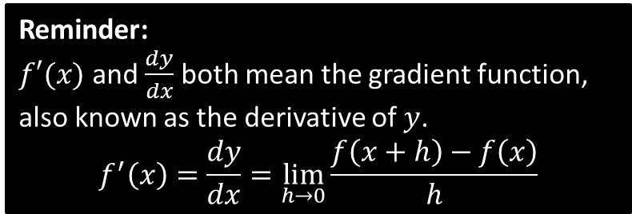
Exercise 12.2
Pearson Pure Mathematics Year 1/AS
Page 93
Reminder:
$f′(x)$ and $\frac{dy}{dx}$ both mean the gradient function, also known as the derivative of $y$.
$$f^{′}\left(x\right)=\frac{dy}{dx}=\lim_{h→0}{\frac{f\left(x+h\right)−f\left(x\right)}{h}}$$

Slide 7

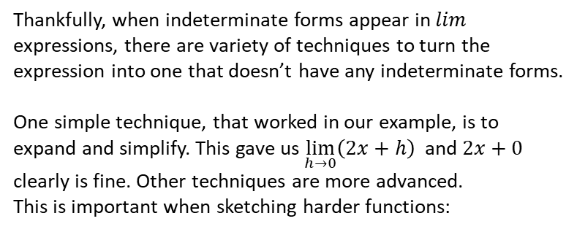
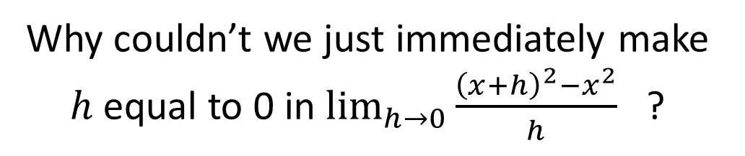
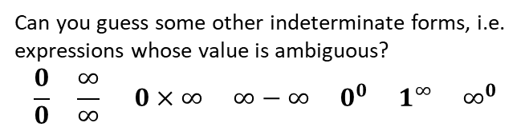
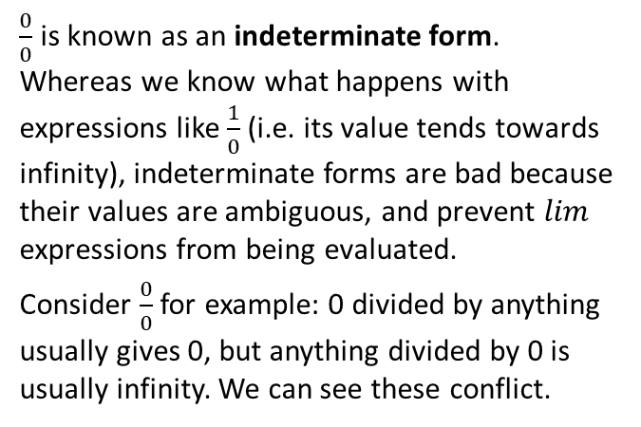
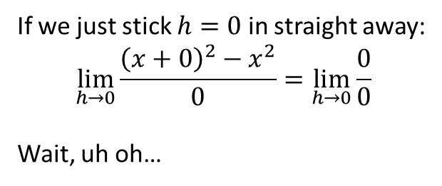
Just for your interest…
Why couldn’t we just immediately make $h$ equal to 0 in $\lim_{h→0}{\frac{{\left(x+h\right)}^{2}−x^{2}}{h}}$ ?
Not another one of these…
$\frac{0}{0}$ is known as an indeterminate form. Whereas we know what happens with expressions like $\frac{1}{0}$ (i.e. its value tends towards infinity), indeterminate forms are bad because their values are ambiguous, and prevent $lim$ expressions from being evaluated.
Consider $\frac{0}{0}$ for example: 0 divided by anything usually gives 0, but anything divided by 0 is usually infinity. We can see these conflict.
If we just stick $h=0$ in straight away:
$$\lim_{h→0}{\frac{{\left(x+0\right)}^{2}−x^{2}}{0}}=\lim_{h→0}{\frac{0}{0}}$$
Wait, uh oh…
Thankfully, when indeterminate forms appear in $lim$ expressions, there are variety of techniques to turn the expression into one that doesn’t have any indeterminate forms.
One simple technique, that worked in our example, is to expand and simplify. This gave us $\lim_{h→0}\left(2x+h\right)$ and $2x+0$ clearly is fine. Other techniques are more advanced.
This is important when sketching harder functions:
Can you guess some other indeterminate forms, i.e. expressions whose value is ambiguous?
$$\frac{0}{0} \frac{∞}{∞} 0×∞ ∞−∞ 0^{0} 1^{∞} ∞^{0}$$
?

Slide 8
Exercise 12.2
Pearson Pure Mathematics Year 1/AS
Page 1

Slide 9
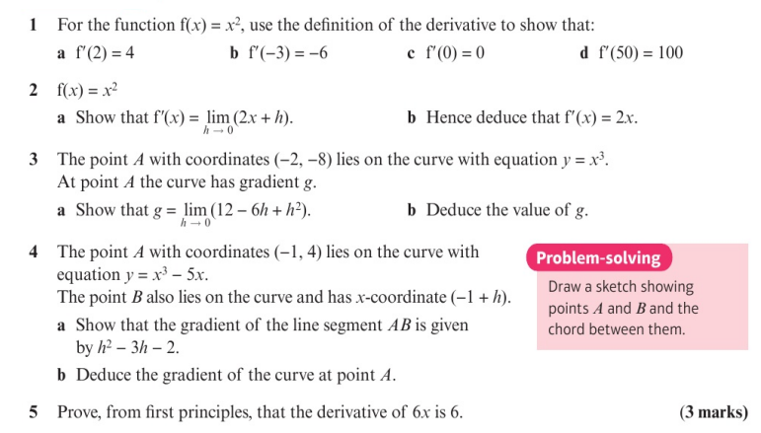
Homework Exercise

Slide 10
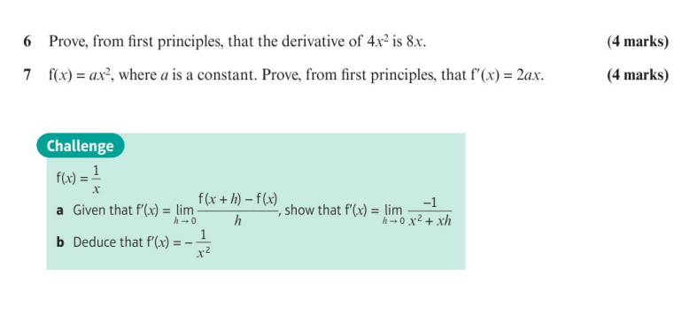
Homework Exercise

Slide 11
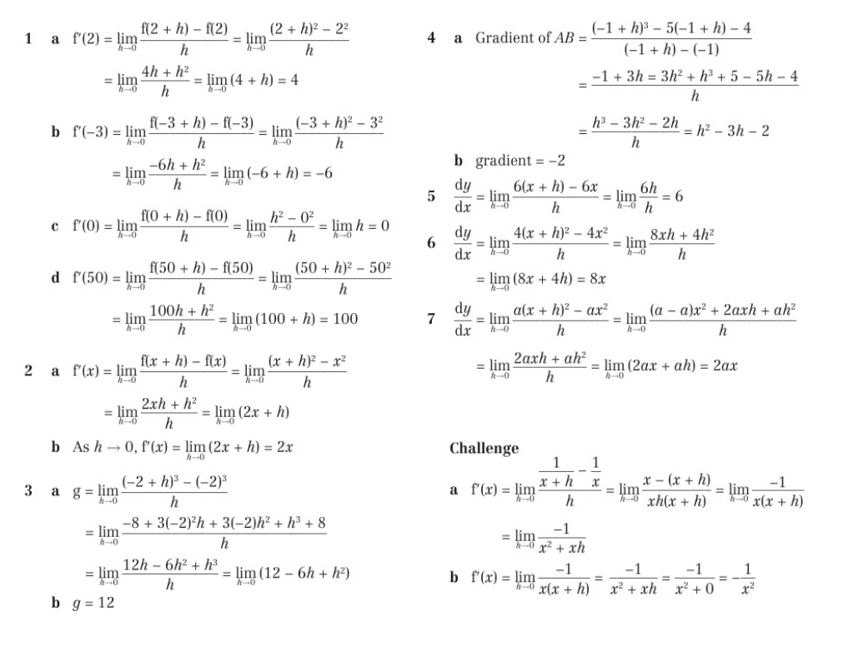
Homework Answers

