Slide 1
P1 Chapter 13: Integration
Bounded Areas

Slide 2





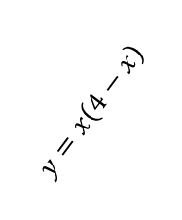
Areas between curves and lines
$$y$$
$$y=x$$
How could we find the area between the line and the curve?
$$?$$
?
Start with the area under $y=x\left(4−x\right)$ up to the point of intersection, then subtract the area of the triangle to ‘cut it out’.
$$y=x\left(4−x\right)$$
Click for
animation >
Determine the area between the lines with equations $y=x\left(4−x\right)$ and $y=x$
?
Find point of intersection:
$$x\left(4−x\right)=x \\ ∴x=0 or x=3$$
Area under curve:
$$\int_{0}^{3}{x\left(4−x\right) dx}={\left[2x^{2}−\frac{1}{3}x^{3}\right]}_{0}^{3}=9$$
Area of triangle $=\frac{1}{2}×3×3=\frac{9}{2}$
$∴$ Shaded area $=9−\frac{9}{2}=\frac{9}{2}$

Slide 3
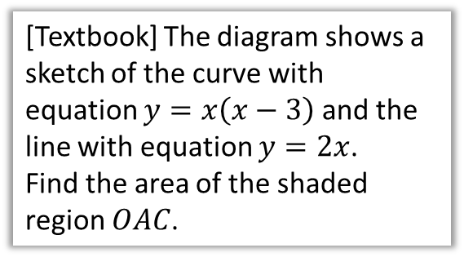

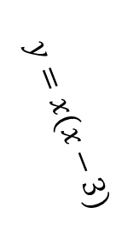





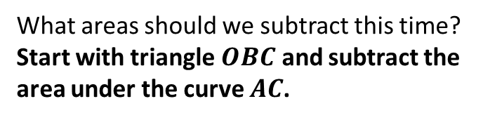
A Harder One
[Textbook] The diagram shows a sketch of the curve with equation $y=x\left(x−3\right)$ and the line with equation $y=2x$.
Find the area of the shaded region $OAC$.
$$y=x(x−3)$$
$$C$$
$$y=2x$$
What areas should we subtract this time?
Start with triangle $OBC$ and subtract the area under the curve $AC$.
$$O$$
$$A$$
$$B$$
?
First find points of intersection:
$$x\left(x−3\right)=2x → x=0 or x=5$$
When $x=5, y=10 → C\left(5,10\right)$
Also need to find the point $A$:
$$x\left(x−3\right)=0 → A(3,0)$$
$∴$ Area of triangle $OBC=\frac{1}{2}×5×10=25$
Area under $AC$: $\int_{3}^{5}{x\left(x−3\right)dx}= …=\frac{26}{3}$
$∴$ Shaded area $=25−\frac{26}{3}=\frac{49}{3}$
?

Slide 4
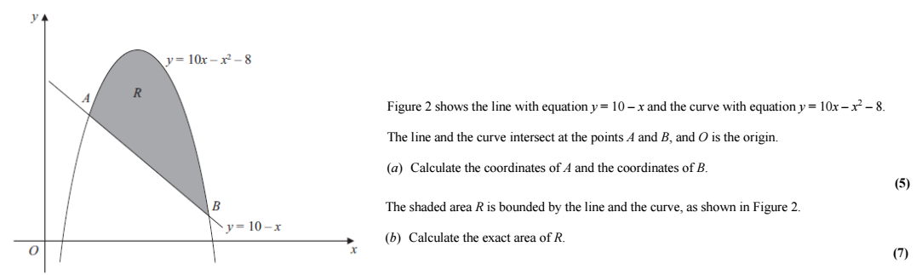

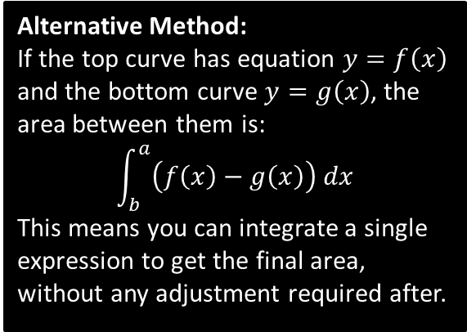

Test Your Understanding
Edexcel C2 May 2012 Q5
Alternative Method:
If the top curve has equation $y=f\left(x\right)$ and the bottom curve $y=g\left(x\right)$, the area between them is:
$$\int_{b}^{a}{\left(f\left(x\right)−g\left(x\right)\right) dx}$$
This means you can integrate a single expression to get the final area, without any adjustment required after.
a
? a
$$A\left(2,8\right), B\left(9,1\right)$$
b
? b
$57\frac{1}{6}$ or $\frac{343}{6}$

Slide 5

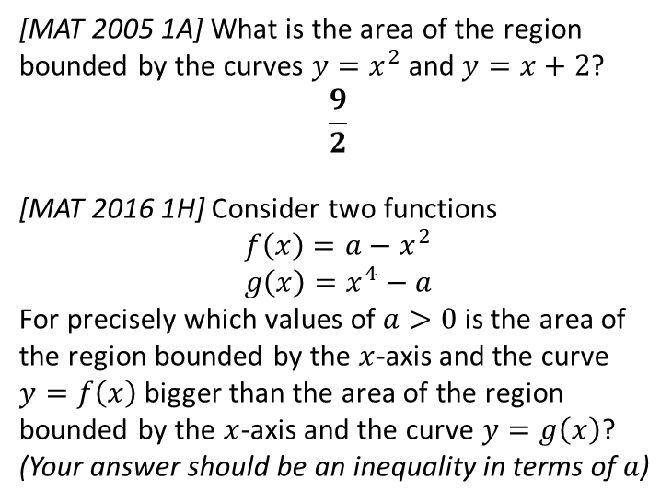
Exercise 13G
Pearson Pure Mathematics Year 1/AS
Pages 304-306
Extension
[MAT 2005 1A] What is the area of the region bounded by the curves $y=x^{2}$ and $y=x+2$?
$$\frac{9}{2}$$
[MAT 2016 1H] Consider two functions
$$f\left(x\right)=a−x^{2} \\ g\left(x\right)=x^{4}−a$$
For precisely which values of $a>0$ is the area of the region bounded by the $x$-axis and the curve $y=f\left(x\right)$ bigger than the area of the region bounded by the $x$-axis and the curve $y=g\left(x\right)$?
(Your answer should be an inequality in terms of $a$)
? 2
1
(Official solution)
The area bounded by the $x$-axis and the curve $y=f\left(x\right)$, $A_{1}$ is equal to
$$A_{1}=\int_{\sqrt{a}}^{\sqrt{a}}{f(x)} dx=\frac{4}{3}a^{\frac{3}{2}}$$
whilst the area bounded by the $x$-axis and the curve $y=g\left(x\right)$, $A_{2}$ is equal to
$$A_{2}=\left|\int_{−\sqrt[4]{a}}^{\sqrt[4]{a}}{g\left(x\right)dx} \right|=\frac{8}{5}a^{\frac{5}{4}}$$
We require an $a$ such that $A_{1}>A_{2}$ so
$$\frac{4}{3}a^{\frac{3}{2}}>\frac{8}{5}a^{\frac{5}{4}} \\ 20a^{\frac{6}{4}}>24a^{\frac{5}{4}} \\ a^{\frac{1}{4}}>\frac{6}{5}$$
and so the answer is (e).
? 1
2

Slide 6

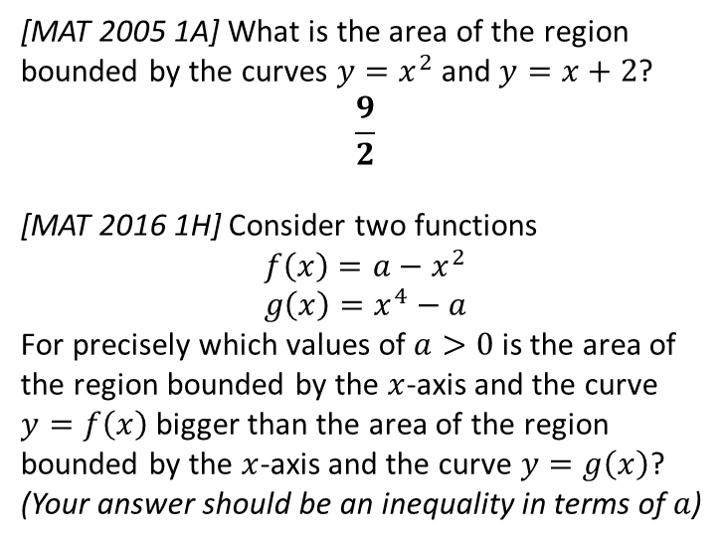
Exercise 13.7
Pearson Pure Mathematics Year 1/AS
Page 110
Extension
? 2
(Official solution)
The area bounded by the $x$-axis and the curve $y=f\left(x\right)$, $A_{1}$ is equal to
$$A_{1}=\int_{\sqrt{a}}^{\sqrt{a}}{f(x)} dx=\frac{4}{3}a^{\frac{3}{2}}$$
whilst the area bounded by the $x$-axis and the curve $y=g\left(x\right)$, $A_{2}$ is equal to
$$A_{2}=\left|\int_{−\sqrt[4]{a}}^{\sqrt[4]{a}}{g\left(x\right)dx} \right|=\frac{8}{5}a^{\frac{5}{4}}$$
We require an $a$ such that $A_{1}>A_{2}$ so
$$\frac{4}{3}a^{\frac{3}{2}}>\frac{8}{5}a^{\frac{5}{4}} \\ 20a^{\frac{6}{4}}>24a^{\frac{5}{4}} \\ a^{\frac{1}{4}}>\frac{6}{5}$$
and so the answer is (e).
1
[MAT 2005 1A] What is the area of the region bounded by the curves $y=x^{2}$ and $y=x+2$?
$$\frac{9}{2}$$
[MAT 2016 1H] Consider two functions
$$f\left(x\right)=a−x^{2} \\ g\left(x\right)=x^{4}−a$$
For precisely which values of $a>0$ is the area of the region bounded by the $x$-axis and the curve $y=f\left(x\right)$ bigger than the area of the region bounded by the $x$-axis and the curve $y=g\left(x\right)$?
(Your answer should be an inequality in terms of $a$)
? 1
2

Slide 7
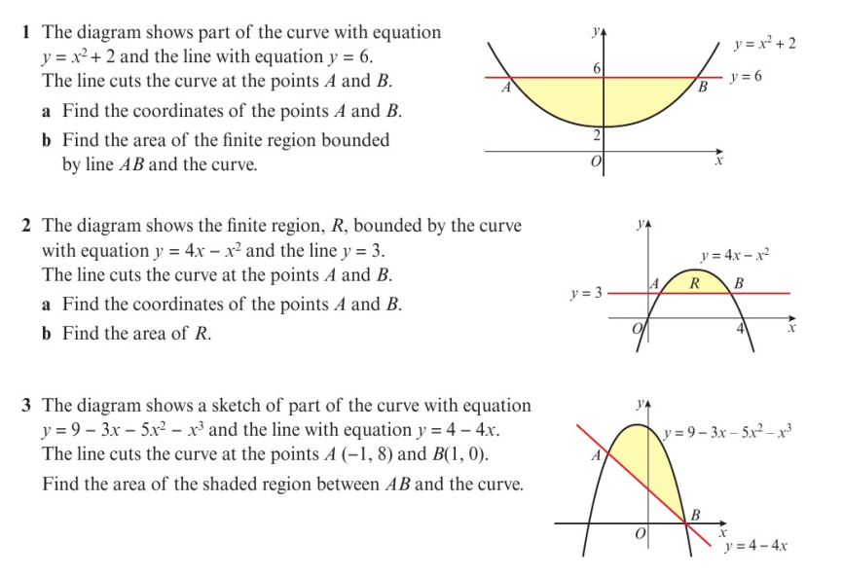
Homework Exercise

Slide 8
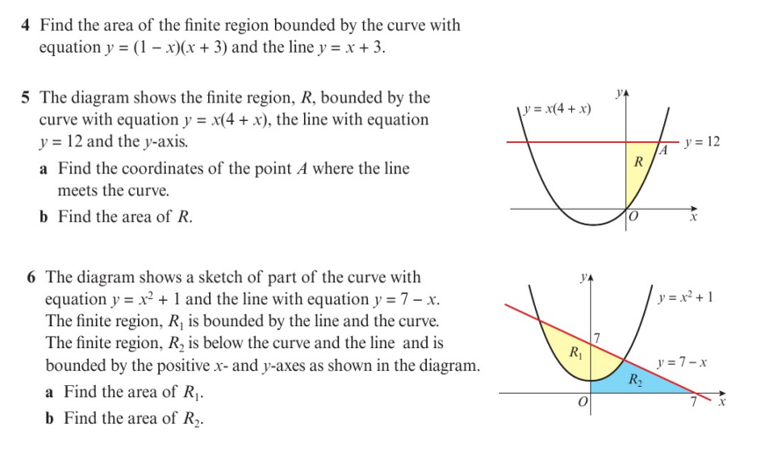
Homework Exercise

Slide 9
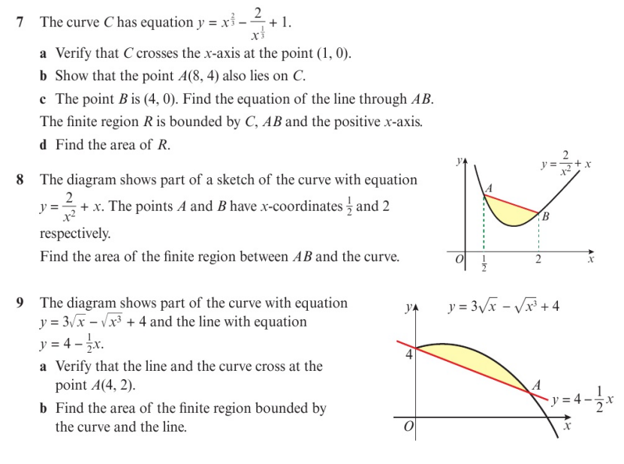
Homework Exercise

Slide 10
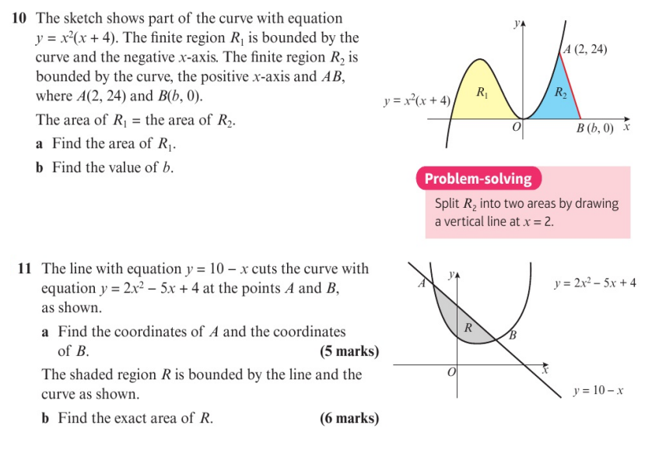
Homework Exercise

Slide 11
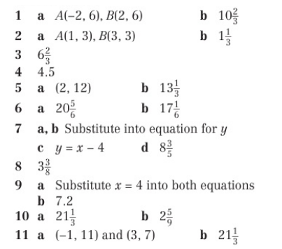
Homework Answers

