Slide 1
P2 Chapter 11: Integration Using Partial Fractions

Slide 2


SKILL #7: Using Partial Fractions
We saw earlier that we can split some expressions into partial fractions. This allows us to integrate some expressions with more complicated denominators.
Find $\int{\frac{2}{x^{2}−1} dx}$
?
$$\frac{2}{x^{2}−1}=\frac{2}{\left(x+1\right)\left(x−1\right)}=\frac{A}{x+1}+\frac{B}{x−1} \\ 2=A\left(x−1\right)+B\left(x+1\right) \\ 2=Ax−A+Bx+B \\ A+B=0 B−A=2 \\ B=1 A=−1$$
$$∫\frac{2}{x^{2}−1}dx=\int{−\frac{1}{x+1}+\frac{1}{x−1} dx} \\ =−\ln\left|x+1\right|+\ln\left|x−1\right|+C \\ =ln \left|\frac{x−1}{x+1}\right|+C$$

Slide 3




Further Examples
Find $\int{\frac{x−5}{\left(x+1\right)\left(x−2\right)} dx}$
Find $\int{\frac{8x^{2}−19x+1}{\left(2x+1\right){\left(x−2\right)}^{2}} dx}$
?
?
$$\frac{x−5}{\left(x+1\right)\left(x−2\right)}≡\frac{A}{x+1}+\frac{B}{x−2} \\ A=2 and B=−1$$
$$\int{\frac{x−5}{\left(x+1\right)\left(x−2\right)} dx}=∫\frac{2}{x+1}−\frac{1}{x−2}dx \\ =2\ln\left|x+1\right|−\ln\left|x−2\right|+C \\ =\ln\left|\frac{{\left(x+1\right)}^{2}}{x−2}\right|+C$$
$$\frac{8x^{2}−19x+1}{\left(2x+1\right){\left(x−2\right)}^{2}}=\frac{A}{2x+1}+\frac{B}{{\left(x−2\right)}^{2}}+\frac{C}{x−2}$$
$$A=2, B=−1, C=3$$
$$\int{\frac{8x^{2}−19x+1}{\left(2x+1\right){\left(x−2\right)}^{2}} dx}=\ln\left|\left(2x+1\right){\left(x−2\right)}^{3}\right|+\frac{1}{x−2}+C$$

Slide 4
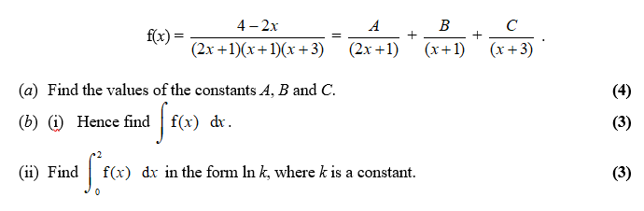
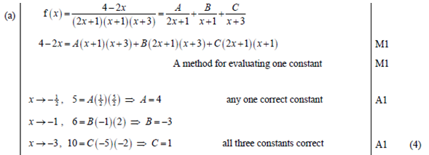
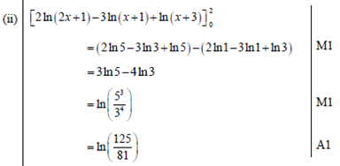
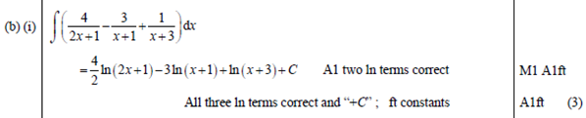
Test Your Understanding
Edexcel C4 June 2009 Q3
?
?
?

Slide 5

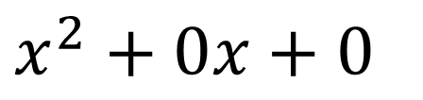

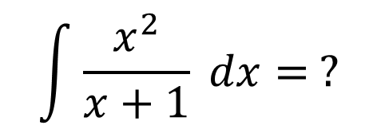
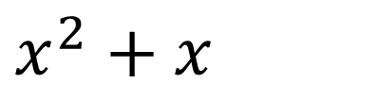



SKILL #8: Integrating top-heavy algebraic fractions
$$\int{\frac{x^{2}}{x+1} dx= ?}$$
How would we deal with this? (the clue’s in the title)
Some manipulation to simplify
?
Now integrate
?
$$x −1$$
$$\int{\frac{x^{2}}{x+1} dx}=\int{x−1+\frac{1}{x+1}}dx \\ =\frac{1}{2}x^{2}−x+\ln\left|x+1\right|$$ $+C$
$$x+1$$
$$x^{2}+0x+0$$
$$x^{2}+x$$
$$−x+0 \\ −x−1$$
$$1$$

Slide 6


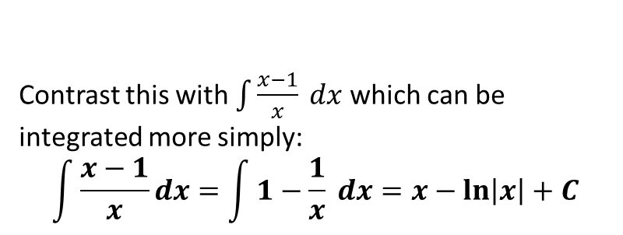
Test Your Understanding
$$\int{\frac{x^{3}+2}{x+1} dx} \\ =\frac{1}{3}x^{3}−\frac{1}{2}x^{2}+x$$ $+\ln\left|x+1\right|+C$
$$\int{\frac{x}{x−1} dx} \\ =\int{\frac{x−1+1}{x−1} dx}=\int{1+\frac{1}{x−1}dx} \\ =x+\ln\left|x−1\right|+C$$
?
?
Contrast this with $\int{\frac{x−1}{x} dx}$ which can be integrated more simply:
$$\int{\frac{x−1}{x}dx}=\int{1−\frac{1}{x} dx}=x−\ln\left|x\right|+C$$

Slide 7
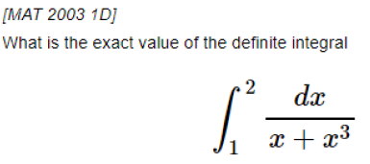

Exercise 11.7
Pearson Pure Year 2
Page 95
Extension:
?
Solution: $\frac{1}{2}\ln\left(\frac{8}{5}\right)$

Slide 8
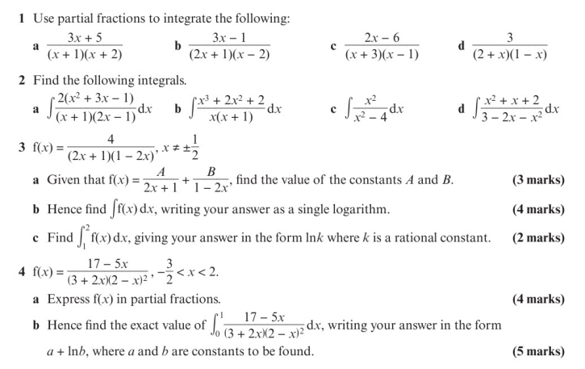
Homework Exercise

Slide 9
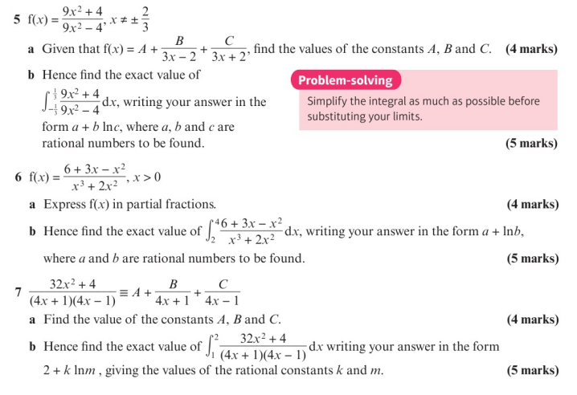
Homework Exercise

Slide 10
Homework Answers

