Slide 1
P2 Chapter 11: Integration Solving Differential Equations

Slide 2
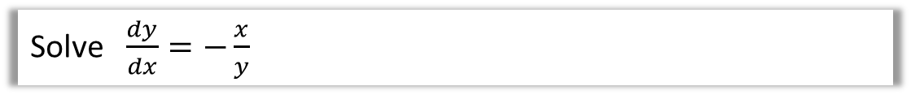
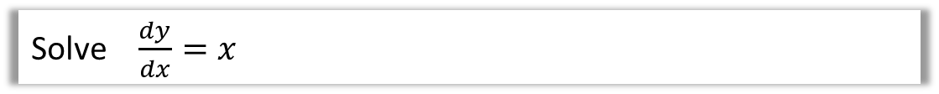

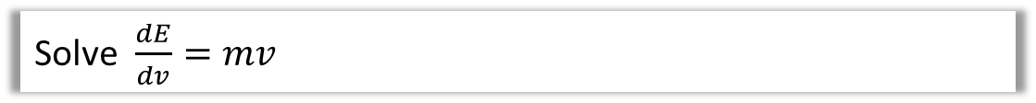
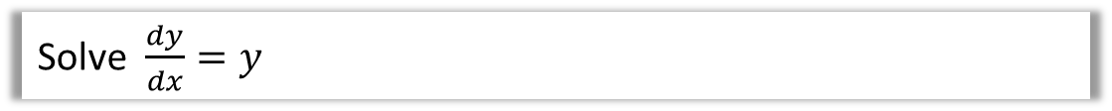
Introduction
1
Solve $\frac{dy}{dx}=x$
2
Solve $\frac{dy}{dx}=−\frac{x}{y}$
3
Solve $\frac{dy}{dx}=y$
4
Solve $\frac{dE}{dv}=mv$
4
Solve $\frac{dE}{dx}=kx$

Slide 3



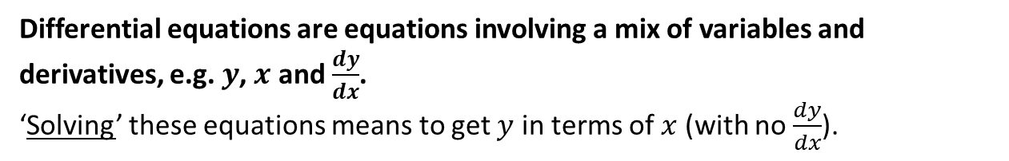
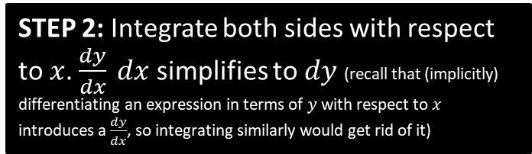
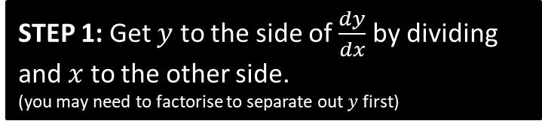

Differential Equations
Differential equations are equations involving a mix of variables and derivatives, e.g. $y$, $x$ and $\frac{dy}{dx}$.
‘Solving’ these equations means to get $y$ in terms of $x$ (with no $\frac{dy}{dx}$).
Q
Find the general solution to $\frac{dy}{dx}=xy+y$
?
$$\frac{dy}{dx}=y\left(x+1\right) \\ \frac{1}{y}\frac{dy}{dx}=x+1 \\ \int{\frac{1}{y}\frac{dy}{dx}dx=\int{x+1 dx}} \\ \int{\frac{1}{y}} dy=\int{x+1} dx \\ \ln\left|y\right|=\frac{1}{2}x^{2}+x+C \\ y=e^{\frac{1}{2}x^{2}+x+C} =e^{\frac{1}{2}x^{2}+x}e^{C} \\ =Ae^{\frac{1}{2}x^{2}+x}$$
STEP 1: Get $y$ to the side of $\frac{dy}{dx}$ by dividing and $x$ to the other side.
(you may need to factorise to separate out $y$ first)
I usually skip this line.
?
STEP 2: Integrate both sides with respect to $x$. $\frac{dy}{dx} dx$ simplifies to $dy$ (recall that (implicitly) differentiating an expression in terms of $y$ with respect to $x$ introduces a $\frac{dy}{dx}$, so integrating similarly would get rid of it)
STEP 3: Make $y$ the subject, if the question asks.
?
Fro Tip: When you have $e^{f\left(x\right)+c}=e^{f\left(x\right)}e^{c}$, it’s typical to write $Ae^{f\left(x\right)}$ where $A=e^{c}$ (noting that $A$ is any positive constant since $e^{c}>0$)

Slide 4
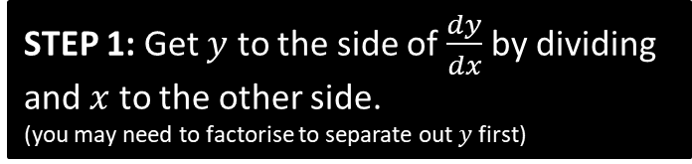
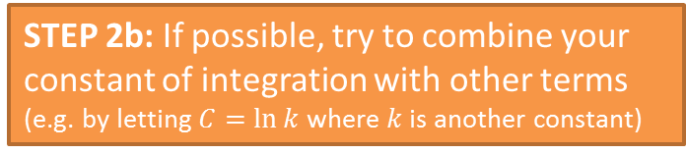


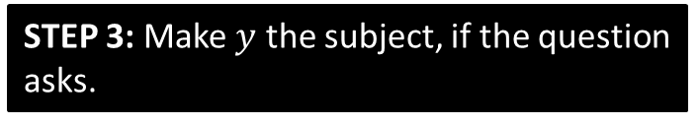

Another Example
Q
Find the general solution to $\left(1+x^{2}\right)\frac{dy}{dx}=x\tan{y}$
?
STEP 1: Get $y$ to the side of $\frac{dy}{dx}$ by dividing and $x$ to the other side.
(you may need to factorise to separate out $y$ first)
$$\frac{1}{\tan{y}}\frac{dy}{dx}=\frac{x}{1+x^{2}}$$
$$\int{\cot{y} dy }=\int{\frac{x}{1+x^{2}}dx} \\ \ln\left|\sin{y}\right|=\frac{1}{2}\ln\left|1+x^{2}\right|+C \\ \ln\left|\sin{y}\right|=\frac{1}{2}\ln\left|1+x^{2}\right|+\ln{k} \\ \ln\left|\sin{y}\right|=\ln\left|k\sqrt{1+x^{2}}\right| \\ \sin{y}=k\sqrt{1+x^{2}} \\ y=\arcsin\left(k\sqrt{1+x^{2}}\right)$$
?
STEP 2: Integrate both sides with respect to $x$.
?
STEP 2b: If possible, try to combine your constant of integration with other terms
(e.g. by letting $C=\ln{k}$ where $k$ is another constant)
?
STEP 3: Make $y$ the subject, if the question asks.

Slide 5

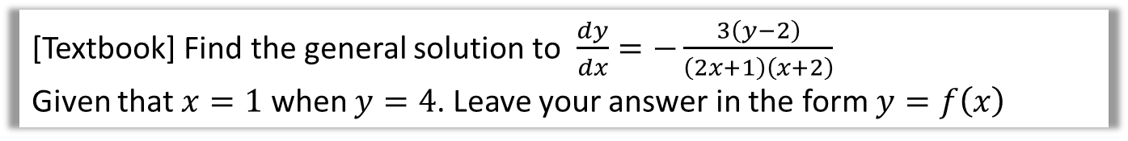
Differential Equations with Boundary Conditions
Q
[Textbook] Find the general solution to $\frac{dy}{dx}=−\frac{3\left(y−2\right)}{\left(2x+1\right)\left(x+2\right)}$
Given that $x=1$ when $y=4$. Leave your answer in the form $y=f\left(x\right)$
?
$$\int{\frac{1}{y−2} dy}=\int{\frac{−3}{\left(2x+1\right)\left(x+2\right)}dx}$$
Use partial fractions to split up RHS.
$$\frac{−3}{\left(2x+1\right)\left(x+2\right)}≡\frac{A}{2x+1}+\frac{B}{x+2} \\ A=−2, B=1$$
$$\int{\frac{1}{y−2} dy}=\int{\frac{1}{x+2}−\frac{2}{2x+1}dx} \\ \ln\left|y−2\right|=\ln\left|x+2\right|−\ln\left|2x+1\right|+\ln{k} \\ \ln\left|y−2\right|=\ln\left|\frac{k\left(x+2\right)}{2x+1}\right| \\ y−2=\frac{k\left(x+2\right)}{2x+1}$$
When $x=1,y=4$: $4−2=\frac{k\left(1+2\right)}{2+1} →k=2$
$$y=3+\frac{3}{2x+1}$$
Bro Tip: While it doesn’t matter when you determine your constant using the boundary conditions, usually it’s easiest to determine it as soon as possible.

Slide 6
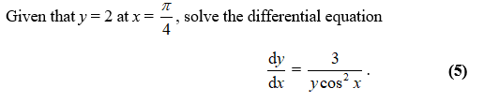
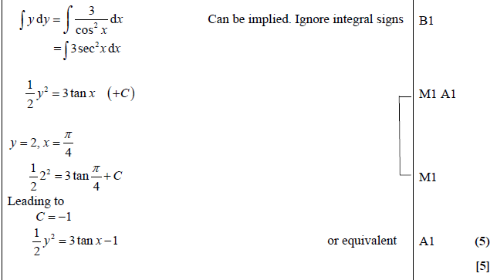
Test Your Understanding
Edexcel C4 Jan 2012 Q4
?

Slide 7
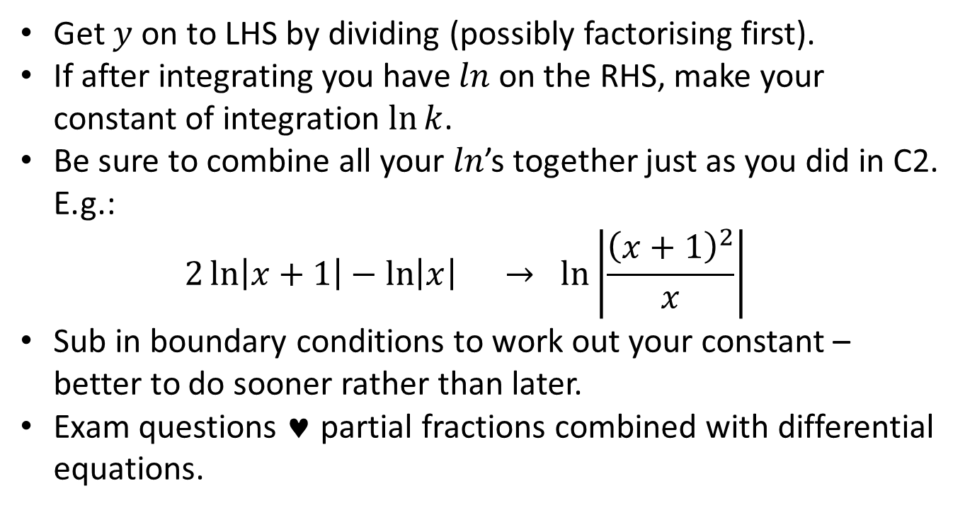
Key Points on Differential Equations
Get $y$ on to LHS by dividing (possibly factorising first).
If after integrating you have $ln$ on the RHS, make your constant of integration $\ln{k}$.
Be sure to combine all your $ln$’s together just as you did in C2. E.g.: $2\ln\left|x+1\right|−\ln\left|x\right| → \ln\left|\frac{{\left(x+1\right)}^{2}}{x}\right|$
Sub in boundary conditions to work out your constant – better to do sooner rather than later.
Exam questions ♥ partial fractions combined with differential equations.
?

Slide 8
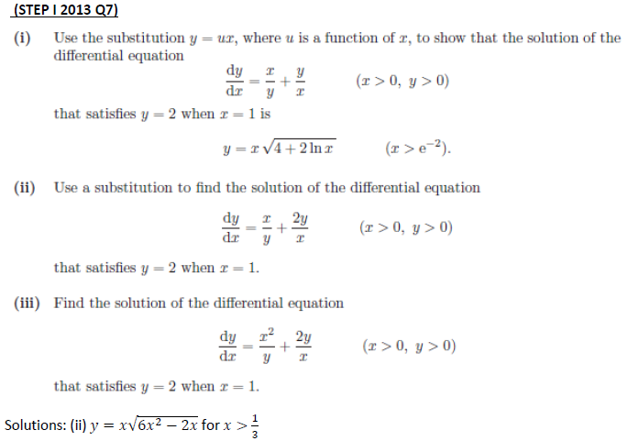
Exercise 11.7
Pearson Pure Year 2
Page 95
Extension:
?

Slide 9
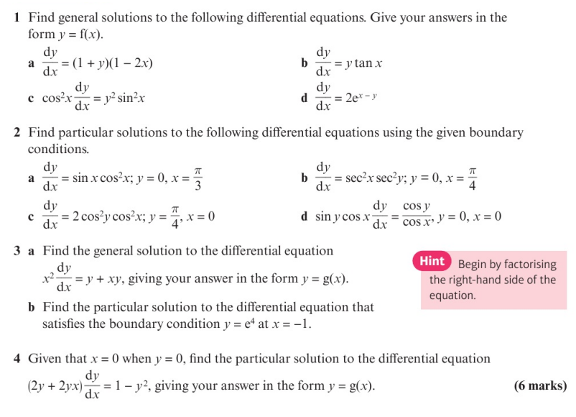
Homework Exercise

Slide 10
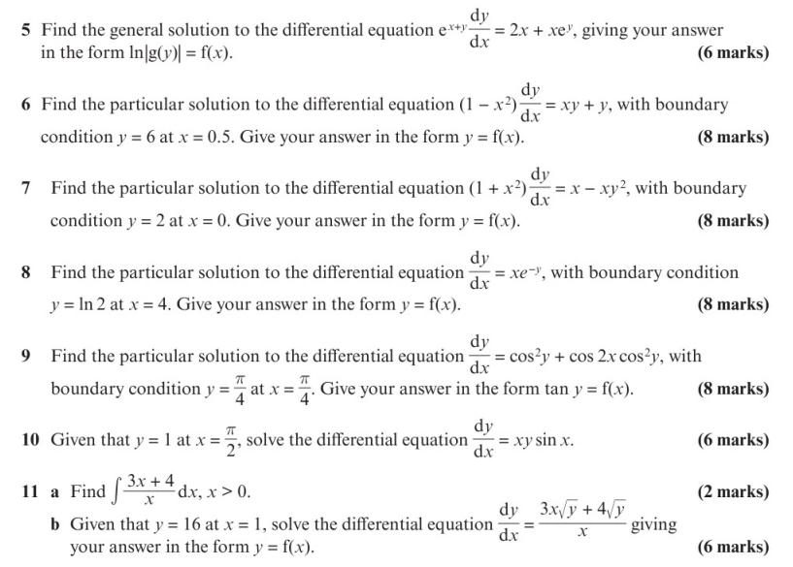
Homework Exercise

Slide 11
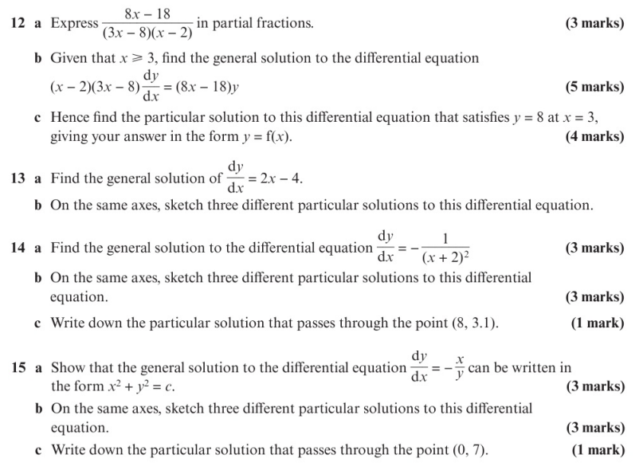
Homework Exercise

Slide 12
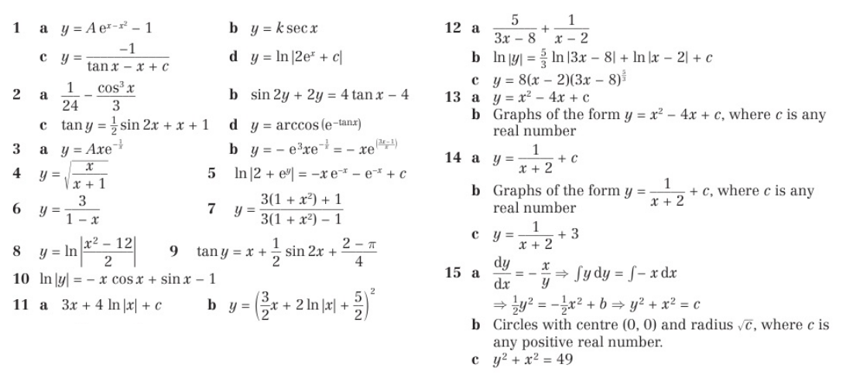
Homework Answers

