Slide 1
P2 Chapter 5: Radians
Radian Measure

Slide 2
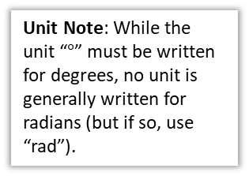
Radians
So far you’ve used degrees as the unit to measure angles.
But outside geometry, mathematicians pretty much always use radians.
r
Unit Note: While the unit “$°$” must be written for degrees, no unit is generally written for radians (but if so, use “rad”).
1°
r
1 rad
A degree is a 360th of a rotation around a full circle. This is a somewhat arbitrary definition!
One radian however is the movement of one radius’ worth around the circumference of the circle.
Click to Start Degree Animation
Click to Start Radian Animation
?
Thinking about how many radii around the circumference we can go: $360°=2π$ rad

Slide 3
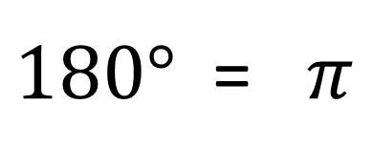




Converting between radians and degrees
?
$÷180$ and $×π$
$180°$ = $π$
$÷π$ and $×180$
?
$$135°=\frac{3}{4}π \\ \frac{3}{2}π=270° \\ 72°=\frac{2}{5}π \\ \frac{5π}{6}=150°$$
?
?
$$90°=\frac{π}{2} \\ \frac{π}{3}=60° \\ 45°=\frac{π}{4} \\ \frac{π}{6}=30°$$
?
?
?
?
?
?

Slide 4
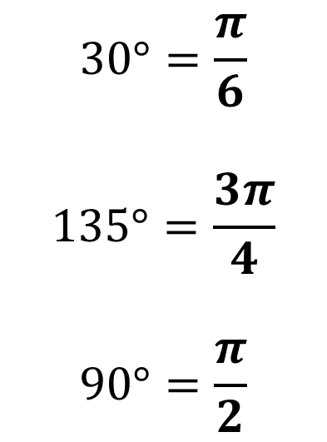
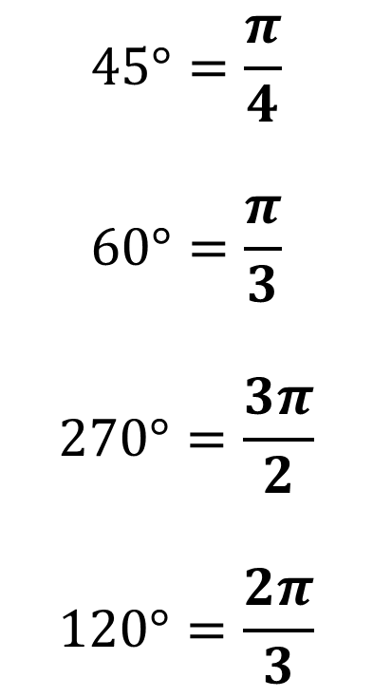
Be able to convert common angles in your head…
?
?
$$45°=\frac{π}{4}$$
$$60°=\frac{π}{3}$$
$$270°=\frac{3π}{2}$$
$$120°=\frac{2π}{3}$$
$$30°=\frac{π}{6}$$
$$135°=\frac{3π}{4}$$
$$90°=\frac{π}{2}$$
?
?
?
?
?

Slide 5



















Graph Sketching with Radians
We can replace the values $90°, 180°, 270°, 360°$ on the $x$-axis with their equivalent value in radians.
$$y$$
$$y$$
$$y=cos\left(x\right)$$
$$1$$
$$1$$
$$y=sin\left(x\right)$$
$$x$$
$$x$$
$$\frac{π}{2}$$
$$π$$
$$\frac{3}{2}π$$
$$2π$$
$$\frac{π}{2}$$
$$π$$
$$\frac{3}{2}π$$
$$2π$$
$$−1$$
$$−1$$

Slide 6










Test Your Understanding
Sketch the graph of $y=\cos\left(x+\frac{π}{2}\right)$ for $0≤x<2π$.
?
$$y$$
$$y=cos\left(x+\frac{π}{2}\right)$$
$$1$$
$$y=cos\left(x\right)$$
$$x$$
$$\frac{π}{2}$$
$$π$$
$$\frac{3}{2}π$$
$$2π$$
$$−1$$

Slide 7



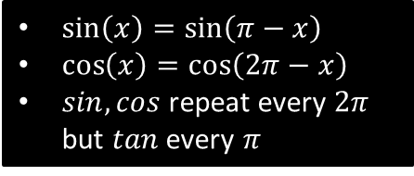

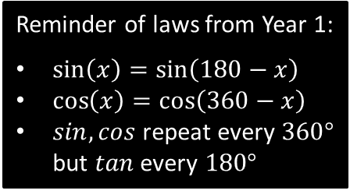






sin, cos, tan of angles in radians
Reminder of laws from Year 1:
$\sin\left(x\right)=\sin\left(180−x\right)$
$\cos\left(x\right)=\cos\left(360−x\right)$
$sin,cos$ repeat every $360°$ but $tan$ every $180°$
$\sin\left(x\right)=\sin\left(π−x\right)$
$\cos\left(x\right)=\cos\left(2π−x\right)$
$sin,cos$ repeat every $2π$ but $tan$ every $π$
To find sin/cos/tan of a ‘common’ angle in radians without using a calculator, it is easiest to just convert to degrees first.
?
$$\cos\left(\frac{4π}{3}\right)=\cos\left(240°\right)=\cos\left(120°\right)=−\cos\left(60°\right)=−\frac{1}{2}$$
$$\frac{1}{2}$$
$$60$$
$$120$$
$$x$$
$$90$$
$$180$$
?
$$\sin\left(−\frac{7π}{6}\right)=\sin\left(−210°\right)=\sin\left(150°\right)=\sin\left(30°\right)=\frac{1}{2}$$
To find $\cos\left(\frac{4π}{3}\right)$ directly using your calculator, you need to switch to radians mode. Press $SHIFT→SETUP$, then $ANGLE UNIT$, then $Radians$. An $R$ will appear at the top of your screen, instead of $D$.

Slide 8
Exercise 5.1
Pearson Pure Year 2
Page 35

Slide 9
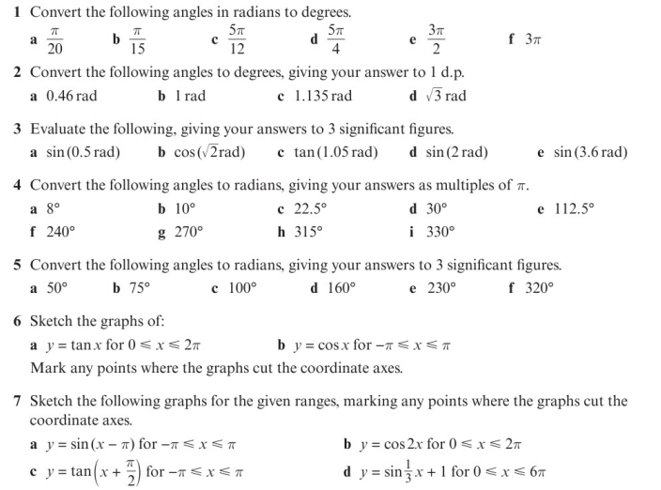
Homework Exercise

Slide 10
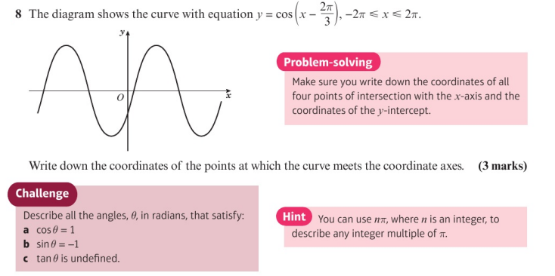
Homework Exercise

Slide 11
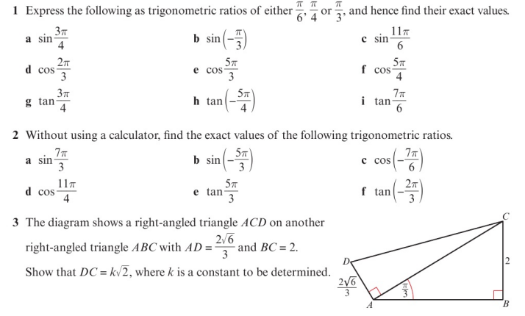
Homework Exercise

Slide 12
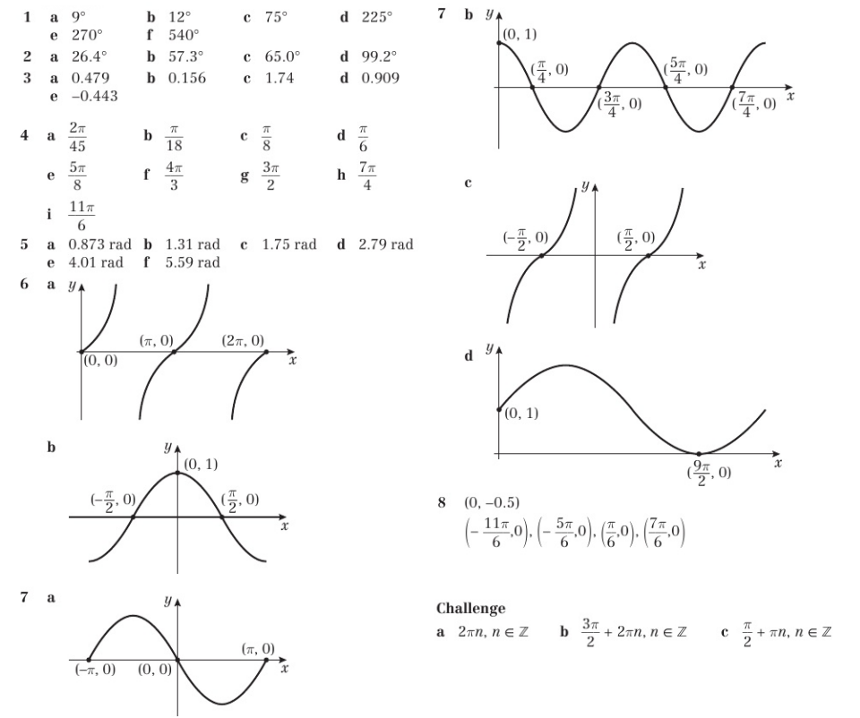
Homework Answers

Slide 13
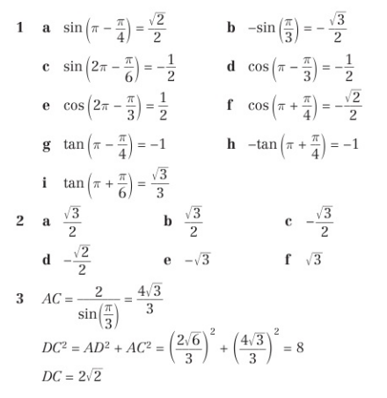
Homework Answers

