Slide 1
Stats Yr2 Chapter 3: Distribution-N Normal Hypothesis Testing

Slide 2

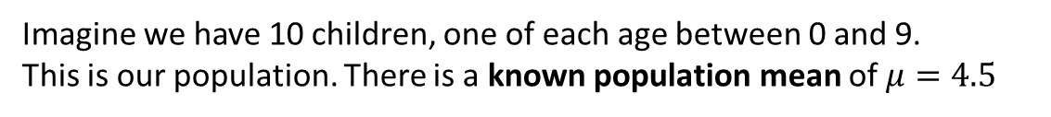
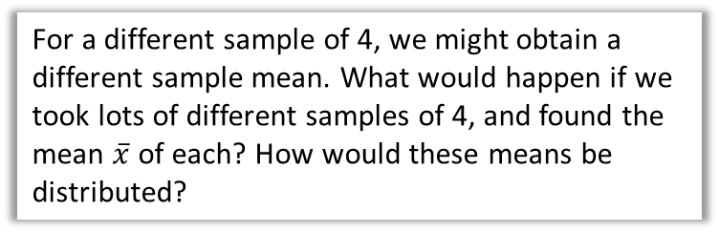
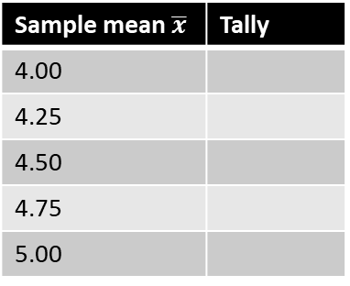

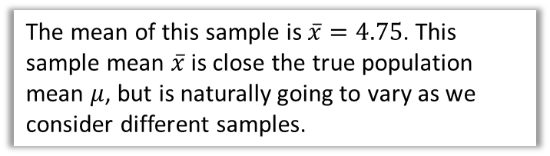

Hypothesis Testing on the Sample Mean
0
1
2
3
4
5
6
7
8
9
Imagine we have 10 children, one of each age between 0 and 9.
This is our population. There is a known population mean of $μ=4.5$
$$\overline{x}$$
Suppose we took a sample of 4 children.
Sample 1:
1
3
7
8
4.75
Sample 2:
6
2
0
9
4.25
Sample mean $\overline{x}$ | Tally
4.00
4.25
4.50
4.75
5.00
…
The mean of this sample is $\overline{x}=4.75$. This sample mean $\overline{x}$ is close the true population mean $μ$, but is naturally going to vary as we consider different samples.
$$\overline{X}$$
For a different sample of 4, we might obtain a different sample mean. What would happen if we took lots of different samples of 4, and found the mean $\overline{x}$ of each? How would these means be distributed?
I took 1000 random samples.
In this histogram, 5 actually means $4.5≤\overline{x}<5$

Slide 3


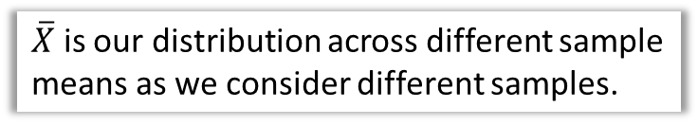
Hypothesis Testing on the Sample Mean
$\overline{X}$ is our distribution across different sample means as we consider different samples.
1000 samples.
Size of each sample: 4 children.
Question 1: What type of distribution is $\overline{X}$?
From the left it seems like it is approximately normally distributed!
Question 2: On average, what sample mean do we see? (i.e. the mean of the means!)
$μ$. The sample means $\overline{x}$ vary around the population mean $μ$, but on average is $μ$.
Question 3: Is the variance of $\overline{X}$ (i.e. how spread out the sample means are) the same as that of the variance of the population of children?
No! On the left, we can see that how spread out the sample means are depends on the sample size. If the sample size is small, the sample means are likely to vary quite a bit. But with a larger sample size, we expect the different $\overline{x}$ to be closer to the population mean $μ$.
?
?
1000 samples.
Size of each sample: 10 children.
?
! For a random sample of size $n$ taken from a random variable $X$, the sample mean $\overline{X}$ is normally distributed with $\overline{X}\sim N\left(μ,\frac{σ^{2}}{n}\right)$

Slide 4

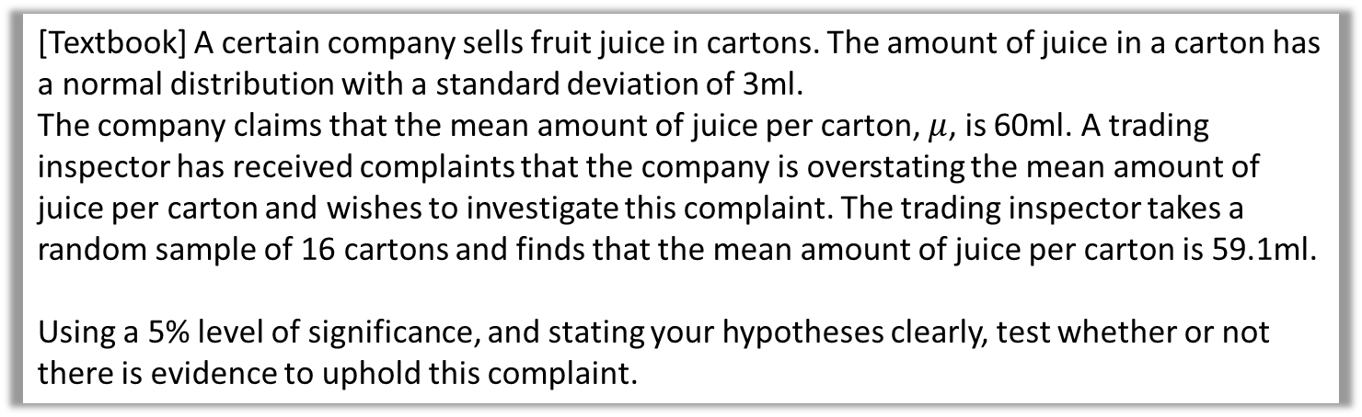
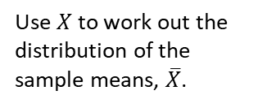
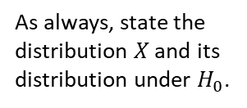
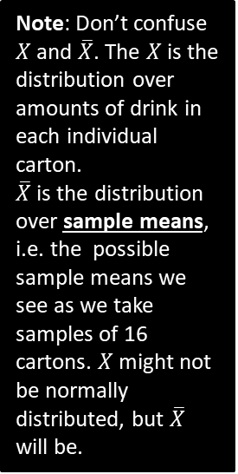
Examples
[Textbook] A certain company sells fruit juice in cartons. The amount of juice in a carton has a normal distribution with a standard deviation of 3ml.
The company claims that the mean amount of juice per carton, $μ$, is 60ml. A trading inspector has received complaints that the company is overstating the mean amount of juice per carton and wishes to investigate this complaint. The trading inspector takes a random sample of 16 cartons and finds that the mean amount of juice per carton is 59.1ml.
Using a 5% level of significance, and stating your hypotheses clearly, test whether or not there is evidence to uphold this complaint.
?
As always, state the distribution $X$ and its distribution under $H_{0}$.
Note: Don’t confuse $X$ and $\overline{X}$. The $X$ is the distribution over amounts of drink in each individual carton.
$\overline{X}$ is the distribution over sample means, i.e. the possible sample means we see as we take samples of 16 cartons. $X$ might not be normally distributed, but $\overline{X}$ will be.
$$H_{0}:μ=60 \\ H_{1}:μ<60$$
Let $X$ be the amount of juice per carton.
Assuming $H_{0}$, $X\sim N\left({60,3}^{2}\right)$
$$∴\overline{X}\sim N\left(60,\frac{3^{2}}{16}\right) → \overline{X}\sim N\left({60,0.75}^{2}\right)$$
$$P\left(\overline{X}<59.1\right)=0.1151$$
$0.1151>0.05$ so there is insufficient evidence to reject $H_{0}$ and conclude that the mean amount of juice in the whole population is less than 60 ml.
?
?
?
Use $X$ to work out the distribution of the sample means, $\overline{X}$.
?
?

Slide 5
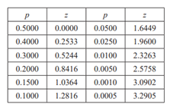

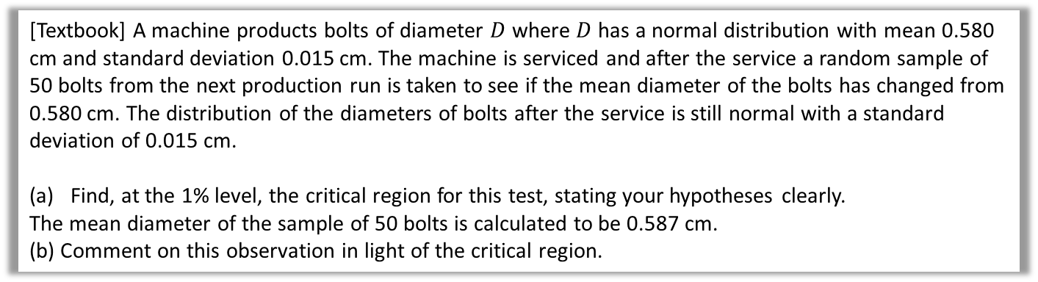
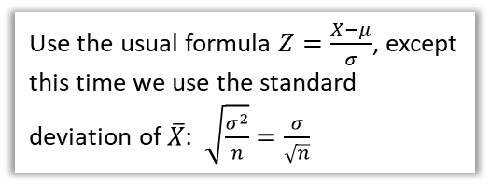
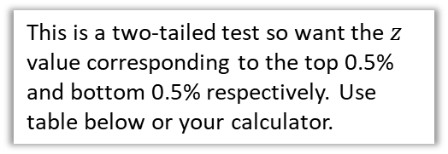
Finding the critical region
[Textbook] A machine products bolts of diameter $D$ where $D$ has a normal distribution with mean 0.580 cm and standard deviation 0.015 cm. The machine is serviced and after the service a random sample of 50 bolts from the next production run is taken to see if the mean diameter of the bolts has changed from 0.580 cm. The distribution of the diameters of bolts after the service is still normal with a standard deviation of 0.015 cm.
Find, at the 1% level, the critical region for this test, stating your hypotheses clearly.
The mean diameter of the sample of 50 bolts is calculated to be 0.587 cm.
(b) Comment on this observation in light of the critical region.
$$H_{0}:μ=0.580, H_{1}:μ≠0.580$$
Assuming $H_{0}$, $D\sim N\left(0.580, {0.015}^{2}\right)$
$$\overline{D}\sim N\left(0.580,\frac{{0.015}^{2}}{50}\right) → \overline{D}\sim N\left(0.580, {\left(\frac{0.015}{\sqrt{50}}\right)}^{2}\right)$$
$$z=±2.5758$$
$$−2.5758=\frac{\overline{d}−0.580}{\frac{0.015}{\sqrt{50}}} → \overline{d}=0.5745$$
$$2.5758=\frac{\overline{d}−0.580}{\frac{0.015}{\sqrt{50}}} → \overline{d}=0.5854$$
Critical region is $\overline{D}≤0.575$ or $\overline{D}≥0.585 (3sf)$
Observed value falls within critical region so sufficient evidence at 1% level that mean diameter has changed from 0.580cm.
a
?
This is a two-tailed test so want the $z$ value corresponding to the top 0.5% and bottom 0.5% respectively. Use table below or your calculator.
?
?
?
?
Use the usual formula $Z=\frac{X−μ}{σ}$, except this time we use the standard deviation of $\overline{X}$: $\sqrt{\frac{σ^{2}}{n}}=\frac{σ}{\sqrt{n}}$
b
?

Slide 6
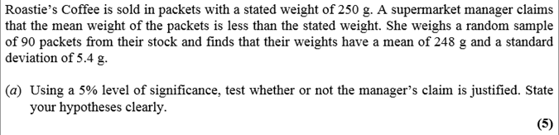
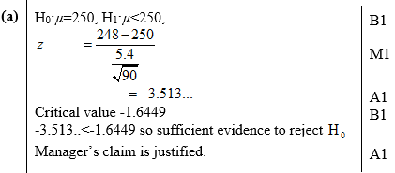
Test Your Understanding
Edexcel S3 June 2011 Q7a
?

Slide 7
Exercise 3.7
Pearson Stats/Mechanics Year 2
Pages 29-30

Slide 8
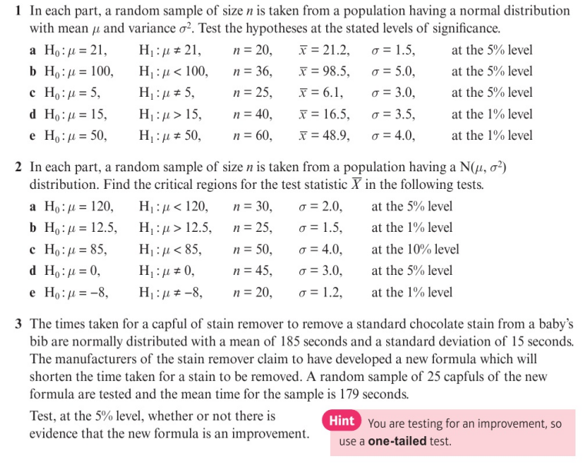
Homework Exercise

Slide 9
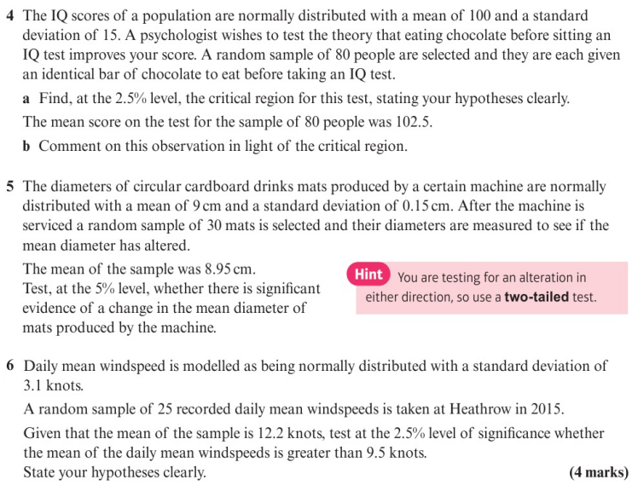
Homework Exercise

Slide 10
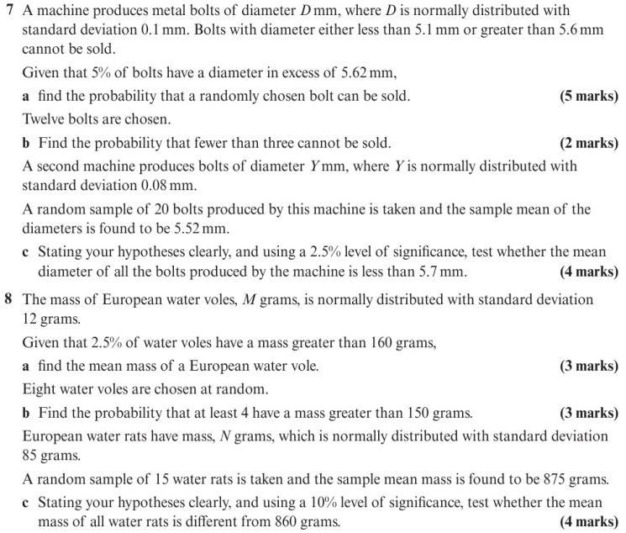
Homework Exercise

Slide 11
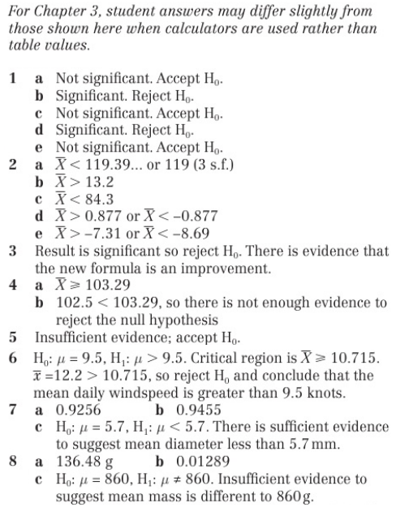
Homework Answers

