Slide 1
Stats1 Chapter 5: Probability Tree Diagrams

Slide 2
















Tree Diagrams
At GCSE we saw that tree diagrams were an effective way of showing the outcome of two events which happen in succession.
(Personal opinion however is that their use is easily avoidable)
$$0.6$$
$$A$$
$$0.3$$
$$A$$
$$not A$$
$$0.4$$
$$not A$$
$$0.8$$
$$A$$
$$0.7$$
There are 3 yellow and 2 green counters in a bag. I take two counters at random. Determine the probability that:
They are of the same colour.
They are of different colours.
$$0.2$$
$$not A$$
$$GY:\frac{2}{5}×\frac{3}{4}=\frac{6}{20} \\ YG:\frac{3}{5}×\frac{2}{4}=\frac{6}{20} \\ P\left(different\right)=\frac{6}{20}+\frac{6}{20}=\frac{3}{5}$$
(Or we could have used our answer to (a): $1−\frac{2}{5}=\frac{3}{5}$)
$$YY: \frac{3}{5}×\frac{2}{4}=\frac{6}{20} \\ GG:\frac{2}{5}×\frac{1}{4}=\frac{2}{20} \\ P\left(same\right)=\frac{6}{20}+\frac{2}{20}=\frac{8}{20}=\frac{2}{5}$$
b
?
a
?
Note that if the outcomes are the same but reordered, the probability will be the same. So we could have quickly done $\frac{2}{5}×\frac{3}{4}×2$
Tip: List out the matching sequences of outcomes first, then find the probability for each.
The probability I hit a target on each shot is 0.3. I keep firing until I hit the target. Determine the probability I hit the target on the 5th shot.
?
$${0.7}^{4}×0.3=0.07203$$

Slide 3
Exercise 5D
Pearson Pure Mathematics Year 1/AS
Pages 35-36

Slide 4
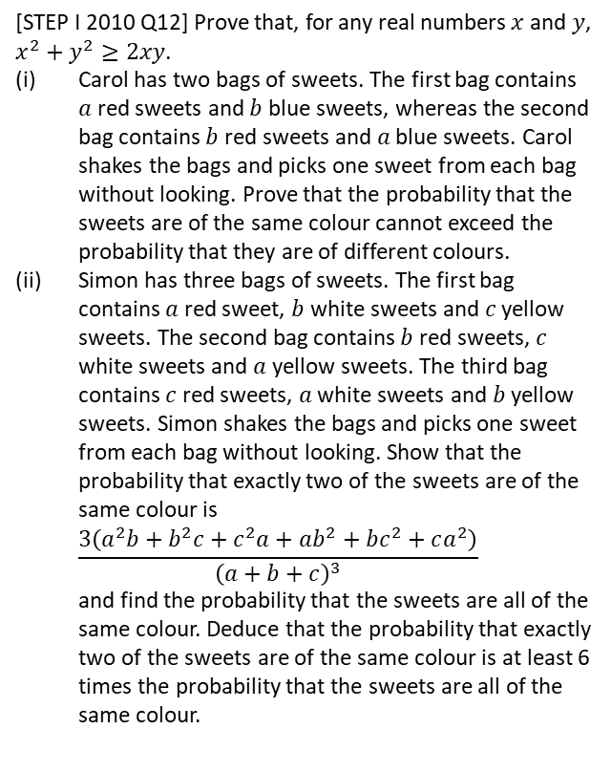

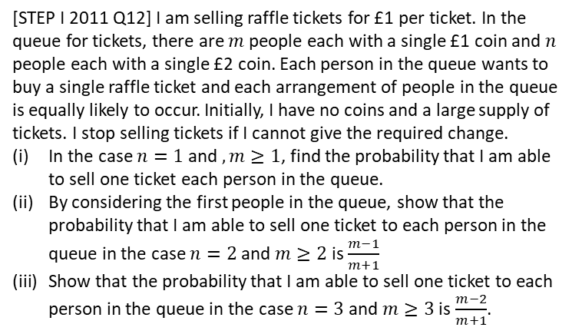
Extension Questions
Extension Questions
2
[STEP I 2011 Q12] I am selling raffle tickets for £1 per ticket. In the queue for tickets, there are $m$ people each with a single £1 coin and $n$ people each with a single £2 coin. Each person in the queue wants to buy a single raffle ticket and each arrangement of people in the queue is equally likely to occur. Initially, I have no coins and a large supply of tickets. I stop selling tickets if I cannot give the required change.
In the case $n=1$ and $,m≥1$, find the probability that I am able to sell one ticket each person in the queue.
By considering the first people in the queue, show that the probability that I am able to sell one ticket to each person in the queue in the case $n=2$ and $m≥2$ is $\frac{m−1}{m+1}$
Show that the probability that I am able to sell one ticket to each person in the queue in the case $n=3$ and $m≥3$ is $\frac{m−2}{m+1}$.
1
[STEP I 2010 Q12] Prove that, for any real numbers $x$ and $y$, $x^{2}+y^{2}≥2xy$.
Carol has two bags of sweets. The first bag contains $a$ red sweets and $b$ blue sweets, whereas the second bag contains $b$ red sweets and $a$ blue sweets. Carol shakes the bags and picks one sweet from each bag without looking. Prove that the probability that the sweets are of the same colour cannot exceed the probability that they are of different colours.
Simon has three bags of sweets. The first bag contains $a$ red sweet, $b$ white sweets and $c$ yellow sweets. The second bag contains $b$ red sweets, $c$ white sweets and $a$ yellow sweets. The third bag contains $c$ red sweets, $a$ white sweets and $b$ yellow sweets. Simon shakes the bags and picks one sweet from each bag without looking. Show that the probability that exactly two of the sweets are of the same colour is $\frac{3\left(a^{2}b+b^{2}c+c^{2}a+ab^{2}+bc^{2}+ca^{2}\right)}{{\left(a+b+c\right)}^{3}}$ and find the probability that the sweets are all of the same colour. Deduce that the probability that exactly two of the sweets are of the same colour is at least 6 times the probability that the sweets are all of the same colour.
3
I have an unfair coin with a fixed probability $p$ of heads. Determine how the unfair coin could be used to simulate a fair coin, i.e. you declare “Heads” or “Tails” each with probability 0.5.
Throw the coin twice. Then the probability of each sequence:
$$P\left(HH\right)=p^{2} P\left(TT\right)={\left(1−p\right)}^{2} \\ P\left(HT\right)=p\left(1−p\right) P\left(TH\right)=p(1−p)$$
Note that two of these have the same probability. So if the first throw is Heads and the second Tails, declare “Heads”, or if Tails then Heads, declare “Tails”. If the two throws are the same, repeat the process until the two throws are different.
?

Slide 5
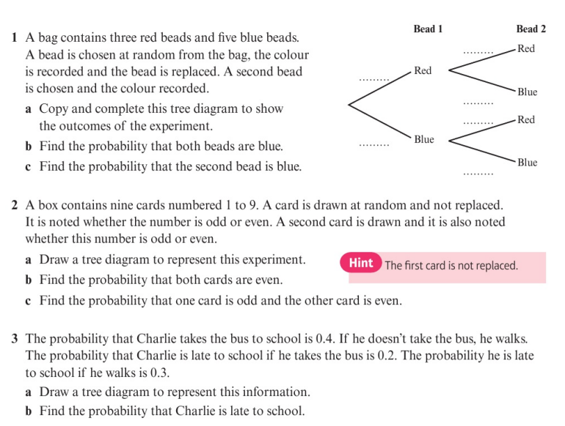
Homework Exercise

Slide 6
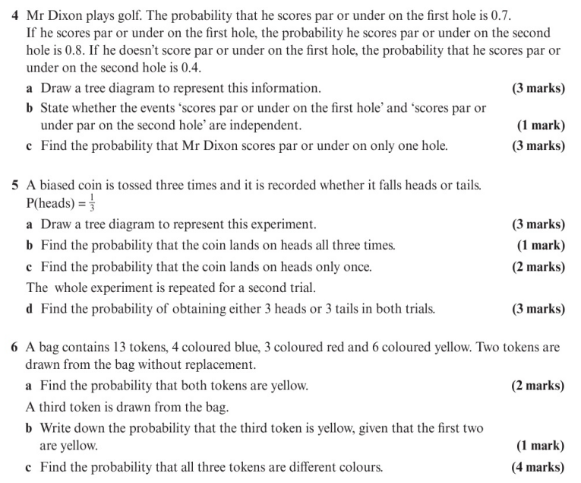
Homework Exercise

Slide 7
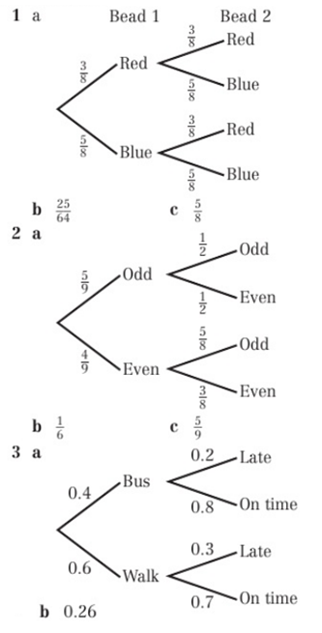
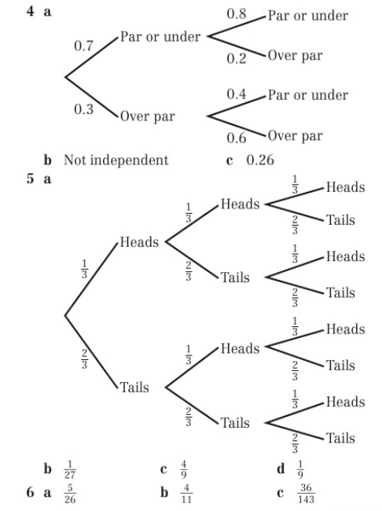
Homework Answers

