Slide 1
P1 Chapter 7: Algebraic Methods Polynomial Long Division

Slide 2

Terminology
$$11÷4=2 r 3$$
?
dividend
(the thing we’re dividing)
quotient
?
divisor
(the thing we’re dividing by)
?
remainder
?

Slide 3
Normal Long Division
3
8 .
11
4 2 3 . 0 0 0 0
3 3
1. We found how many whole number of times (i.e. the quotient) the divisor went into the dividend.
9 3
8 8
5 0
2. We multiplied the quotient by the dividend.
3. …in order to find the remainder.
4. Find we ‘brought down’ the next number.

Slide 4
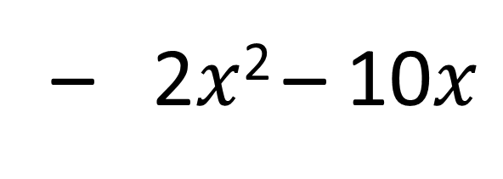
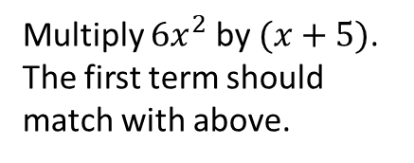
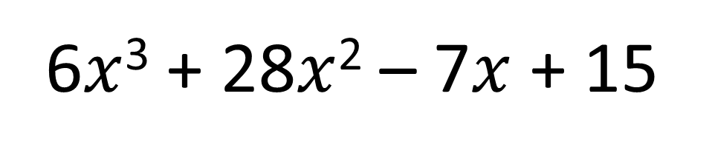
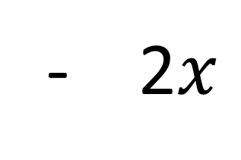

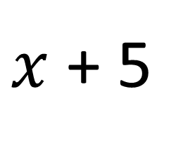
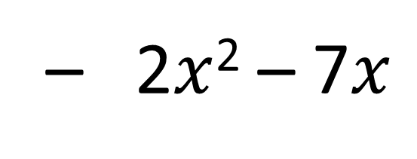
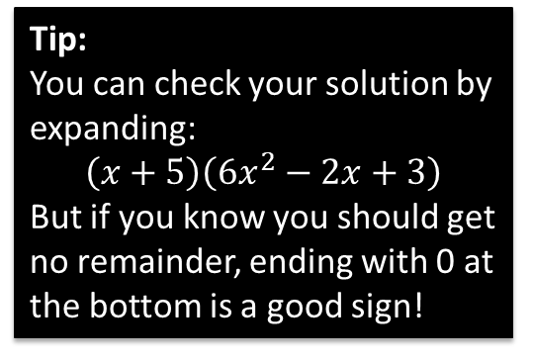
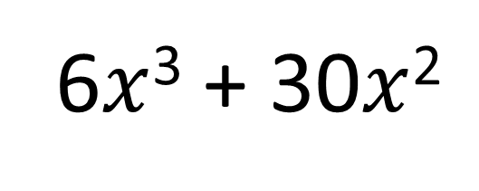
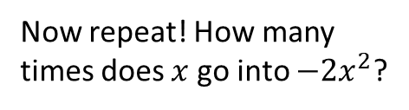
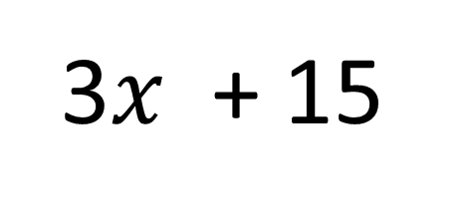
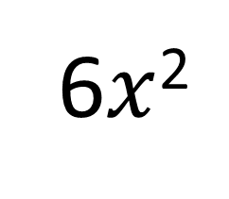
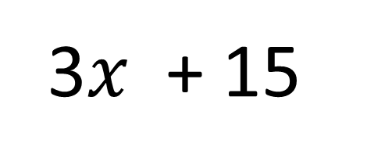
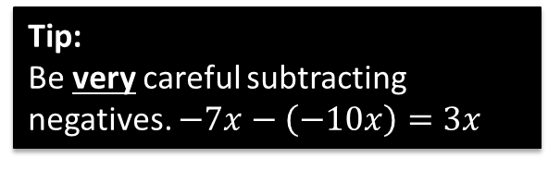
How many times does $x$ go into $6x^{3}$?
Now repeat! How many times does $x$ go into $−2x^{2}$?
6$x$²
- 2$x$
+ 3
$x$ + 5
6$x$³ + 28$x$² – 7$x$ + 15
6$x$³ + 30$x$²
Subtract and carry down next term.
Multiply $6x^{2}$ by $(x+5)$. The first term should match with above.
– 2$x$² – 7$x$
Tip:
You can check your solution by expanding:
$$\left(x+5\right)\left(6x^{2}−2x+3\right)$$
But if you know you should get no remainder, ending with 0 at the bottom is a good sign!
– 2$x$² – 10$x$
3$x$ + 15
3$x$ + 15
Tip:
Be very careful subtracting negatives. $−7x−\left(−10x\right)=3x$
This is the remainder.
0

Slide 5
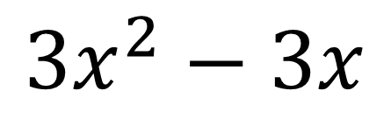
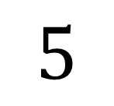
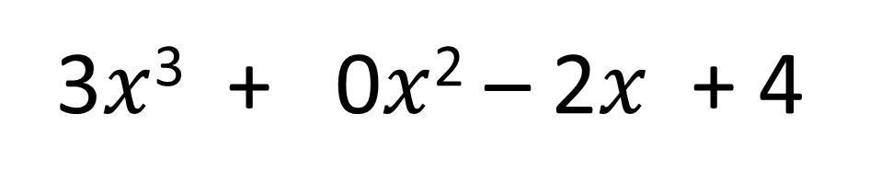
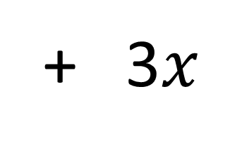
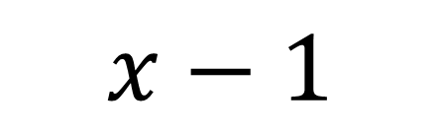
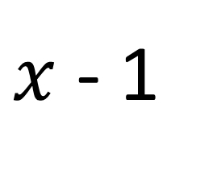
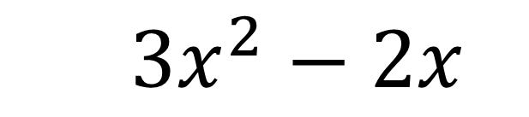
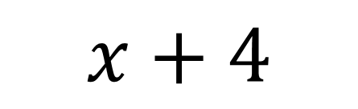
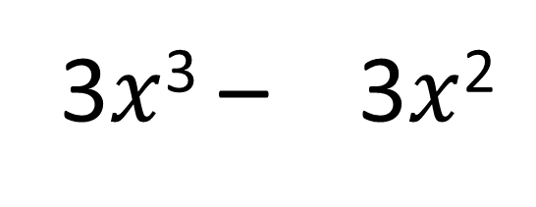
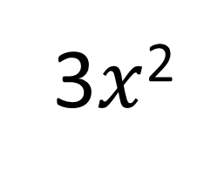
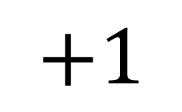
Further Example
Find the remainder when $3x^{3}−2x+4$ is divided by $x−1$.
3$x$²
+ 3$x$
$$+1$$
$x$ - 1
3$x$³ + 0$x$² – 2$x$ + 4
3$x$³ – 3$x$²
$3x^{2}−2x$
$$3x^{2}−3x$$
$$x+4$$
Note: Ensure that any missing terms in the polynomial are filled in, so that the powers decrease by 1 each time.
$$x−1$$
$$5$$
The remainder is 5.

Slide 6


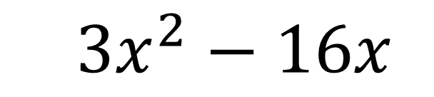

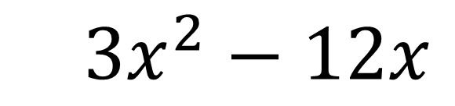
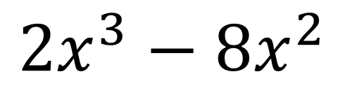
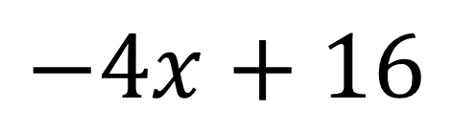


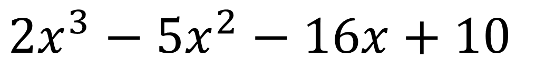
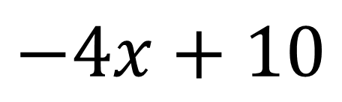
Test Your Understanding
Find the remainder when $2x^{3}−5x^{2}−16x+10$ is divided by $x−4$.
?
$$2x^{2}$$
$$+3x$$
$$−4$$
$$x−4$$
$$2x^{3}−5x^{2}−16x+10$$
$$2x^{3}−8x^{2}$$
$3x^{2}−16x$
$3x^{2}−12x$
$$−4x+10$$
$$−4x+16$$
$$−6$$
The remainder is -6.

Slide 7
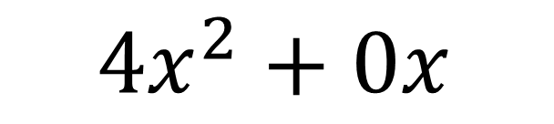
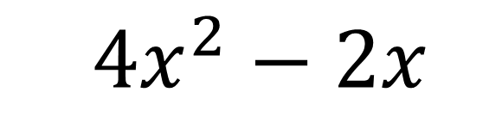
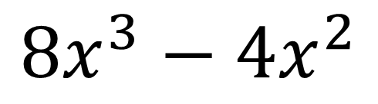
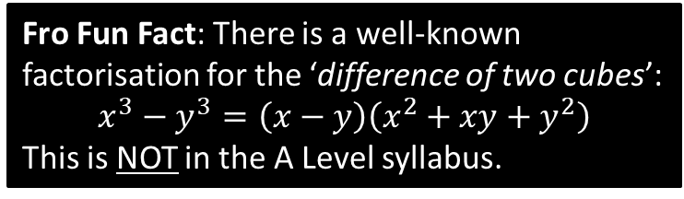
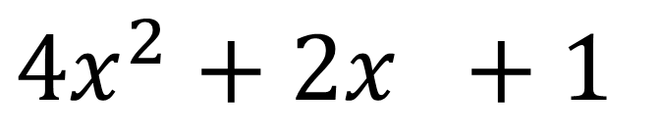

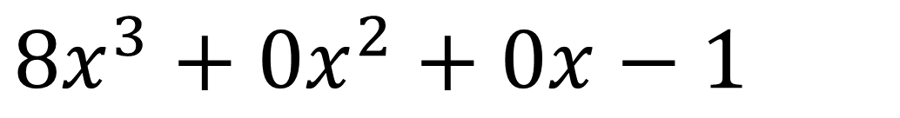
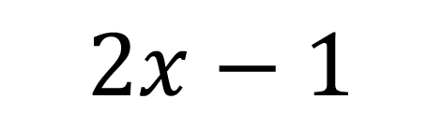

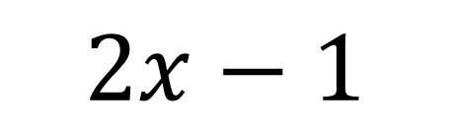
Further Test Your Understanding
Divide $8x^{3}−1$ by $2x−1$.
?
$$4x^{2}+2x +1$$
$$2x−1$$
$$8x^{3}+0x^{2}+0x−1$$
$$8x^{3}−4x^{2}$$
$4x^{2}+0x$
$4x^{2}−2x$
$$2x−1$$
Fro Fun Fact: There is a well-known factorisation for the ‘difference of two cubes’:
$$x^{3}−y^{3}=\left(x−y\right)\left(x^{2}+xy+y^{2}\right)$$
This is NOT in the A Level syllabus.
$$2x−1$$
$$0$$

Slide 8
Exercise 7.1
Pearson Pure Mathematics Year 1/AS
Pages 1

Slide 9
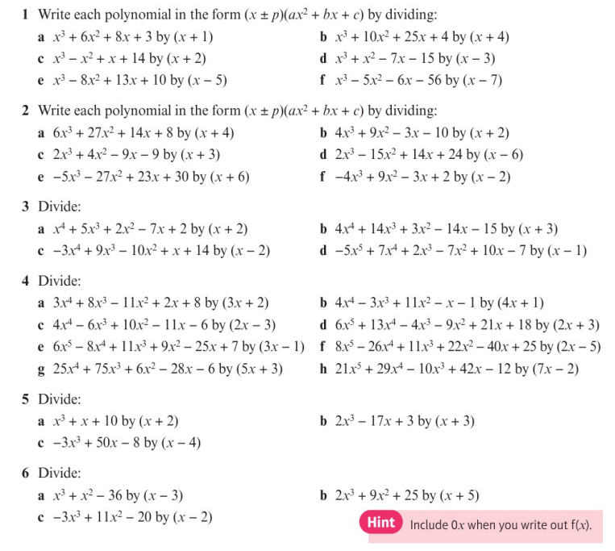
Homework Exercise

Slide 10
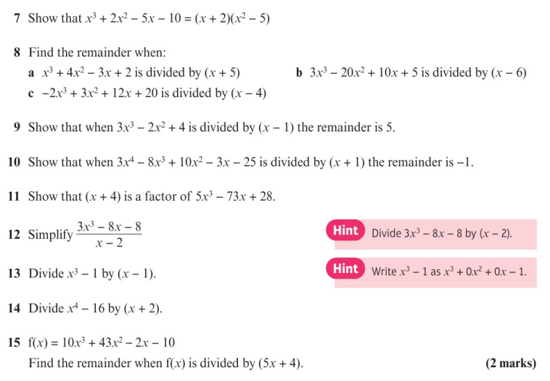
Homework Exercise

Slide 11
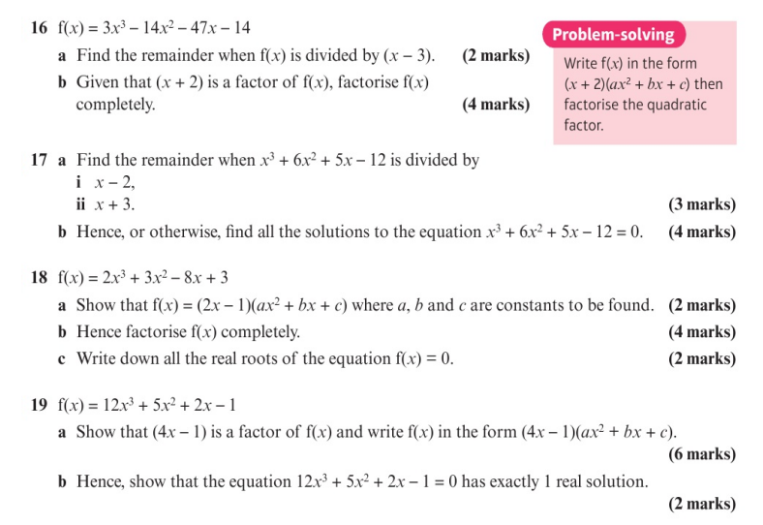
Homework Exercise

Slide 12
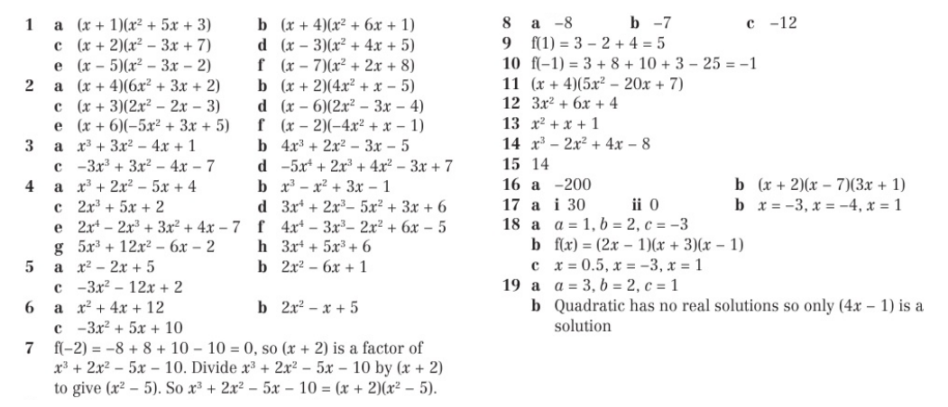
Homework Answers

