Slide 1
P1 Chapter 9: Trigonometric Ratios Solving Triangle Problems

Slide 2
















Sin or cosine rule?
Recall that whenever we have two “side-angle pairs” involved, use sine rule. If there’s 3 sides involved, we can use cosine rule. Sine rule is generally easier to use than cosine rule.
Sine
Cosine
$$3$$
$$3$$
$$100°$$
$$x$$
$$40°$$
$$a$$
$$5$$
$$5$$
Sine
Cosine
$$3$$
$$3$$
$$x$$
$$40°$$
$$2$$
$$45°$$
$$a$$
$$5$$
Sine
Cosine
Sine
Cosine

Slide 3

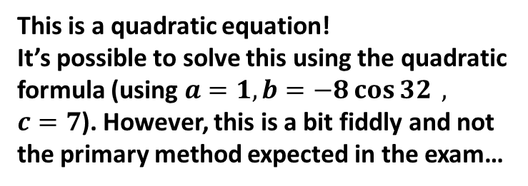




Using sine rule twice
You have | You want | Use
#4 Two sides known and a missing side not opposite known angle | Remaining side | Sine rule twice
Given there is just one angle involved, you might attempt to use the cosine rule:
$$3^{2}=x^{2}+4^{2}−\left(2×x×4×\cos{32}\right)$$
$$9=x^{2}+16−8x\cos{32}$$
$$4$$
?
$$3$$
$$32°$$
$$x$$
This is a quadratic equation!
It’s possible to solve this using the quadratic formula (using $a=1, b=−8\cos{32} ,$ $c=7$). However, this is a bit fiddly and not the primary method expected in the exam…

Slide 4


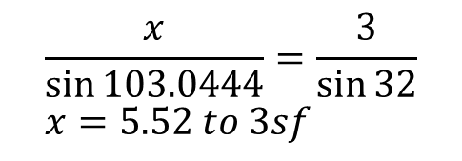
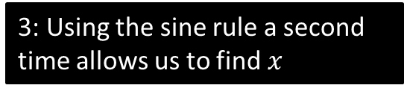



Using sine rule twice
You have | You want | Use
#4 Two sides known and a missing side not opposite known angle | Remaining side | Sine rule twice
!
2: Which means we would then know this angle.
$$4$$
?
$$180−32−44.9556=103.0444$$
1: We could use the sine rule to find this angle.
$$32°$$
$$3$$
3: Using the sine rule a second time allows us to find $x$
?
$$\frac{\sin{A}}{4}=\frac{\sin{32}}{3}$$
$$A=44.9556°$$
$$x$$
$$\frac{x}{\sin{103.0444}}=\frac{3}{\sin{32}} \\ x=5.52 to 3sf$$
?

Slide 5



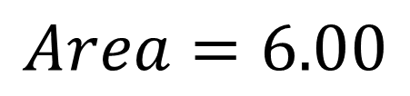


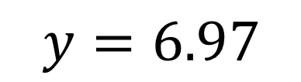


Test Your Understanding
$$9$$
?
$$y=6.97$$
$$y$$
$$61°$$
$$10$$
$$4$$
$$3$$
$$53°$$
?
$$Area=6.00$$

Slide 6




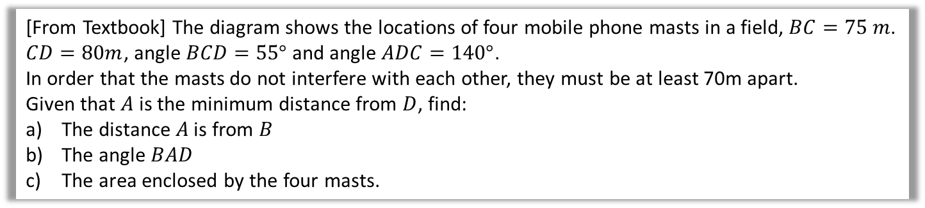






Problem Solving With Sine/Cosine Rule
[From Textbook] The diagram shows the locations of four mobile phone masts in a field, $BC=75 m$.
$CD=80m$, angle $BCD=55°$ and angle $ADC=140°$.
In order that the masts do not interfere with each other, they must be at least 70m apart.
Given that $A$ is the minimum distance from $D$, find:
The distance $A$ is from $B$
The angle $BAD$
The area enclosed by the four masts.
Using triangle $BCD$: $BD^{2}={75}^{2}+{80}^{2}−2×75×80×\cos{55°}$ $$BD=71.708…$$ Then use sine rule to find $∠BDC$: $\frac{\sin\left(∠BDC\right)}{75}=\frac{\sin\left(55\right)}{71.708} → ∠BDC=58.954$
$$∴∠BDA=81.045…$$
We can then use cosine rule on $ΔABD$:
$$AB^{2}={70}^{2}+{71.708}^{2}−2×70×71.708×cos\left(81.045\right)$$
$$AB=92.1 m \left(3sf\right)$$
Using sine rule on $ΔABD, ∠BAD=50.3° (3sf)$
By adding areas of $ΔABD$ and $ΔBDC$:
$$Area ABCD=4940 m^{2} (3sf)$$
$$B$$
a
?
$$75 m$$
$$55°$$
$$A$$
$$C$$
$$70 m$$
$$140°$$
$$80 m$$
$$D$$
b
?
c
?

Slide 7
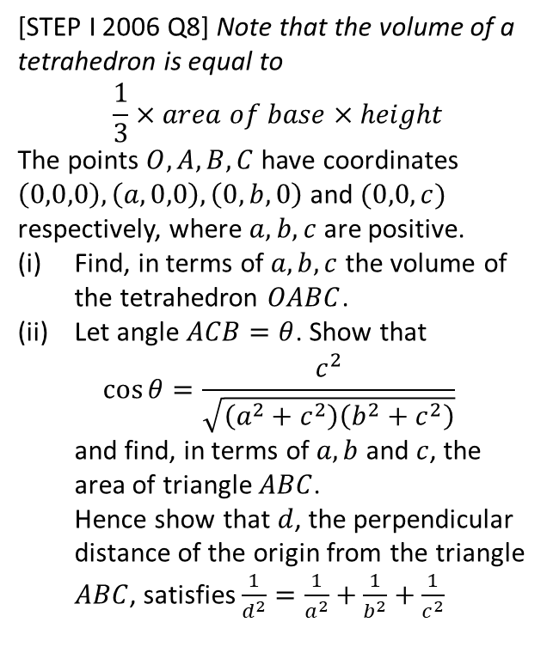
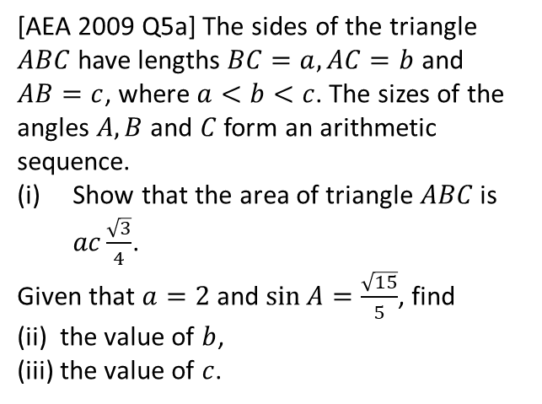
Exercise 9.4
Pearson Pure Mathematics Year 1/AS
Page 72
1
[AEA 2009 Q5a] The sides of the triangle $ABC$ have lengths $BC=a, AC=b$ and $AB=c$, where $a<b<c$. The sizes of the angles $A, B$ and $C$ form an arithmetic sequence.
Show that the area of triangle $ABC$ is $ac\frac{\sqrt{3}}{4}$.
Given that $a=2$ and $\sin{A}=\frac{\sqrt{15}}{5}$, find
(ii) the value of $b$,
(iii) the value of $c$.
2
[STEP I 2006 Q8] Note that the volume of a tetrahedron is equal to $$\frac{1}{3}×area of base×height$$
The points $O, A, B, C$ have coordinates $\left(0,0,0\right),\left(a,0,0\right), \left(0,b,0\right)$ and $(0,0,c)$ respectively, where $a,b,c$ are positive.
Find, in terms of $a,b,c$ the volume of the tetrahedron $OABC$.
Let angle $ACB=θ$. Show that $\cos{θ=\frac{c^{2}}{\sqrt{\left(a^{2}+c^{2}\right)\left(b^{2}+c^{2}\right)}}}$ and find, in terms of $a,b$ and $c$, the area of triangle $ABC$. Hence show that $d$, the perpendicular distance of the origin from the triangle $ABC$, satisfies $\frac{1}{d^{2}}=\frac{1}{a^{2}}+\frac{1}{b^{2}}+\frac{1}{c^{2}}$
Solutions to extension problems on next slides.

Slide 8
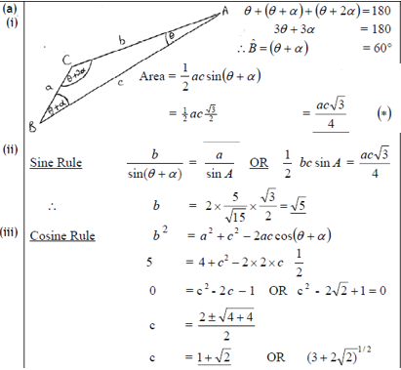
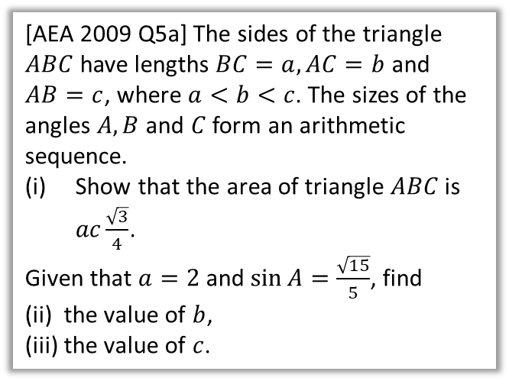
Solution to Extension Problem 1
[AEA 2009 Q5a] The sides of the triangle $ABC$ have lengths $BC=a, AC=b$ and $AB=c$, where $a<b<c$. The sizes of the angles $A, B$ and $C$ form an arithmetic sequence.
Show that the area of triangle $ABC$ is $ac\frac{\sqrt{3}}{4}$.
Given that $a=2$ and $\sin{A}=\frac{\sqrt{15}}{5}$, find
(ii) the value of $b$,
(iii) the value of $c$.

Slide 9
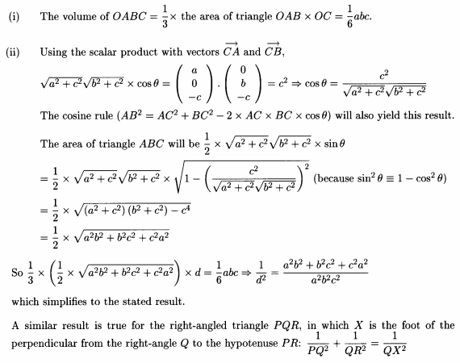
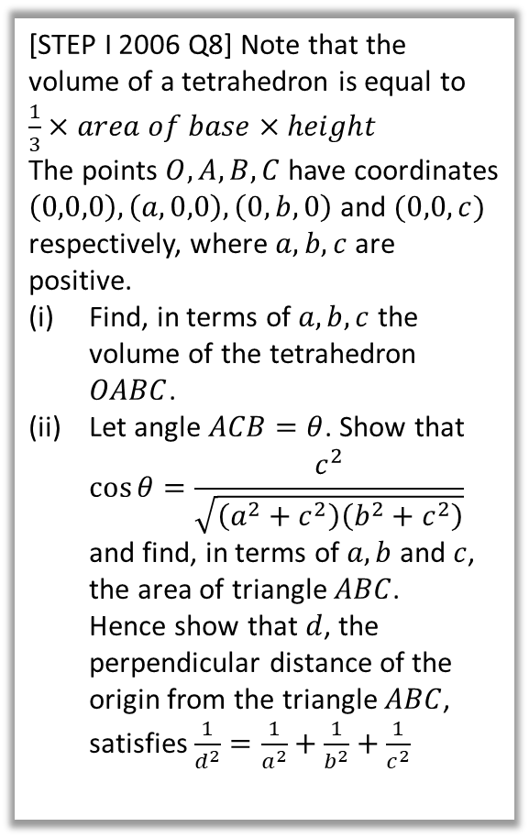
Solution to Extension Problem 2
[STEP I 2006 Q8] Note that the volume of a tetrahedron is equal to $\frac{1}{3}×area of base×height$
The points $O, A, B, C$ have coordinates $\left(0,0,0\right),\left(a,0,0\right), \left(0,b,0\right)$ and $(0,0,c)$ respectively, where $a,b,c$ are positive.
Find, in terms of $a,b,c$ the volume of the tetrahedron $OABC$.
Let angle $ACB=θ$. Show that $\cos{θ=\frac{c^{2}}{\sqrt{\left(a^{2}+c^{2}\right)\left(b^{2}+c^{2}\right)}}}$ and find, in terms of $a,b$ and $c$, the area of triangle $ABC$. Hence show that $d$, the perpendicular distance of the origin from the triangle $ABC$, satisfies $\frac{1}{d^{2}}=\frac{1}{a^{2}}+\frac{1}{b^{2}}+\frac{1}{c^{2}}$
This is FM content, but see a few lines below.

Slide 10
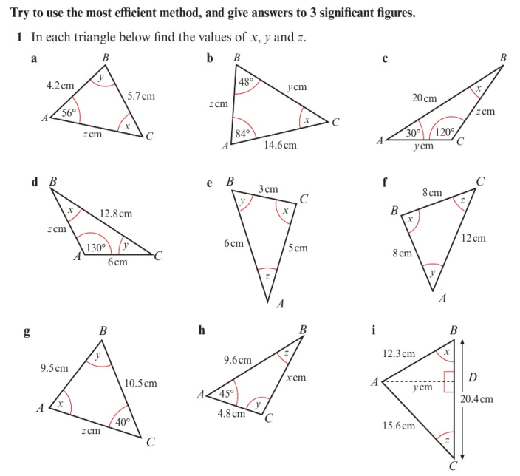
Homework Exercise

Slide 11
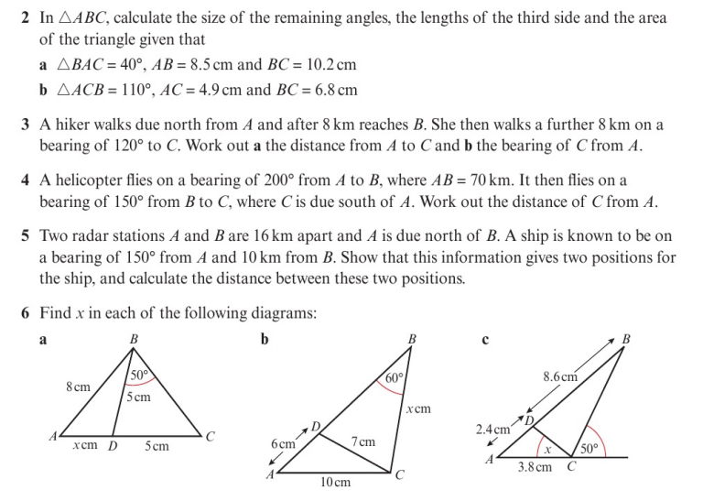
Homework Exercise

Slide 12
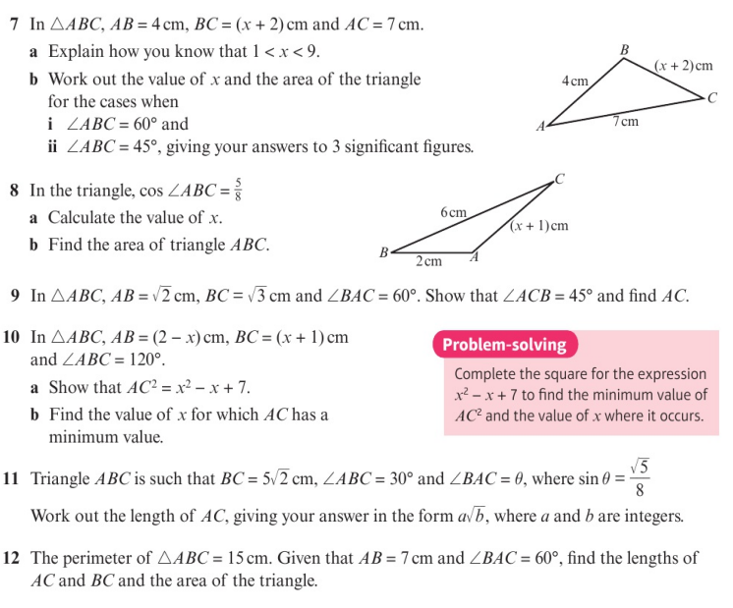
Homework Exercise

Slide 13
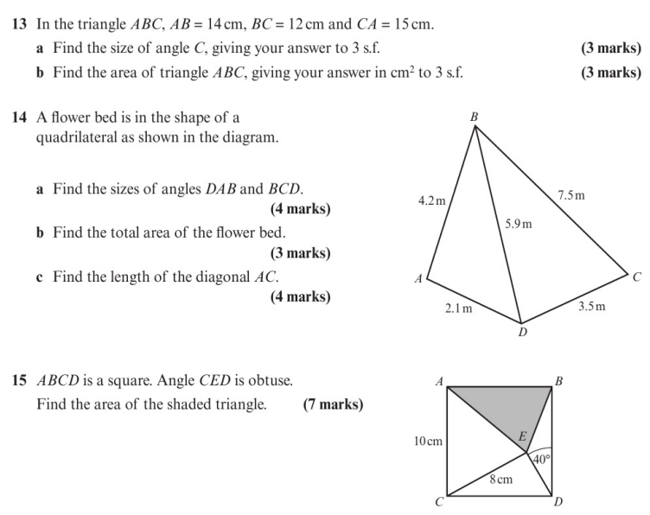
Homework Exercise

Slide 14
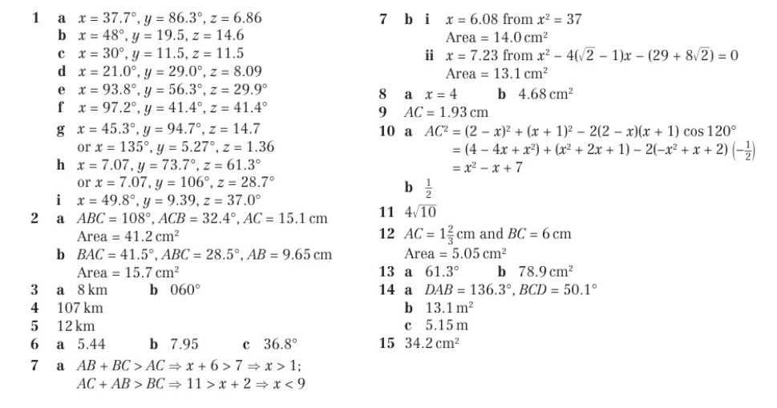
Homework Answers

