Slide 1
P2 Chapter 9: Differentiation Trigonometric Gradient Functions

Slide 2
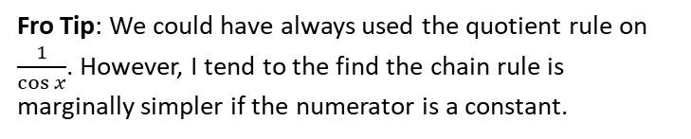

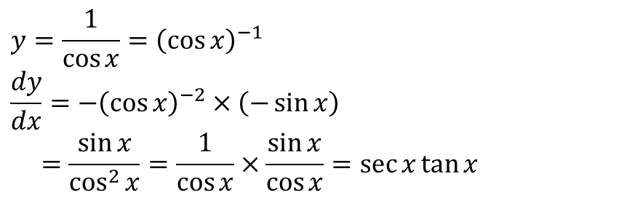




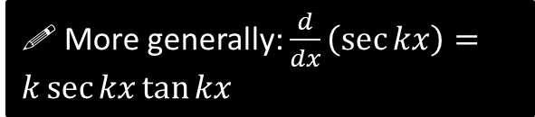
Differentiating other trigonometric functions
Differentiate $y=\tan{x}$
?
$$y=\frac{\sin{x}}{\cos{x}} \\ u=\sin{x} v=\cos{x} \\ \frac{du}{dx}=\cos{x} \frac{dv}{dx}=−\sin{x} \\ \frac{dy}{dx}=\frac{\cos^{2}{x}+\sin^{2}{x}}{\cos^{2}{x}}=\frac{1}{\cos^{2}{x}}=\sec^{2}{x}$$
Use definition of $\tan{x}$
Use quotient rule.
! More generally: $\frac{d}{dx}\left(\tan{kx}\right)=k\sec^{2}{kx}$
Fro Tip: This is in the formula booklet, but I HIGHLY encourage your to memorise it to save you time in the exam.
Differentiate $y=\sec{x}$
?
$$y=\frac{1}{\cos{x}}={\left(\cos{x}\right)}^{−1} \\ \frac{dy}{dx}=−{\left(\cos{x}\right)}^{−2}×\left(−\sin{x}\right) \\ =\frac{\sin{x}}{\cos^{2}{x}}=\frac{1}{\cos{x}}×\frac{\sin{x}}{\cos{x}}=\sec{x}\tan{x}$$
Fro Tip: We could have always used the quotient rule on $\frac{1}{\cos{x}}$. However, I tend to the find the chain rule is marginally simpler if the numerator is a constant.
! More generally: $\frac{d}{dx}\left(\sec{kx}\right)=k\sec{kx}\tan{kx}$

Slide 3
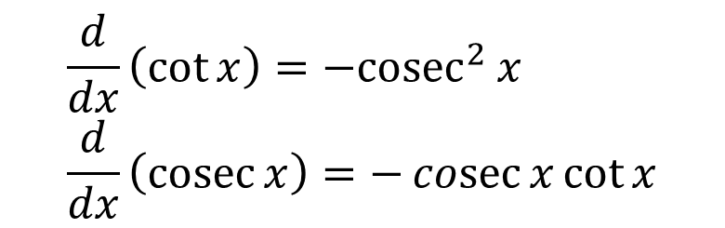

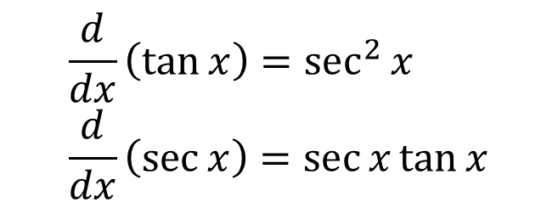

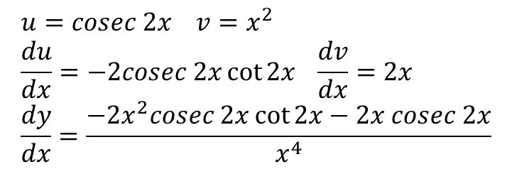
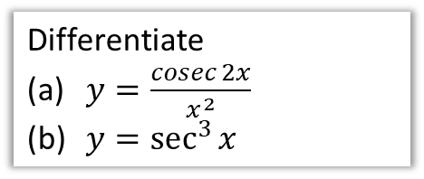
Differentiating other trigonometric functions
$$\frac{d}{dx}\left(\tan{x}\right)=\sec^{2}{x} \\ \frac{d}{dx}\left(\sec{x}\right)=\sec{x}\tan{x}$$
$$\frac{d}{dx}\left(\cot{x}\right)={−cosec}^{2}{x} \\ \frac{d}{dx}\left(\operatorname{cosec}{x}\right)=−\operatorname{cosec}{x}\cot{x}$$
Memory Tip: To memorise the two on the right, notice that when we ‘co’ the two on the left, it ‘co’s each term in the derivative, but also negates it.
Differentiate
$y=\frac{cosec 2x}{x^{2}}$
$y=\sec^{3}{x}$
b
$$y={\left(\sec{x}\right)}^{3} \\ \frac{dy}{dx}=3{\left(\sec{x}\right)}^{2}×\sec{x}\tan{x} \\ =3\sec^{3}{x}\tan{x}$$
?
a
$$u=cosec 2x v=x^{2} \\ \frac{du}{dx}=−2cosec 2x\cot{2x} \frac{dv}{dx}=2x \\ \frac{dy}{dx}=\frac{−2x^{2}cosec 2x\cot{2x}−2x cosec 2x}{x^{4}}$$
?
Observation: Notice that when differentiating a power of $sec$, the power stays the same. This will be relevant when we come to integration.

Slide 4
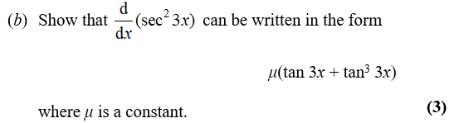
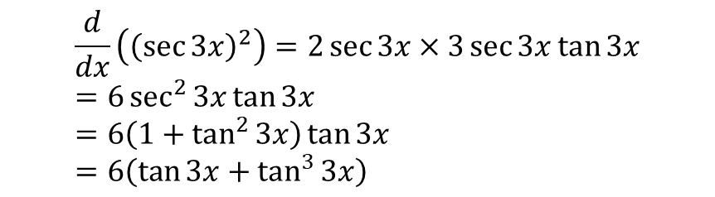
Test Your Understanding So Far
Edexcel C3 June 2013(R) Q5b
?
$$\frac{d}{dx}\left({\left(\sec{3x}\right)}^{2}\right)=2\sec{3x}×3\sec{3x}\tan{3x} \\ =6\sec^{2}{3x}\tan{3x} \\ =6\left(1+\tan^{2}{3x}\right)\tan{3x} \\ =6\left(\tan{3x}+\tan^{3}{3x}\right)$$

Slide 5
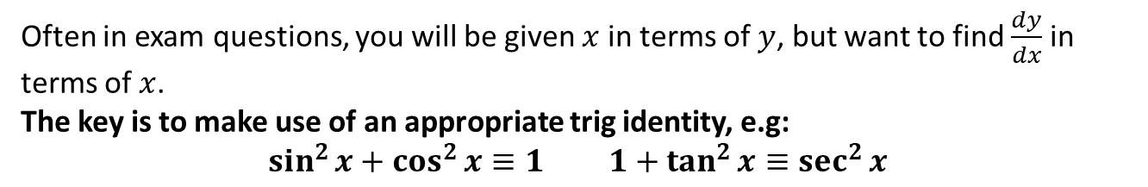

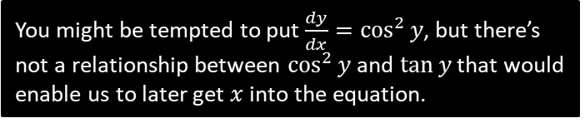

Making use of $1÷dx/dy$
Often in exam questions, you will be given $x$ in terms of $y$, but want to find $\frac{dy}{dx}$ in terms of $x$.
The key is to make use of an appropriate trig identity, e.g:
$$\sin^{2}{x}+\cos^{2}{x}≡1 1+\tan^{2}{x}≡\sec^{2}{x}$$
Given that $x=\tan{y}$, express $\frac{dy}{dx}$ in terms of $x$.
?
$$\frac{dx}{dy}=\sec^{2}{y}$$
$$\frac{dy}{dx}=\frac{1}{\sec^{2}{y}}$$
Note that $1+\tan^{2}{y}≡\sec^{2}{y}$ $$=\frac{1}{1+\tan^{2}{y}}=\frac{1}{1+x^{2}}$$
You might be tempted to put $\frac{dy}{dx}=\cos^{2}{y}$, but there’s not a relationship between $\cos^{2}{y}$ and $\tan{y}$ that would enable us to later get $x$ into the equation.
Using $1+\tan^{2}{y}≡\sec^{2}{y}$ is sensible because we know that $x=\tan{y}$.

Slide 6



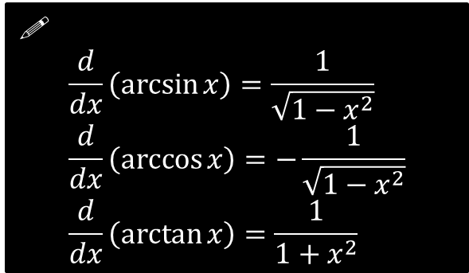

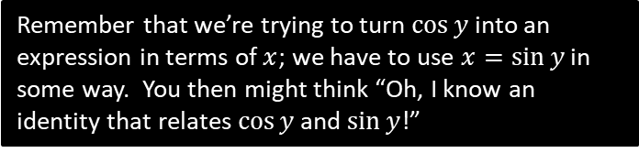
Further Examples
Show that if $y=\arcsin{x}$, then $\frac{dy}{dx}=\frac{1}{\sqrt{1−x^{2}}}$
?
$$y=\arcsin{x} \\ x=\sin{y} \\ \frac{dx}{dy}=\cos{y} \\ \frac{dy}{dx}=\frac{1}{\cos{y}}$$
We know that $sin^{2}y+cos^{2}y≡1$ $$=\frac{1}{\sqrt{1−\sin^{2}{y}}}=\frac{1}{\sqrt{1−x^{2}}}$$
Remember that we’re trying to turn $\cos{y}$ into an expression in terms of $x$; we have to use $x=\sin{y}$ in some way. You then might think “Oh, I know an identity that relates $\cos{y}$ and $\sin{y}$!”
!
$$\frac{d}{dx}\left(\arcsin{x}\right)=\frac{1}{\sqrt{1−x^{2}}} \\ \frac{d}{dx}\left(\arccos{x}\right)=−\frac{1}{\sqrt{1−x^{2}}} \\ \frac{d}{dx}\left(\arctan{x}\right)=\frac{1}{1+x^{2}}$$
Given that $y=\arcsin{x^{2}}$ find $\frac{dy}{dx}$
?
Using the chain rule:
$$\frac{dy}{dx}=\frac{1}{\sqrt{1−{\left(x^{2}\right)}^{2}}}×2x \\ =\frac{2x}{\sqrt{1−x^{4}}}$$

Slide 7
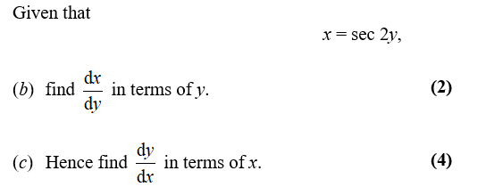
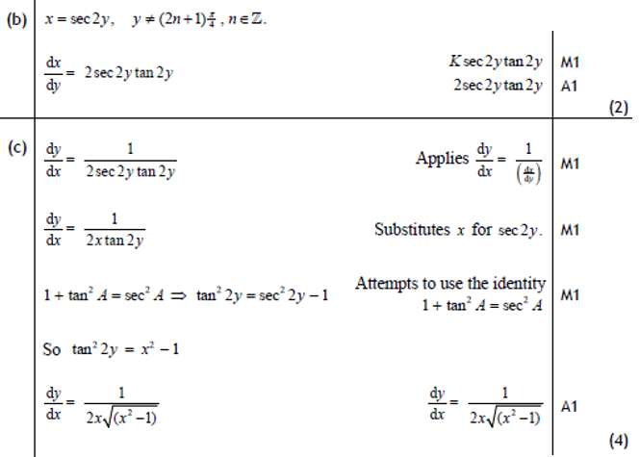

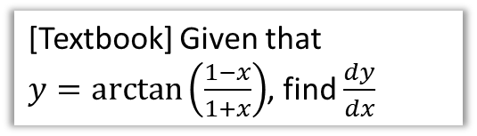
Test Your Understanding
Edexcel C3 Jan 2011 Q8b,c
[Textbook] Given that
$y=\arctan\left(\frac{1−x}{1+x}\right)$, find $\frac{dy}{dx}$
?
(Let’s use the ‘full’ Chain Rule method this time)
Let $u=\frac{1−x}{1+x}$
$$\frac{du}{dx}=…=−\frac{2}{{\left(1+x\right)}^{2}}$$
$$y=\arctan{u} \\ ∴\frac{dy}{du}=\frac{1}{1+u^{2}}$$
By the Chain Rule:
$$\frac{dy}{dx}=\frac{dy}{du}×\frac{du}{dx} \\ =\frac{1}{1+u^{2}}×\left(−\frac{2}{{\left(1+x\right)}^{2}}\right) \\ =… \\ =−\frac{1}{1+x^{2}}$$
?

Slide 8
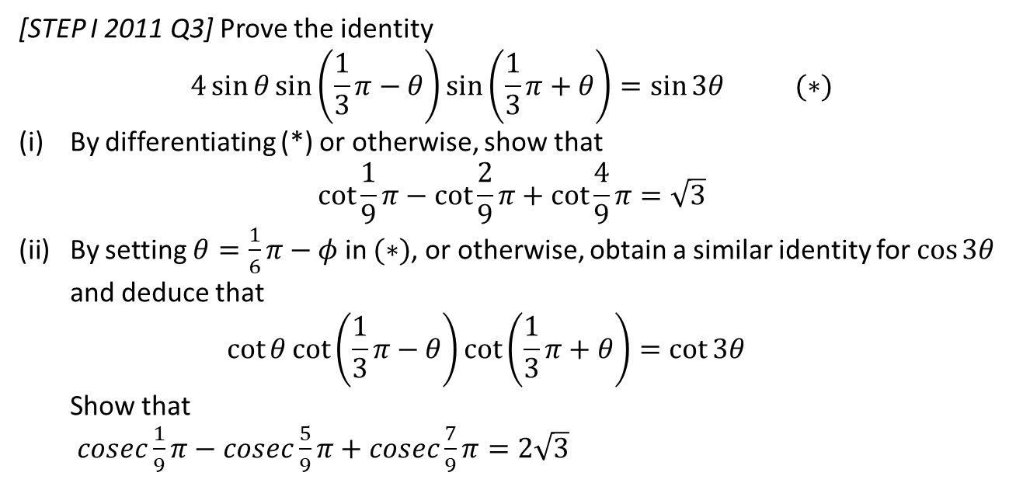
Exercise 9.6
Pearson Pure Year 2
Page 74
Extension:
[STEP I 2011 Q3] Prove the identity
$$4\sin{θ}\sin\left(\frac{1}{3}π−θ\right)\sin\left(\frac{1}{3}π+θ\right)=\sin{3θ} (∗)$$
By differentiating (*) or otherwise, show that $\cot{\frac{1}{9}π}−\cot{\frac{2}{9}π}+\cot{\frac{4}{9}π}=\sqrt{3}$
By setting $θ=\frac{1}{6}π−φ$ in $(∗)$, or otherwise, obtain a similar identity for $\cos{3θ}$ and deduce that $\cot{θ}\cot\left(\frac{1}{3}π−θ\right)\cot\left(\frac{1}{3}π+θ\right)=\cot{3θ}$ Show that $cosec\frac{1}{9}π−cosec\frac{5}{9}π+cosec\frac{7}{9}π=2\sqrt{3}$

Slide 9
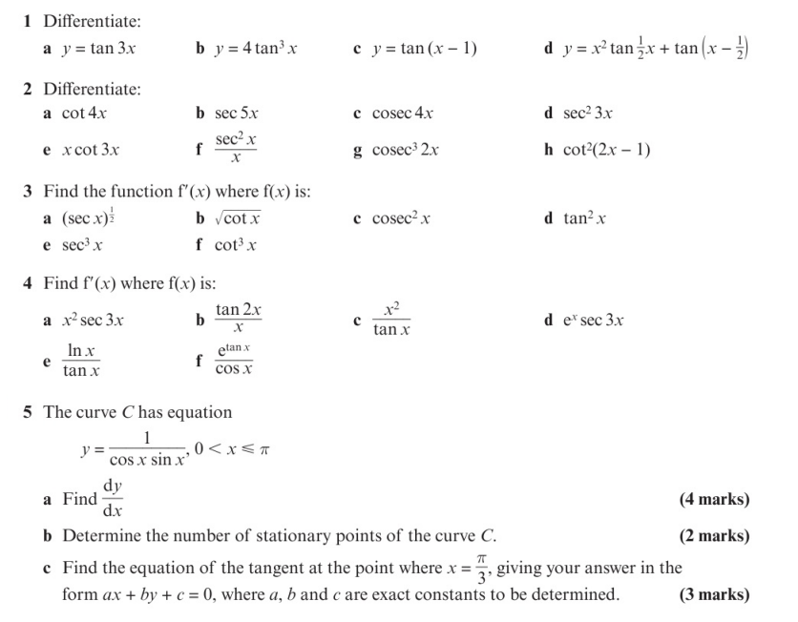
Homework Exercise

Slide 10
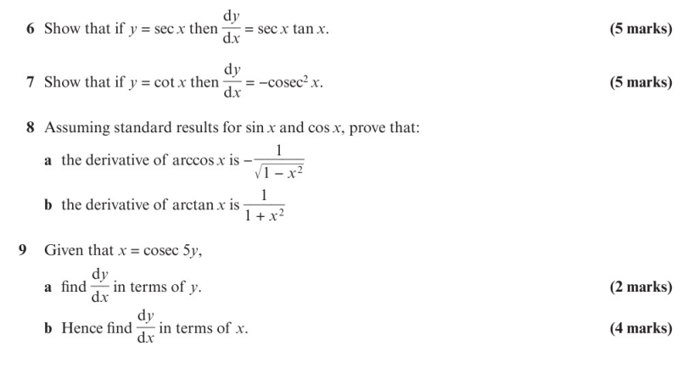
Homework Exercise

Slide 11
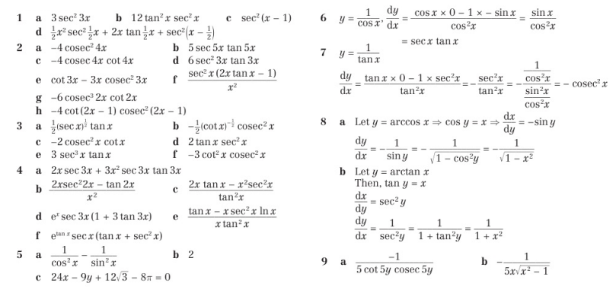
Homework Answers

