Slide 1
Stats Yr2 Chapter 3: Distribution-N Binomial Approximation

Slide 2
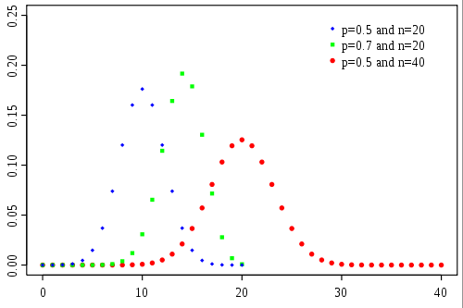
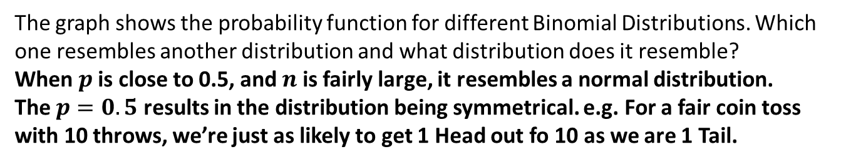


Approximating a Binomial Distribution
$$p\left(x\right)$$
$x$ (#successes)
The graph shows the probability function for different Binomial Distributions. Which one resembles another distribution and what distribution does it resemble?
When $p$ is close to 0.5, and $n$ is fairly large, it resembles a normal distribution.
The $p=0.5$ results in the distribution being symmetrical. e.g. For a fair coin toss with 10 throws, we’re just as likely to get 1 Head out fo 10 as we are 1 Tail.
?

Slide 3
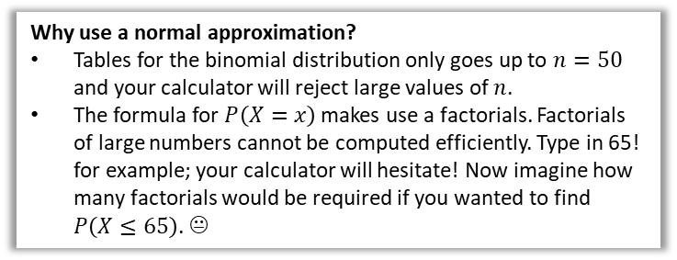
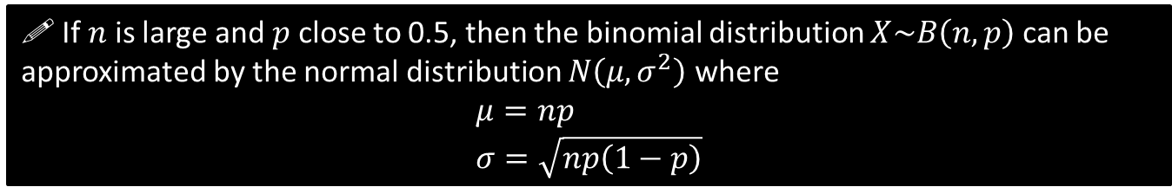
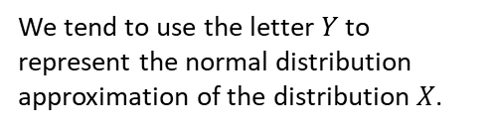

Approximating a Binomial Distribution
If we’re going to use a normal distribution to approximate a Binomial distribution, it makes sense that we set the mean and standard deviation of the normal distribution to match that of the original binomial distribution:
?
$$μ=np \\ σ=\sqrt{np\left(1−p\right)}$$
?
! If $n$ is large and $p$ close to 0.5, then the binomial distribution $X\sim B\left(n,p\right)$ can be approximated by the normal distribution $N\left(μ,σ^{2}\right)$ where
$$μ=np \\ σ=\sqrt{np\left(1−p\right)}$$
Quickfire Questions:
We tend to use the letter $Y$ to represent the normal distribution approximation of the distribution $X$.
?
$$X\sim B\left(10,0.2\right) → Y\sim N(2, 1.6)$$
?
$$X\sim B\left(20,0.5\right) → Y\sim N(10, 5)$$
Why use a normal approximation?
Tables for the binomial distribution only goes up to $n=50$ and your calculator will reject large values of $n$.
The formula for $P\left(X=x\right)$ makes use a factorials. Factorials of large numbers cannot be computed efficiently. Type in 65! for example; your calculator will hesitate! Now imagine how many factorials would be required if you wanted to find $P\left(X≤65\right)$. 😐
$$X\sim B\left(6, 0.3\right) → Y\sim N(1.8, 1.26)$$
?

Slide 4
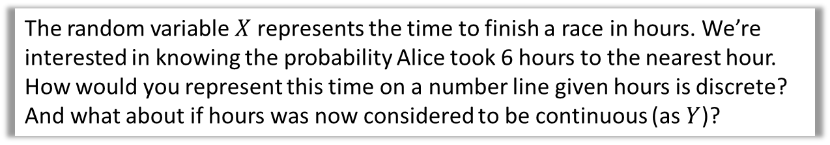

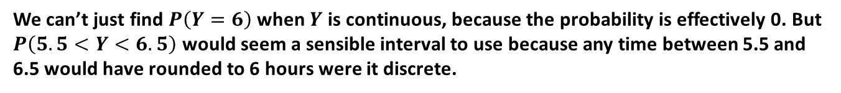
Continuity Corrections
One problem is that the outcomes of a binomial distribution (i.e. number of successes) are discrete whereas the Normal distribution is continuous.
We apply something called a continuity correction to approximate a discrete distribution using a continuous one.
The random variable $X$ represents the time to finish a race in hours. We’re interested in knowing the probability Alice took 6 hours to the nearest hour.
How would you represent this time on a number line given hours is discrete? And what about if hours was now considered to be continuous (as $Y$)?
Discrete:
$$X=6$$
$$5.5<Y<6.5$$
Continuous:
?
3 4 5 6 7 8 9 10
We can’t just find $P\left(Y=6\right)$ when $Y$ is continuous, because the probability is effectively 0. But $P\left(5.5<Y<6.5\right)$ would seem a sensible interval to use because any time between 5.5 and 6.5 would have rounded to 6 hours were it discrete.

Slide 5

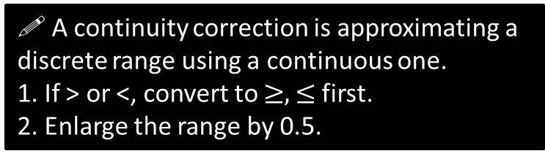



Continuity Corrections
If $X$ is a discrete variable, and $Y$ is its continuous equivalent, how would you represent $P\left(X≥5\right)$ for $Y$?
Discrete:
$$X≥5$$
?
Continuous:
$$Y≥4.5$$
Notice the range has been enlarged by an extra 0.5.
3 4 5 6 7 8 9 10
How would represent $P\left(X<9\right)$ for $Y$?
Discrete:
$$X<9→X≤8$$
?
Continuous:
$$Y≤8.5$$
3 4 5 6 7 8 9 10
! A continuity correction is approximating a discrete range using a continuous one.
1. If > or <, convert to $≥,≤$ first.
2. Enlarge the range by 0.5.

Slide 6
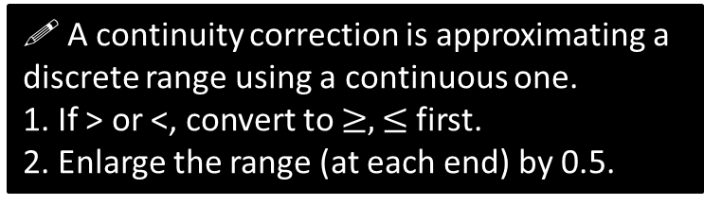
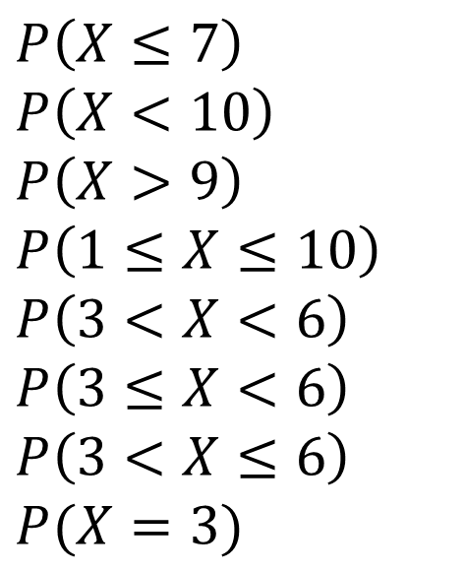

Examples
Discrete
Continuous
$$P\left(X≤7\right) \\ P\left(X<10\right) \\ P\left(X>9\right) \\ P\left(1≤X≤10\right) \\ P\left(3<X<6\right) \\ P\left(3≤X<6\right)$$
$$P\left(3<X≤6\right)$$
$$P(X=3)$$
?
$$≈P\left(Y≤7.5\right) \\ =P\left(X≤9\right)≈P\left(Y≤9.5\right) \\ =P\left(X≥10\right)≈P\left(Y≥9.5\right) \\ ≈P\left(0.5≤Y≤10.5\right) \\ =P\left(4≤X≤5\right)≈P\left(3.5≤Y≤5.5\right) \\ ≈P\left(2.5≤Y≤5.5\right)$$
$$≈P\left(3.5≤X≤6.5\right)$$
$$≈P\left(2.5≤X≤3.5\right)$$
?
?
?
?
?
?
?
! A continuity correction is approximating a discrete range using a continuous one.
1. If > or <, convert to $≥,≤$ first.
2. Enlarge the range (at each end) by 0.5.

Slide 7

Full Example
[Textbook - Edited] For a particular type of flower bulbs, 55% will produce yellow flowers. A random sample of 80 bulbs is planted.
Calculate the actual probability that there are exactly 50 flowers.
Use a normal approximation to find a estimate that there are exactly 50 flowers.
Hence determine the percentage error of the normal approximation for 50 flowers.
a
$$X\sim B\left(80, 0.55\right) \\ P\left(X=50\right)=\left(\begin{matrix}80 \\ 50 \end{matrix}\right)×{0.55}^{50}×{0.45}^{30}=0.0365$$
$$Y\sim N\left(44, 19.8\right) \\ P\left(X=50\right)≈P\left(49.5<Y<50.5\right) \\ =0.9280−0.8918=0.0362 (4dp)$$
Percentage error:
$$\frac{0.0365−0.0362}{0.0365}×100=0.82\%$$
?
b
?
c
?

Slide 8
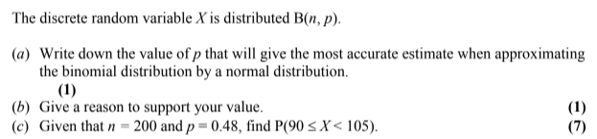
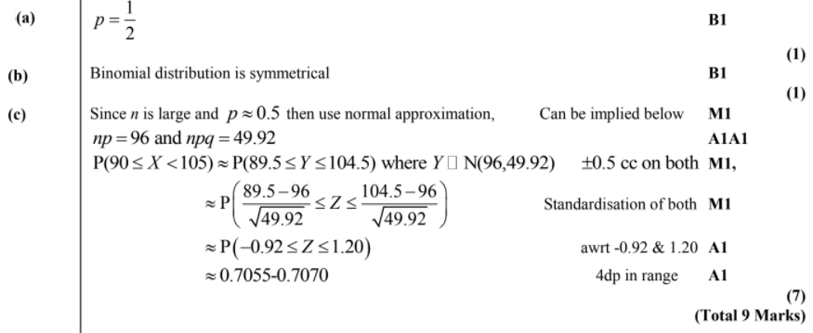

Test Your Understanding
Edexcel S2 Jan 2004 Q3
?
?
?
$$\sim$$

Slide 9
Exercise 3.6
Pearson Stats/Mechanics Year 2
Page 27-28

Slide 10
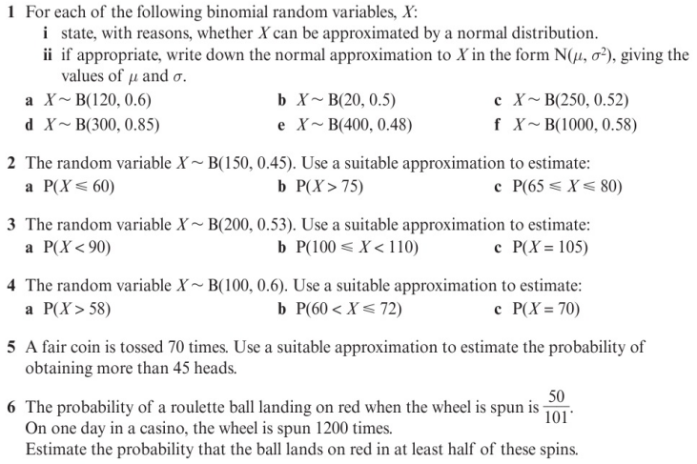
Homework Exercise

Slide 11
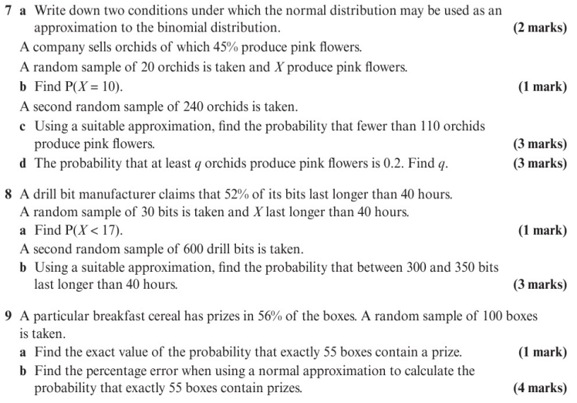
Homework Exercise

Slide 12
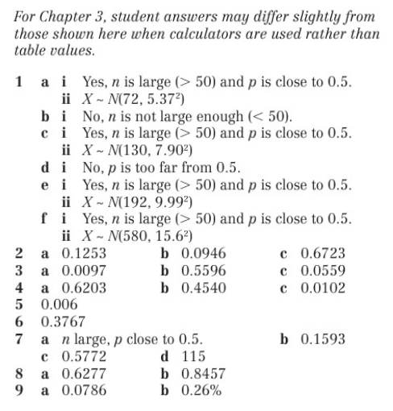
Homework Answers

