Slide 1
S1 Chapter 3: Data Representations Box Plots and Outliers

Slide 2
This Chapter Overview
We’ve seen so far how data is collected and calculations can be made. We now concentrate on how the processed data can be displayed.
BOX PLOTS AND OUTLIERS
CUMULATIVE FREQ DIAGRAMS
NEW since GCSE: Outliers.
Cumulative Frequency
HISTOGRAMS
Height
NEW since GCSE: Area is not necessarily equal to frequency.
Forming a frequency polygon by joining midpoints.

Slide 3
Box Plot recap
Box Plots allow us to visually represent the distribution of the data.
Minimum | Lower Quartile | Median | Upper Quartile | Maximum
3 | 15 | 17 | 22 | 27
Sketch
Sketch
Sketch
Sketch
Sketch
range
IQR
0 5 10 15 20 25 30
How is the IQR represented in this diagram?
Sketch
How is the range represented in this diagram?
Sketch

Slide 4
Interpreting a Box Plot
0 5 10 15 20 25 30
Age (years)
True or false: (click your answer)
“The right box represents more people than the left box.”
False
True
Each box represents 25% of people, i.e. the same number of people!
“The ages are more spread out above the median.”
False
True
The wider the box or whisker, the more spread out the values are within that 25% of the data. We’d say that the data has “positive skew”, but you are not required to know this term.

Slide 5
Outliers
An outlier is: an extreme value.
?
Outliers beyond this point
0 5 10 15 20 25 30
One common definition of an outlier is when we’re 1.5 IQRs beyond the lower and upper quartiles.
(But you will be told in the exam if the rule differs from this)

Slide 6
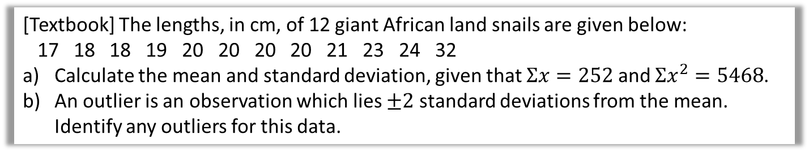
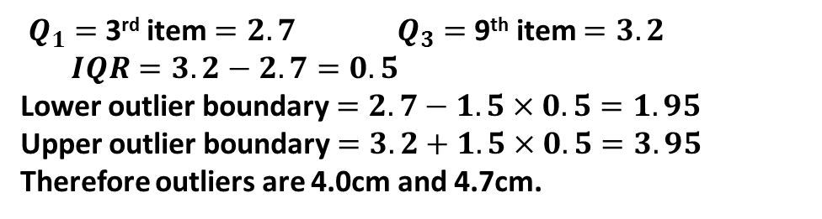

Examples
The diameters of 11 different Roman coins are measured in centimetres:
2.2 2.5 2.7 2.7 2.8 3.0 3.1 3.1 3.2 4.0 4.7
Determine the quartiles and hence any outliers.
$Q_{1}=$3rd item $=2.7$ $Q_{3}=$9th item $=3.2$
$IQR=3.2−2.7=0.5$
Lower outlier boundary $=2.7−1.5×0.5=1.95$
Upper outlier boundary $=3.2+1.5×0.5=3.95$
Therefore outliers are 4.0cm and 4.7cm.
?
[Textbook] The lengths, in cm, of 12 giant African land snails are given below:
17 18 18 19 20 20 20 20 21 23 24 32
Calculate the mean and standard deviation, given that $Σx=252$ and $Σx^{2}=5468$.
An outlier is an observation which lies $±2$ standard deviations from the mean. Identify any outliers for this data.
$$\overline{x}=\frac{252}{12}=21 cm \\ σ=\sqrt{\frac{5468}{12}−{21}^{2}}=3.83 (3sf)$$
Outlier boundaries: $21−2×3.83=13.34$ $$21+2×3.83=28.66$$
Outlier is just 32.
Context: Recall that the standard deviation is, roughly speaking, the average distance of each value from the mean. So the outlier definition is saying we’re at least twice this average distance, which seems like a sensible definition.
In Year 2, you will encounter the normal distribution, which can be used to model data which is clustered about some mean and tails off symmetrical in either direction. If this data was approximately normally distributed, then there is a 5% chance a random observation would fall outside 2 standard deviations within the mean. You will learn then how to make such probability calculations.
? a
? b

Slide 7
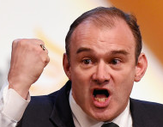

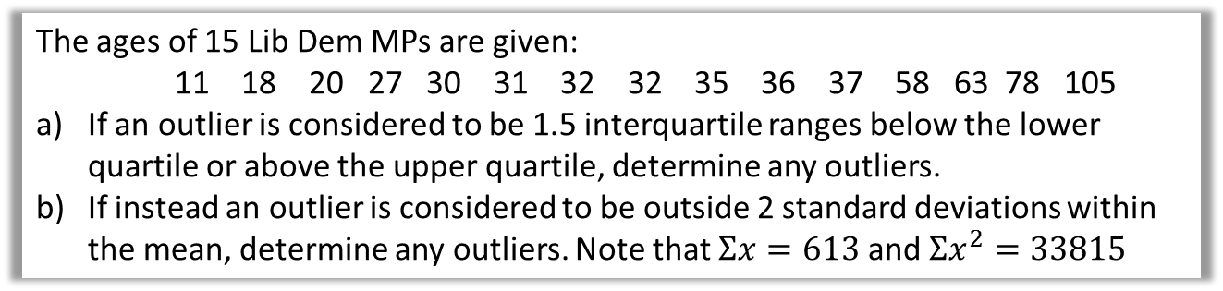
Test Your Understanding
The ages of 15 Lib Dem MPs are given:
11 18 20 27 30 31 32 32 35 36 37 58 63 78 105
If an outlier is considered to be 1.5 interquartile ranges below the lower quartile or above the upper quartile, determine any outliers.
If instead an outlier is considered to be outside 2 standard deviations within the mean, determine any outliers. Note that $Σx=613$ and $Σx^{2}=33815$
? a
$$Q_{1}=27, Q_{3}=58 , IQR=31$$
Boundaries: $27−1.5×31=−19.5$ $$58+1.5×31=104.5$$
Therefore the 105 year old is an outlier.
$$\overline{x}=\frac{613}{15}=40.9 \\ σ=\sqrt{\frac{33815}{15}−{\left(\frac{613}{15}\right)}^{2}}=24.2 (3sf)$$
Boundaries: $40.9+24.2×2=89.3$ $$40.9−24.2×2=−7.5$$
Therefore the 105 year old is an outlier.
? b

Slide 8

Box Plot Example
Smallest values | Largest values | Lower Quartile | Median | Upper Quartile
0, 3 | 21, 27 | 8 | 10 | 14
Draw a box plot to represent the above data.
?
$$IQR=14−8=6$$
Outlier boundaries:
$$14+\left(1.5×6\right)=23 \\ 8−\left(1.5×6\right)=−1$$
Exam Tip: You MUST show your outlier boundary calculations.
When there’s an outlier at one end, there’s two allowable places to put the end of the whisker:
Use a cross for each outlier.
?
The maximum value not an outlier, 21 (I think this one makes most sense).
OR the outlier boundary, 23.
Use one or the other (not both).
0 5 10 15 20 25 30

Slide 9
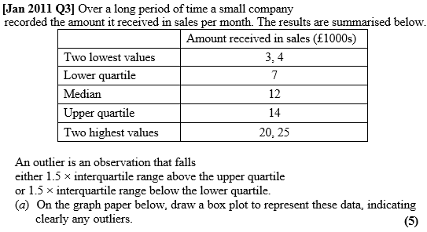
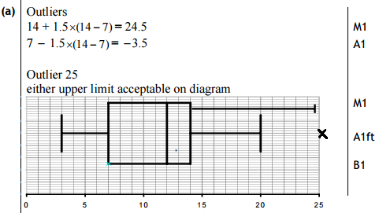

Test Your Understanding
a ?
(c) The company claims that for 75% of the months, the amount received per month is greater than £10 000. Comment on this claim, giving a reason for your answer. (2)
c ?

Slide 10
Comparing Box Plots
Box Plot comparing house prices of Croydon and Kingston-upon-Thames:
Croydon
Kingston
£400k £450k £500k £550k £600k £650k £700k £750k
“Compare the prices of houses in Croydon with those in Kingston”. (2 marks)
For 1 mark, one of:
In interquartile range of house prices in Kingston is greater than Croydon.
The range of house prices in Kingston is greater than Croydon.
For 1 mark:
“The median house price in Kingston was greater than that in Croydon.”
?
?
Include some measure of location (median is best).
Include some measure of spread.

Slide 11
Exercise 3.1 / 3.2
Pearson Pure Mathematics Year 1/AS
Pages 17 – 18 : Q5, 6
Pages 18 – 19 : Q3, 4

Slide 12
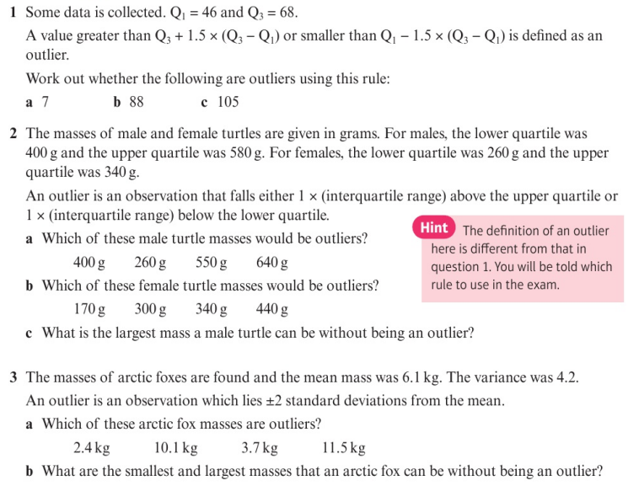
Homework Exercise

Slide 13
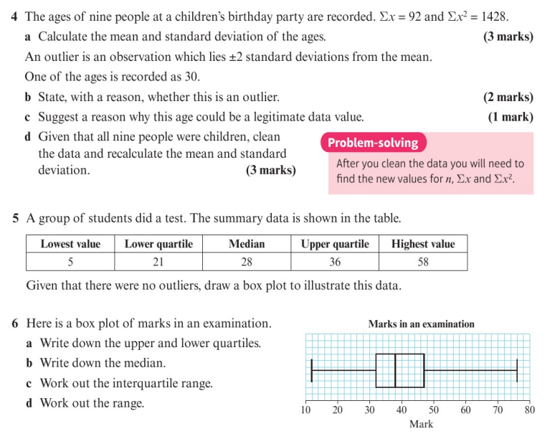
Homework Exercise

Slide 14
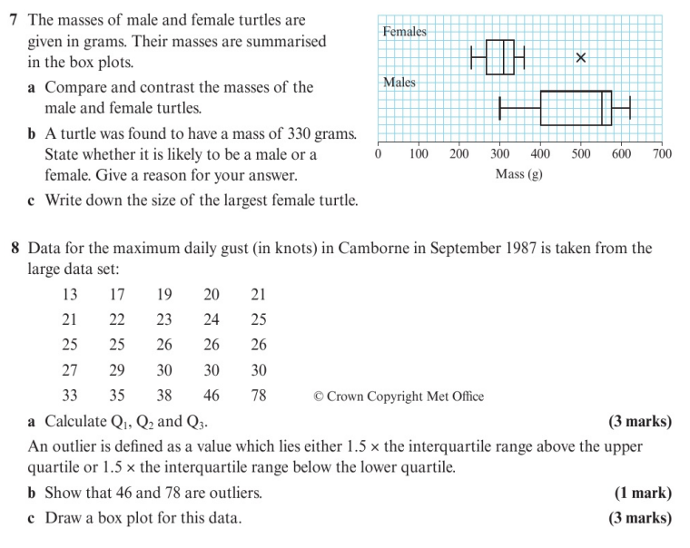
Homework Exercise

Slide 15
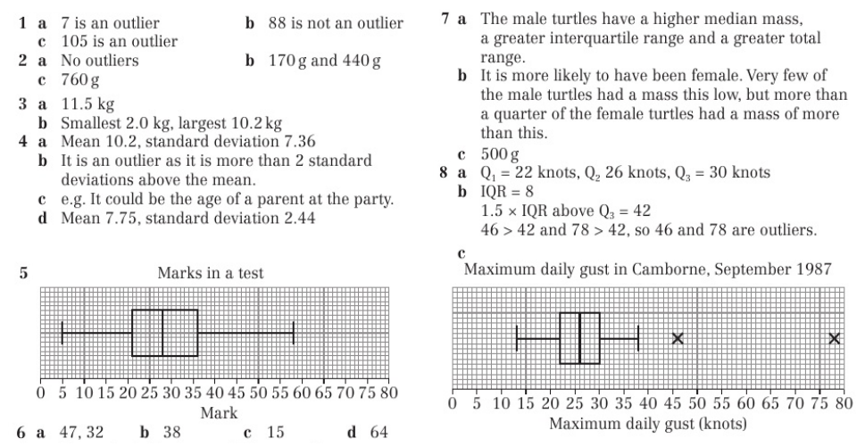
Homework Answers

