Slide 1
Iterative Formulae

Slide 2
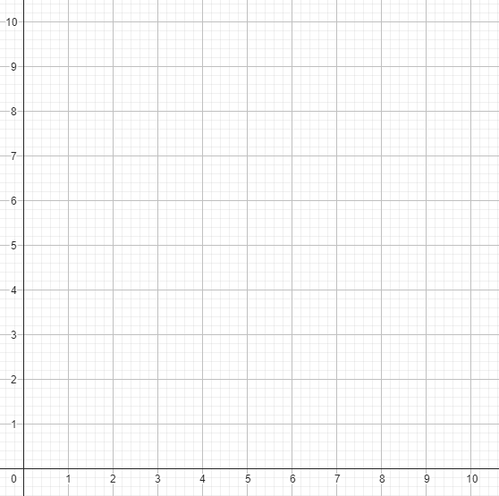
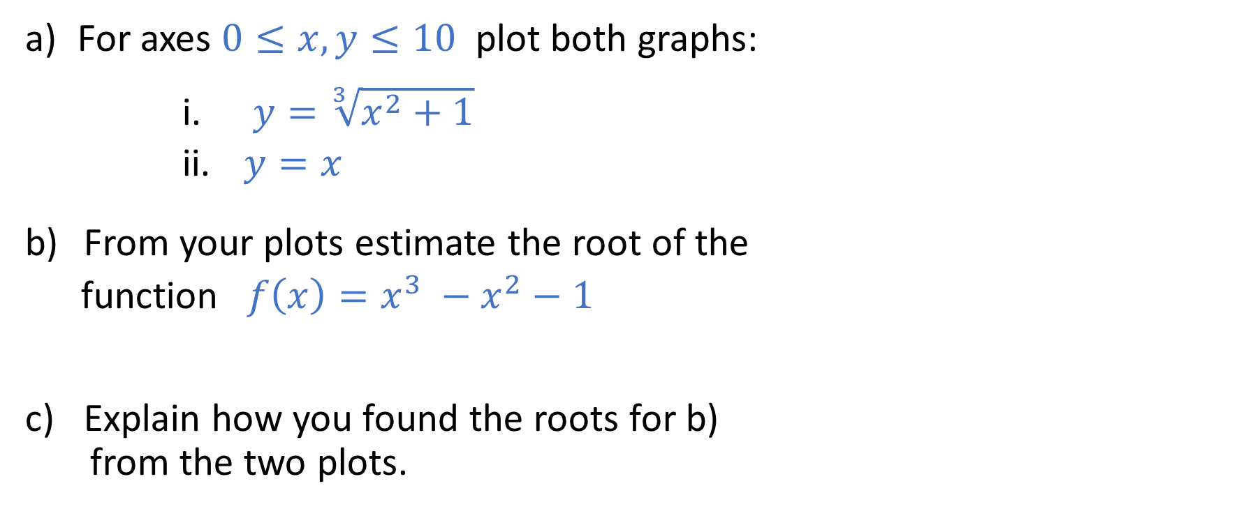
Iterative Formulae
For axes $0≤x,y≤10$ plot both graphs:
$y=\sqrt[3]{x^{2}+1}$
$y=x$
From your plots estimate the root of the
function ${f\left(x\right)=x}^{3} −x^{2}−1$
Explain how you found the roots for b)
from the two plots.

Slide 3
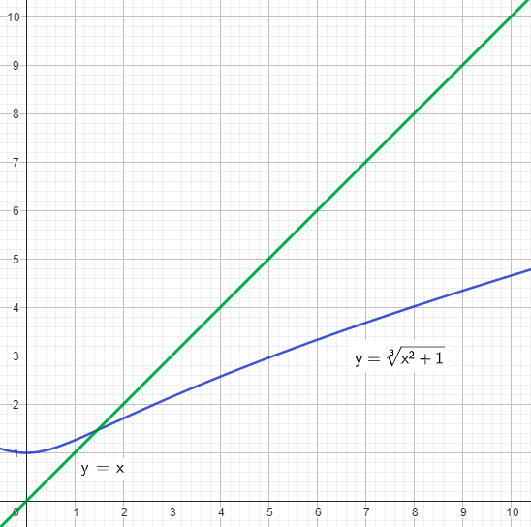
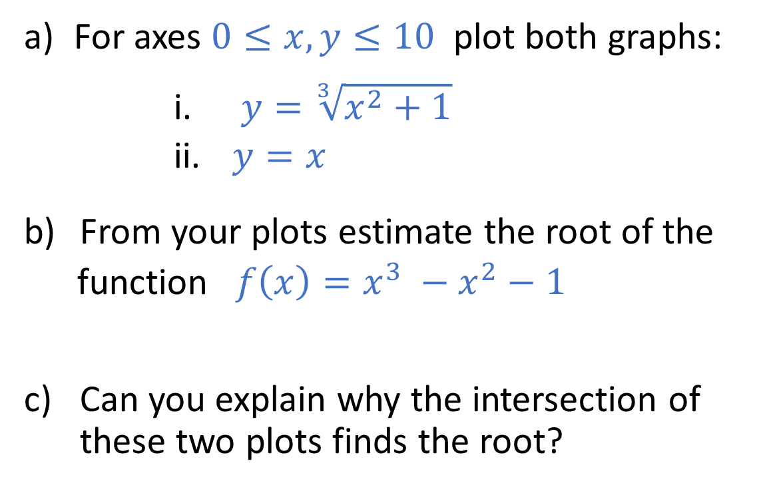
Iterative Formulae
For axes $0≤x,y≤10$ plot both graphs:
$y=\sqrt[3]{x^{2}+1}$
$y=x$
From your plots estimate the root of the
function ${f\left(x\right)=x}^{3} −x^{2}−1$
Can you explain why the intersection of these two plots finds the root?

Slide 4

Iterative Formulae
a) Take the highest power of $x$ and make that the subject for
$x^{3} −x^{2}−1=0$
b) Make the highest power of $x$ a single power to give
$$x=\sqrt[3]{x^{2}+1}$$
c) If we take $x_{0}=10$ to be an initial guess of the root we can
use this formula to make an improved guess $x_{1}$.
$$x_{1}=\sqrt[3]{{x_{0}}^{2}+1}$$

Slide 5
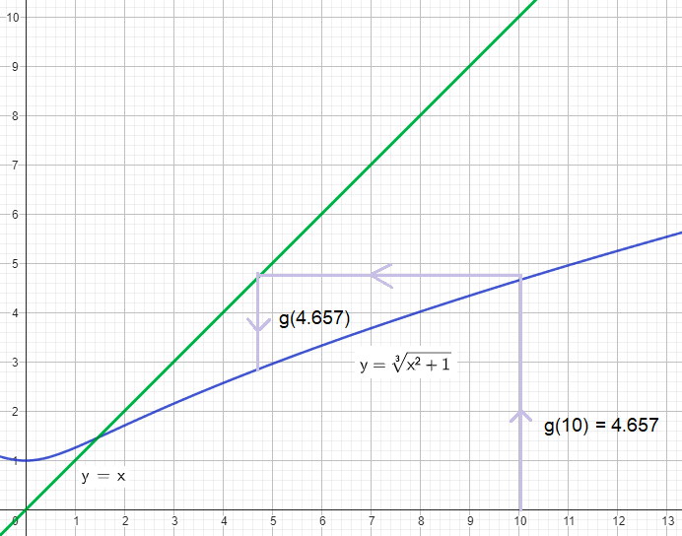
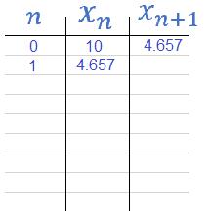

Iterative Formulae
Copy and complete the table for improved guesses as far as $x_{5}$.
e) Draw this sequence onto your graph.
f) Where is the value
of $x_{n}$ headed?

Slide 6

Summary
Functions can be rearranged to make iterative root finding formulae.
The sequence of guesses $x_{n}$ may:
make a staircase pattern until a root is found;
make a cobweb pattern (spiral) until a root is found;
run away and never find a root.

Slide 7
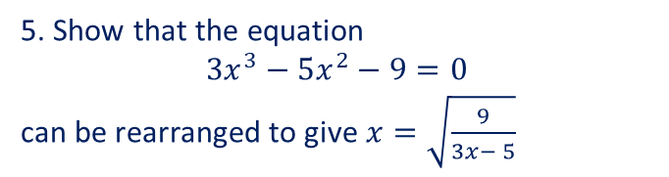
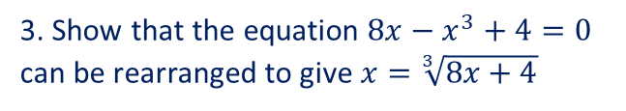
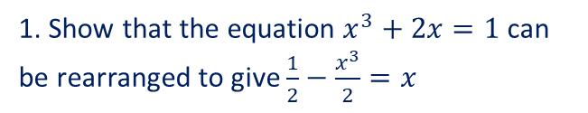
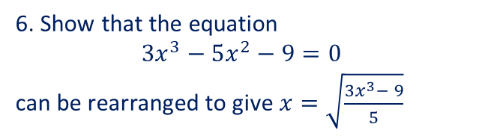
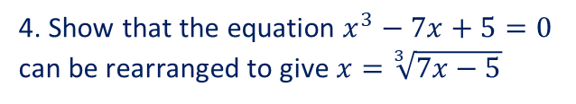
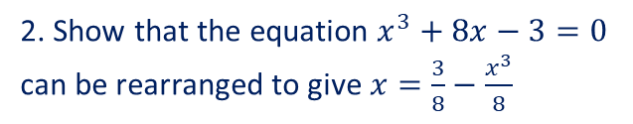
Introducing iteration – Independent Practice (2)
1. Show that the equation $x^{3}+2x=1$ can be rearranged to give $\frac{1}{2}−\frac{x^{3}}{2}=x$
2. Show that the equation $x^{3}+8x−3=0$ can be rearranged to give $x=\frac{3}{8}−\frac{x^{3}}{8}$
3. Show that the equation $8x−x^{3}+4=0$ can be rearranged to give $x=\sqrt[3]{8x+4}$
4. Show that the equation $x^{3}−7x+5=0$ can be rearranged to give $x=\sqrt[3]{7x−5}$
5. Show that the equation
$3x^{3}−5x^{2}−9=0$
can be rearranged to give $x=\sqrt{\frac{9}{3x− 5}}$
6. Show that the equation
$3x^{3}−5x^{2}−9=0$
can be rearranged to give $x=\sqrt{\frac{3x^{3}− 9}{5}}$

Slide 8



Introducing iteration – Independent Practice (2)
1. Show that the equation $x^{3}+2x=1$ can be rearranged to give $\frac{1}{2}−\frac{x^{3}}{2}=x$
2. Show that the equation $x^{3}+8x−3=0$ can be rearranged to give $x=\frac{3}{8}−\frac{x^{3}}{8}$
3. Show that the equation $8x−x^{3}+4=0$ can be rearranged to give $x=\sqrt[3]{8x+4}$
$$x^{3}+2x=1$$
$$2x=1−x^{3}$$
$$\frac{2x}{2}=\frac{1}{2}−\frac{x^{3}}{2}$$
$$x=\frac{1}{2}−\frac{x^{3}}{2}$$
$$x^{3}+8x=3$$
$$8x=3−x^{3}$$
$$\frac{8x}{8}=\frac{3}{8}−\frac{x^{3}}{8}$$
$$x=\frac{3}{8}−\frac{x^{3}}{8}$$
$$8x−x^{3}+4=0$$
$$8x+4=x^{3}$$
$$\sqrt[3]{8x+4}=x$$
$$x=\sqrt[3]{8x+4}$$
4. Show that the equation $x^{3}−7x+5=0$ can be rearranged to give $x=\sqrt[3]{7x−5}$
5. Show that the equation
$3x^{3}−5x^{2}−9=0$
can be rearranged to give $x=\sqrt{\frac{9}{3x− 5}}$
6. Show that the equation
$3x^{3}−5x^{2}−9=0$
can be rearranged to give $x=\sqrt{\frac{3x^{3}− 9}{5}}$

Slide 9



Introducing iteration – Independent Practice (2) – ANSWERS
1. Show that the equation $x^{3}+2x=1$ can be rearranged to give $\frac{1}{2}−\frac{x^{3}}{2}=x$
2. Show that the equation $x^{3}+8x−3=0$ can be rearranged to give $x=\frac{3}{8}−\frac{x^{3}}{8}$
3. Show that the equation $8x−x^{3}+4=0$ can be rearranged to give $x=\sqrt[3]{8x+4}$
$$x^{3}+2x=1$$
$$2x=1−x^{3}$$
$$\frac{2x}{2}=\frac{1}{2}−\frac{x^{3}}{2}$$
$$x=\frac{1}{2}−\frac{x^{3}}{2}$$
$$x^{3}+8x=3$$
$$8x=3−x^{3}$$
$$\frac{8x}{8}=\frac{3}{8}−\frac{x^{3}}{8}$$
$$x=\frac{3}{8}−\frac{x^{3}}{8}$$
$$8x−x^{3}+4=0$$
$$8x+4=x^{3}$$
$$\sqrt[3]{8x+4}=x$$
$$x=\sqrt[3]{8x+4}$$
4. Show that the equation $x^{3}−7x+5=0$ can be rearranged to give $x=\sqrt[3]{7x−5}$
5. Show that the equation
$3x^{3}−5x^{2}−9=0$
can be rearranged to give $x=\sqrt{\frac{9}{3x− 5}}$
6. Show that the equation
$3x^{3}−5x^{2}−9=0$
can be rearranged to give $x=\sqrt{\frac{3x^{3}− 9}{5}}$
$$x^{3}−7x+5=0$$
$$x^{3}=7x−5$$
$$x=\sqrt[3]{7x−5}$$
$$3x^{3}−5x^{2}−9=0$$
$$x^{2}\left(3x−5\right)−9=0$$
$$x^{2}\left(3x−5\right)=9$$
$$x^{2}=\frac{9}{3x−5}$$
$$∴x=\sqrt{\frac{9}{3x−5}}$$
$$3x^{3}−5x^{2}−9=0$$
$$3x^{3}−9=5x^{2}$$
$$\frac{3x^{3}−9}{5}=x^{2}$$
$$∴x=\sqrt{\frac{3x^{3}−9}{5}}$$

Slide 10




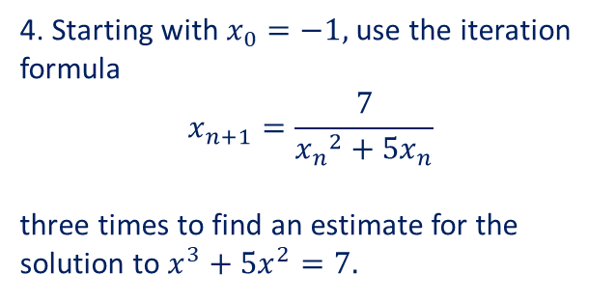

Using iteration to find a solution – Independent Practice
1. Using,
$$x_{n+1}=5+\frac{9}{{x_{n}}^{2}}$$
Starting with $x_{0}=4.$
Find the values of $x_{1},$ $x_{2}$ and $x_{3}$.
2. Using,
$$x_{n+1}=8+\frac{11}{{x_{n}}^{3}}$$
Starting with $x_{0}=7.$
Find the values of $x_{1},$ $x_{2}$ and $x_{3}$.
3. Starting with $x_{0}=6,$ use the iteration formula
$$x_{n+1}=\sqrt[3]{7{x_{n}}^{2}−3}$$
three times to find an estimate for the solution to $x^{3}−{7x}^{2}+3=0.$
4. Starting with $x_{0}=−1,$ use the iteration formula
$$x_{n+1}=\frac{7}{{x_{n}}^{2}+{5x}_{n}}$$
three times to find an estimate for the solution to $x^{3}+{5x}^{2}=7.$
5. Starting with $x_{0}=2,$ use the iteration formula
$$x_{n+1}=\sqrt[5]{9{x_{n}}^{3}−3}$$
three times to find an estimate for the solution to $x^{5}−{9x}^{3}+3=0.$
6.
Show that the equation $x^{4}−{9x}^{2}+5=0$ has a solution between $x=2$ and $x=3.$
Show that the equation $x^{4}−{9x}^{2}+5=0$ can be rearranged to give $x_{n+1}=\sqrt[4]{9{x_{n}}^{2}−5}$
Starting with $x_{0}=2$, use the iteration formula $x_{n+1}=\sqrt[4]{9{x_{n}}^{2}−5}$ three times to find an estimate for the solution of
$$x^{4}−{9x}^{2}+5=0$$

Slide 11



Using iteration to find a solution – Independent Practice
1. Using,
$$x_{n+1}=5+\frac{9}{{x_{n}}^{2}}$$
Starting with $x_{0}=4.$
Find the values of $x_{1},$ $x_{2}$ and $x_{3}$.
2. Using,
$$x_{n+1}=8+\frac{11}{{x_{n}}^{3}}$$
Starting with $x_{0}=7.$
Find the values of $x_{1},$ $x_{2}$ and $x_{3}$.
3. Starting with $x_{0}=6,$ use the iteration formula
$$x_{n+1}=\sqrt[3]{7{x_{n}}^{2}−3}$$
three times to find an estimate for the solution to $x^{3}−{7x}^{2}+3=0.$
$$x_{1}=5.5625$$
$x_{2}=5.290872365$
$x_{3}=5.321505154$
$x_{1}=8.032069971$ $x_{2}=8.021228057$ $x_{3}=8.021314252$
$x_{1}=6.291194552$ $x_{2}=6.495491171$ $x_{3}=6.63686017$
4. Starting with $x_{0}=−1,$ use the iteration formula
$$x_{n+1}=\frac{7}{{x_{n}}^{2}+{5x}_{n}}$$
three times to find an estimate for the solution to $x^{3}+{5x}^{2}=7.$
5. Starting with $x_{0}=2,$ use the iteration formula
$$x_{n+1}=\sqrt[5]{9{x_{n}}^{3}−3}$$
three times to find an estimate for the solution to $x^{5}−{9x}^{3}+3=0.$
6.
Show that the equation $x^{4}−{9x}^{2}+5=0$ has a solution between $x=2$ and $x=3.$
Show that the equation $x^{4}−{9x}^{2}+5=0$ can be rearranged to give $x_{n+1}=\sqrt[4]{9{x_{n}}^{2}−5}$
Starting with $x_{0}=2$, use the iteration formula $x_{n+1}=\sqrt[4]{9{x_{n}}^{2}−5}$ three times to find an estimate for the solution of
$$x^{4}−{9x}^{2}+5=0$$

Slide 12


Using iteration to find a solution – Independent Practice – ANSWERS
1. Using,
$$x_{n+1}=5+\frac{9}{{x_{n}}^{2}}$$
Starting with $x_{0}=4.$
Find the values of $x_{1},$ $x_{2}$ and $x_{3}$.
2. Using,
$$x_{n+1}=8+\frac{11}{{x_{n}}^{3}}$$
Starting with $x_{0}=7.$
Find the values of $x_{1},$ $x_{2}$ and $x_{3}$.
3. Starting with $x_{0}=6,$ use the iteration formula
$$x_{n+1}=\sqrt[3]{7{x_{n}}^{2}−3}$$
three times to find an estimate for the solution to $x^{3}−{7x}^{2}+3=0.$
$$x_{1}=5.5625$$
$x_{2}=5.290872365$
$x_{3}=5.321505154$
$x_{1}=8.032069971$ $x_{2}=8.021228057$ $x_{3}=8.021314252$
$x_{1}=6.291194552$ $x_{2}=6.495491171$ $x_{3}=6.63686017$
4. Starting with $x_{0}=−1,$ use the iteration formula
$$x_{n+1}=\frac{7}{{x_{n}}^{2}+{5x}_{n}}$$
three times to find an estimate for the solution to $x^{3}+{5x}^{2}=7.$
5. Starting with $x_{0}=2,$ use the iteration formula
$$x_{n+1}=\sqrt[5]{9{x_{n}}^{3}−3}$$
three times to find an estimate for the solution to $x^{5}−{9x}^{3}+3=0.$
6.
Show that the equation $x^{4}−{9x}^{2}+5=0$ has a solution between $x=2$ and $x=3.$
Show that the equation $x^{4}−{9x}^{2}+5=0$ can be rearranged to give $x_{n+1}=\sqrt[4]{9{x_{n}}^{2}−5}$
Starting with $x_{0}=2$, use the iteration formula $x_{n+1}=\sqrt[4]{9{x_{n}}^{2}−5}$ three times to find an estimate for the solution of
$$x^{4}−{9x}^{2}+5=0$$
$$x_{1}=2.332221626$$
$$x_{2}=2.565650608$$
$$x_{3}=2.720417198$$
$$x_{1}=−1.75$$
$x_{2}=−1.230769231$ $x_{3}=−1.508928571$
See solution on the next slide

Slide 13


Using iteration to find a solution – Independent Practice – ANSWERS
6.
Show that the equation $x^{4}−{9x}^{2}+5=0$ has a solution between $x=2$ and $x=3.$
Show that the equation $x^{4}−{9x}^{2}+5=0$ can be rearranged to give $x_{n+1}=\sqrt[4]{9{x_{n}}^{2}−5}$
Starting with $x_{0}=2$, use the iteration formula $x_{n+1}=\sqrt[4]{9{x_{n}}^{2}−5}$ three times to find an estimate for the solution of
$x^{4}−{9x}^{2}+5=0$
a) $2^{4}−9({2)}^{2}+5=−15$
$${ 3}^{4}− 9({3)}^{2}+5=5$$
A change of sign has occurred so there is a solution between $x=2$ and $x=3$
b)
$$x^{4}−{9x}^{2}+5=0$$
$$x^{4}={9x}^{2}−5$$
$$x=\sqrt[4]{9x^{2}−5}$$
$$x_{n+1}=\sqrt[4]{9{x_{n}}^{2}−5}$$
c)
$$x_{1}=2.359611062$$
$$x_{2}=2.591599671$$
$$x_{3}=2.728792368$$

Slide 14
Exercise 13.3 page 183

