Slide 1
P2 Chapter 1: Algebra Techniques
Partial Fractions

Slide 2
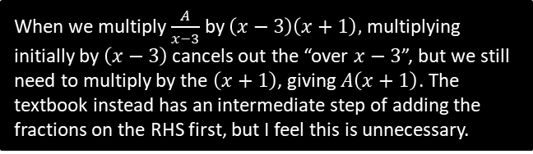
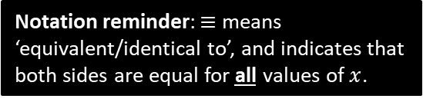





Partial Fractions
If the denominator is a product of a linear terms, it can be split into the sum of ‘partial fractions’, where each denominator is a single linear term.
$$\frac{6x−2}{\left(x−3\right)\left(x+1\right)}≡\frac{A}{x−3}+\frac{B}{x+1}$$
Notation reminder: $≡$ means ‘equivalent/identical to’, and indicates that both sides are equal for all values of $x$.
Method 1: Substitution
Method 2: Comparing Coefficients
?
?
$$6x−2≡A\left(x+1\right)+B\left(x−3\right)$$
Let $x=−1$:
$$−8=−4B → B=2$$
Let $x=3$:
$$16=4A → A=4$$
$$∴\frac{6x−2}{\left(x−3\right)\left(x+1\right)}≡\frac{4}{x−3}+\frac{2}{x+1}$$
We don’t like fractions, so multiply through by denominator of LHS.
See note below.
$$6x−2≡A\left(x+1\right)+B\left(x−3\right)$$
Comparing coefficients of $x$ terms:
$$6=A+B$$
Comparing constant terms:
$$−2=A−3B$$
Solving simultaneously:
$$A=4, B=2$$
$$∴\frac{6x−2}{\left(x−3\right)\left(x+1\right)}≡\frac{4}{x−3}+\frac{2}{x+1}$$
If two sides are identical, $x$ terms must match, constant terms must match and so on, e.g. if
$$3x+4≡ax+b$$
Then $a=3$ and $b=4$, whereas this is not necessarily true for a normal equality.
Choose values of $x$ that make one of brackets disappear.
When we multiply $\frac{A}{x−3}$ by $\left(x−3\right)\left(x+1\right),$ multiplying initially by $\left(x−3\right)$ cancels out the “over $x−3$”, but we still need to multiply by the $\left(x+1\right)$, giving $A\left(x+1\right)$. The textbook instead has an intermediate step of adding the fractions on the RHS first, but I feel this is unnecessary.

Slide 3

Further Example
Given that $\frac{6x^{2}+5x−2}{x\left(x−1\right)\left(2x+1\right)}≡\frac{A}{x}+\frac{B}{x−1}+\frac{C}{2x+1}$, find the values of the constants $A,B,C$.
?
$$6x^{2}+5x−2≡A\left(x−1\right)\left(2x+1\right)+Bx\left(2x+1\right)+Cx\left(x−1\right)$$
Let $x=1$:
$$9=3B → B=3$$
Let $x=−\frac{1}{2}$:
$$−3=\frac{3}{4}C → C=−4$$
Let $x=0$:
$$−2=−A → A=2$$
$$∴ \frac{6x^{2}+5x−2}{x\left(x−1\right)\left(2x+1\right)}≡\frac{2}{x}+\frac{3}{x−1}−\frac{4}{2x+1}$$

Slide 4

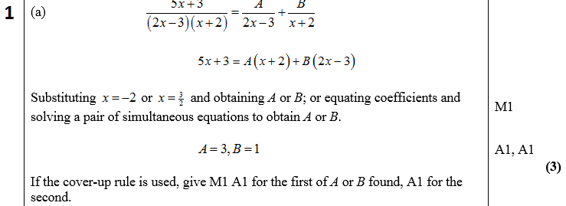
Test Your Understanding
C4 June 2005 Q3a
?

Slide 5
Exercise 1.3
Pearson Pure Mathematics Year 2/AS
Page 2

Slide 6
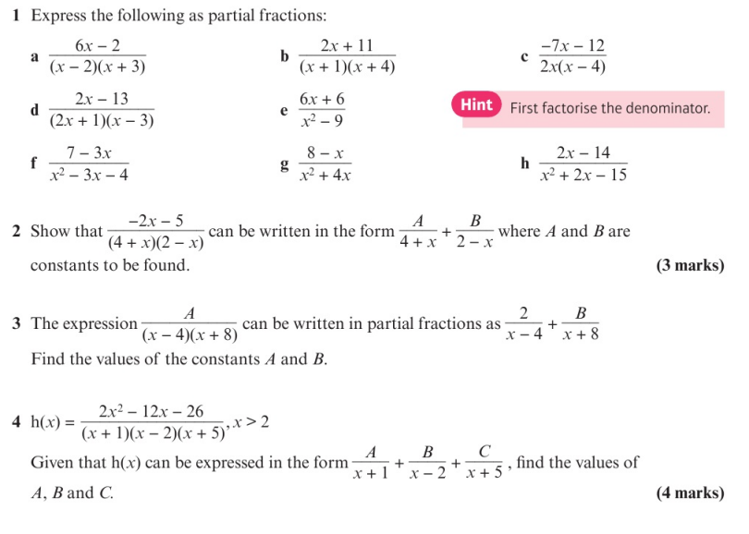
Homework Exercise

Slide 7
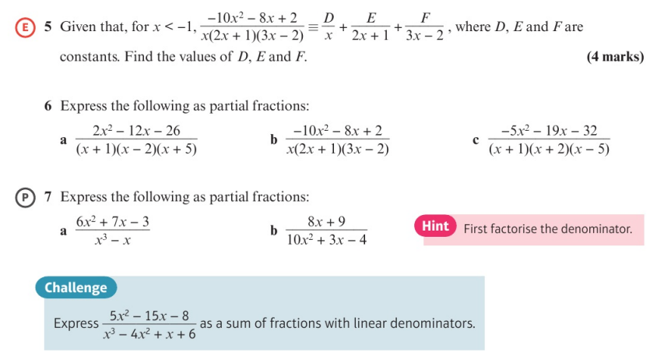
Homework Exercise

Slide 8
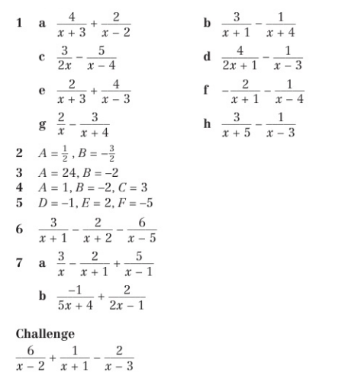
Homework Answers

