Slide 1
P1 Chapter 8: Binomial Expansion Pascal’s Triangle

Slide 2

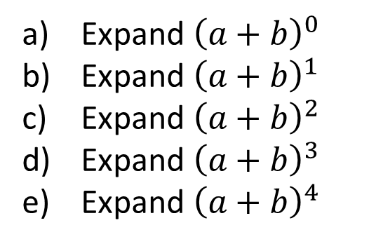
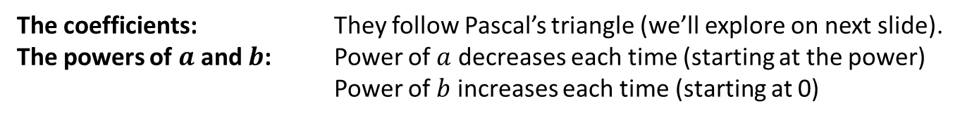
Starter
Expand ${\left(a+b\right)}^{0}$
Expand ${\left(a+b\right)}^{1}$
Expand ${\left(a+b\right)}^{2}$
Expand ${\left(a+b\right)}^{3}$
Expand ${\left(a+b\right)}^{4}$
$$1$$
$$1a + 1b$$
$$1a^{2} + 2ab + 1b^{2}$$
$$1a^{3} + 3a^{2}b + 3ab^{2} + 1b^{3}$$
$$1a^{4} + 4a^{3}b + 6a^{2}b^{2} + 4ab^{3} + 1b^{4}$$
?
?
?
?
?
What do you notice about:
?
The coefficients: They follow Pascal’s triangle (we’ll explore on next slide).
The powers of $a$ and $b$: Power of $a$ decreases each time (starting at the power)
Power of $b$ increases each time (starting at 0)
?

Slide 3
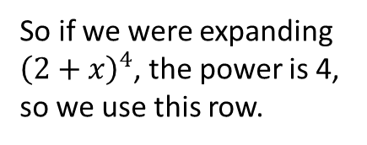
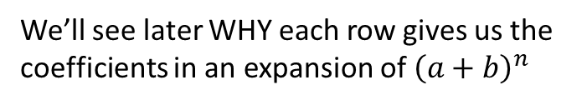
More on Pascal’s Triangle
The second number of each row tells us what row we should use for an expansion.
In Pascal’s Triangle, each term (except for the 1s) is the sum of the two terms above.
1
So if we were expanding ${\left(2+x\right)}^{4}$, the power is 4, so we use this row.
1
1
1
2
1
Fro Tip: I highly recommend memorising each row up to what you see here.
1
3
3
1
1
4
6
4
1
1
5
10
10
1
1
We’ll see later WHY each row gives us the coefficients in an expansion of ${\left(a+b\right)}^{n}$

Slide 4

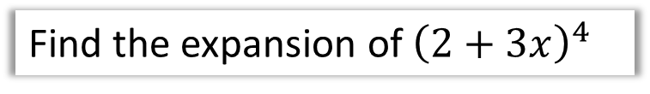
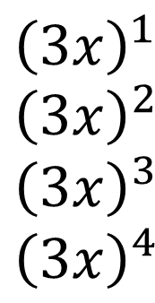
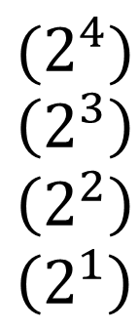
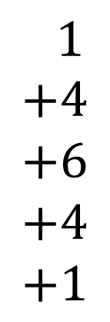
Example
Next have descending or ascending powers of one of the terms, going between 0 and 4 (note that if the power is 0, the term is 1, so we need not write it).
Find the expansion of ${\left(2+3x\right)}^{4}$
$$1 \\ +4 \\ +6 \\ +4 \\ +1$$
$$(2^{4}) \\ \left(2^{3}\right) \\ \left(2^{2}\right) \\ \left(2^{1}\right)$$
$${\left(2+3x\right)}^{4}=$$
$${\left(3x\right)}^{1} \\ {\left(3x\right)}^{2} \\ {\left(3x\right)}^{3} \\ {\left(3x\right)}^{4}$$
First fill in the correct row of Pascal’s triangle.
And do the same with the second term but with powers going the opposite way, noting again that the ‘power of 0’ term does not appear.
Simplify each term (ensuring any number in a bracket is raised to the appropriate power)
$$=16+96x+216x^{2}+216x^{3}+81x^{4}$$
Fro Tip: Initially write one line per term for your expansion (before you simplify at the end), as we have done above. There will be less faffing trying to ensure you have enough space for each term.

Slide 5
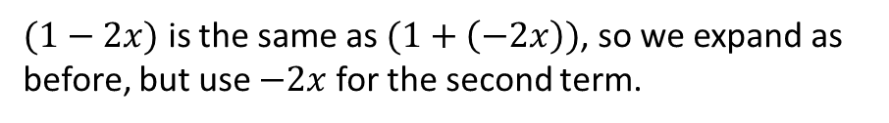


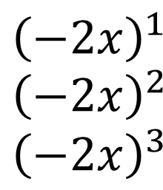
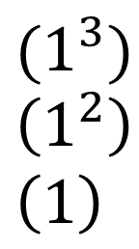
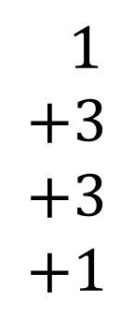
Another Example
$(1−2x)$ is the same as $(1+\left(−2x\right))$, so we expand as before, but use $−2x$ for the second term.
$${\left(1−2x\right)}^{3}=$$
$$1 \\ +3 \\ +3 \\ +1$$
$$(1^{3}) \\ \left(1^{2}\right) \\ \left(1\right)$$
$${\left(−2x\right)}^{1} \\ {\left(−2x\right)}^{2} \\ {\left(−2x\right)}^{3}$$
$$=1−6x+12x^{2}−8x^{3}$$
Fro Tip: If one of the terms in the original bracket is negative, the terms in your expansion will oscillate between positive and negative. If they don’t (e.g. two consecutive negatives), you’ve done something wrong!

Slide 6
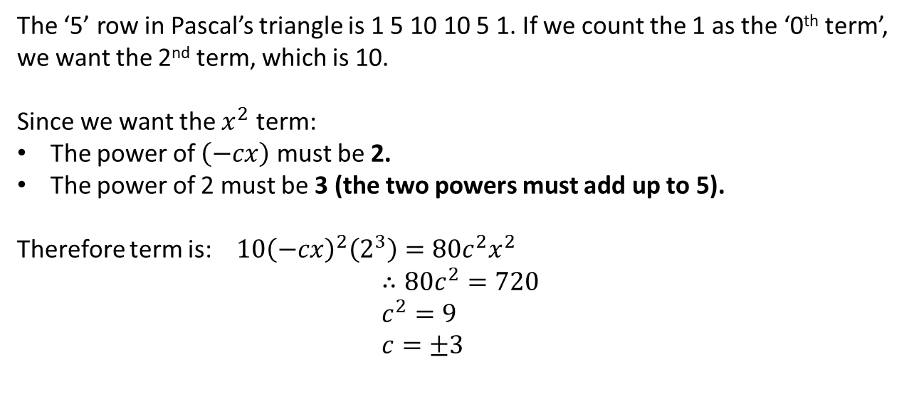
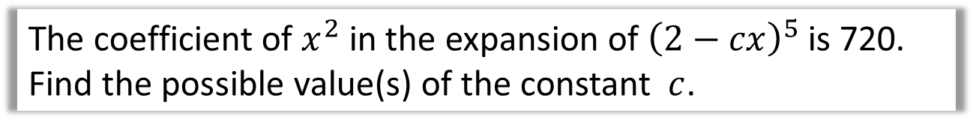
Getting a single term in the expansion
The coefficient of $x^{2}$ in the expansion of ${\left(2−cx\right)}^{5}$ is 720. Find the possible value(s) of the constant $c$.
The ‘5’ row in Pascal’s triangle is 1 5 10 10 5 1. If we count the 1 as the ‘0th term’, we want the 2nd term, which is 10.
Since we want the $x^{2}$ term:
The power of $\left(−cx\right)$ must be 2.
The power of 2 must be 3 (the two powers must add up to 5).
Therefore term is: $10{\left(−cx\right)}^{2}\left(2^{3}\right)={80c}^{2}x^{2}$
$$∴80c^{2}=720 \\ c^{2}=9 \\ c=±3$$
?
?
?

Slide 7
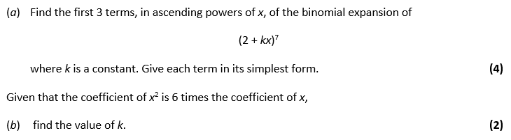
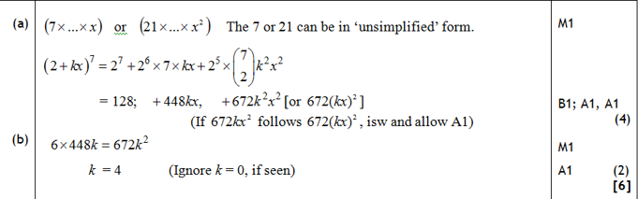
Test Your Understanding
Edexcel C2
?
?

Slide 8

Exercise 8.1
Pearson Pure Mathematics Year 1/AS
Pages 62
Extension
[MAT 2009 1J]
The number of pairs of positive integers $x,y$ which solve the equation:
$$x^{3}+6x^{2}y+12xy^{2}+8y^{3}=2^{30}$$
is:
0
$2^{6}$
$2^{9}−1$
$2^{10}+2$
The LHS is the binomial expansion of ${\left(x+2y\right)}^{3}$, therefore:
$${\left(x+2y\right)}^{3}=2^{30} \\ x+2y=2^{10} \\ x=2\left(2^{9}−y\right)$$
In order for $x$ to be a positive integer, $y$ can be between 1 and $2^{9}−1$. The answer is C.
1
?

Slide 9
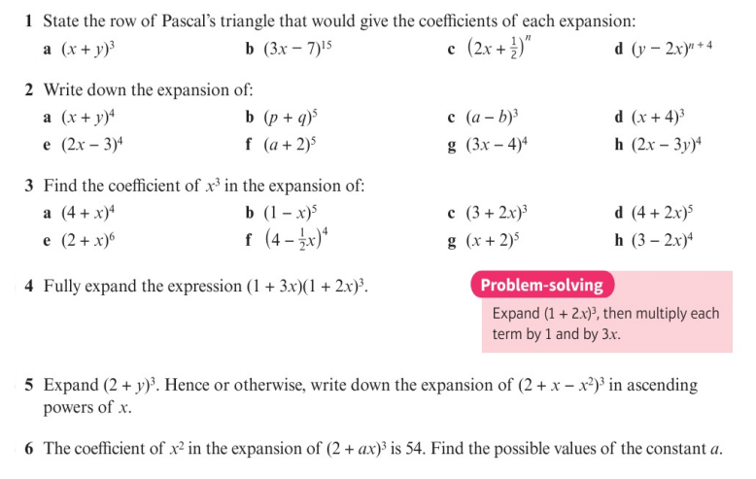
Homework Exercise

Slide 10
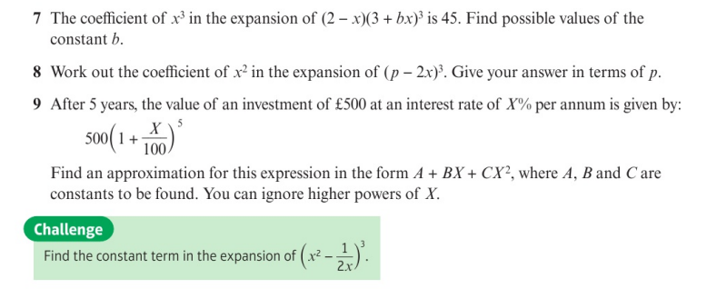
Homework Exercise

Slide 11
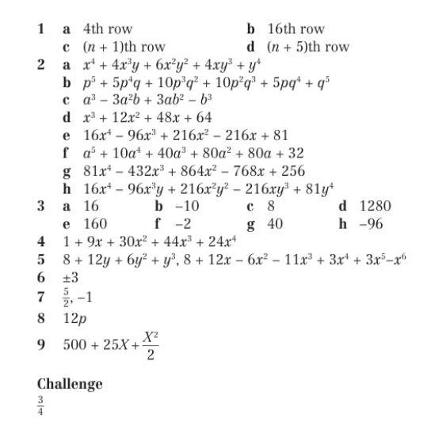
Homework Exercise

