Slide 1
P1 Chapter 1: Algebra Factorising

Slide 2
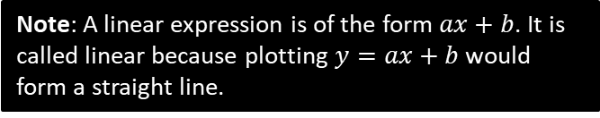
Factorising
Informally, factorising is the opposite of expanding brackets.
More formally, a factorised expression is one which is expressed as a product of expressions.
$$x(x+1)(x+2)$$
Factorised as it is the product of 3 linear factors, $x, x+1$ and $x+2$.
Note: A linear expression is of the form $ax+b$. It is called linear because plotting $y=ax+b$ would form a straight line.
$$x\left(x+1\right)+\left(x−1\right)\left(x+1\right)$$
Not factorised because the outer-most operation is a sum, not a product.
Basic Examples:
?
$$x^{3}+x^{2} =x^{2}\left(x+1\right) \\ 4x−8xy=4x\left(1−2y\right)$$
?

Slide 3
Factorising Quadratics
Recap:
We find two numbers which multiply to give the coefficient of $x$ and multiply to give the constant term.
$$⊕$$
$$⊗$$
?
$$x^{2}−5x−14=\left(x−7\right)\left(x+2\right)$$
Fro Note: The coefficient of a term is the constant on front of it, e.g. the coefficient of $4x^{2}$ is 4.
But what if the coefficient of $x^{2}$ is not 1?
$${2x}^{2}+5x−12=\left(2x−3\right)\left(x+4\right)$$
?
The easiest way is to use your common sense to guess the brackets. What multiplies to give the $2x^{2}$? What multiplies to give the constant term of $−12$?
?
Or you can ‘split the middle term’ (don’t be embarrassed if you’ve forgotten how to!)
$$⊕5 \\ ⊗−24$$
$${2x}^{2}+5x−12 \\ =2x^{2}+8x−3x−12 \\ =2x\left(x+4\right)−3\left(x+4\right) \\ =(x+4)(2x−3)$$
?
STEP 1: Find two numbers which add to give the middle number and multiply to give the first times last.
?
STEP 2: Split the middle term.
?
STEP 3: Factorise first half and second half ensuring bracket is duplicated..
?
STEP 4: Factorise out bracket.

Slide 4
Other Factorisations
Difference of two squares:
?
$$4x^{2}−9=\left(2x+3\right)\left(2x−3\right)$$
Using multiple factorisations:
$$x^{3}−x \\ =x\left(x^{2}−1\right) \\ =x(x+1)(x−1)$$
Tip: Always look for a common factor first before using other factorisation techniques.
?
$$x^{3}+3x^{2}+2x \\ =x\left(x^{2}+3x+2\right) \\ =x\left(x+2\right)\left(x+1\right)$$
?

Slide 5
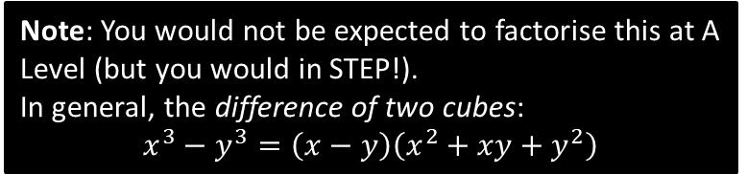
Test Your Understanding
1
Factorise completely:
$$6x^{2}+x−2$$
2
Factorise completely:
$$x^{3}−7x^{2}+12x$$
$$6x^{2}+x−2 ⊕1 ⊗−12 \\ =6x^{2}+4x−3x−2 \\ =2x\left(3x+2\right)−1\left(3x+2\right) \\ =\left(3x+2\right)\left(2x−1\right)$$
$$=x\left(x^{2}−7x+12\right) \\ =x\left(x−3\right)\left(x−4\right)$$
?
?
N
Factorise completely:
$$x^{4}−1$$
N
Factorise completely:
$$x^{3}−1$$
?
$$=(x−1)(x^{2}+x+1)$$
$$=\left(x^{2}+1\right)\left(x^{2}−1\right) \\ =\left(x^{2}+1\right)\left(x+1\right)\left(x−1\right)$$
?
Note: You would not be expected to factorise this at A Level (but you would in STEP!).
In general, the difference of two cubes:
$$x^{3}−y^{3}=\left(x−y\right)\left(x^{2}+xy+y^{2}\right)$$

Slide 6
Exercise 1.3
Pearson Pure Mathematics Year 1/AS
Page 2

Slide 7
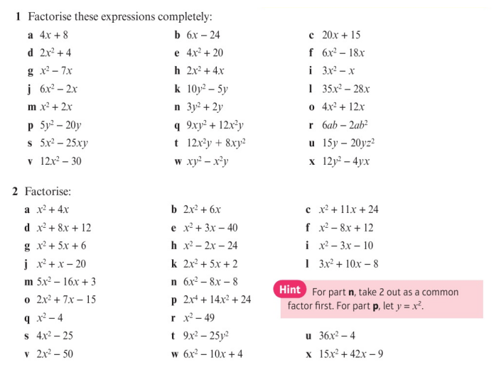
Homework Exercise

Slide 8
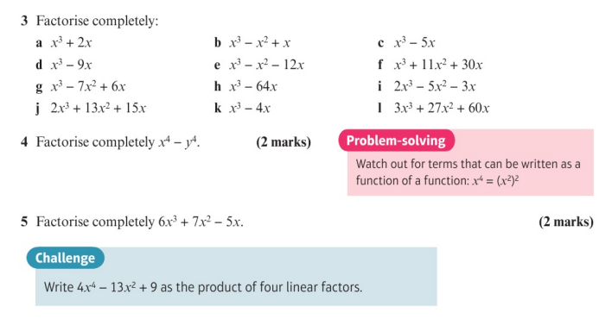
Homework Exercise

Slide 9
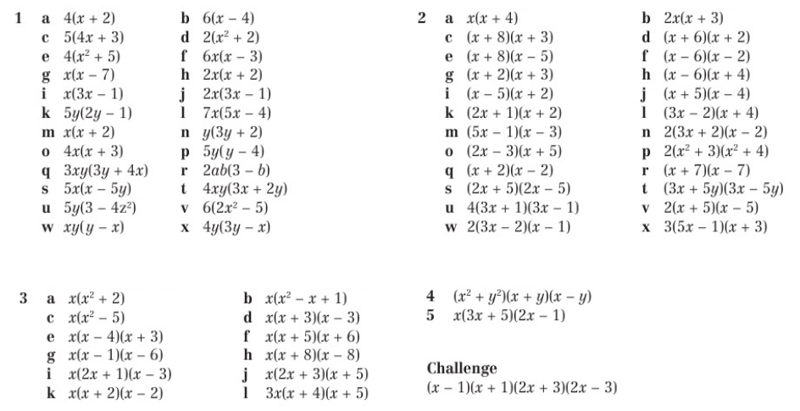
Homework Answers

