Slide 1
P1 Chapter 10: Trigonometry Equations Harder Trig Equations

Slide 2




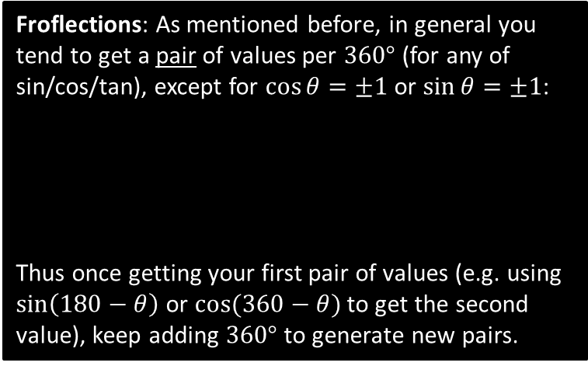


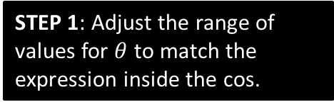


Harder Equations
Harder questions replace the angle $θ$ with a linear expression.
Solve $\cos{3x=−\frac{1}{2}}$ in the interval $0≤x≤360°$.
?
STEP 1: Adjust the range of values for $θ$ to match the expression inside the cos.
$$0≤3x<1080° \\ 3x=\cos^{−1}\left(−\frac{1}{2}\right)=120° \\ 3x=120°,240°,480°,600°,840°,960° \\ x=40°,80°,160°,200°,280°,320°$$
STEP 2: Immediately after applying an inverse trig function (and BEFORE dividing by 3!), find all solutions up to the end of the interval.
Froflections: As mentioned before, in general you tend to get a pair of values per $360°$ (for any of sin/cos/tan), except for $\cos{θ=±1}$ or $\sin{θ}=±1$:
Thus once getting your first pair of values (e.g. using $\sin\left(180−θ\right)$ or $cos⁡(360−θ)$ to get the second value), keep adding $360°$ to generate new pairs.
$$y$$
STEP 3: Then do final manipulation to each value.
$$y=\cos\left(x\right)$$
$$90$$
$$180$$
$$270$$
$$360$$
$$x$$

Slide 3
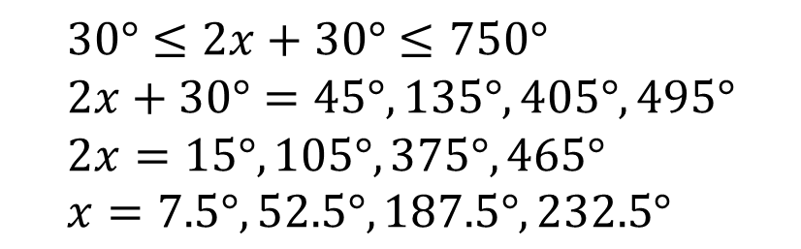
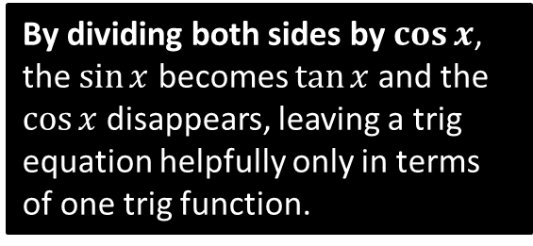
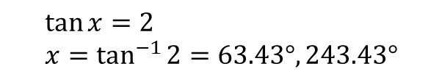

Further Examples
Solve $\sin{(2x+30°)=\frac{1}{\sqrt{2}}}$ in the interval $0≤x≤360°$.
?
$$30°≤2x+30°≤750° \\ 2x+30°=45°, 135°, 405°,495° \\ 2x=15°,105°,375°,465° \\ x=7.5°,52.5°,187.5°,232.5°$$
To get from $x$ to $2x+30°$ we double and add $30°$. So do the same to the upper and lower bound!
Solve $\sin{x}=2\cos{x}$ in the interval $0≤x<300°$
?
$$\tan{x}=2 \\ x=\tan^{−1}{2}=63.43°, 243.43°$$
By dividing both sides by $\cos{x}$, the $\sin{x}$ becomes $\tan{x}$ and the $\cos{x}$ disappears, leaving a trig equation helpfully only in terms of one trig function.

Slide 4
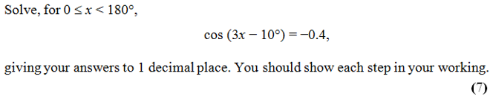
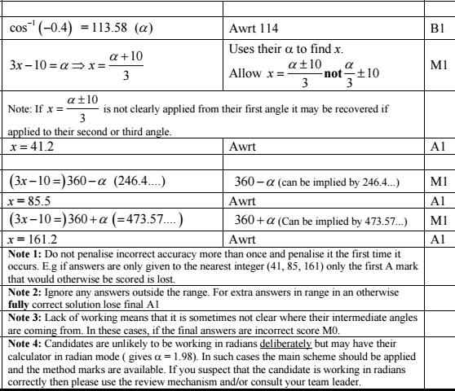
Test Your Understanding
Edexcel C2 Jan 2013 Q4
?

Slide 5
Exercise 10.5
Pearson Pure Mathematics Year 1/AS
Page 82

Slide 6
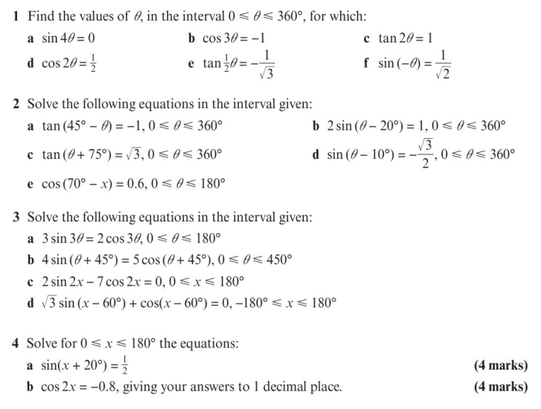
Homework Exercise

Slide 7
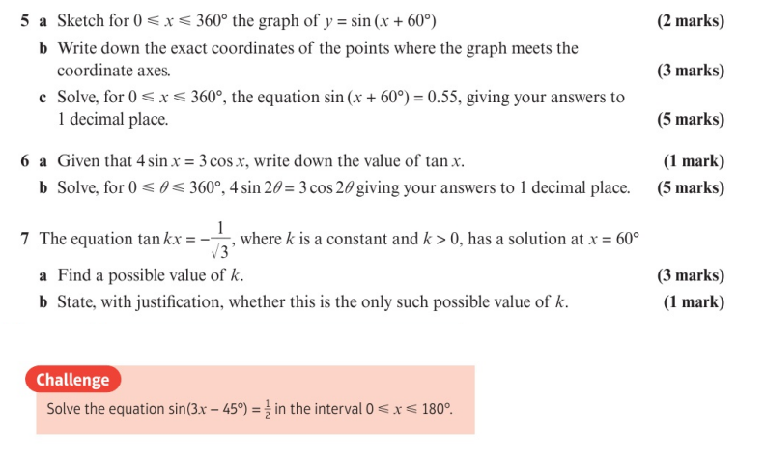
Homework Exercise

Slide 8
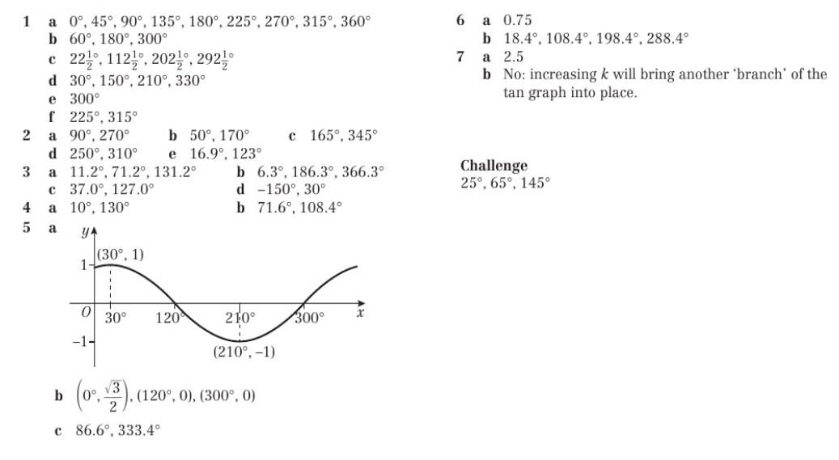
Homework Answers

