Slide 1
P1 Chapter 7: Algebraic Methods Methods of Proof

Slide 2
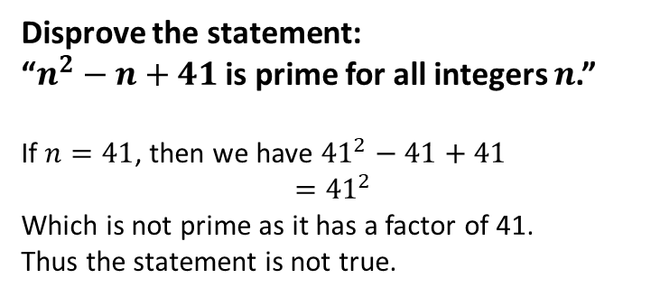

Other Types of Proof
b. Proof by Exhaustion
c. Disproof by Counter-Example
This means breaking down the statement into all possible smaller cases, where we prove each individual case.
(This technique is sometimes known as ‘case analysis’)
While to prove a statement is true, we need to prove every possible case (potentially infinitely many!), we only need one example to disprove a statement.
This is known as a counterexample.
Prove that $n^{2}+n$ is even for all integers $n$.
$n$ is either even or odd.
If $n$ is even:
$n^{2}+n=even×even+even$ $$=even+even \\ =even$$
If $n$ is odd:
$$n^{2}+n=odd×odd+odd \\ =odd+odd \\ =even$$
$∴$ $n^{2}+n$ is even for all integers $n$.
?
Disprove the statement:
“$n^{2}−n+41$ is prime for all integers $n$.”
If $n=41$, then we have ${41}^{2}−41+41$ $$={41}^{2}$$
Which is not prime as it has a factor of 41.
Thus the statement is not true.
?

Slide 3
Further Types of Proof
d. Proof by Induction
c. Proof by Contradiction
This proves a conjecture of an n-th term formulae given n=1 is known to be true.
The classic example is proving the square root of two is irrational.
These are only in Further Maths

Slide 4
Exercise 7.5
Pearson Pure Mathematics Year 1/AS
Page 59

Slide 5
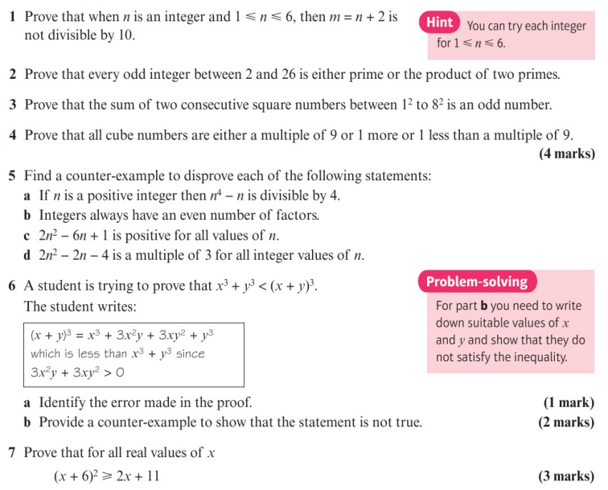
Homework Exercise

Slide 6
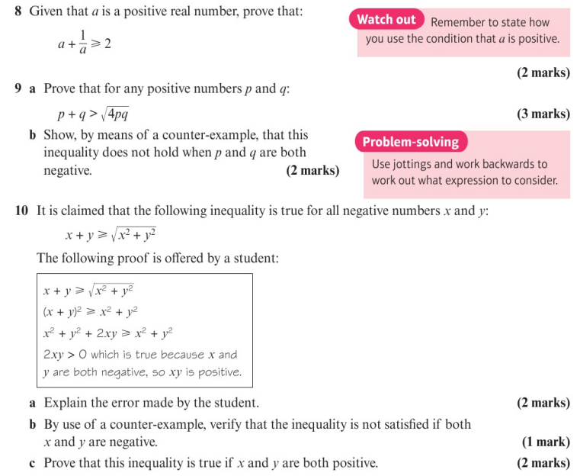
Homework Exercise

Slide 7
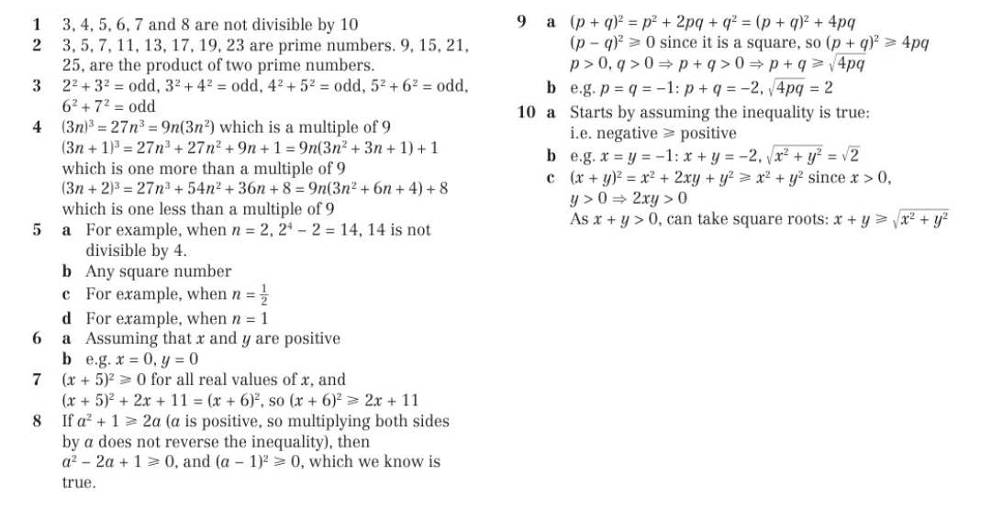
Homework Answers

