Slide 1
P1 Chapter 10: Trigonometry Equations The Unit Circle

Slide 2
sin/cos/tan of $30°, 45°, 60°$
You will frequently encounter angles of $30°, 60°, 45°$ in geometric problems. Why?
We see these angles in equilateral triangles and half squares.
?
Although you will always have a calculator, you need to know how to derive these.
All you need to remember:
! Draw half a unit square and half an equilateral triangle of side 2.
$$\sin\left(30°\right)=\frac{1}{2} \\ \cos\left(30°\right)=\frac{\sqrt{3}}{2} \\ \tan\left(30°\right)=\frac{1}{\sqrt{3}} \\ \sin\left(60°\right)=\frac{\sqrt{3}}{2} \\ \cos\left(60°\right)=\frac{1}{2} \\ \tan\left(60°\right)=\sqrt{3}$$
?
$$\sin\left(45°\right)=\frac{1}{\sqrt{2}} \\ \cos\left(45°\right)=\frac{1}{\sqrt{2}} \\ \tan\left(45°\right)=1$$
?
?
$$\sqrt{2}$$
?
?
$$1$$
?
?
$$30°$$
$$2$$
?
?
?
$$\sqrt{3}$$
$$45°$$
?
?
$$1$$
?
?
?
$$60°$$
$$1$$
?
?
?

Slide 3
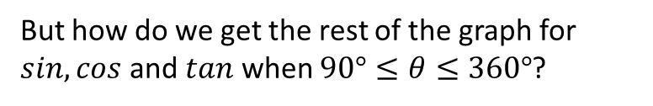




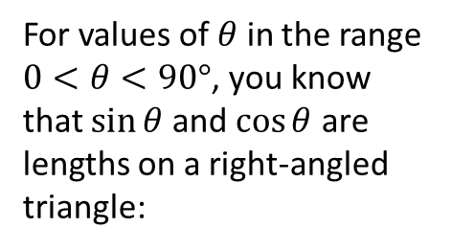




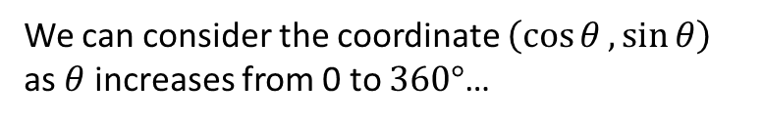


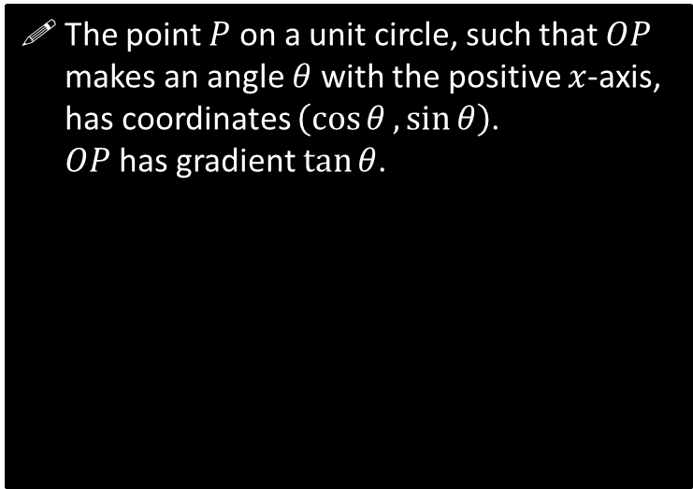

The Unit Circle and Trigonometry
For values of $θ$ in the range $0<θ<90°$, you know that $\sin{θ}$ and $\cos{θ}$ are lengths on a right-angled triangle:
But how do we get the rest of the graph for $sin, cos$ and $tan$ when $90°≤θ≤360°$?
The point $P$ on a unit circle, such that $OP$ makes an angle $θ$ with the positive $x$-axis, has coordinates $\left(\cos{θ},\sin{θ}\right)$. $OP$has gradient $\tan{θ}$.
$$1$$
?
$$y$$
$$\sin{θ}$$
$$P\left(\cos{θ},\sin{θ}\right)$$
$$θ$$
$$1$$
$$\cos{θ}$$
$$θ$$
?
$$O$$
$$x$$
And what would be the gradient of the bold line?
$$m=\frac{Δy}{Δx}=\frac{\sin{θ}}{\cos{θ}}$$
But also: $\tan{θ}=\frac{opp}{adj}=\frac{\sin{θ}}{\cos{θ}}$
$$∴m=\tan{θ}$$
?
Angles are always measured anticlockwise. (Further Mathematicians will encounter the same when they get to Complex Numbers)
We can consider the coordinate $\left(\cos{θ},\sin{θ}\right)$ as $θ$ increases from 0 to $360°$…

Slide 4
































Mini-Exercise
Use the unit circle to determine each value in the table, using either “0”, “+ve”, “-ve”, “1”, “-1” or “undefined”. Recall that the point on the unit circle has coordinate $(\cos{θ},\sin{θ})$ and $OP$ has gradient $\tan{θ}$.
$x$-value
$y$-value
Gradient of $OP$.
$$\cos{θ}$$
$$\sin{θ}$$
$$\tan{θ}$$
$$\cos{θ}$$
$$\sin{θ}$$
$$\tan{θ}$$
$$θ=0$$
$$θ=180°$$
?
$$y$$
$$y$$
1
0
0
?
-1
0
0
$$P$$
$$x$$
$$P$$
$$θ$$
$$x$$
$$0<θ<90°$$
?
$$180°<θ<270°$$
?
$$y$$
$$y$$
$$P$$
+ve
+ve
+ve
?
-ve
-ve
+ve
$$1$$
$$θ$$
$$θ$$
$$x$$
$$x$$
$$P$$
$$θ=90°$$
?
$$θ=270°$$
?
$$y$$
$$y$$
?
0
1
Undefined
(vertical lines don’t have a well-defined gradient)
?
0
-1
Undefined
$$P$$
$$θ$$
$$θ$$
$$x$$
$$x$$
$$P$$
$$90°<θ<180°$$
?
$$270°<θ<360°$$
?
$$y$$
-ve
+ve
-ve
$$y$$
+ve
-ve
-ve
?
?
$$P$$
$$θ$$
$$P$$
$$x$$
$$θ$$
$$x$$

Slide 5



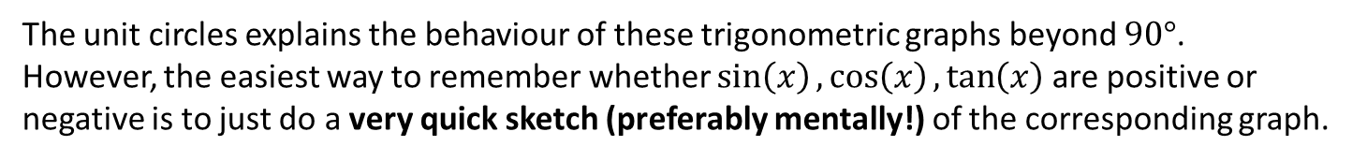



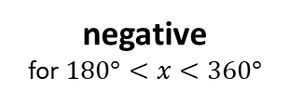

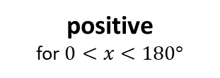
The Unit Circle and Trigonometry
The unit circles explains the behaviour of these trigonometric graphs beyond $90°$.
However, the easiest way to remember whether $\sin\left(x\right),\cos\left(x\right),\tan\left(x\right)$ are positive or negative is to just do a very quick sketch (preferably mentally!) of the corresponding graph.
$$y$$
positive
for $0<x<180°$
$$y=sin\left(x\right)$$
$$x$$
$$90$$
$$180$$
$$270$$
$$360$$
Note: The textbook uses something called ‘CAST diagrams’. I will not be using them in these slides, but you may wish to look at these technique as an alternative approach to various problems in the chapter.
negative
for $180°<x<360°$

Slide 6

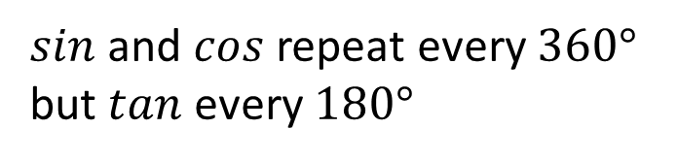


















A Few Trigonometric Angle Laws
The following are all easily derivable using a quick sketch of a trigonometric graph, and are merely a convenience so you don’t always have to draw out a graph every time.
You are highly encouraged to memorise these so that you can do exam questions faster.
$$y=\sin\left(x\right)$$
1
$$\sin\left(x\right)=\sin\left(180°−x\right)$$
We saw this in the previous chapter when covering the ‘ambiguous case’ when using the sine rule.
e.g. $\sin\left(150°\right)=\sin\left(30°\right)$
$$30$$
$$150$$
$$180$$
$$y=\cos\left(x\right)$$
2
$$\cos\left(x\right)=\cos\left(360°−x\right)$$
$$30$$
$$330$$
$$360$$
e.g. $\cos\left(330°\right)=\cos\left(30°\right)$
$sin$ and $cos$ repeat every $360°$
but $tan$ every $180°$
$$y=\sin\left(x\right)$$
3
$$30$$
$$360$$
$$390$$
$$720$$
e.g. $\sin\left(390°\right)=\sin\left(30°\right)$
$\sin\left(x\right)=\cos\left(90°−x\right)$
Remember from the previous chapter that “cosine” by definition is the sine of the “complementary” angle.
This was/is never covered in the textbook but caught everyone by surprise when it came up in a C3 exam.
4
e.g. $\sin\left(50°\right)=\cos\left(40°\right)$

Slide 7
Exercise 10.1
Pearson Pure Mathematics Year 1/AS
Page 78

Slide 8
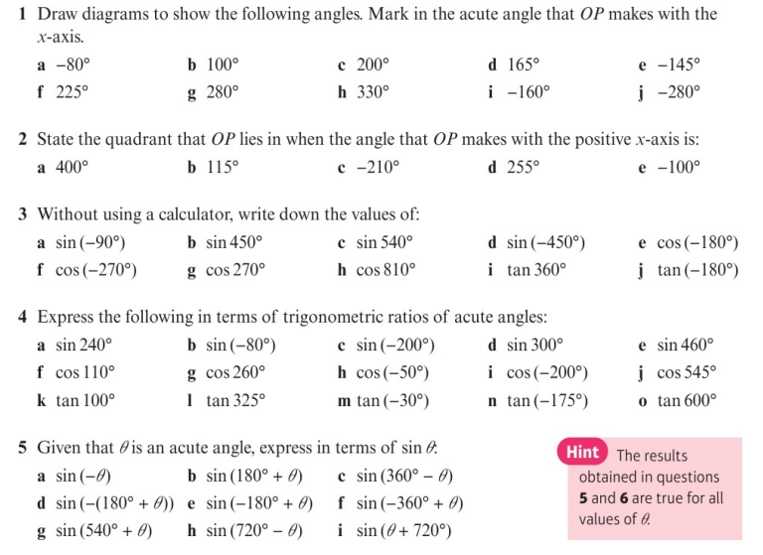
Homework Exercise

Slide 9
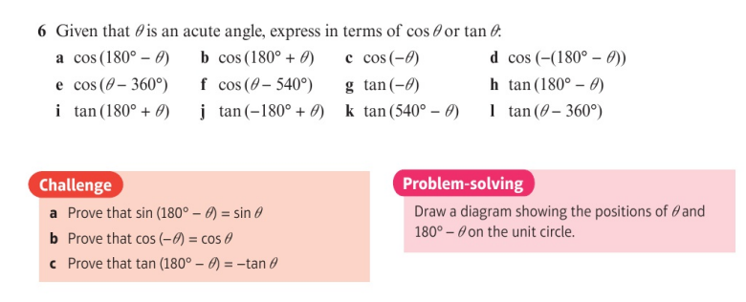
Homework Exercise

Slide 10
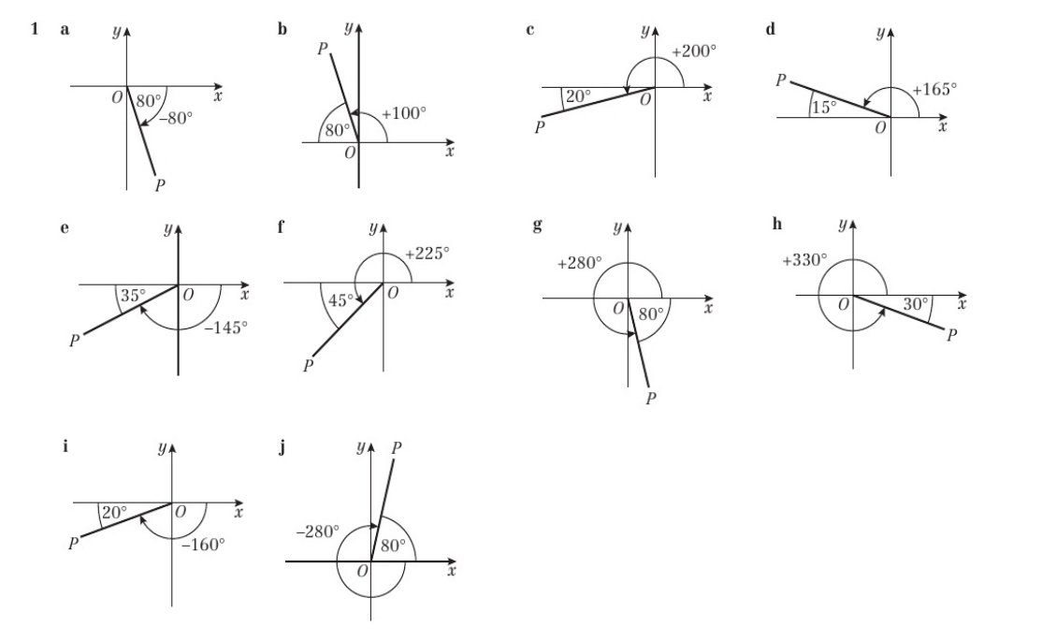
Homework Answers

Slide 11
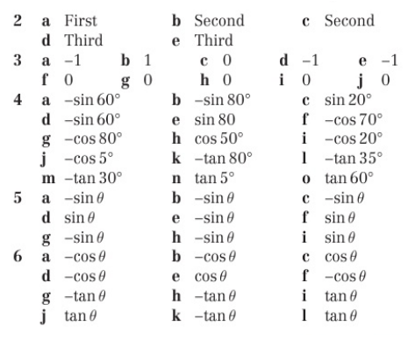
Homework Answers

Slide 12
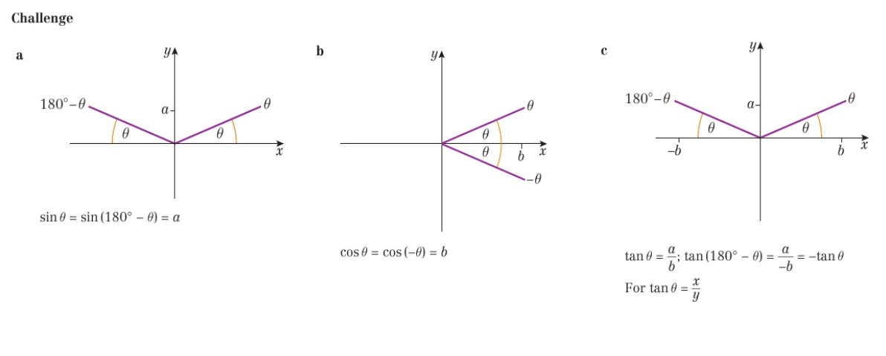
Homework Answers

